Slide 1
Scottish Independence Social Media Analyses - some R tm analyses
Dr Stephen Tagg, Dr Mark Shepard, Dr Stephen Quinlan HASS/SBS University of Strathclyde

Slide 2
Social Media Analysis: Methods and Ethics Friday April 25th 10:50
This paper describes work done as part of a small ESRC project coding forum contributions and tweets.
The R tm analyses have extended the hand coding using sentiment analysis and general inquirer tag codes, and have explored ways of automatically coding pro-independence and pro-union attitudes in tweets.
Future developments may allow the identification of tweet bots, to discover the relative usage by the yes and no campaigns.

Slide 3
Sentiment Analyses
The following measures from (Bautin, Ward et al. 2010) are used in the sentiment plugin and attempt to produce comparable scores.
Polarity =(positive-negative)/(positive+negative)
Subjectivity= (positive+negative)/total number of words
Pos-refs per ref= positive/number of words
Neg refs per ref= Negative/ number of words
Senti-diffs-per ref= (positive-negative)/number of words

Slide 4
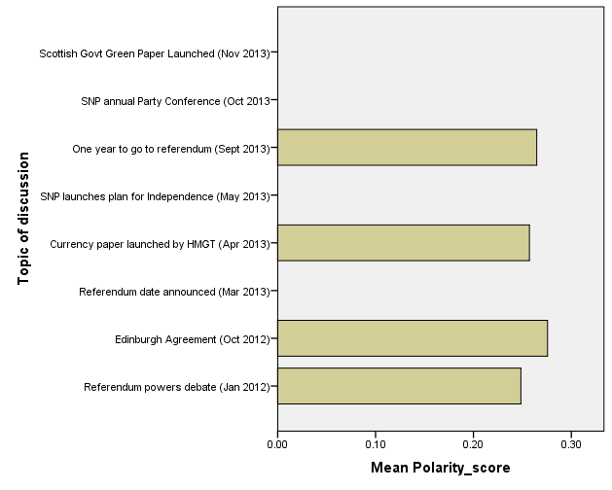
Sentiment Analysis

Slide 5
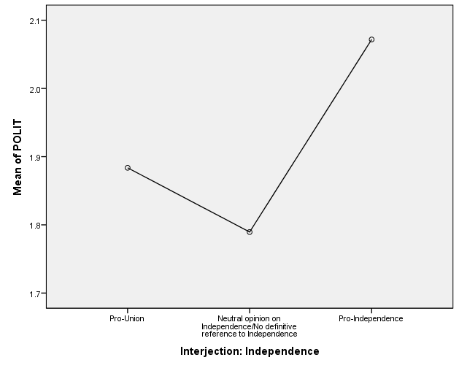
General Inquirer
Graph

Slide 6
TwitterBot Identification
TwitterBots do not sleep, nor do they stop. They’re there to bias social media analyses
Identification by frequency and time patterns. Time patterns not available for Have Your Say discussions.
Those with more than 10 contributions are more likely to have been identified as Scottish (40% ) rather nationality unidentifiable (28%). Chi-square (over 6 categories )=583, df=5, p<.001.

Slide 7
Summary/ Ethics
Ethics of those trying to use social media metrics – sold to indicate brand reputation
Ethics of using simple ‘bag of words’ methods rather than sophisticated machine learning – with more sensible language processing.

