Slide 1
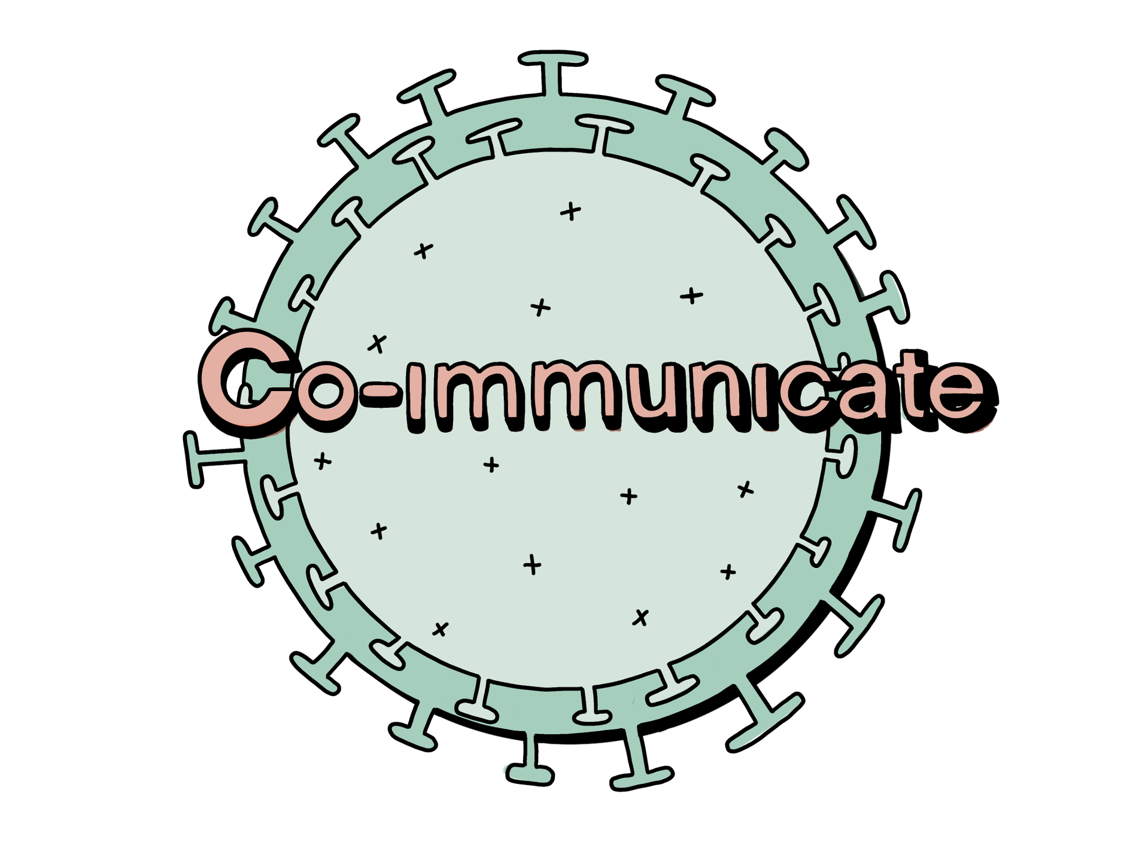
Day 1

Slide 2


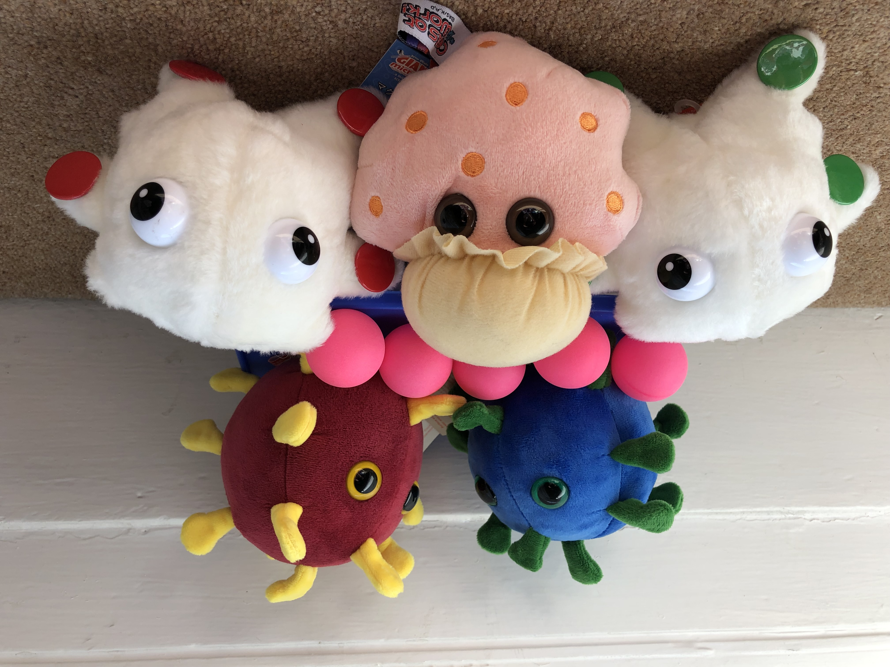
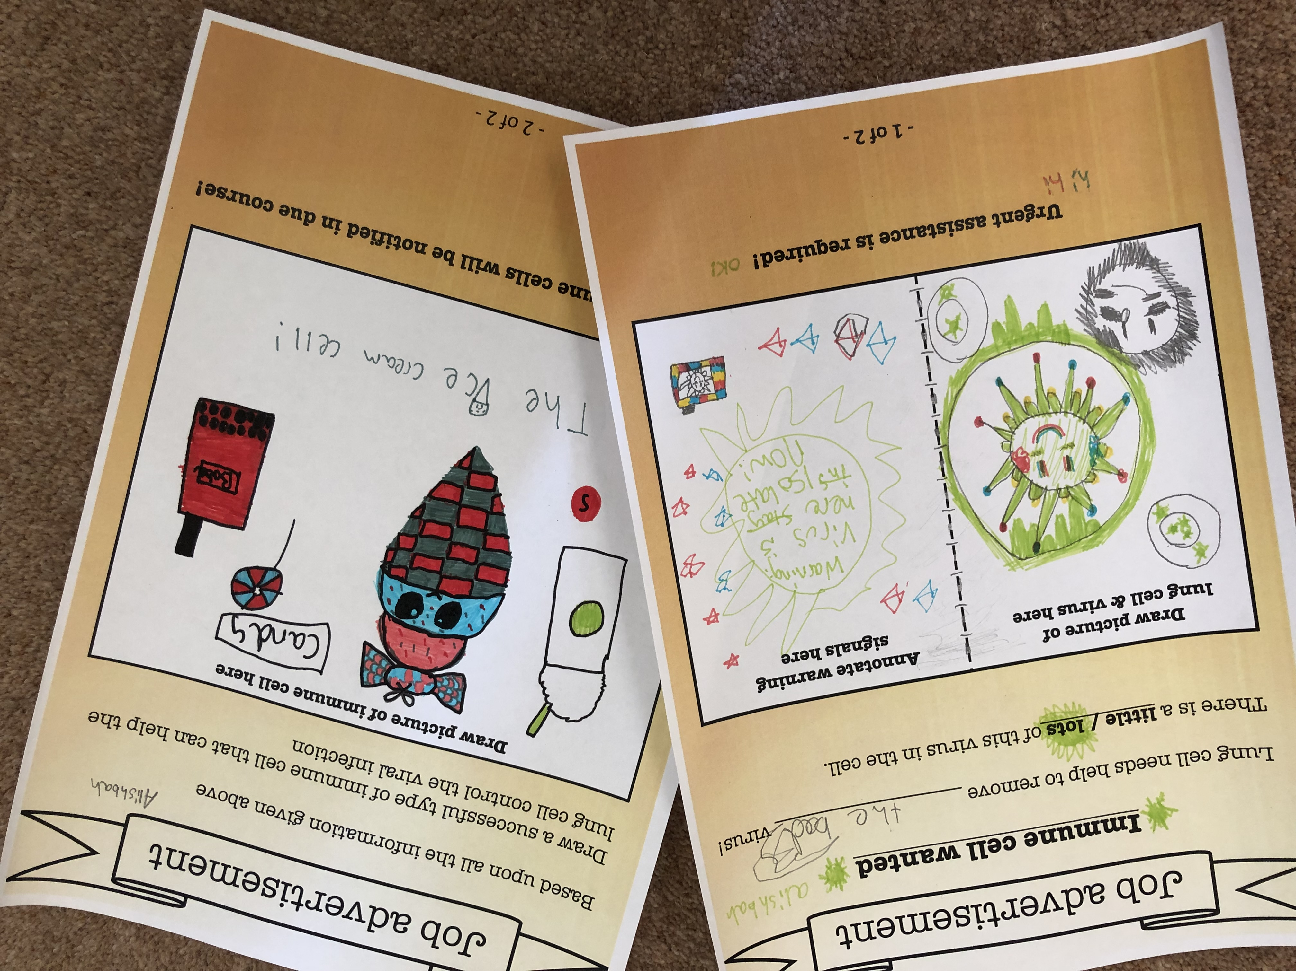
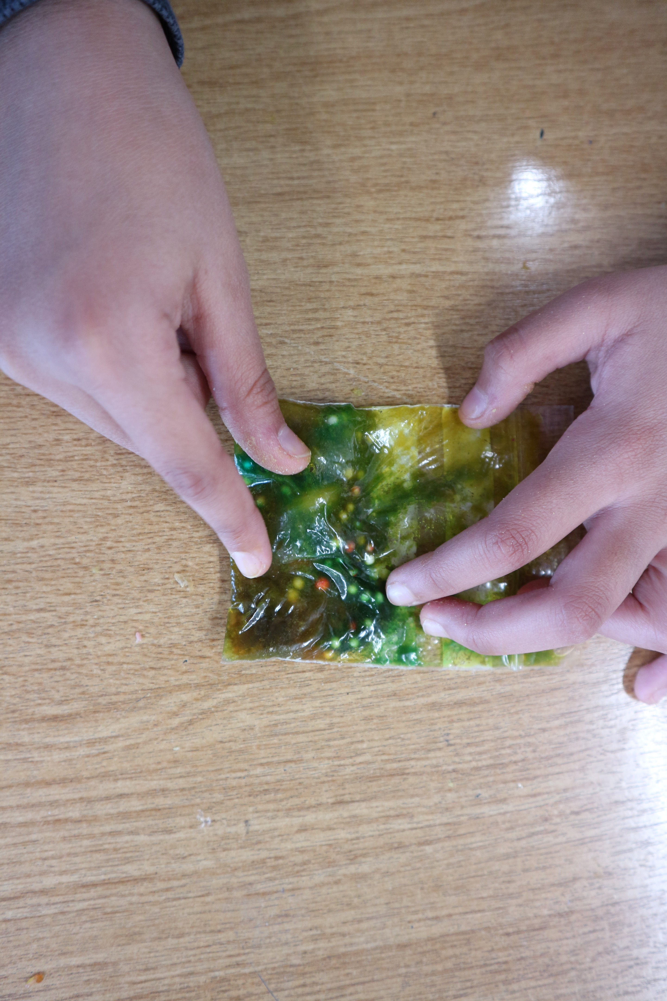
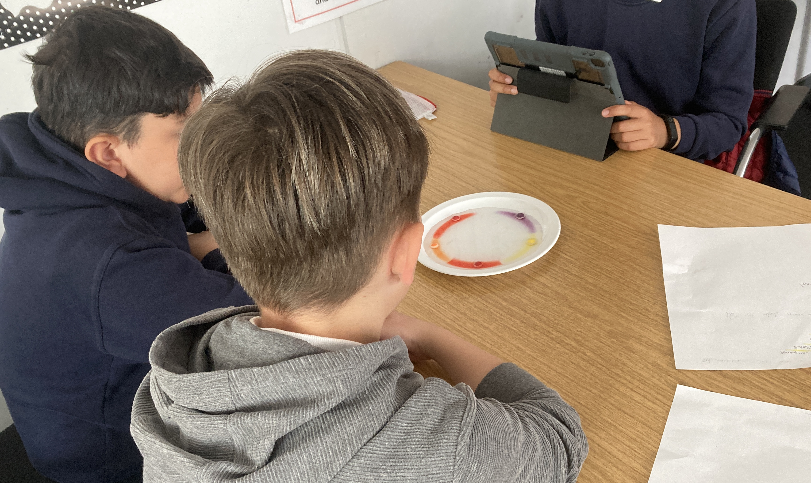
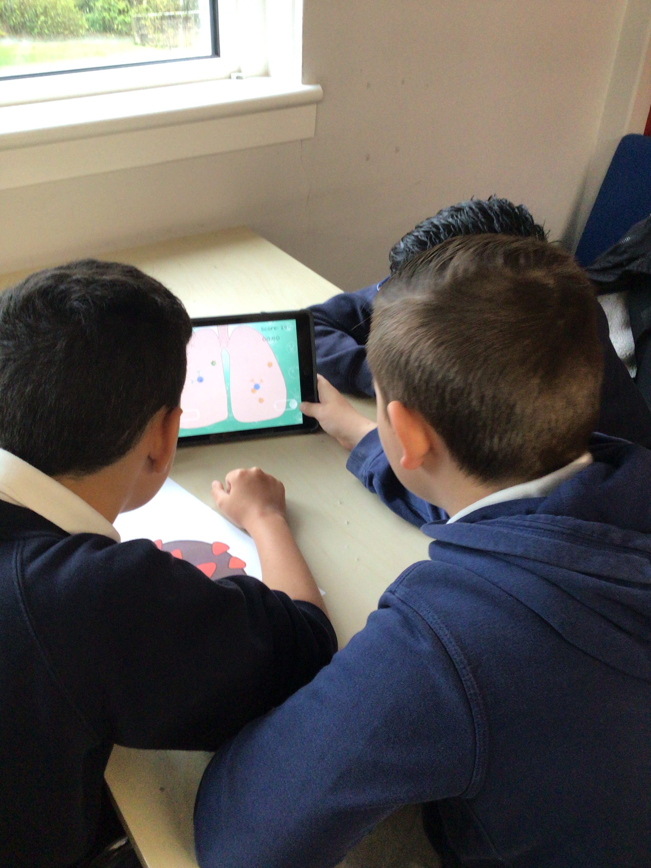
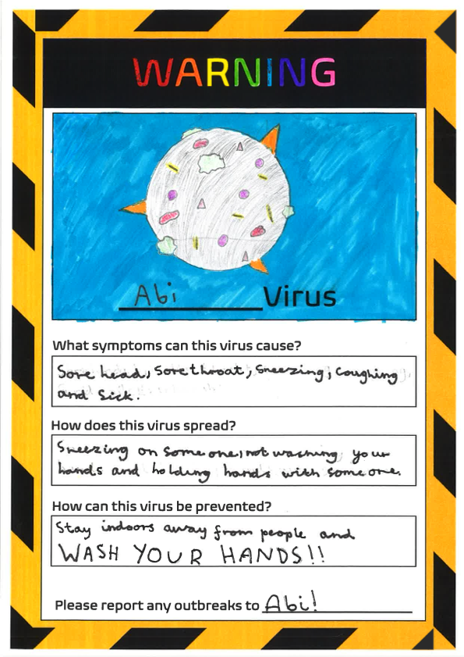
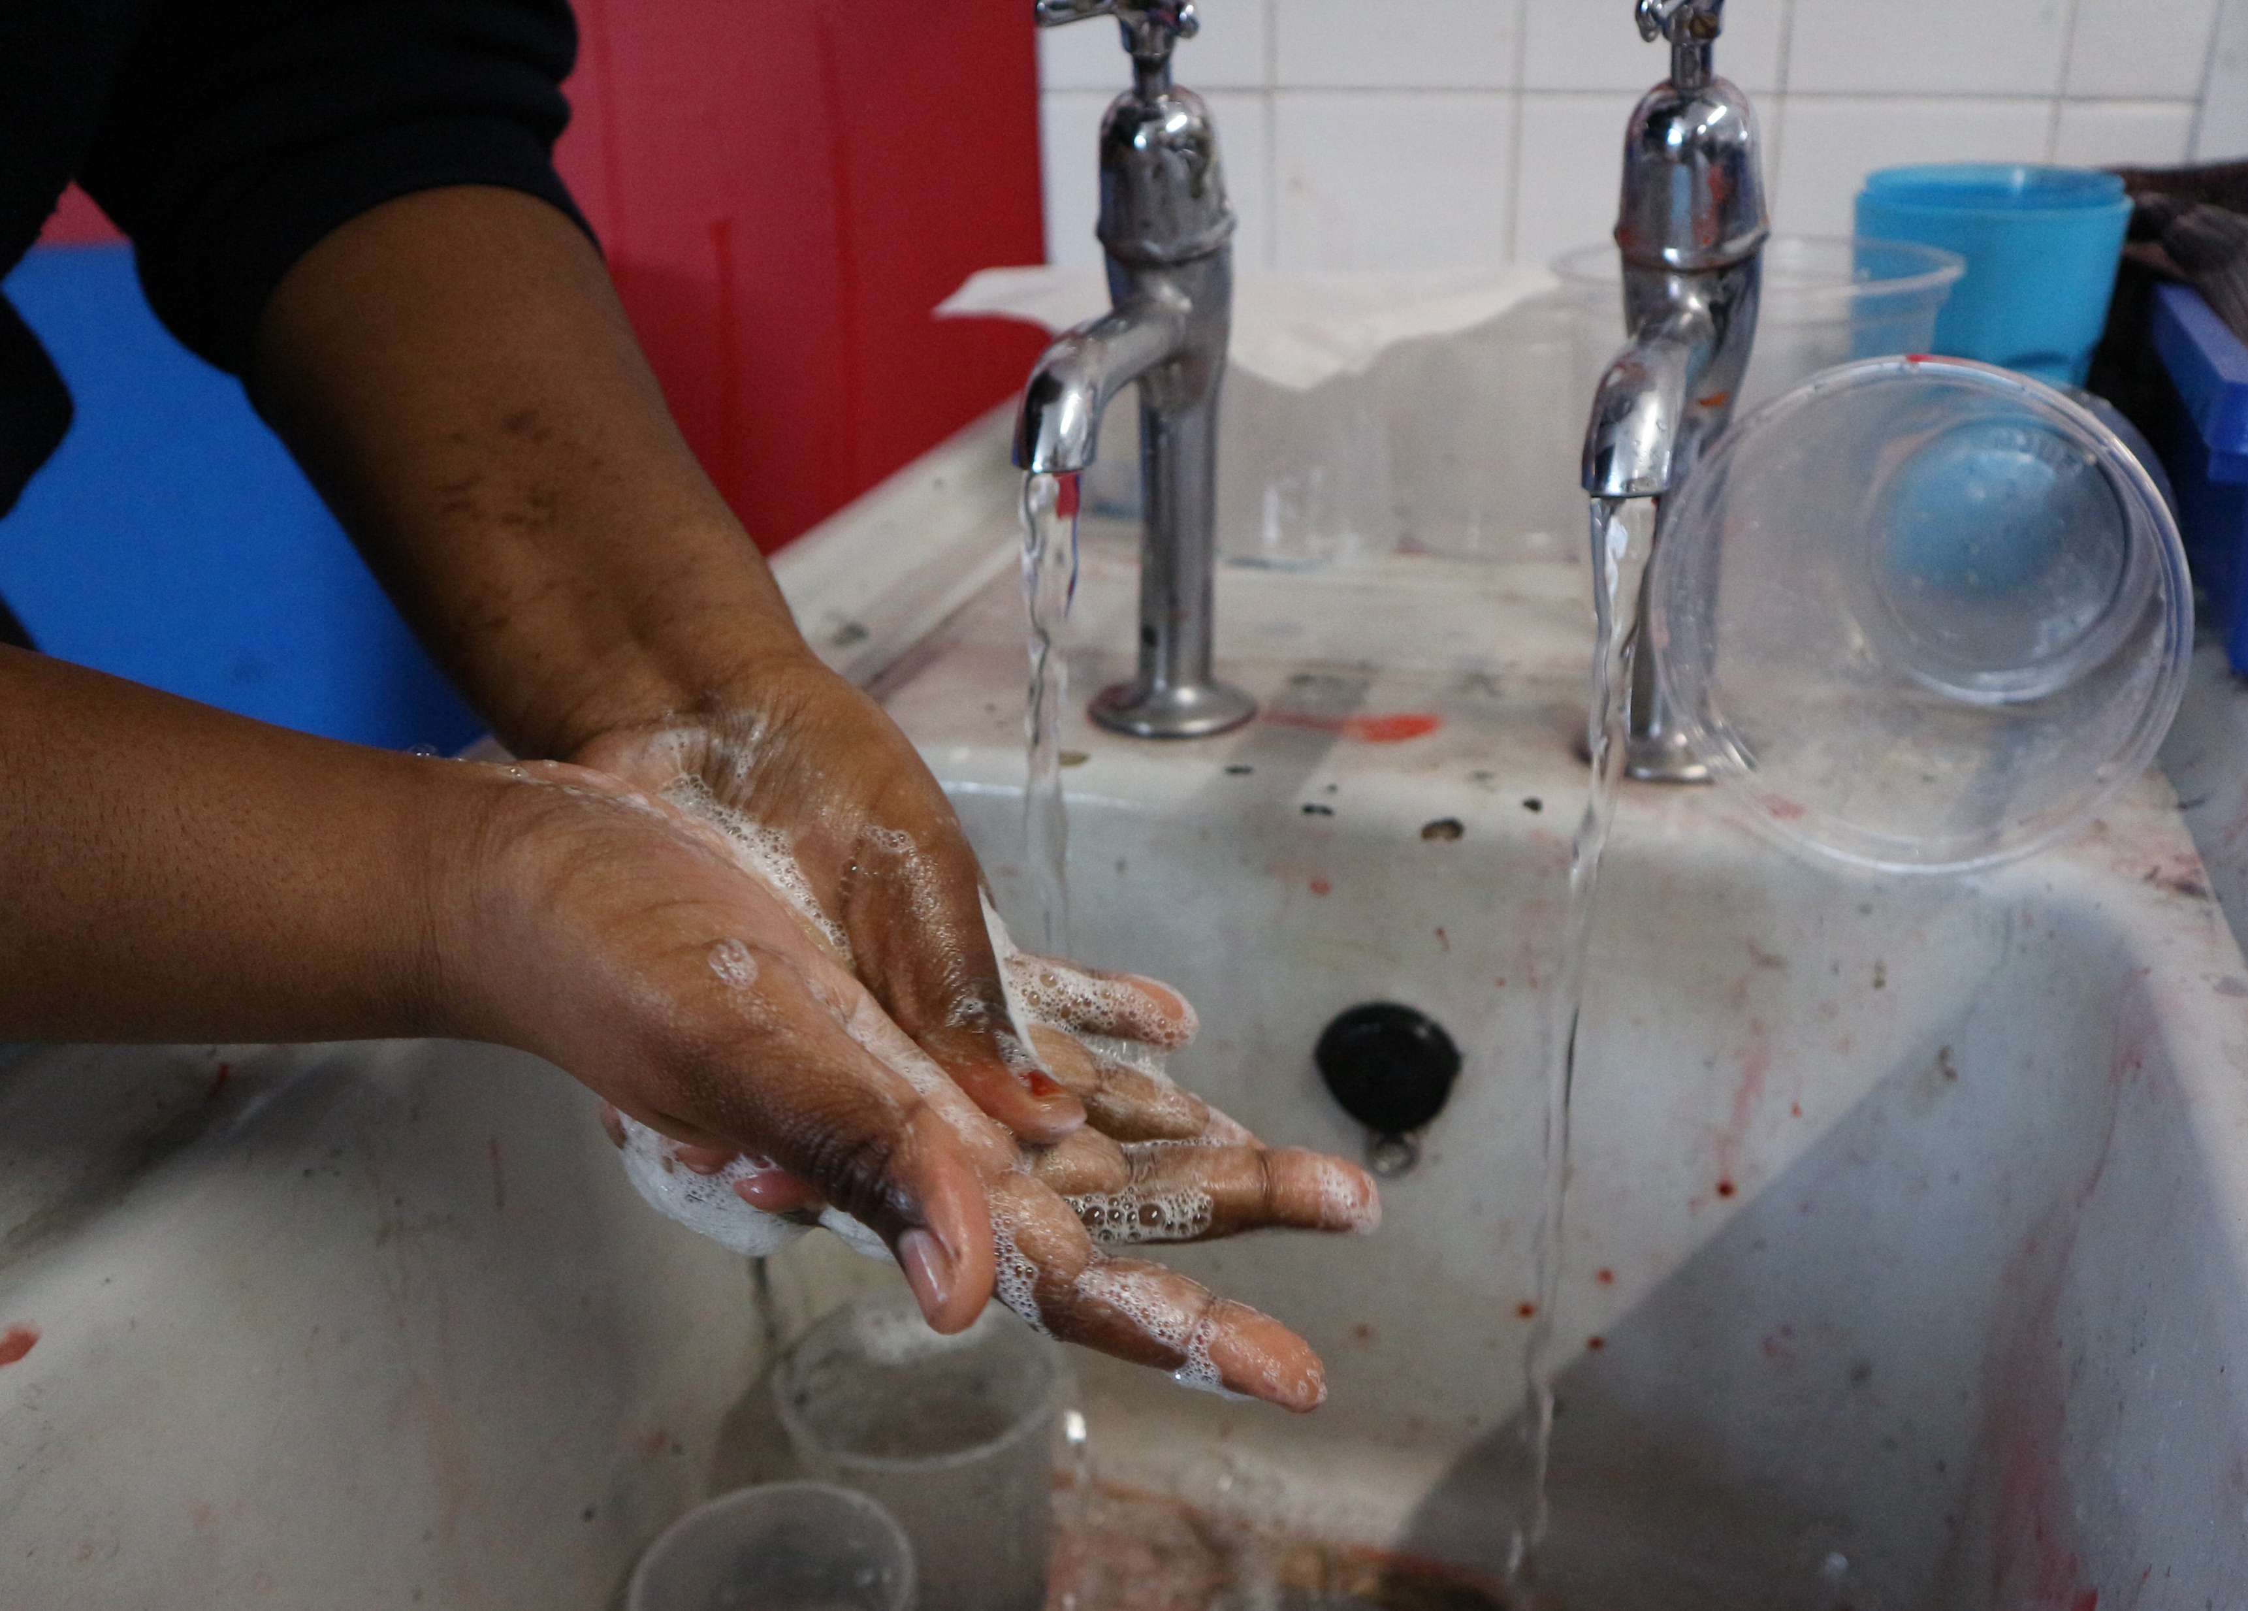
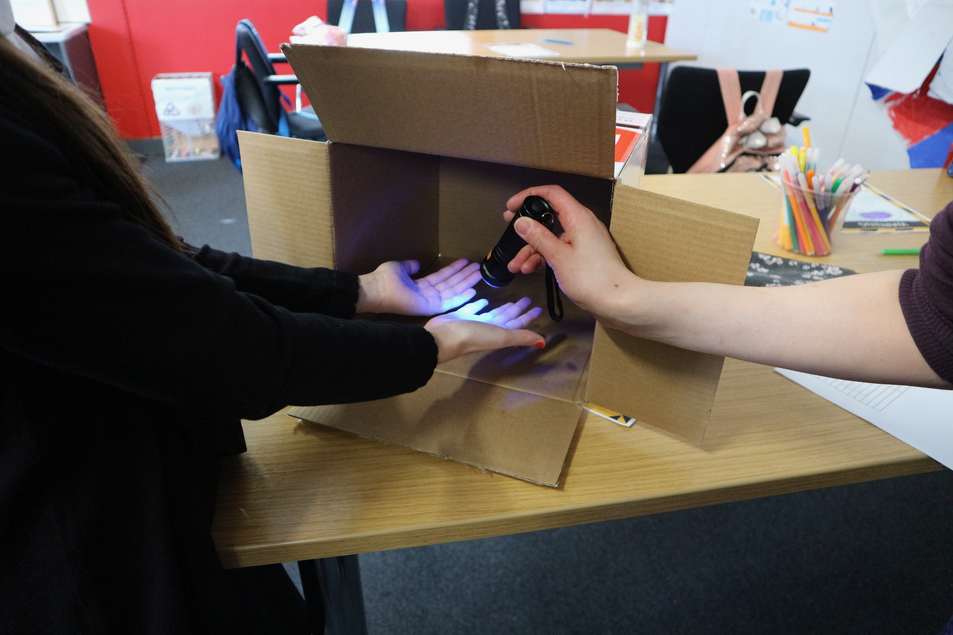
Co-IMMUNicate: 2020-2023
University of Glasgow researchers and Anderson Primary school teachers and pupils working together to communicate understanding of immune responses to viruses

Slide 3
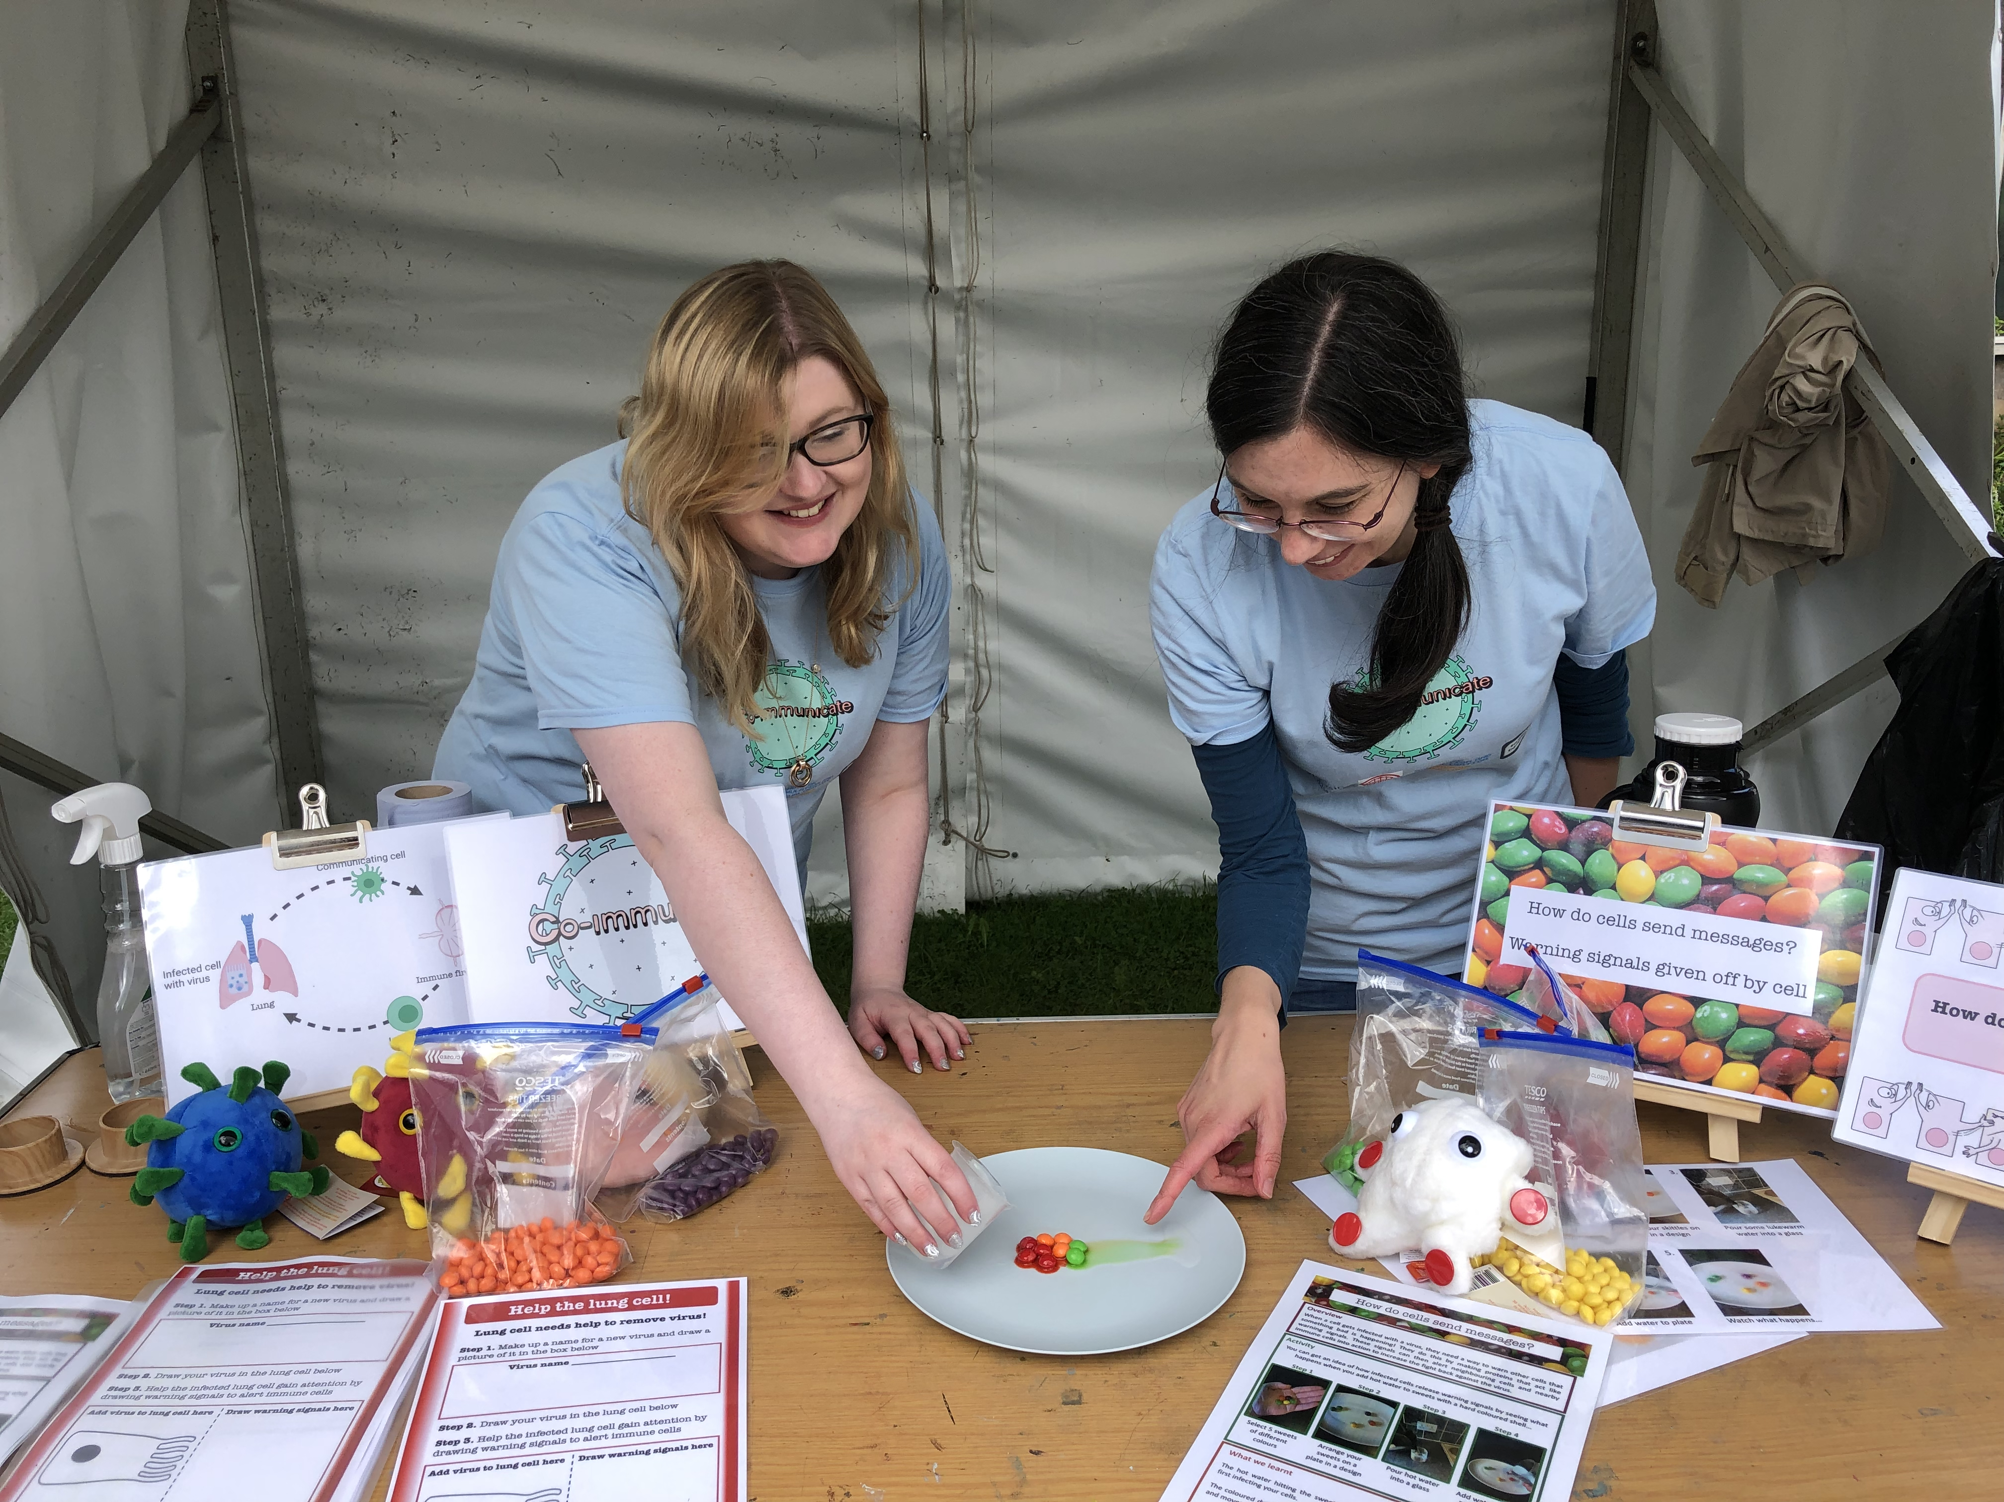

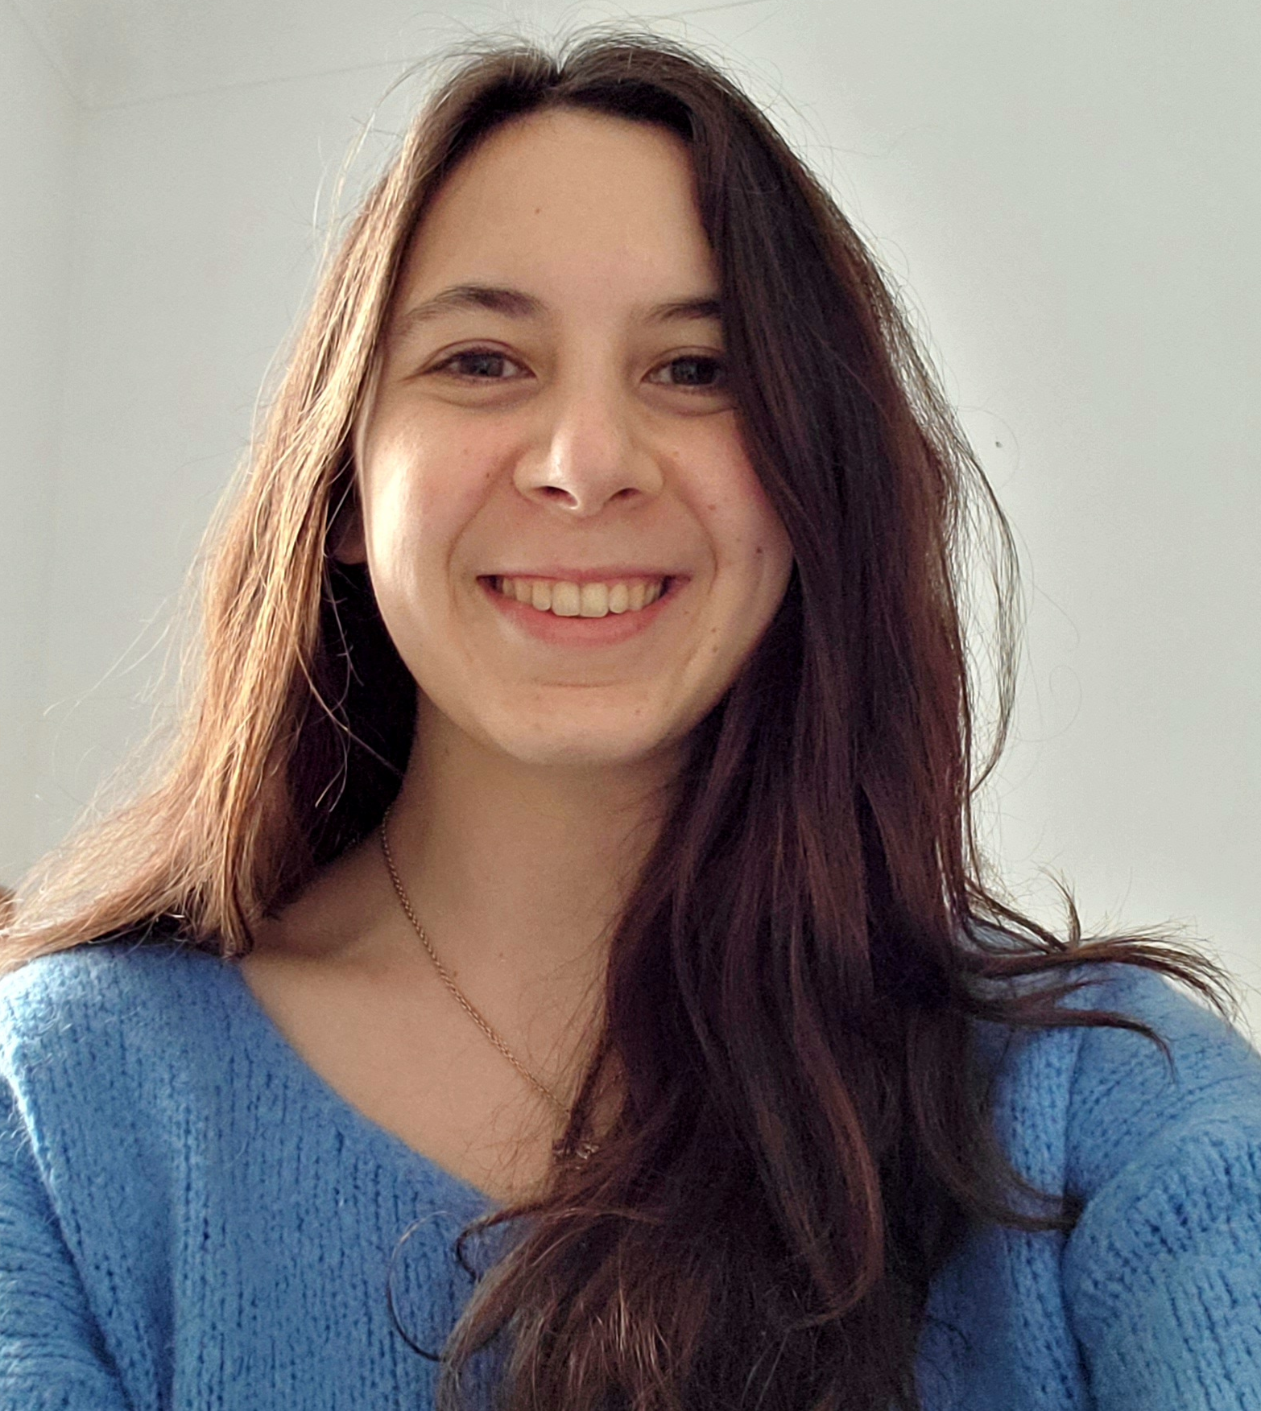
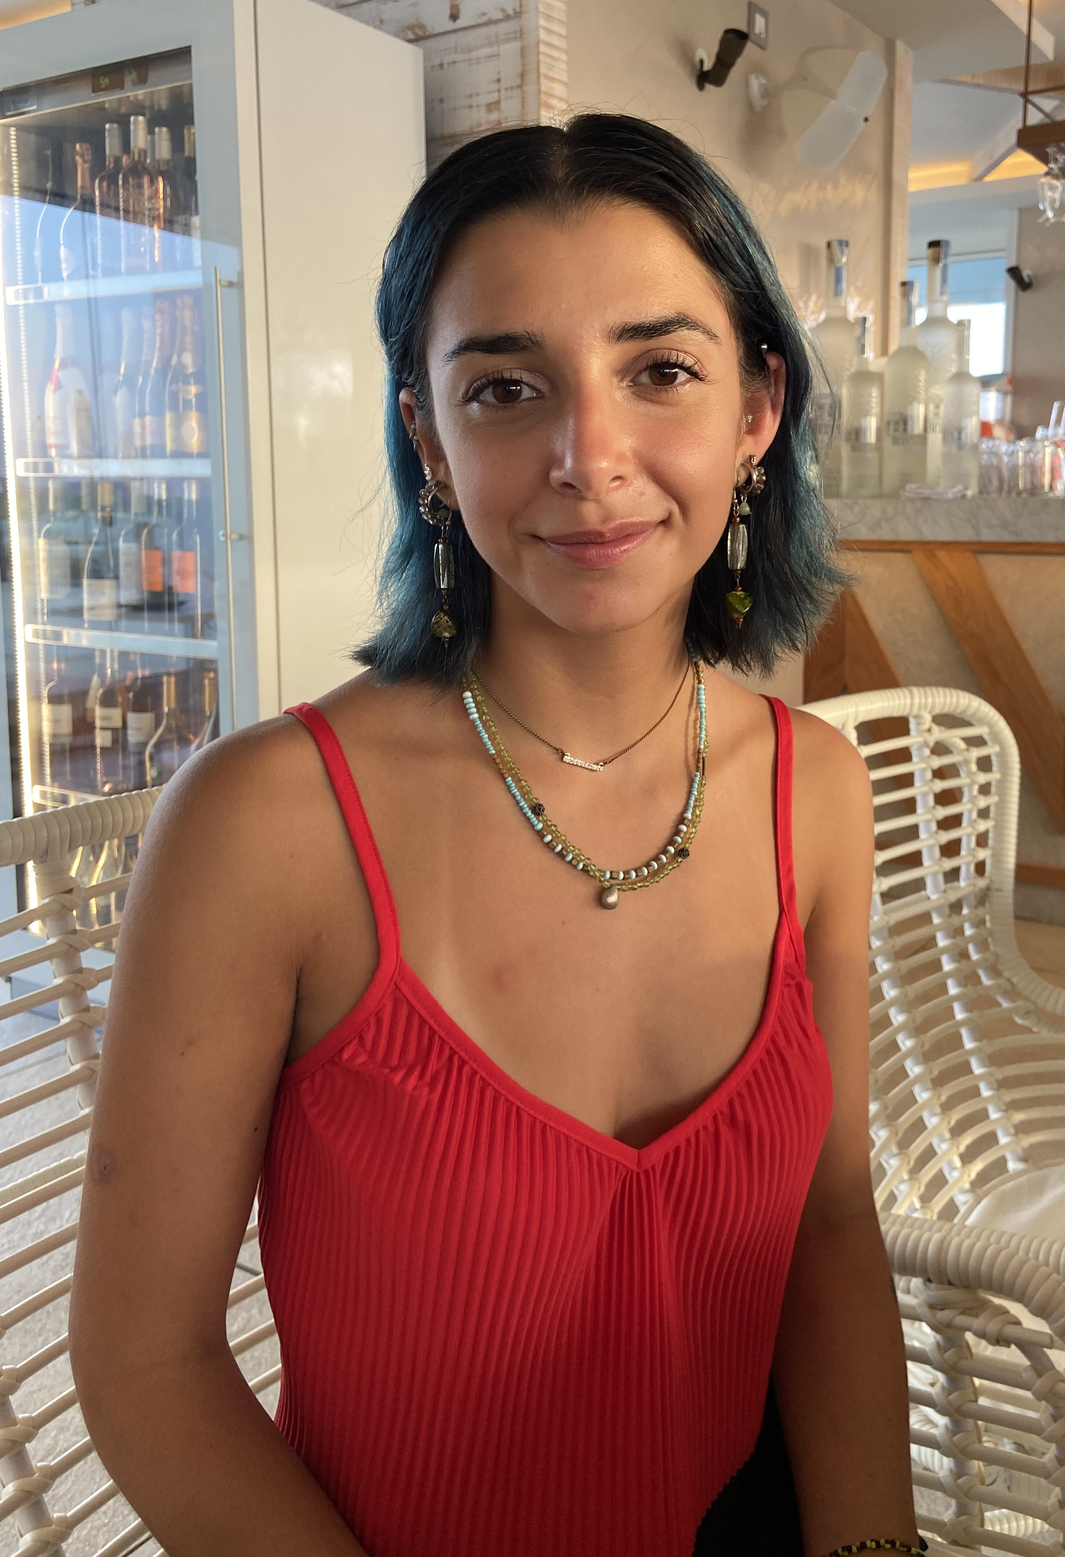
Co-IMMUNicate: University of Glasgow team
Kerrie Hargrave
Megan MacLeod
Euan Brennan
Sophia Di Piazza
Sara Ibgui

Slide 4
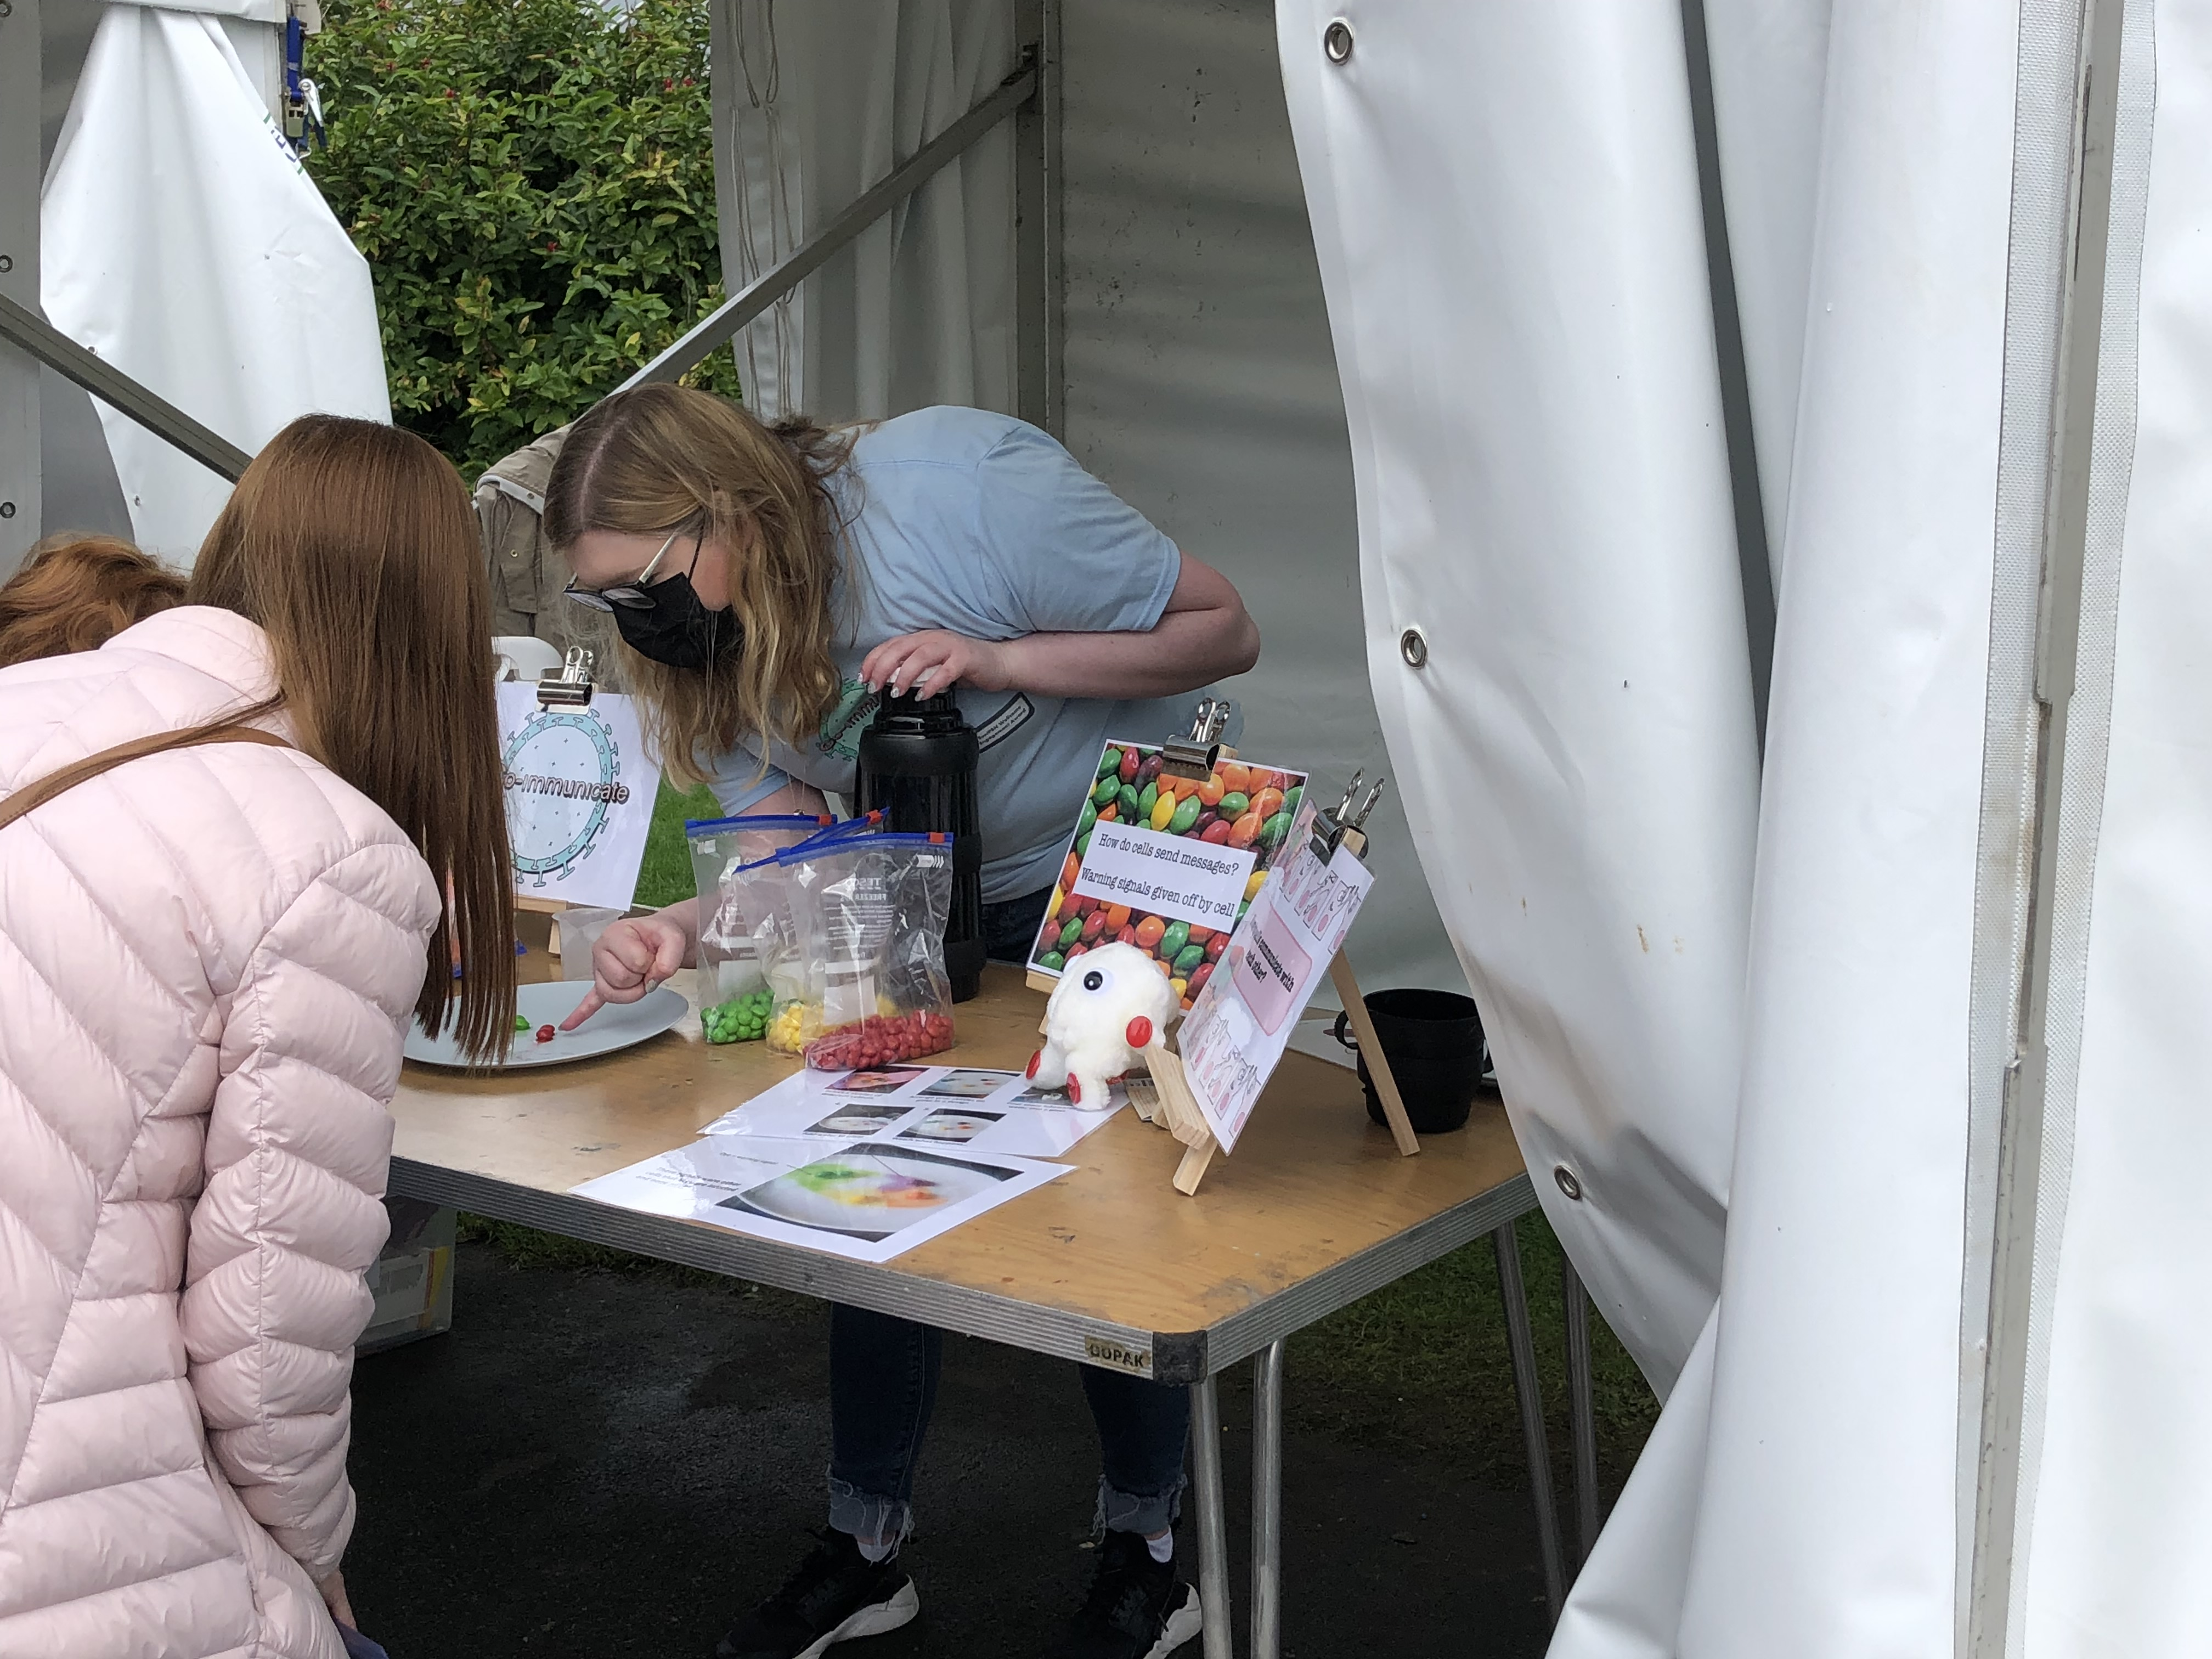
Co-IMMUNicate 2022
In School Activities
Activity Design
Glasgow Science Festival
Tuesday-Thursday this week
Friday this week
Tuesday-Wednesday 7-8th of June
?

Slide 5
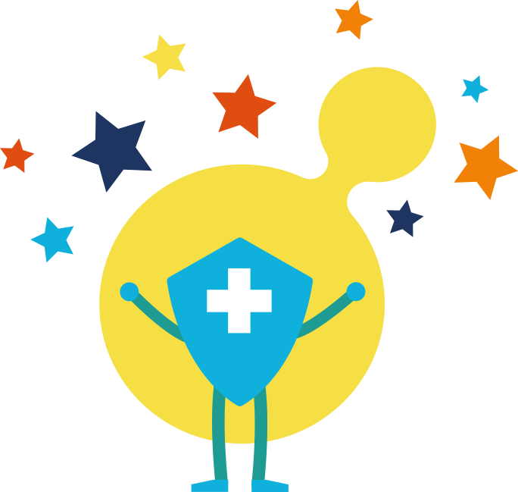

Vaccines and vaccination

Slide 6
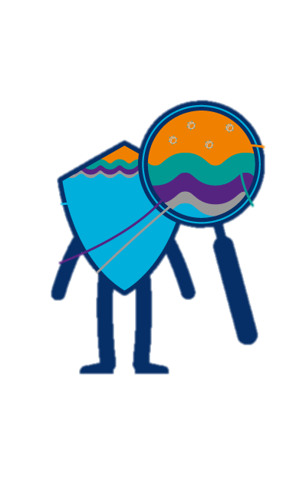
What is a vaccine and what do we mean by vaccination?
Vaccines contain a harmless form of the virus that cause the disease you are being protected against
Vaccination is a common way to protect yourself against a virus that you haven’t met yet
Once you have been vaccinated, your body will be able to quickly fight back against the virus

Slide 7
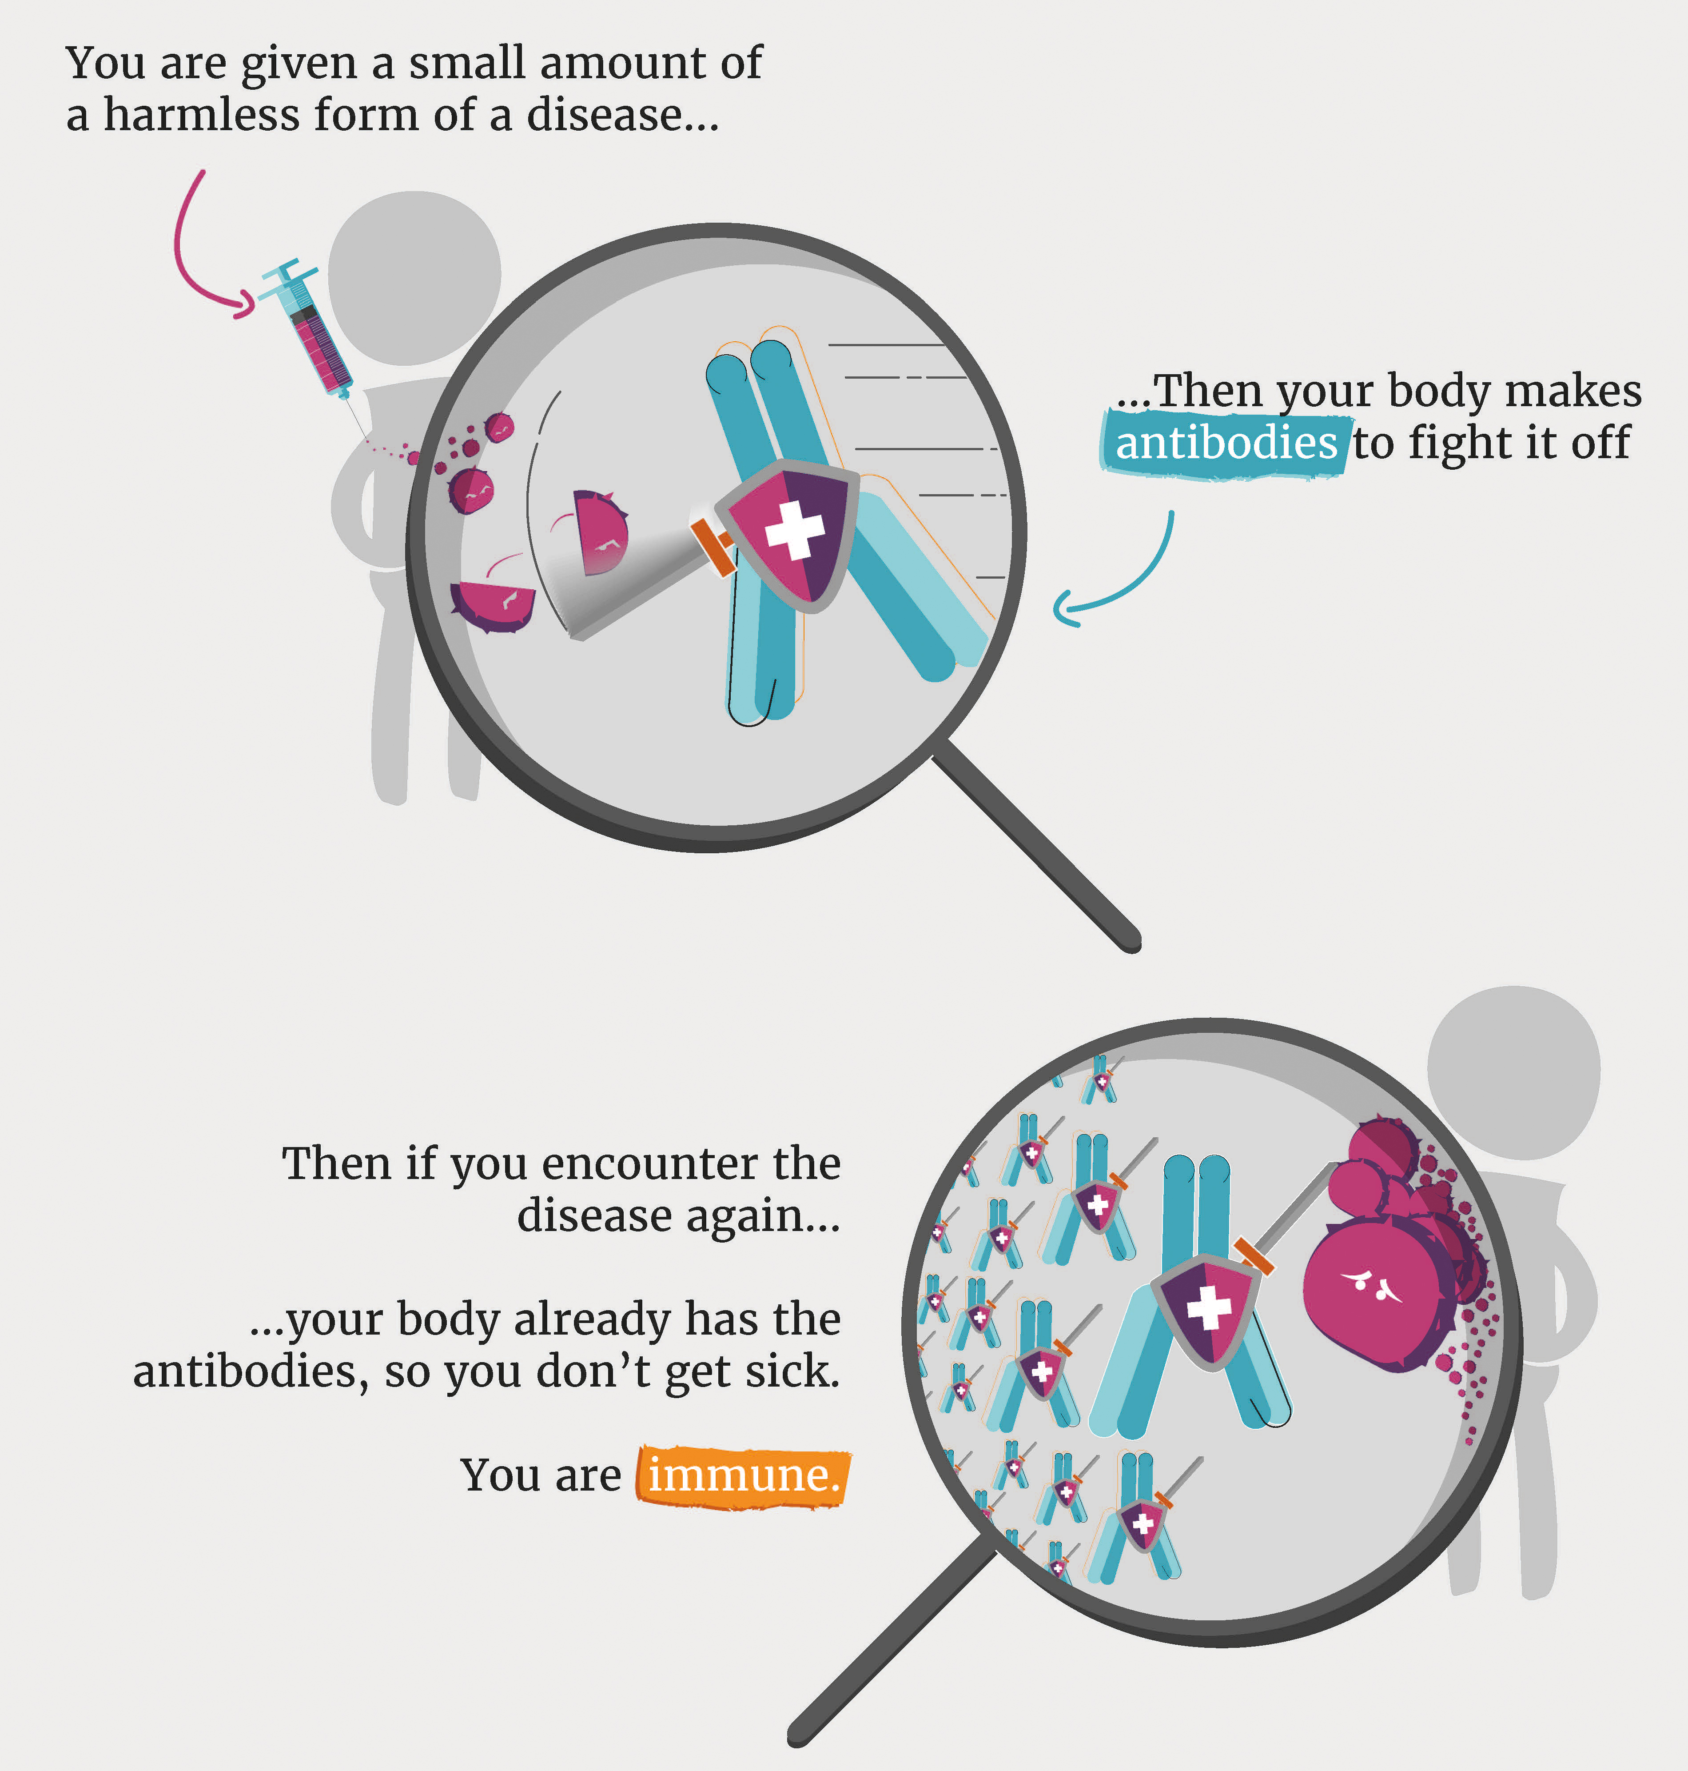
How do vaccines work?

Slide 8
Virus tag!
Red bands: Virus/Infected pupils
Yellow Bands: Vaccinated pupils
Round 1: two pupils wear a red band and carry 4 other red bands
How long does it take them to catch 8 pupils and give them a red band?
Round 2: two pupils wear a red band and carry 4 other red bands
10 pupils have yellow bands - they are protected - even if the virus catches them!
How long does it take 8 other pupils to get infected?

Slide 9
How many pupils were infected when:
No one had yellow bands?
A few pupils had yellow bands?
Does vaccination stop the spread of the virus?

Slide 10
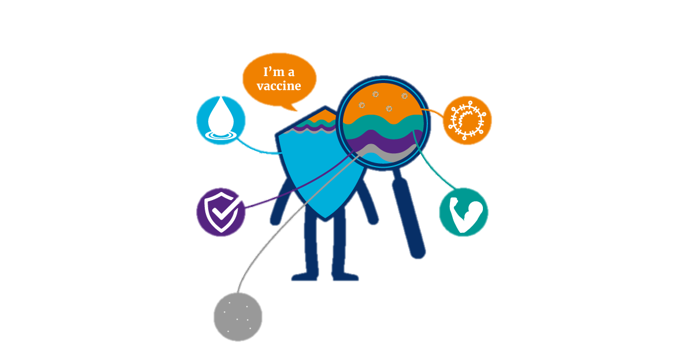
What is in a vaccine?
Active ingredient
Water
Main ingredient
Small amount of harmless form of the virus you are immunising against
Adjuvants
Preservatives and stabilisers
Create a stronger immune response to the vaccine
Maintain vaccine quality, safe storage and prevent contamination
Residual traces
Substances that have been used during vaccine manufacture

Slide 11
Design a vaccine: Part 1
Draw a picture of a virus you want your vaccine to protect against

Slide 12
Day 2

Slide 13
What did you learn yesterday?

Slide 14
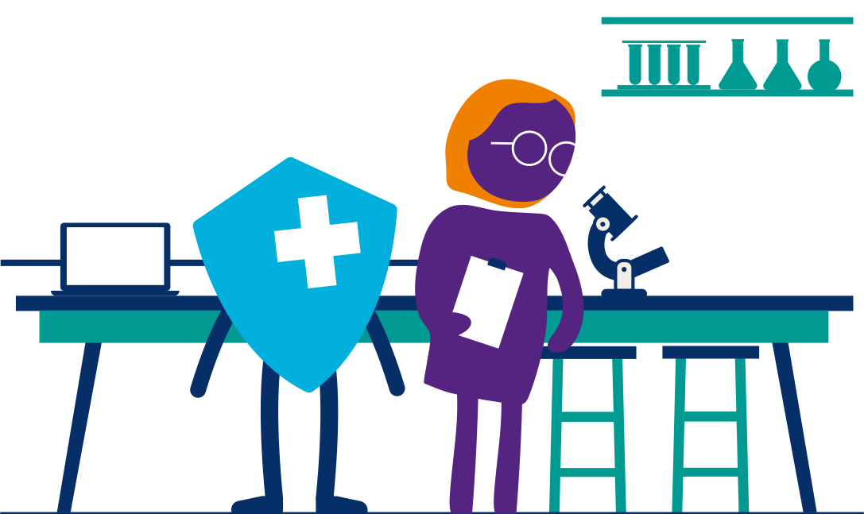
Day 2:
History of vaccination

Slide 15
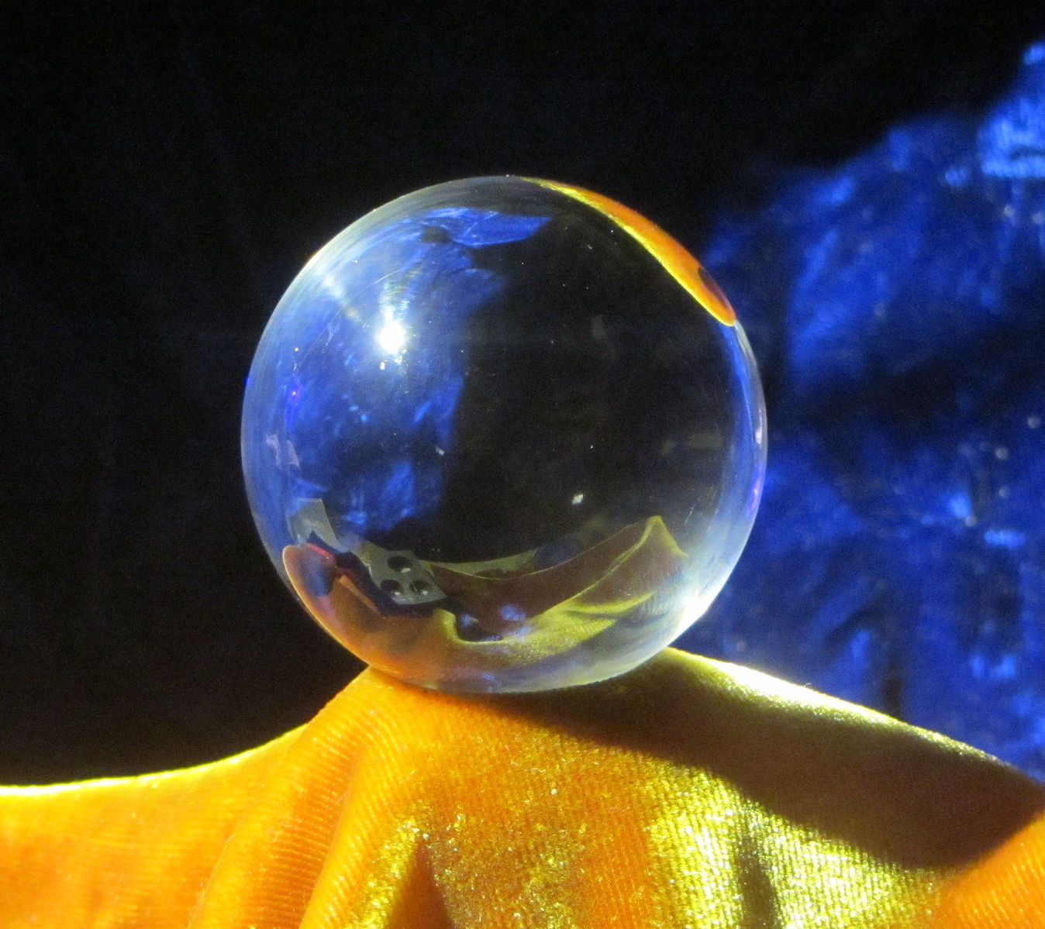
Vaccination can help us predict the future!
https://commons.wikimedia.org/wiki/File:Crystal_ball_by_Ron_Bodoh.JPG

Slide 16
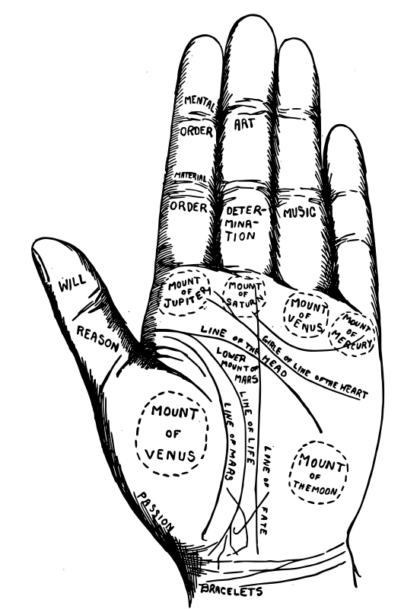
Palm reading – do you think this can predict the future?
Let’s look at the Fate line
Deep line: your life will be controlled by fate!
Breaks in line: you will make many changes in your life
Joined to life line: you will be a self-made individual
Crosses life line: you will be supported by friends/family
Does vaccination help us predict your future?!!
https://openclipart.org/detail/319733/vintage-palmistry-chart

Slide 17
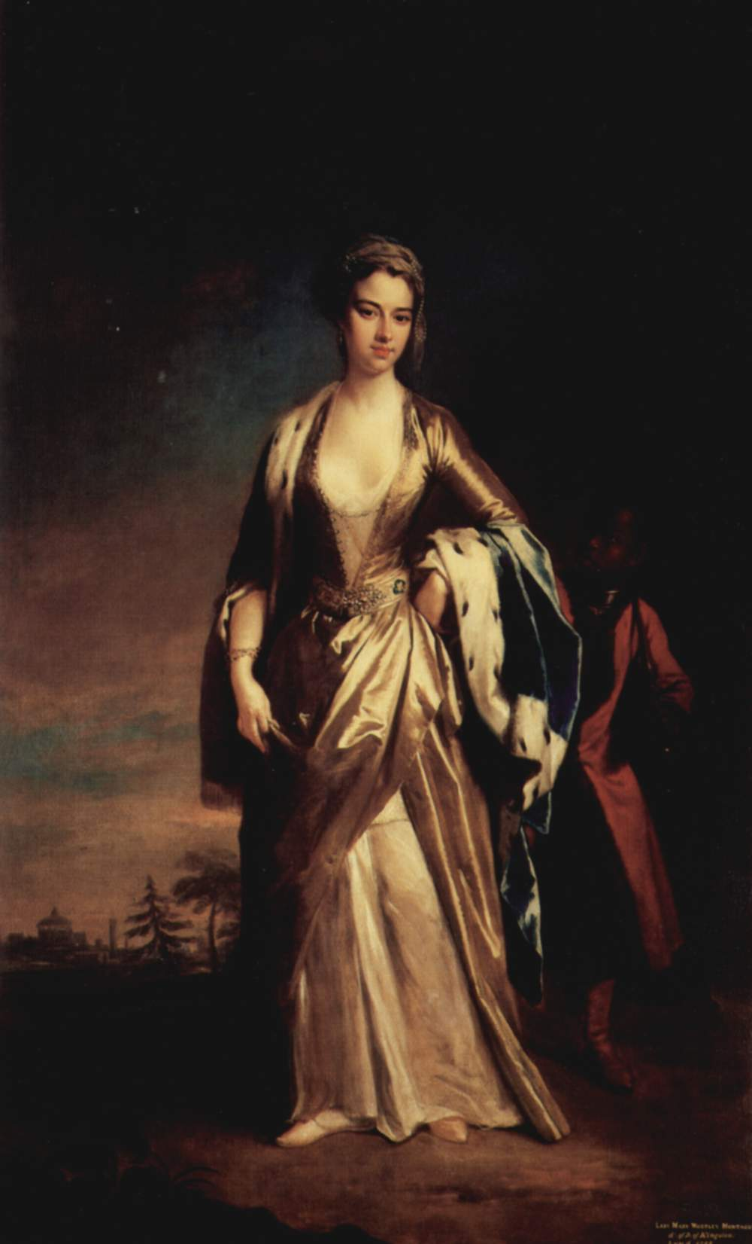
Lady Mary Montagu
Lady Mary lived in the 18th century
Many people died after catching a virus called smallpox. Mary survived but was left with scars on her face
Mary moved to Turkey with her husband and son Edward in 1717
There, it was common to take puss from a sore on the skin caused by smallpox and use it to introduce the virus onto the skin of a healthy person
This is called Variolation
Mary had her son Edward get a shot of live smallpox. He survived!
Via Wikipedia
Notes:
Smallpox was a devastating disease that caused millions of death and disfiguration

Slide 18
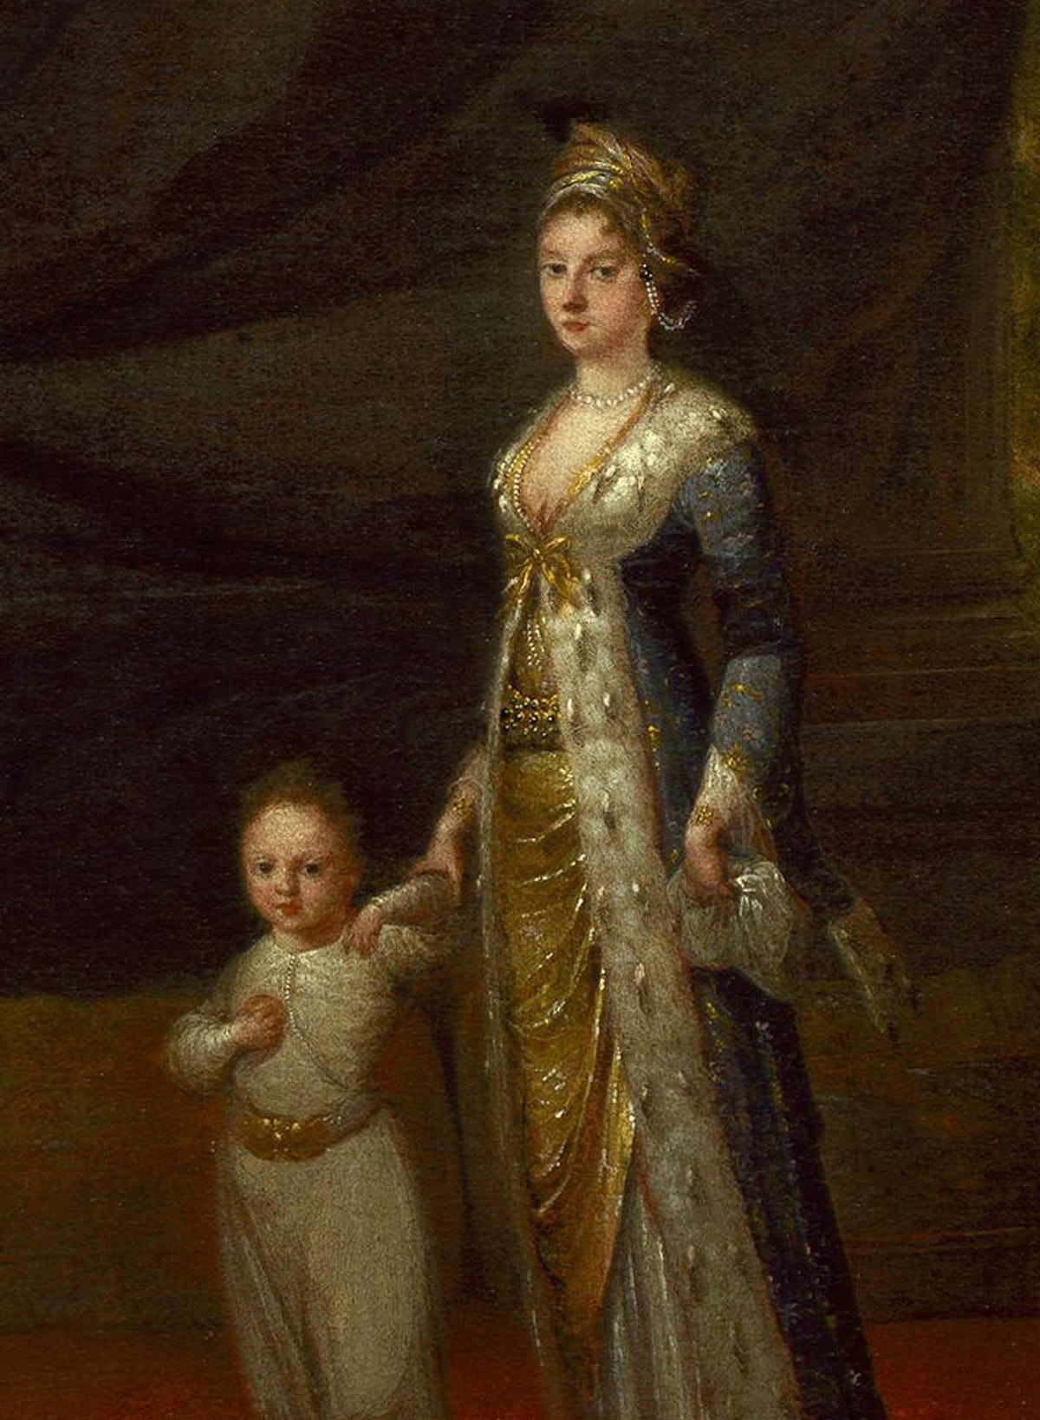
Protecting against smallpox
When Mary came back to England, she brought back the idea of Variolation and inoculated her baby daughter, Mary
As a member of nobility, she had the “ear” of the Royal family
To test the safety of the smallpox inoculation - a trial was arranged
The trial showed that variolation protected against smallpox
The royal children were inoculated and the idea of variolation took hold in Britain
Via Wikipedia

Slide 19
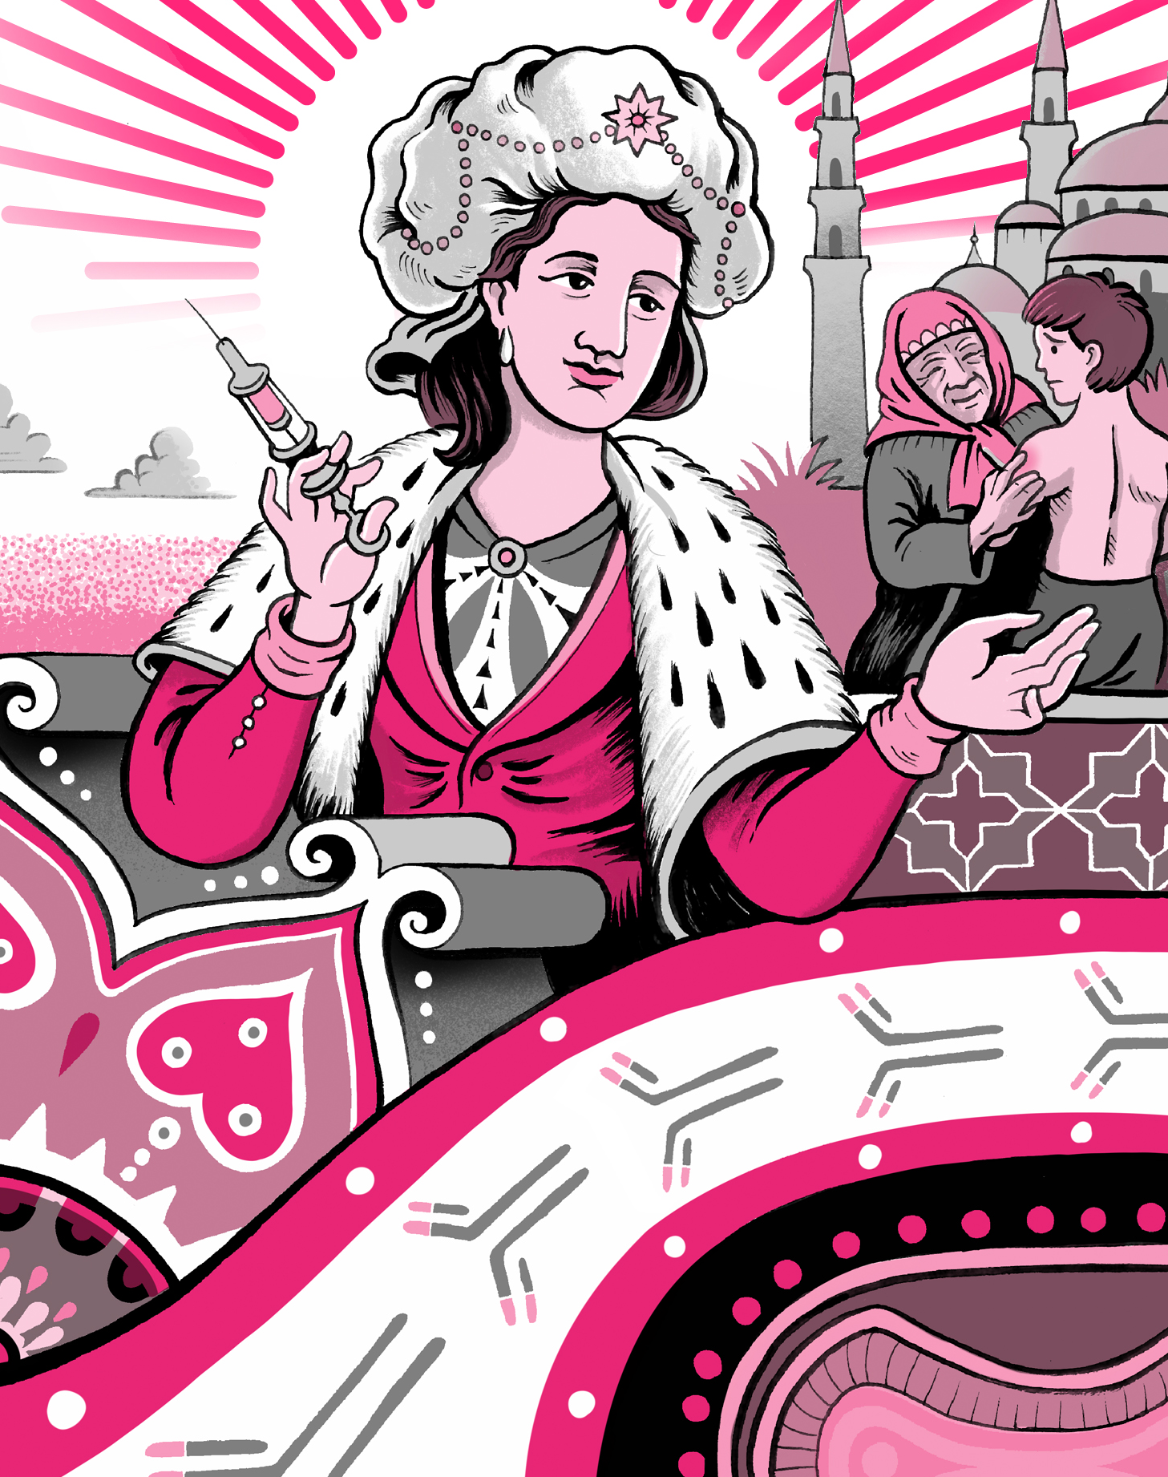
Predicting the future!
Children from lots of different families were variolated
Can you predict what would happen to them if they were exposed to smallpox?
Do you think we can predict your risk of infection?
Matteo Farinella
Published by Massive science
Notes:
Trial - The treatment was tested on six prisoners. All prisoners survived!

Slide 20
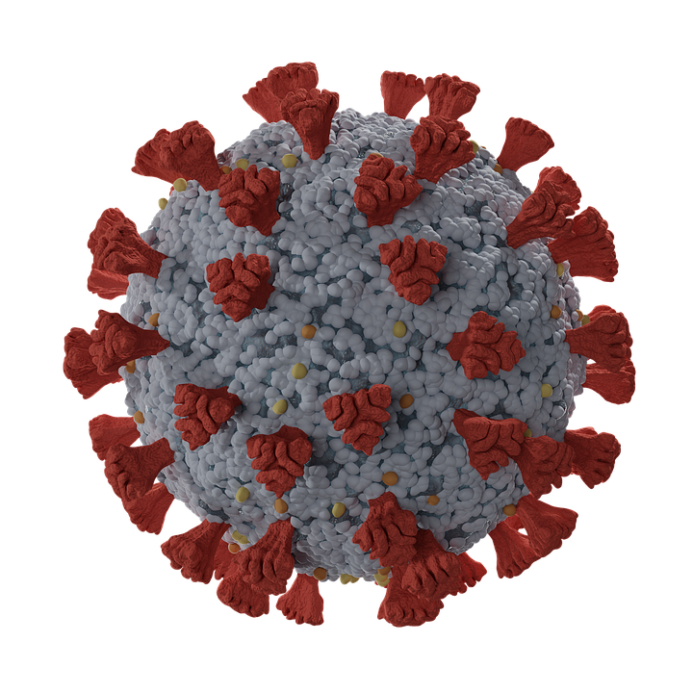

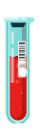
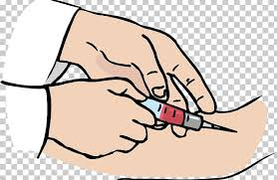
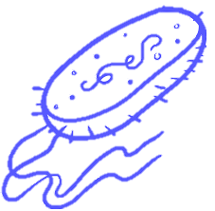
The immune proteins in your blood might predict your future!
We can take a sample of blood from a person’s arm
Each antibody is unique - it only binds to one bug
Your blood contains immune proteins called antibodies
https://pixabay.com/illustrations/virus-covid-19-coronavirus-5538240/
https://imgbin.com/png/AxW0PJFv/drawing-blood-test-png
https://www.vecteezy.com/vector-art/4595215-
https://innovativegenomics.org/glossary/bacteria/

Slide 21



Can you predict which of the samples come from people given your vaccine?
New-born baby: Olga
Teacher: Miss Gurnah
Grandad Mo
Add two drops of purple test liquid to each of the samples
A colour change to pink means the sample contains protective antibodies
Who would be protected against your virus?

Slide 22
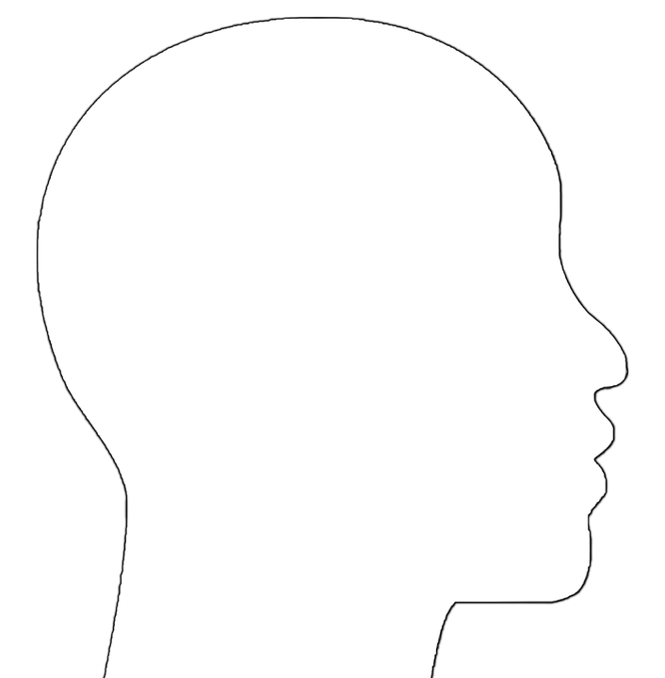
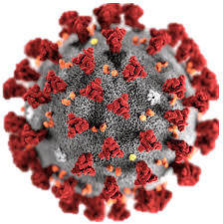
We can also find antibodies in your nose!
Where do you think might be the best place to have antibodies to protect against viruses?

Slide 23
Design a vaccine: Part 2
How will you give people your vaccine?

Slide 24
Day 3

Slide 25
What did you learn yesterday?

Slide 26

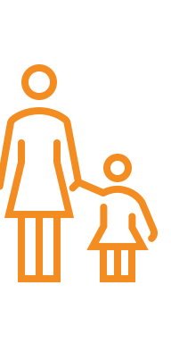
Who is protected when you are vaccinated?
Vaccinated
Unvaccinated

Slide 27
How many infected people are needed to make a community unstable?!
Half the community?
A third of the community?
A fifth of the community?
What happens when you remove the blocks with bugs on them?
Remove one bug block at a time - will the community fall?!

Slide 28
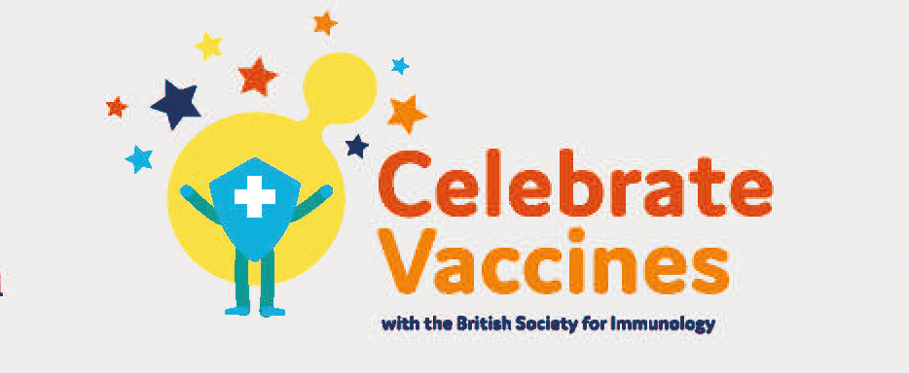
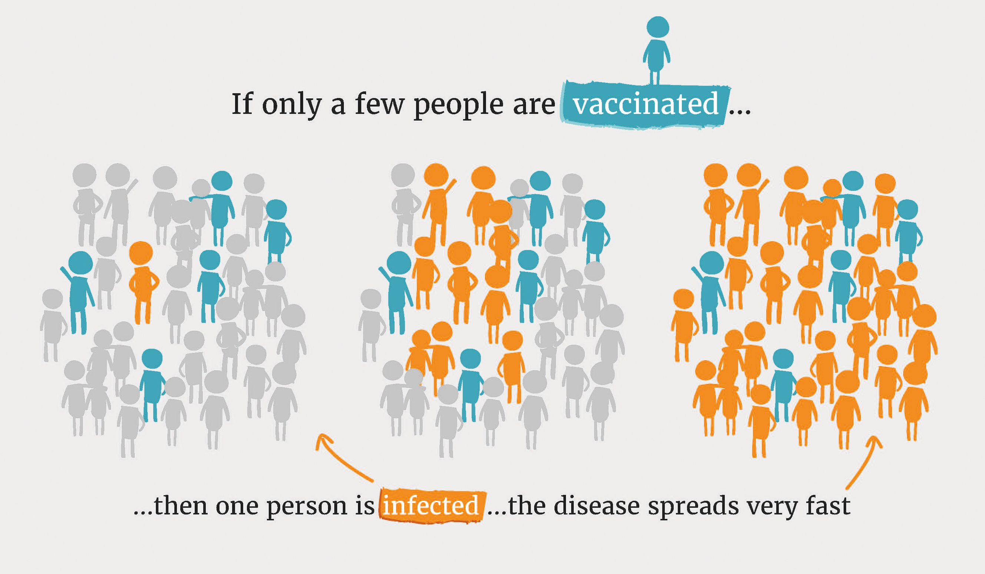
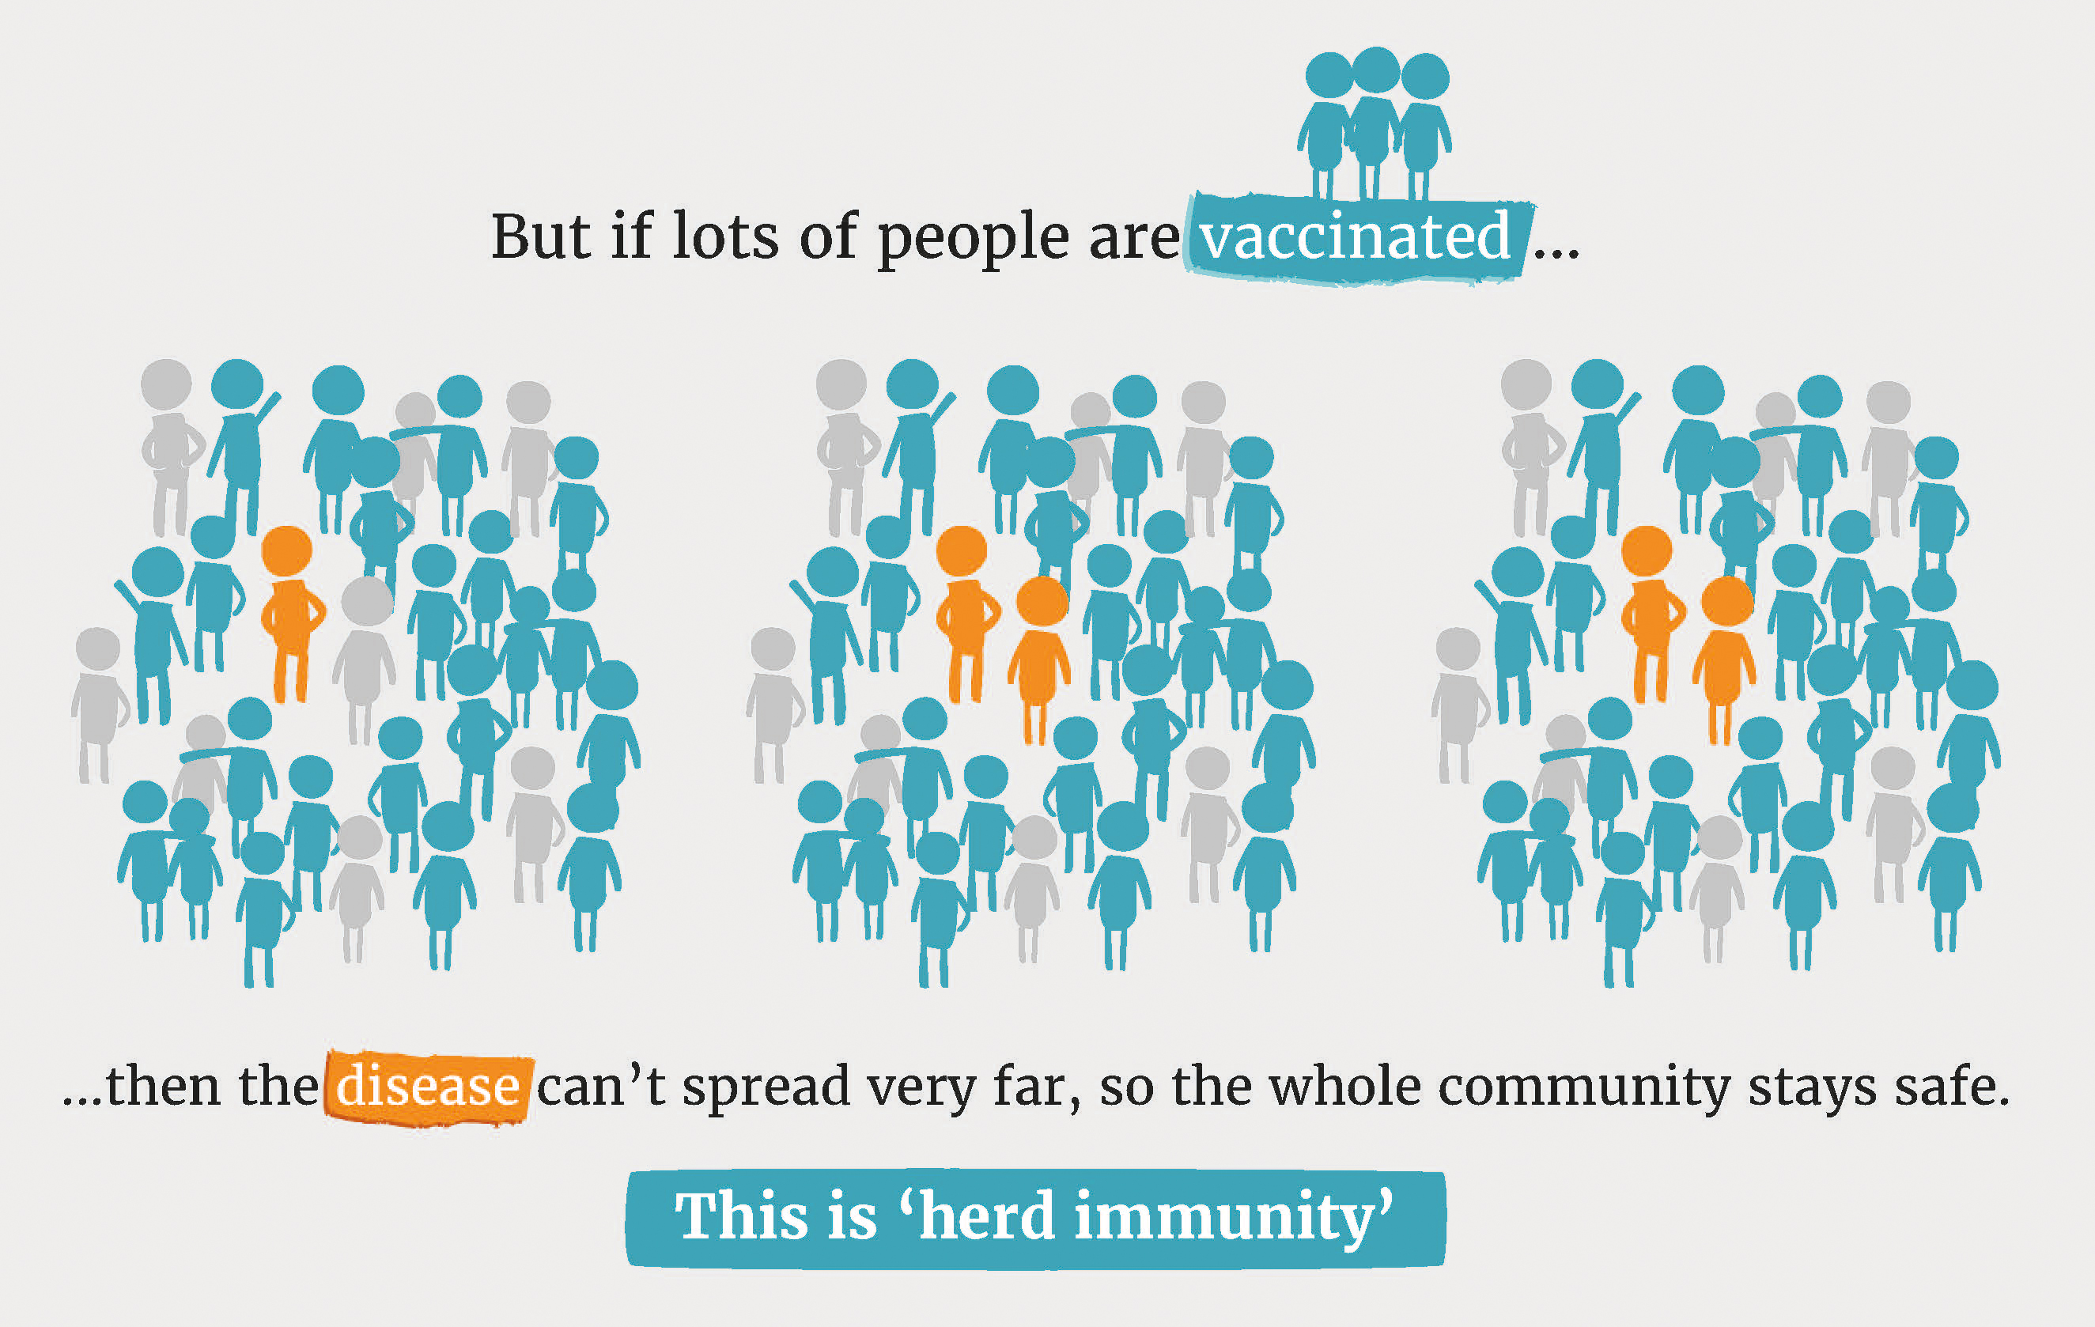
Herd immunity means that you can protect others when you are vaccinated!

Slide 29
Design a vaccine: Part 3
Draw a poster to encourage others to get vaccinated

Slide 30
We need your help: Glasgow Science Festival 2022
Can you design an activity for the Glasgow Science Festival?
The activity needs to be fun!
And help people to understand how vaccines work

