Slide 1
University of Glasgow EON-XR Centre
Academia-Industry Partnership
University of Glasgow and EON Reality
Sajjad Hussain (Sajjad.Hussain@Glasgow.ac.uk),
Hasan T Abbas (Hasan.Abbas@Glasgow.ac.uk),
Qammer H Abbasi (Qammer.Abbasi@Glasgow.ac.uk),
Muhammad A Imran (Muhammad.Imran@Glasgow.ac.uk),
Marcin Kasica (marcin.kasica@eonreality.com),
Renah Wolzinger (renah.wolzinger@eonreality.com),
Mark Cullens (mark@digitalenergygroup.com)

Slide 2
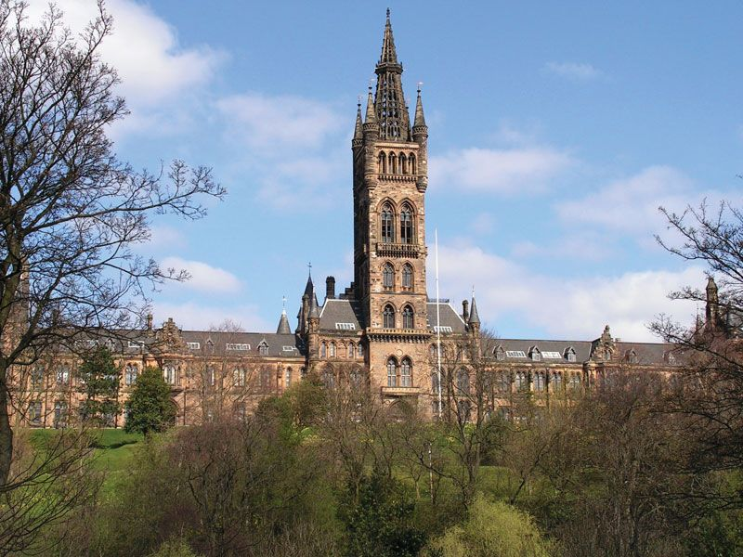
University of Glasgow
Founded in 1451, Glasgow is the fourth-oldest university in the English-speaking world.
The University of Glasgow is ranked 73rd in the world (QS World ranking 2022) and was the first UK university to be rated as 5 Stars Plus overall

Slide 3
EON Reality
EON Reality (https://eonreality.com/) is a non-profit organization focused on advancing the cause of Augmented and Virtual Reality (AVR) education and research.
EON have more than 20 locations worldwide and have created the largest AR/VR training library with over 8,000 applications.
The vision of EON reality is to see a future where the forces of AI, IoT, AR, and VR come to propel human-computer interaction to new levels.

Slide 4
University of Glasgow EON-XR Centre
The Centre is formed as part of EON’s Grant Guarantee Program
A partnership that supports over 2000 University of Glasgow students, internees and staff to create merged reality content.
The Centre is expected to enhance and support students learning through immersive learning

Slide 5
Terminologies
Virtual Reality- interact with 3D environment
EON-XR- interactive experience with the real world environment and virtual assets
Merged XR- Scan your environment, upload, use AI for identifying interactive 3D Elements, walk - talk - interact
Spatial Meetings - Meet and learn with others in virtual spaces

Slide 6
XR - Why, When and How
Situational Learning in Authentic Contexts
Easier to understand complex theoretical concepts
Quickly build competencies in following a process or procedure
Demonstrate understanding of key concepts in solving difficult problems

Slide 7
Pedagogy and Curriculum Implementation
Collaborative learning- Students being able to collaborate with their peers, share opinions and knowledge
Personalized learning- Students are able to learn at their own pace, localized understanding and being able to consume knowledge on their own
Situated Cognition Theory- Knowledge needs to be acquired in the context it is collected (immersion and simulations).
Learning is a social constructivism- Students need to be allowed to explore and try new things without the fear of consequences of the real world.

Slide 8
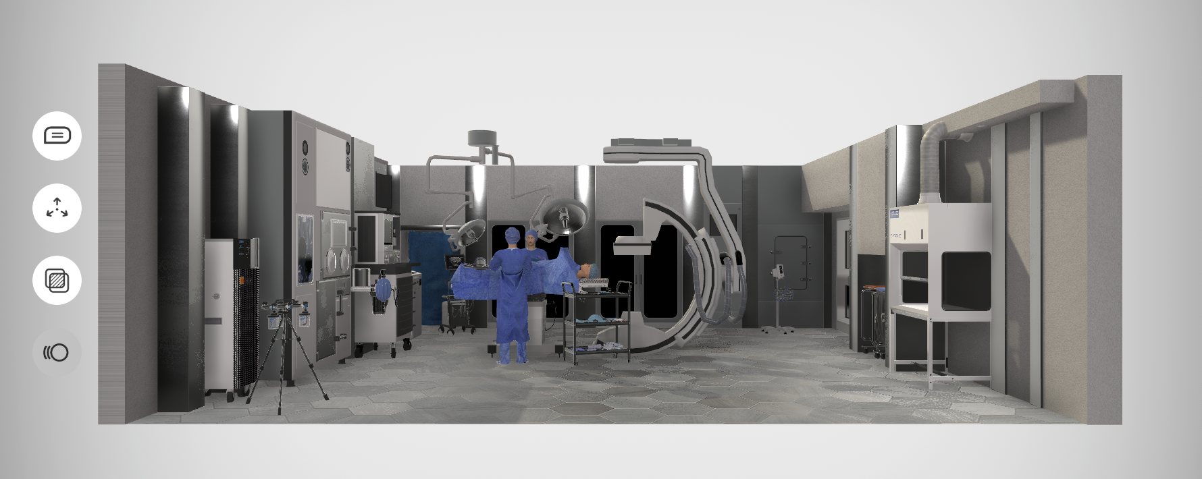
Technology and Educational Philosophy
“The most effective education is experiential: Learning is achieved through personal experience and doing.” John Dewey
Creating the Metaverse
EON XR
EON Merged XR
EON Spatial Meetings

Slide 9
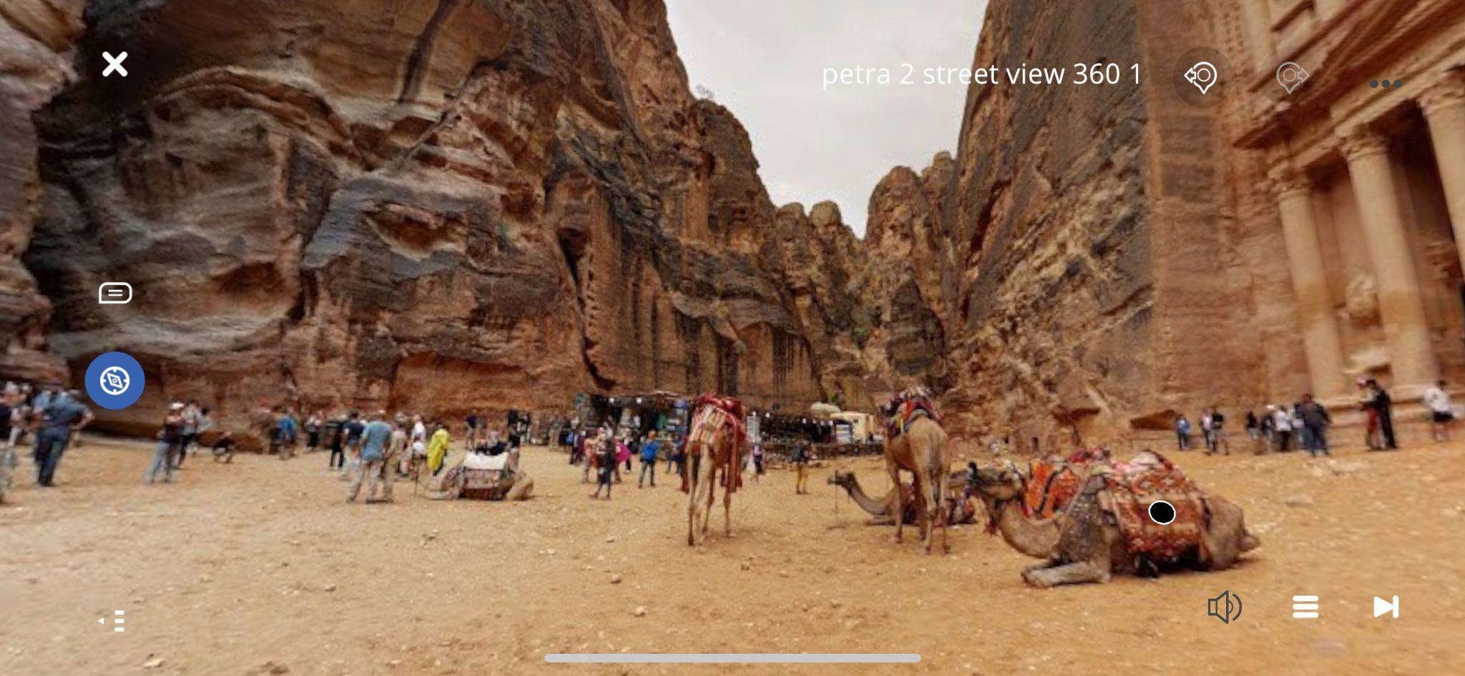
XR - Mixed Reality
Enables experiential learning where it may not have previously been possible
Visit art museums, Archaeology Sites, Mount Everest
Experience Inaccessible Sites like Mars, the Titanic, Deep Oceans
Also, the option of including
Reflection
Self-Assessment
Reanalyzing Learning Outcomes

Slide 10
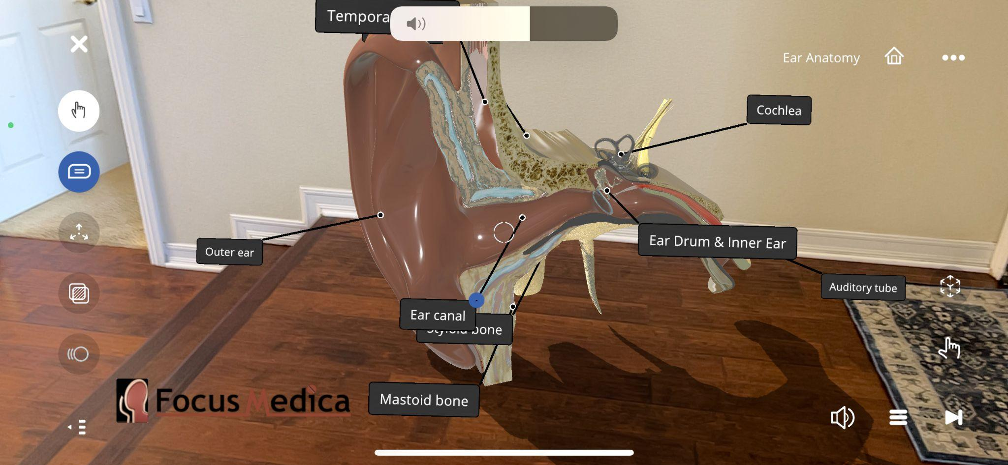
XR - Mixed Reality
Do things impossible in the physical world
Navigate inside veins or arteries, manipulate entire environments
Train for difficult situations in a safe environment
Train firefighters, work on an oil rig

Slide 11
VITALISE VIrTuAL training of reSearch cEntres
University of Glasgow is providing an immersive experience of the state-of-the-art research facilities and the training to the students of cutting-edge equipment available at its various research centers and labs
The target audience is both undergrad and post-grad students who cannot access these facilities under normal circumstances.
Virtual tours and trainings of research centers are prepared using the EON-XR platform.

Slide 12
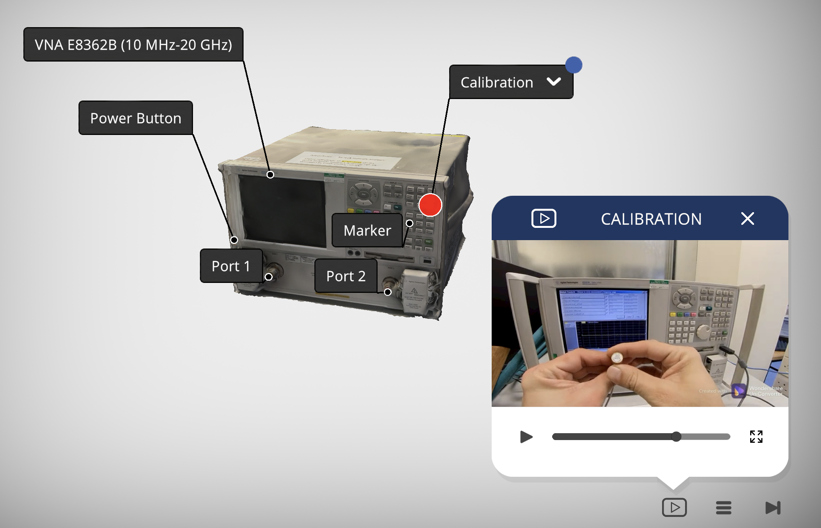
RF and Microwave Lab
https://www.youtube.com/watch?v=n8qzQlLel5g

Slide 13
Conclusion
Through academia-industry partnership in the form of University of Glasgow EON-XR Centre, students and staff can efficiently create AR/VR content without any coding requirements
Through immersive learning, the Centre can enhance University of Glasgow student learning experiences in the UK and its TNE provisions
The integration of 5G research at Glasgow’s 5G Centre and XR has a great potential in contributing to various sectors such as healthcare, medicine, science and engineering.

Slide 14
Thanks!
Contacts
Sajjad Hussain (sajjad.Hussain@Glasgow.ac.uk) University of Glasgow
Renah Wolzinger (renah.wolzinger@eonreality.com) EON Reality

