Slide 1
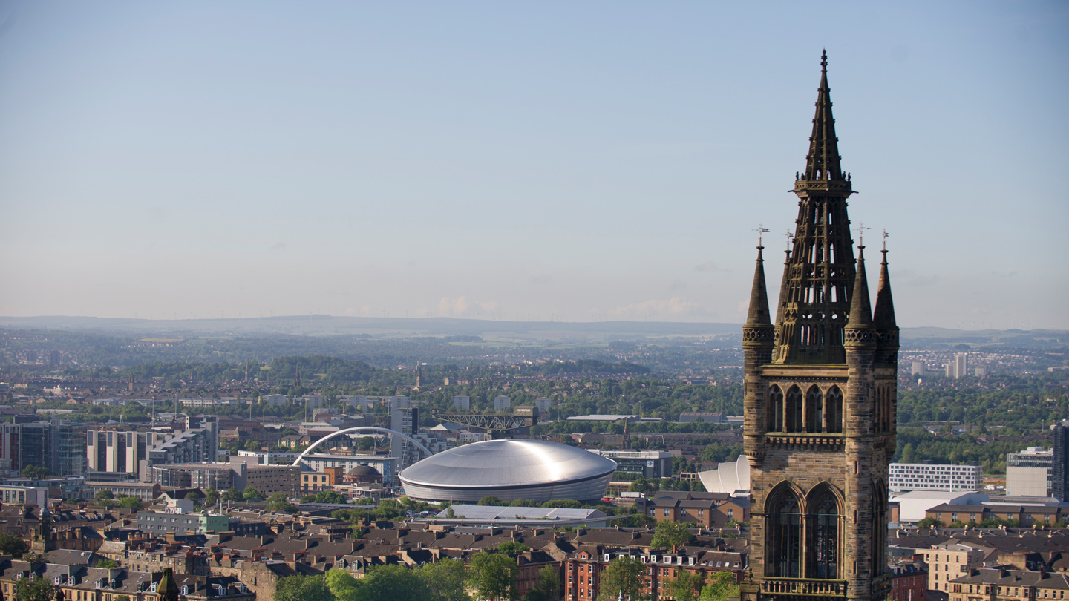
Guidance for Completing a Business Case (<£3m) in 2023

Slide 2
Introduction
A revised Investment Application Form and new Business Case templates were rolled out in 2022
The Investment Approval Flowchart outlines which form should be used, depending on the size of the investment request, the internal source of funding and whether it is in budget
These slides provide guidance to project managers and sponsors on what should go into each section of the Business Case (<£3m)
The first section covers the Executive Summary; the second section covers the main body of the Business Case
The Business Case has been designed as a “one size fits all” document which can be used for any type of investment and any governance body. Not every section of the Business Case will therefore be relevant to every investment request
The aim is to provide increased support for project managers in completing Business Cases, and achieve greater consistency in the form and content of documents being submitted to governance bodies
If any sections are unclear, please contact Management Accounts or your local finance colleagues for clarification. The terms “investment request” and “project” are used interchangeably throughout this document
As this is a relatively new process, constructive feedback is welcome

Slide 3
Executive Summary – Project Overview
Project / Investment Plan Code (if available at this stage):
Submission Date:
Submission Type: select one of
New application, change to an already approved investment
Delivered by: select one of
Estates, Information Services, Transformation, Residences, College, College (PI), Other
“Other” will include areas such as Innovation
Stage and Next Gate: select one each of
Pipeline, Initiation, Feasibility, Design, Decision to Invest, Delivery, Handover, Embed
1. Out of Pipeline, 2. Approval to Design, 3. Decision to Invest, 4. Decision to Handover, 5. Approval to Close
More details on stages and gates are contained in the “Framework” slide in the “Useful Documents” section of this site
Business cases are most commonly prepared at the “Decision to Invest” stage and Gate 3, but may be produced at other times

Slide 4
Executive Summary – Project Summary
This section should contain a concise summary of what the project is for
It is the equivalent of an abstract to an academic journal article, or an “elevator pitch”
Max 500 words

Slide 5
Executive Summary – Change Request Summary
A Change Request is used where a project has already been approved but more time or money will be needed to deliver it or the project will not deliver what was originally promised. Governance bodies must be given the opportunity to re-evaluate a project in these circumstances, but rather than complete a new business case only the “Change Request” section needs to be added
The remainder of the business case should also be updated at this point to reflect the revised costs, timing or benefits of the project
A change request is usually required where a project's spend is expected to be materially higher (or lower) than originally approved. Significant project delays or changes to benefits will also result in a change request, although these should be considered on a “case by case” basis with the project sponsor
If applicable, this section of the form should explain why additional spend is required
For example have there been delays or cost overruns, or has the project’s scope changed
What impact will any changes have on benefits and timescales
Max 500 words

Slide 6
Executive Summary – Financial Overview
This section identifies the source of funding for the Investment. It should be completed in conjunction with your local finance colleagues
Investment Plan Funding Source: select one of
Estates: Major Projects, Maintenance, Campus Enhancement, Should Do Projects, Learning Spaces, Sustainability
IT: Major Projects, Maintenance / BAU Projects, Should Do Projects
Residences
Equipment
College Surplus Roll Forward
Research Strategy, L&T Strategy, Innovation Strategy, Internationalisation Strategy, Strategy Implementation, Other Strategic Initiatives
General Funds, Donations, Endowments, Commercial Income, Research Grants
Where possible, the “Funding Source” selected should match the cost class where the project has been created: for example, if funds are coming from the Research Strategy then the project should be created under cost class 761 (finance colleagues will be able to advise)

Slide 7
Executive Summary – Financial Overview (cont’d)
Amount Already Approved (X) – how much has previously been approved by this governance body in relation to this investment? If this Investment has not previously been to this governance body, this box will be zero
Additional Amount Requested Now (Y) – the incremental funding being requested today (this is the figure which should appear at the top of the form)
Total Amount Requested to Date – the sum of X+Y
Total per Investment Plan – the funding available for this Investment in the latest Investment Plan
External Funding - if all or part of the funding is coming from an external source, the amount should be stated
External sources of funding may include research grants, income from commercial partners, endowments or donations
External funding will generally be incremental to figures in the other boxes

Slide 8
Executive Summary – Financial Overview (cont’d)
Type of Spend / Cost Category – for example, construction costs, technology costs (hardware / software), audio-visual equipment, furniture + fittings, staff costs, recruitment fees, professional fees, contingency
Each type of spend should be on a separate line (see next slide for an example)
Costs Incurred to Date (A) – how much has actually been spent on the project so far
Costs to Complete (B) – what further costs will be required to complete the project
Total Project Costs – the sum of A+B ie the total expected spend over the lifetime of the project
The Total Spend boxes should contain a split of “Total Project Costs” by year to assist in preparing annual budget and forecasts

Slide 9
Executive Summary - Financial Overview (cont’d) - Example
Type of Spend / Cost Category | Costs Incurred to Date (£) | Costs to Complete (£) | Total Project Costs (£)
Construction | 100,000 | 250,000 | 350,000
Technology - hardware | 20,000 | 80,000 | 100,000
Audio-visual equipment |  | 15,000 | 15,000
Furniture + fittings |  | 10,000 | 10,000
Staff costs | 10,000 | 30,000 | 40,000
Recruitment fees | 2,000 | 3,000 | 5,000
Professional fees | 25,000 | 5,000 | 30,000
Other costs | 8,000 | 12,000 | 20,000
Contingency |  | 30,000 | 30,000
Total | 165,000 | 435,000 | 600,000

Slide 10
Executive Summary - Benefits Overview
Every project is likely to have more than one benefit - please use one table for each specific benefit. 3 tables are shown but more can be added, up to a maximum of 7
Each table has 7 boxes:
Type / Outcome – select one of: supporting research; supporting learning & teaching; staff experience; student experience; service excellence; efficiency, other
Description – a one-sentence description of the benefits which the project will deliver. Examples include “increase tuition fee income by doing X”, “improve student experience by doing Y”, “reduce carbon emissions by doing Z”, etc
Owner – the person who will be accountable for delivering the project’s benefits post-completion. This field will usually be a role rather than a named individual eg Head of College or University Services area
Value – quantify the benefits eg £200k per annum, improvement in rankings from A to B. Note that some investment benefits may be qualitative rather than quantitative and thus difficult or impossible to value
Direct financial impact – will the investment result in a specific, measurable and identifiable increase in income or reduction in costs
How will this be measured? – financial benefits will usually be measured through the annual budget or monthly management accounts; non-financial benefits may be measured using surveys or regular reports to governance bodies (eg CMG, PSG)
Timing – when will the project’s benefits arise. This will usually be a specific year or years

Slide 11
Executive Summary - Benefits Overview (cont’d)
The Total Financial Benefits table should contain a split of financial benefits by year to assist in preparing annual budget and forecasts
Projects should focus on benefits which will be realised over the current financial budget cycle to 2026/27
The only exceptions are likely to be Estates Major Projects or significant research investments
Projects should clearly state to what extent benefits are included in the latest financial budget, along with the relevant College / University Services area and account line (for example, CoSE tuition fee income) to enable benefits to be identified and tracked
A small number of measurable benefits (ie 4 or 5), and a realistic approach to measuring those benefits post completion, is strongly preferred to a long list of minor gains or incremental improvements which will be difficult or time-consuming to track
Benefits should ideally link to one or more of the University’s strategic or thematic priorities
The narrative in the business case should contain more detail on each benefit, including any underlying assumptions, the assumed baseline and incremental improvement, benefit drivers, confidence in delivery, ease of realisation, and scale of impact

Slide 12
Executive Summary - Benefits Overview (cont’d): Example
Heading | Example
Outcome heading / benefit type | Supporting research
Benefit description | Increase in research grant income in School of Medicine
Benefit owner | Dean of MVLS
Benefit value | £200k per annum
Direct financial impact | Y
How will this be measured? | Annual budget and monthly management accounts
Timing of benefit | From 2024/25

Slide 13
Executive Summary – Strategic Alignment
Which of the University’s strategic themes is the investment most aligned to:
Community | Connectivity | Challenges
People centred, globally engaged | Collaboratively minded, digitally enhanced | Solution focused, impact oriented
Leading with our values and putting our people first | Creating space to connect through new collaborative and social space on campus | Embracing challenge-led research to address the needs of global society
Engaging with our civic mission via our local and global communities | Investing in our digital realm to enhance the staff and student experience | Reimagining our curriculum to prepare students for a challenging and changing world
Strengthening our partnerships to amplify our local and global impact | Adopting collaborative technologies for frictionless and flexible work and study | Building a sustainable future through our research, education and actions

Slide 14
Executive Summary - Prioritisation
This section has 5 boxes:
Health & Safety / Regulatory – select one of the following dropdowns
Statutory or legislative requirement
Potential statutory or legislative requirement
Not a statutory or legislative requirement
Business Continuity – select one of the following dropdowns
Almost certain to disrupt business critical services
High risk to disrupt business critical services and almost certain to disrupt non business critical services
Significant impact to business services and operations
Some impact to business services and operations
No impact to business services and operations

Slide 15
Executive Summary - Prioritisation (cont’d)
Sustainability – select one of the following dropdowns
Direct positive contribution towards our net carbon footprint
Indirectly supports a positive contribution towards our net carbon footprint
Does not relate to our sustainability goals
Would result in an increase to our carbon footprint
Strategic Alignment – select one of the following dropdowns
We could not meet our strategic goals or more than 3 KPIs
We may not be able to meet our strategic goals or 1 or 2 KPIs
There would be some impact on our KPIs
There may be an indirect impact on our strategic goals or KPIs

Slide 16
Executive Summary - Prioritisation (cont’d)
Capability & Competition – select one of the following dropdowns
Be new and innovative giving us a competitive advantage
Be improved but failure to invest will mean a loss in quality
Possible result in a loss in quality if not invested
Not impacted by this investment
There is also a mandatory section where further details of the impact of this investment on sustainability at the University should be provided
This section does not just relate to Estates
For example, the University reports annually against the UN’s Sustainable Development Goals: any investment which improves the University’s rating in this area will be relevant

Slide 17
Executive Summary - Sustainability (Estates-only)
This section is specific to Estates

Slide 18
Executive Summary – Equipment and Estates
This section is generally used for new or replacement items of equipment:
Equipment Cost - how much will the equipment cost? This may only be one element of the overall project cost
Building/Location - where will the equipment be located?
Estates Cost - what costs will Estates incur in installing the equipment?
Estates Investment Support Contact - who in Estates are you liaising with regarding the equipment?
Date sent to Estates (for installation cost) - when were Estates informed?
If this section is not relevant to your project, please retain the heading but replace the table with “Not applicable”

Slide 19
Executive Summary – Additional Information
Any further relevant points
Any further documentation presented as part of this application

Slide 20
Executive Summary – Approvals
Please obtain any local approvals required from relevant individuals or committees, including your local Head of Finance

Slide 21
1. Project Background, Context and Objectives
This section should detail why the investment is needed, what will be delivered and when it will be delivered
For example:
What is the current position or context for the investment?
What are the project’s objectives?
What benefits will be delivered and are they already included in the latest financial budget?
Outline the relevant College and account line (for example, CoSE tuition fee income) to enable benefits to be identified

Slide 22
2. Strategic Alignment and KPI
This section should link to the Strategic Alignment section in the Executive Summary
It provides space to detail how the project will support and impact the University’s strategic themes and KPIs

Slide 23
3. Solution Design
This section is most applicable to property or technology projects
It provides space to identify and describe each solution or design element of the overall project
If the Project Background section is “what will be delivered”, “when it will be delivered”, and “why it is needed”, the Solution Design section is “how it will be delivered”
If this section is not relevant to your project, please retain the heading but replace the table with “Not applicable”

Slide 24
4. Options Considered
This section outlines possible alternative solutions to the investment requested
“Do nothing” is (almost) always an option, but the consequences of this option should be detailed
“Preferred Option” can be brief as it’s the content of the business case
Alternative approaches to achieve the project’s objectives should be considered and outlined, along with why those approaches have been rejected
The Investment Committee should be given sufficient information to arrive at a different decision – it should not be presented with a “fait accompli”
Occasionally a project will have no realistic alternatives
this is most likely to occur when the investment requested is in additional staff

Slide 25
5. Procurement & Funding Approach
This section is most applicable to property or technology projects
It outlines how the project will be procured:
Procurement Approach – has a competitive tender been performed or has a range of quotes been obtained? How do costs compare to relevant benchmarks?
Supplier and Costs – which supplier(s) has been selected and how much will they charge (including VAT)?
Alternative Suppliers and Costs – which alternative suppliers were approached and how much did they quote?
Additional Notes
Why did we select our preferred supplier? Do they have experience in successfully delivering projects of this nature? Have we worked with them before?
In what circumstances could we change supplier if they cease trading or the project goes off-track?
Large or complex projects should work with the Procurement team on selecting a supplier

Slide 26
5. Procurement & Funding Approach (cont’d)
Occasionally a project will have no formal procurement approach
This is most likely to occur when the investment requested is in additional staff
If this section is not relevant to your project, please retain the heading but replace the table with “Not applicable”
This section also outlines how the project will be funded:
Funding Source - is funding coming from an external source or the University’s own funds (or a mixture of both)? Select one of:
External, University Funding, Part External / Part University (this should match the “Executive Summary – Funding Type” section)
Grant or other funding details – if a third party is providing funding, where is it coming from? Is release of funding in stages, or subject to satisfactory progress or any other conditions?
Funding additional notes – any other relevant points

Slide 27
6. Delivery Approach & Governance
This section is most applicable to property or technology projects
It details the key individuals and techniques involved in delivering and monitoring the project:
Project Sponsor – who is the Project Sponsor(s)?
Project Manager – who is the Project Manager?
Additional resources identified / required – are any other UofG staff required? Are they available? Is an external project management firm being engaged?
Project Approach Overview – will an approach such as Agile or RIBA be adopted?
Project Governance Arrangements – will regular reports be provided to any UofG committees? How will the project’s progress be monitored? Who is entitled to decide on any changes to the project’s scope or timing?
Additional information on delivery approach
Occasionally a project will have no formal delivery or governance approach
This is most likely to occur when the investment requested is in additional staff
If this section is not relevant to your project, please retain the heading but replace the table with “Not applicable”

Slide 28
7. Milestone & Delivery Planning
Insert a table or chart showing milestones and key delivery dates
This section will always be required, but depending on the complexity of the project it may be relatively straightforward
Items to consider including:
When will the project begin?
When will staff be in place?
When will the project end?
When will benefits become visible?
For building or technology projects, when will the project be handed over? When will post-implementation support or warranties end?
Projects should not be overly optimistic around timescales, especially those involving recruitment, technology changes or planning permissions

Slide 29
8. Risks, Assumptions, Constraints & Dependencies
What are the main risks the project faces? How will these be mitigated?
Risks can include a lack of available resource, technological complexity, planning issues, etc
If there are more than 3 main risks, further rows can be added
What are the main assumptions behind the project?
These can include projected growth in student numbers
If there is more than 1 main assumptions, further rows can be added
Are there any constraints on the project?
This can include time if the project must be completed by a set date
Does the project have any dependencies?
This can include a reliance on other projects and / or a reliance that other projects have on this one
Other - is there anything else that reviewers and approvers should be aware of?

