Slide 1
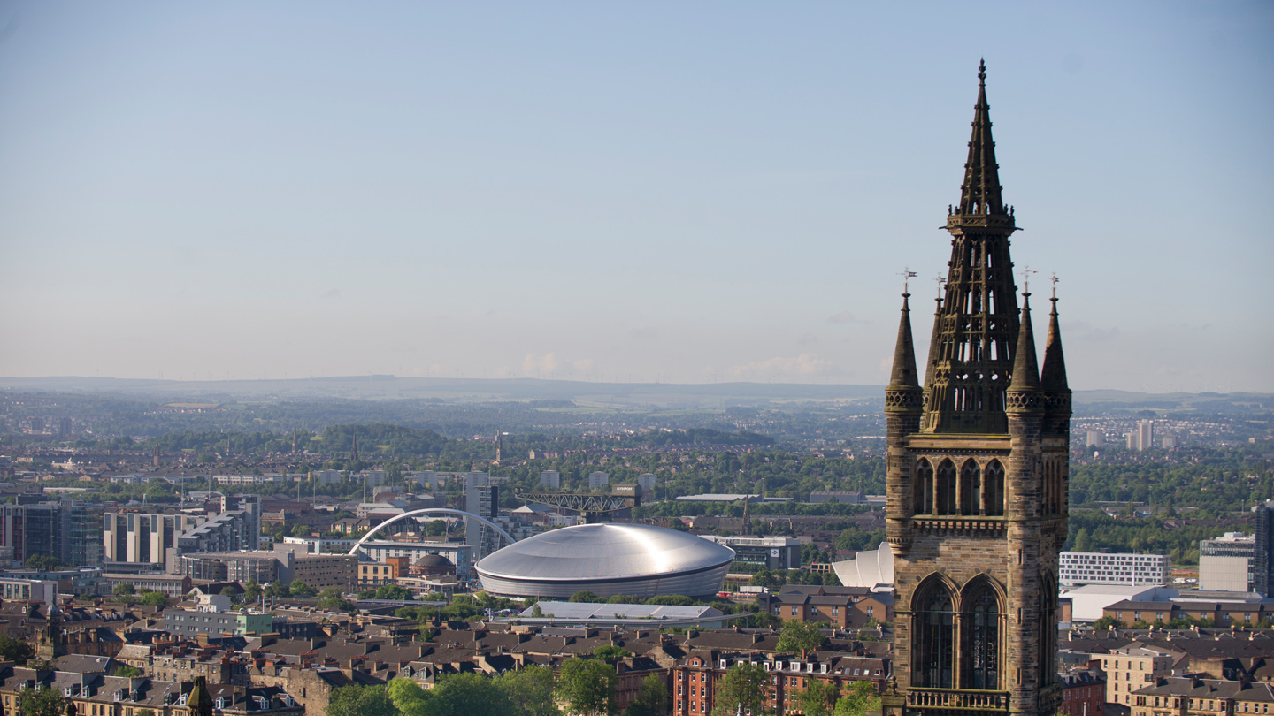
Guidance for Completing an Investment Application Form in 2023

Slide 2
Introduction
A revised Investment Application Form and new Business Case templates were rolled out in 2022
The Investment Approval Flowchart outlines which form should be used, generally depending on the size of the investment request, the internal source of funding and whether it is in budget
These slides provide guidance to project managers and sponsors on what should go into each section of the Investment Application Form. This form is generally used for investment requests which are <£500k AND are not seeking to utilise the strategic investment funds (eg Research Strategy, L&T Strategy, Innovation Strategy, College Surplus, etc)
by exception, investments >£500k may use this form if they are relatively straightforward (eg College equipment which will be wholly or substantially grant-funded with minimal contribution from University funds)
The aim is to provide increased support for project managers in completing Investment Application Forms, and achieve greater consistency in the form and content of documents being submitted to governance bodies
If any sections are unclear, please contact Management Accounts or your local finance colleagues for clarification

Slide 3
1. Project Overview
Project / Investment Plan Code (if available at this stage):
Submission Date:
Submission Type: select one of
New application, change to an already approved investment
Delivered by: select one of
Estates, Information Services, Transformation, Residences, College, College (PI), Other
“Other” will include areas such as Innovation

Slide 4
2. Project Summary
If the project is a “new application”, this section should contain a description of:
what the project is for / why it is needed
what costs will be incurred, when, and on what (for example, buildings, technology, equipment, staff, etc)
for buildings or technology costs: have these been estimated / tendered or a quote obtained? how do they compare with relevant benchmarks?
a table or chart showing milestones and key delivery dates may be useful
if applicable, is it a new or replacement building or item of technology / equipment
if it is a replacement, what is the current age and condition of the item being replaced
where it will be physically located
what benefits the project will deliver, when, and how these will be tracked
where funding is coming from (for example, university funds or external sources)
how the project will be run, and by who
how the project aligns to the University’s strategic priorities
If the project is a “change to an already approved investment”, this section should also detail the reasons for any cost overruns or delays, and the impact on benefits or any other projects, etc

Slide 5
3. Financial Overview
This section identifies the source of funding for the Investment. It should be completed in conjunction with your local finance colleagues
Investment Plan Funding Source: select one of
Estates: Major Projects, Maintenance, Campus Enhancement, Should Do Projects, Learning Spaces, Sustainability
IT: Major Projects, Maintenance / BAU, Should Do Projects
Residences
Equipment
College Surplus Roll Forward
Research Strategy, L&T Strategy, Innovation Strategy, Internationalisation Strategy, Strategy Implementation, Other Strategic Initiatives
General Funds, Donations, Endowments, Commercial Income, Research Grants
Where possible, the “Funding Source” selected should match the cost class where the project has been created: for example, if funds are coming from the Research Strategy then the project should be created under cost class 761 (finance colleagues will be able to advise)

Slide 6
3. Financial Overview (cont’d)
Amount Already Approved (X) – how much has previously been approved by this governance body in relation to this investment? If this investment has not previously been to this governance body, this box will be zero
Additional Amount Requested Now (Y) – the incremental funding being requested today (this is the figure which should appear at the top of the form)
Total Amount Requested to Date – the sum of X+Y
Total per Investment Plan – the funding available for this Investment in the latest Investment Plan
External Funding - if all or part of the funding is coming from an external source, the amount should be stated
External sources of funding may include research grants, income from commercial partners, endowments or donations
External funding will generally be incremental to figures in the other boxes

Slide 7
3. Financial Overview (cont’d)
Type of Spend / Cost Category – for example, construction costs, technology costs (hardware / software), audio-visual equipment, furniture + fittings, staff costs, recruitment fees, professional fees, contingency
Each type of spend should be on a separate line (see next slide for an example)
Costs Incurred to Date (A) – how much has actually been spent on the project so far
Costs to Complete (B) – what further costs will be required to complete the project
Total Project Costs – the sum of A+B ie the total expected spend over the lifetime of the project
The Total Spend table should contain a split of “Total Project Costs” by year to assist in preparing annual budget and forecasts

Slide 8
3. Financial Overview (cont’d) - Example
Type of Spend / Cost Category | Costs Incurred to Date (£) | Costs to Complete (£) | Total Project Costs (£)
Construction | 100,000 | 250,000 | 350,000
Technology - hardware | 20,000 | 80,000 | 100,000
Audio-visual equipment |  | 15,000 | 15,000
Furniture + fittings |  | 10,000 | 10,000
Staff costs | 10,000 | 30,000 | 40,000
Recruitment fees | 2,000 | 3,000 | 5,000
Professional fees | 25,000 | 5,000 | 30,000
Other costs | 8,000 | 12,000 | 20,000
Contingency |  | 30,000 | 30,000
Total | 165,000 | 435,000 | 600,000

Slide 9
4. Benefits Overview
Every project is likely to have more than one benefit - please use one table for each specific benefit. 3 tables are shown but more can be added, up to a maximum of 7
Each table has 7 boxes:
Type / Outcome – select one of: supporting research; supporting learning & teaching; staff experience; student experience; service excellence; efficiency, other
Description – a one-sentence description of the benefits which the project will deliver. Examples include “increase tuition fee income by doing X”, “improve student experience by doing Y”, “reduce carbon emissions by doing Z”, etc
Owner – the person who will be accountable for delivering the project’s benefits post-completion. This field will usually be a role rather than a named individual eg Head of College or University Services area
Value – quantify the benefits eg £200k per annum, improvement in rankings from A to B. Note that some investment benefits may be qualitative rather than quantitative and thus difficult or impossible to value
Direct financial impact – will the investment result in a specific, measurable and identifiable increase in income or reduction in costs
How will this be measured? – financial benefits will usually be measured through the annual budget or monthly management accounts; non-financial benefits may be measured using surveys or regular reports to governance bodies (eg CMG, PSG)
Timing – when will the project’s benefits arise. This will usually be a specific year or years

Slide 10
4. Benefits Overview (cont’d)
The Total Financial Benefits table should contain a split of financial benefits by year to assist in preparing annual budget and forecasts
Projects should focus on benefits which will be realised over the current financial budget cycle to 2026/27
The only exceptions are likely to be Estates Major Projects or significant research investments
Projects should clearly state to what extent benefits are included in the latest financial budget, along with the relevant College / University Services area and account line (for example, CoSE tuition fee income) to enable benefits to be identified and tracked
A small number of measurable benefits (ie 4 or 5), and a realistic approach to measuring those benefits post completion, is strongly preferred to a long list of minor gains or incremental improvements which will be difficult or time-consuming to track
Benefits should ideally link to one or more of the University’s strategic or thematic priorities
The narrative in the business case should contain more detail on each benefit, including any underlying assumptions, the assumed baseline and incremental improvement, benefit drivers, confidence in delivery, ease of realisation, and scale of impact

Slide 11
4. Benefits Overview (cont’d) - Example
Heading | Example
Outcome heading / benefit type | Supporting research
Benefit description | Increase in research grant income in School of Medicine
Benefit owner | Dean of MVLS
Benefit value | £200k per annum
Direct financial impact | Y
How will this be measured? | Annual budget and monthly management accounts
Timing of benefit | From 2024/25

Slide 12
5. Strategic Alignment
Which of the University’s strategic themes is the investment aligned to:
Community | Connectivity | Challenges
People centred, globally engaged | Collaboratively minded, digitally enhanced | Solution focused, impact oriented
Leading with our values and putting our people first | Creating space to connect through new collaborative and social space on campus | Embracing challenge-led research to address the needs of global society
Engaging with our civic mission via our local and global communities | Investing in our digital realm to enhance the staff and student experience | Reimagining our curriculum to prepare students for a challenging and changing world
Strengthening our partnerships to amplify our local and global impact | Adopting collaborative technologies for frictionless and flexible work and study | Building a sustainable future through our research, education and actions

Slide 13
6. Prioritisation
This section has 5 boxes:
Health & Safety / Regulatory – select one of the following dropdowns
Statutory or legislative requirement
Potential statutory or legislative requirement
Not a statutory or legislative requirement
Business Continuity – select one of the following dropdowns
Almost certain to disrupt business critical services
High risk to disrupt business critical services and almost certain to disrupt non business critical services
Significant impact to business services and operations
Some impact to business services and operations
No impact to business services and operations

Slide 14
6. Prioritisation (cont’d)
Sustainability – select one of the following dropdowns
Direct positive contribution towards our net carbon footprint
Indirectly supports a positive contribution towards our net carbon footprint
Does not relate to our sustainability goals
Would result in an increase to our carbon footprint
Strategic Alignment – select one of the following dropdowns
We could not meet our strategic goals or more than 3 KPIs
We may not be able to meet our strategic goals or 1 or 2 KPIs
There would be some impact on our KPIs
There may be an indirect impact on our strategic goals or KPIs

Slide 15
6. Prioritisation (cont’d)
Capability & Competition – select one of the following dropdowns
Be new and innovative giving us a competitive advantage
Be improved but failure to invest will mean a loss in quality
Possible result in a loss in quality if not invested
Not impacted by this investment
There is also a mandatory section where further details of the impact of this investment on sustainability at the University should be provided
This section does not just relate to Estates
For example, the University reports annually against the UN’s Sustainable Development Goals: any investment which improves the University’s rating in this area will be relevant

Slide 16
7. Sustainability (Estates-only)
This section is specific to Estates

Slide 17
8. Equipment and Estates
This section is generally used for new or replacement items of equipment:
Equipment Cost - how much will the equipment cost? This may only be one element of the overall project cost
Building/Location - where will the equipment be located?
Estates Cost - what costs will Estates incur in installing the equipment?
Estates Investment Support Contact - who in Estates are you liaising with regarding the equipment?
Date sent to Estates (for installation cost) - when were Estates informed?
If this section is not relevant to your project, please retain the heading but replace the table with “Not applicable”

Slide 18
9. Risks, Assumptions, Constraints & Dependencies
What are the main risks the project faces? How will these be mitigated?
Risks can include a lack of available resource, technological complexity, planning issues, etc
If there are more than 3 main risks, further rows can be added
What are the main assumptions behind the project?
These can include projected growth in student numbers
If there is more than 1 main assumption, further rows can be added
Are there any constraints on the project?
This can include time if the project must be completed by a set date
Does the project have any dependencies?
This can include a reliance on other projects and / or a reliance that other projects have on this one
Other - is there anything else that reviewers and approvers should be aware of?

Slide 19
10. Additional Information
Any further relevant points
Any further documentation presented as part of this application

Slide 20
11. Approvals
Please obtain any local approvals required from relevant individuals or committees, including your local Head of Finance

