Slide 1





Symposium on Urban Water Governance in Dar Es Salaam (SUWG)
Dr Neil Munro &
Dr Opportuna Kweka
SHLC webinar, 5 May 2022

Slide 2
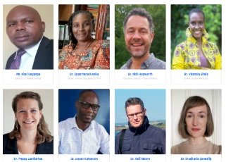
Summary of the activity
  Researchers from UDSM and University of Glasgow worked in partnership with Water Witness International and Shahidi wa Maji to organize an online symposium 5-8 July 2021.
  We sought to publicise our 2018 survey on social accountability for domestic water provision in Dar 10.5255/UKDA-SN-854318
  We aimed at reaching a core audience of NGOs active in the water sector across Africa and other parts of the developing world.
  We used remaining funds in the budget to commission additional fieldwork and a short film.

Slide 3
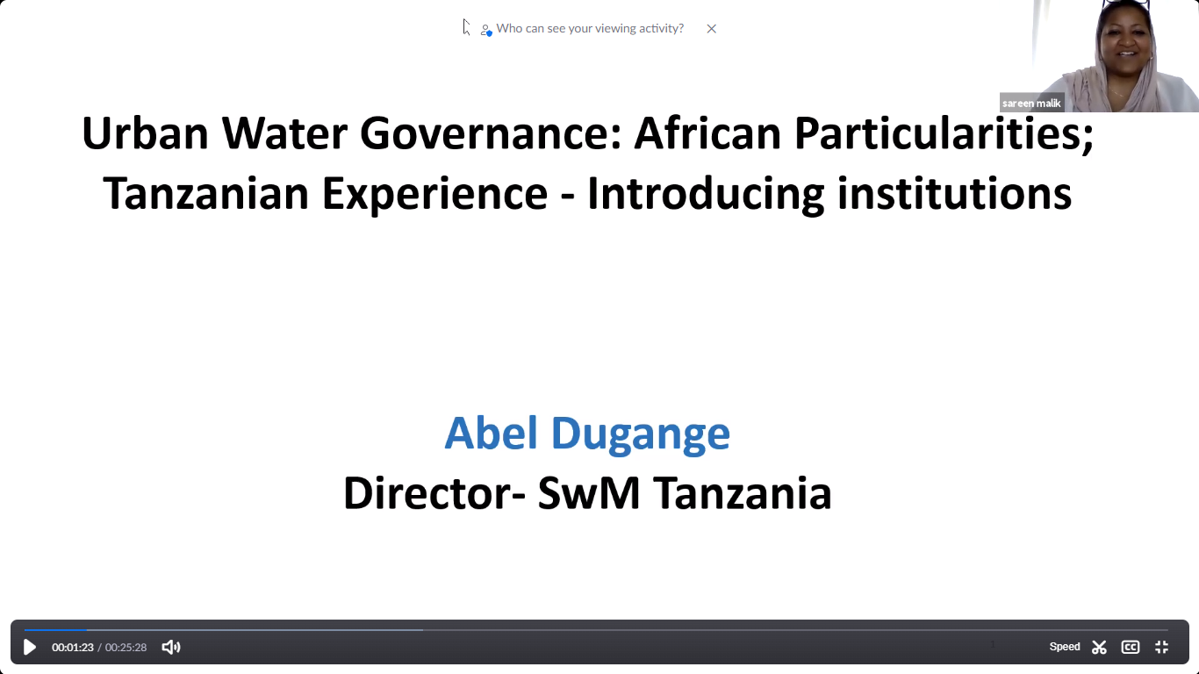
Symposium organization
We commissioned a website which served as the symposium platform and hired a facilitator.
The symposium was held over four days, 5-8 July 2021, with two one-hour sessions each day.
Sixty-seven attendees from civil society, academia and government attended the sessions.
All sessions were recorded on Zoom.
15 participants returned evaluation questionnaires, giving an overall median rating of 5/5.

Slide 4
Symposium Programme
Monday 5th July
Mr Abel Dugange, Chairperson Shahidi Wa Maji, "Urban water governance: African particularities and Tanzanian experience."
Dr Opportuna Kweka, UDSM. "Perceptions of water governance in Dar Es Salaam"
Tuesday 6th July
Dr Nick Hepworth, Water Witness International. "Theory of change for social accountability practice: what we have learned from our experience across Africa."
Dr Vicensia Shule, UDSM. "The power of images: reflections on doing fieldwork with a camera in Dar Es Salaam."
Wednesday 7th July
Dr Poppy Lamberton, University of Glasgow. "A bottom-up approach to finding sustainable WASH interventions: what we can learn from experience in Africa."
Dr Jesper Katomero, UDSM. "Water politics in Tanzania."
Thursday 8th July
Dr Stephanie Connelly, University of Glasgow. "The shift towards decentralised WASH technologies."
Dr Neil Munro, University of Glasgow. "Using data to answer (and ask) practical questions about social accountability for water governance."

Slide 5
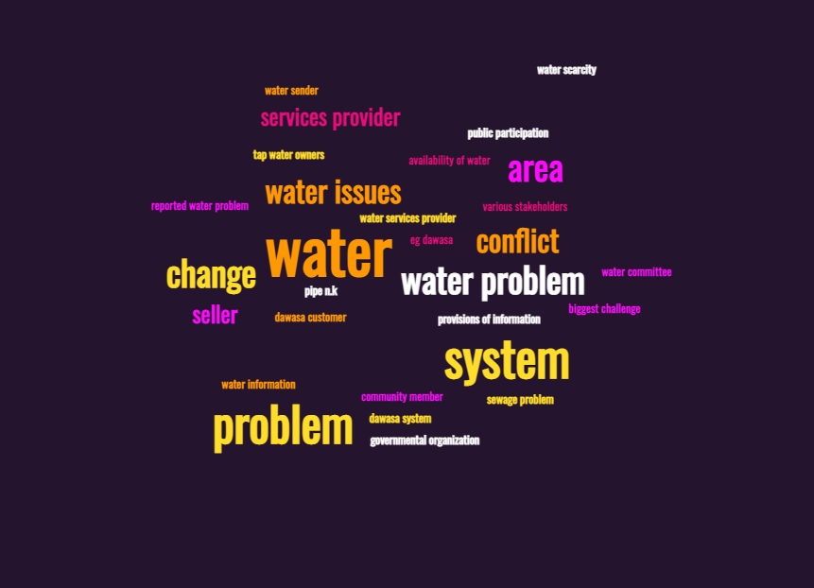
Additional fieldwork
Dr Opportuna Kweka conducted interviews with 92 residents and officials across four districts of Dar Es Salaam.
Ethical approval was sought and obtained from the University of Glasgow College of Social Sciences Research Ethics Committee.
We are currently analysing the results.

Slide 6
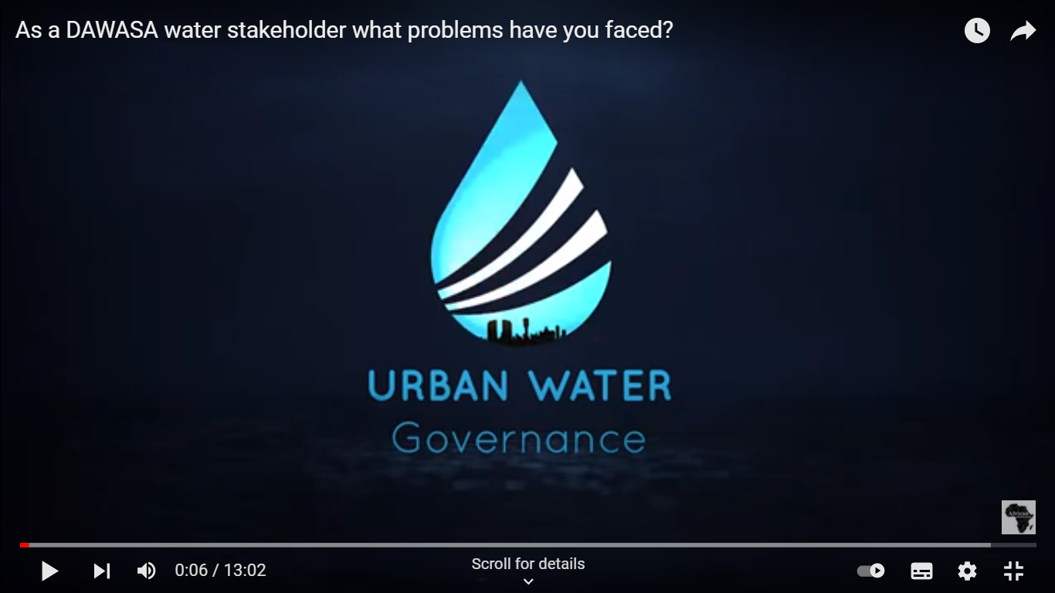
Short film
A short film by Dr Shule recorded twelve interviews with residents and street-level (community) officials, as well as including scenes of water pipes, storage facilities, and urban streetscapes.
The film was blended into our website and provided visual context for the presentations and interviews
The film can be viewed here: https://youtu.be/FVqwcTmYC5Y

Slide 7
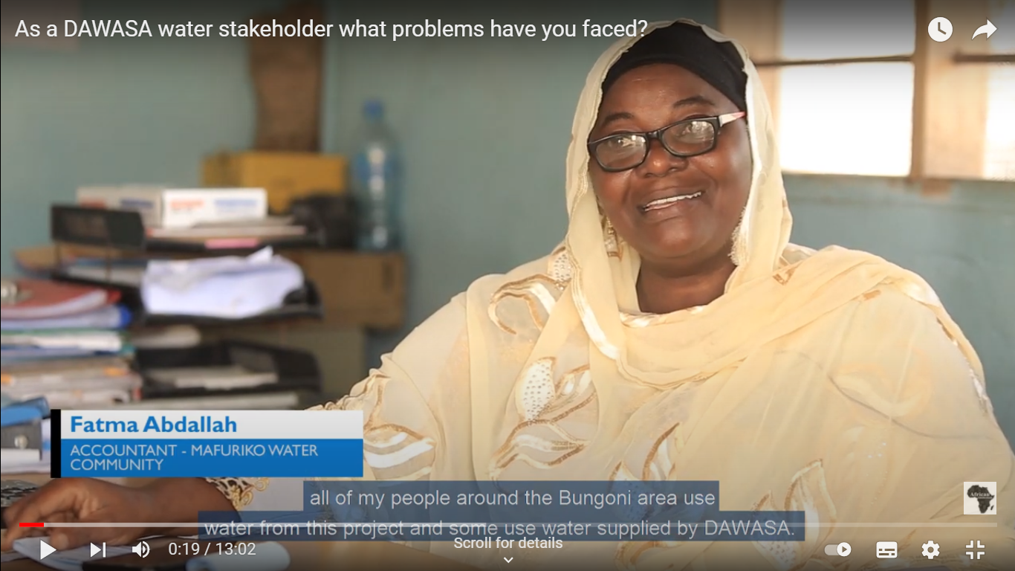
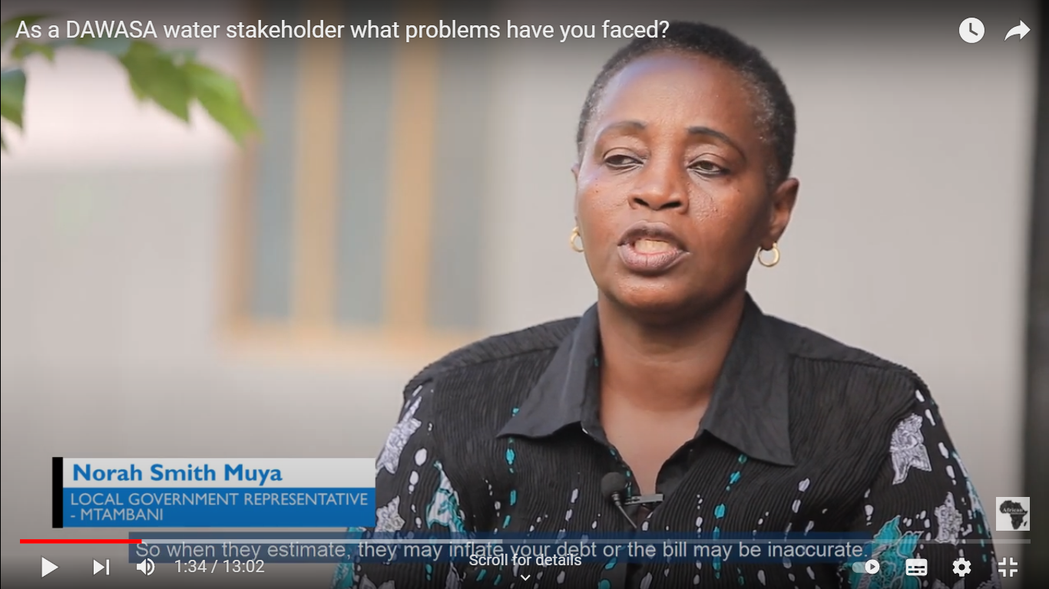
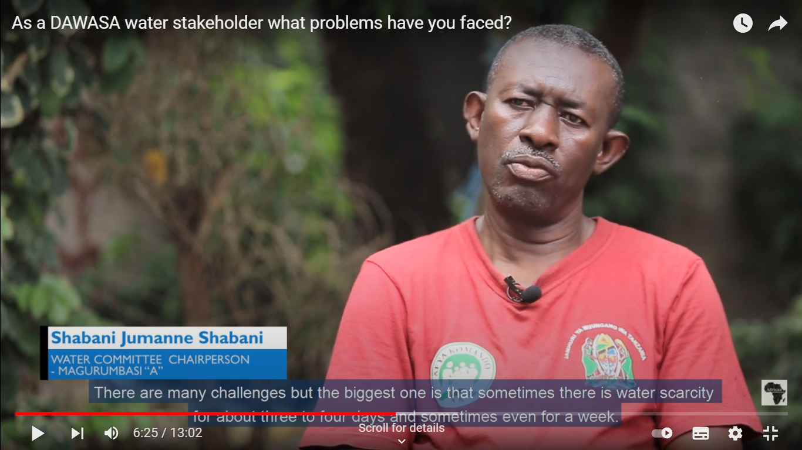
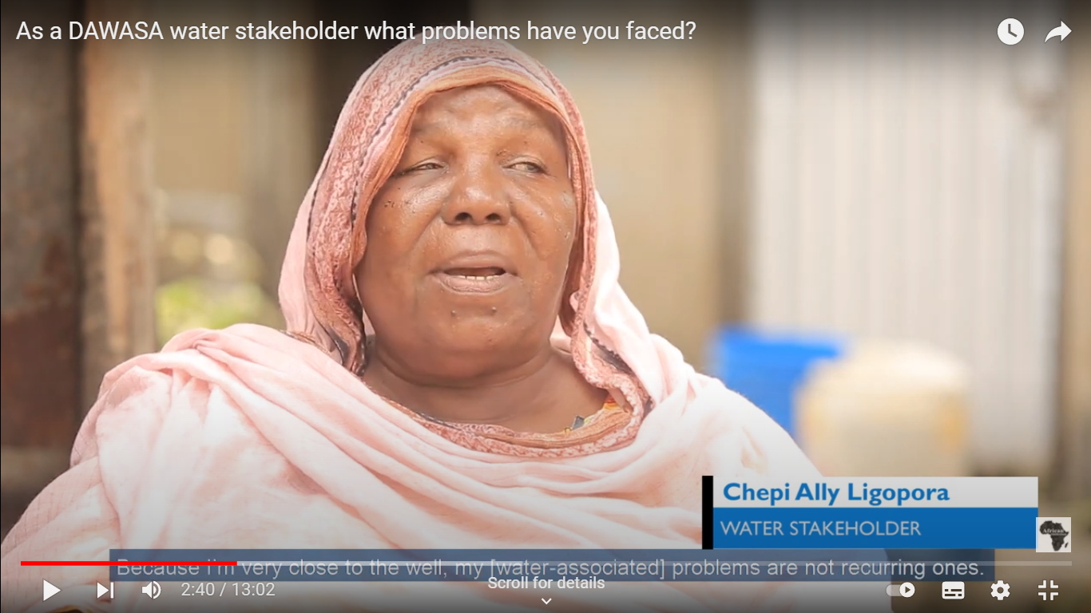
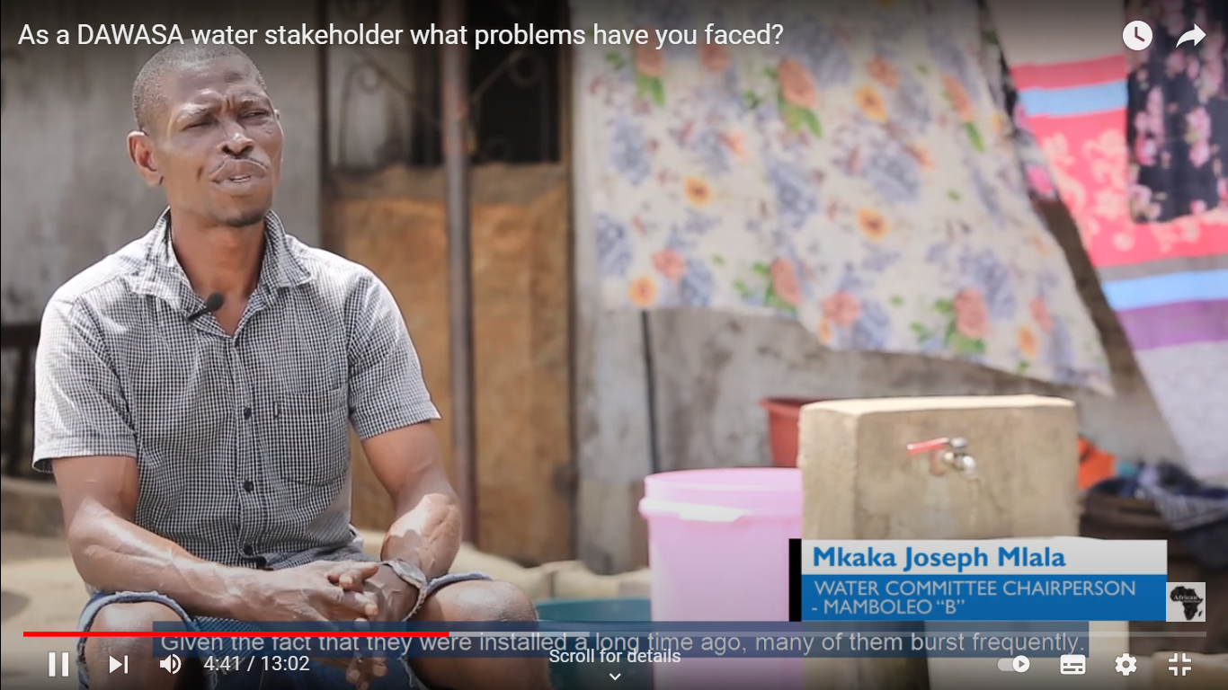
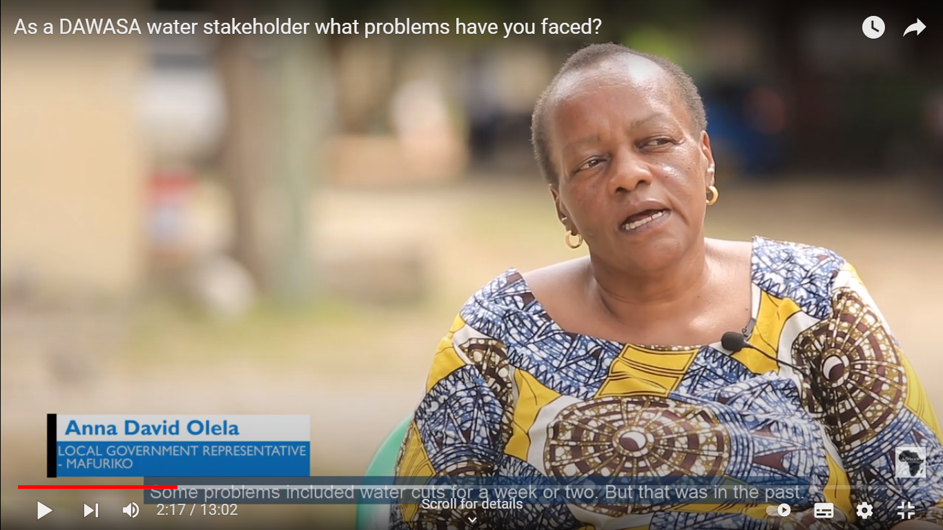
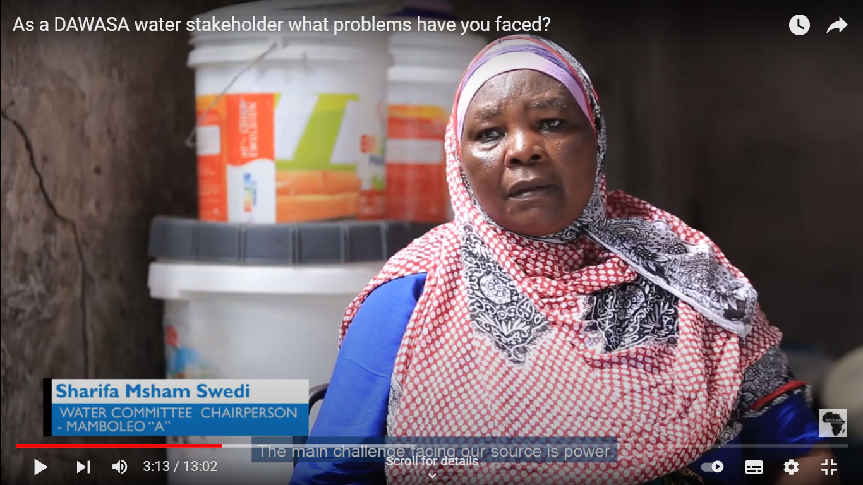
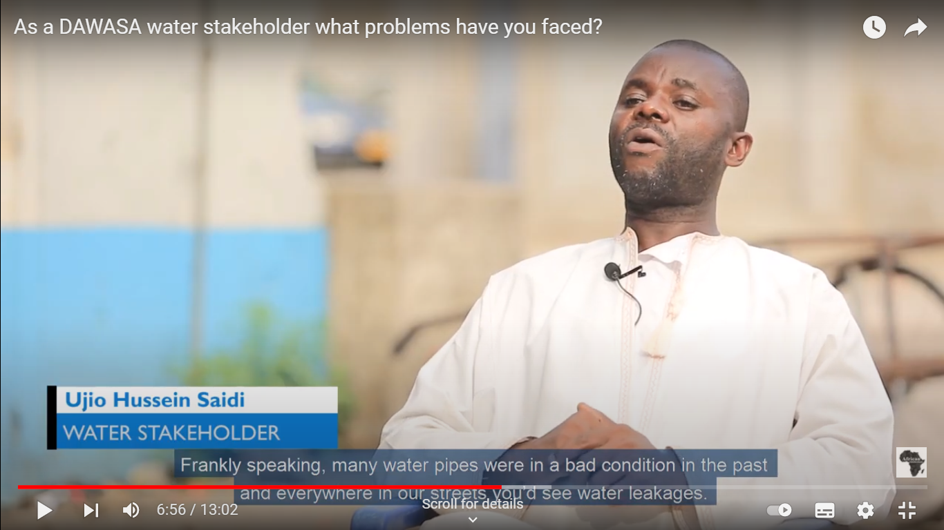
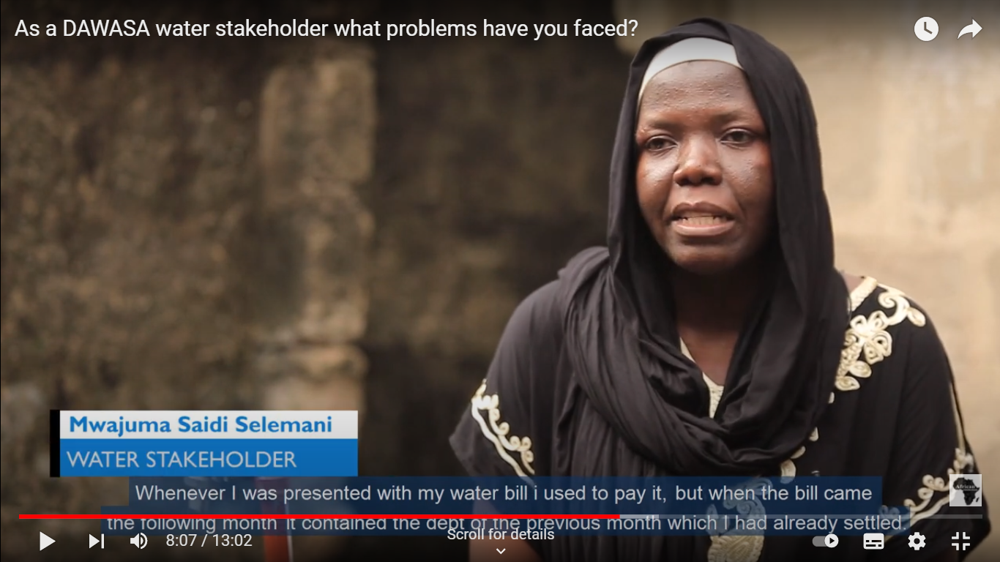
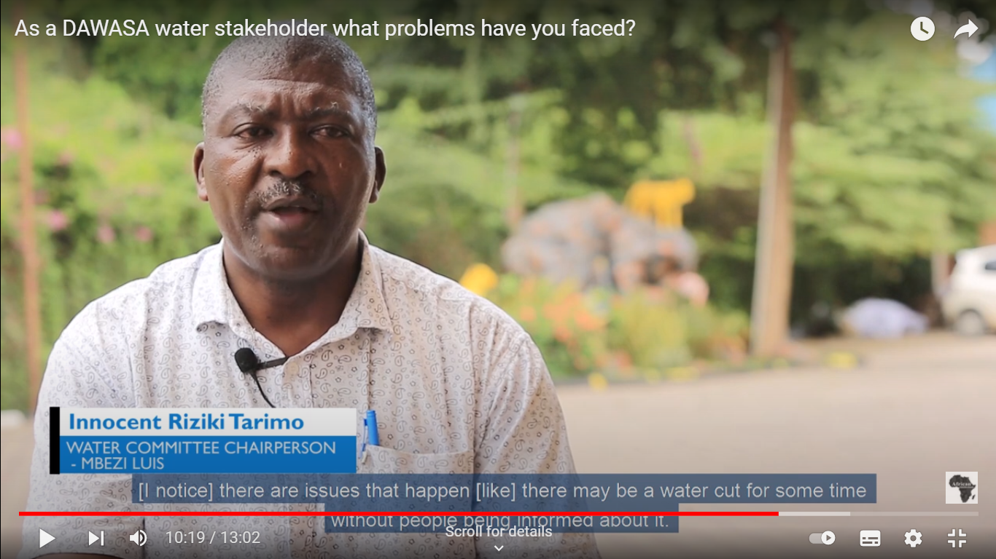
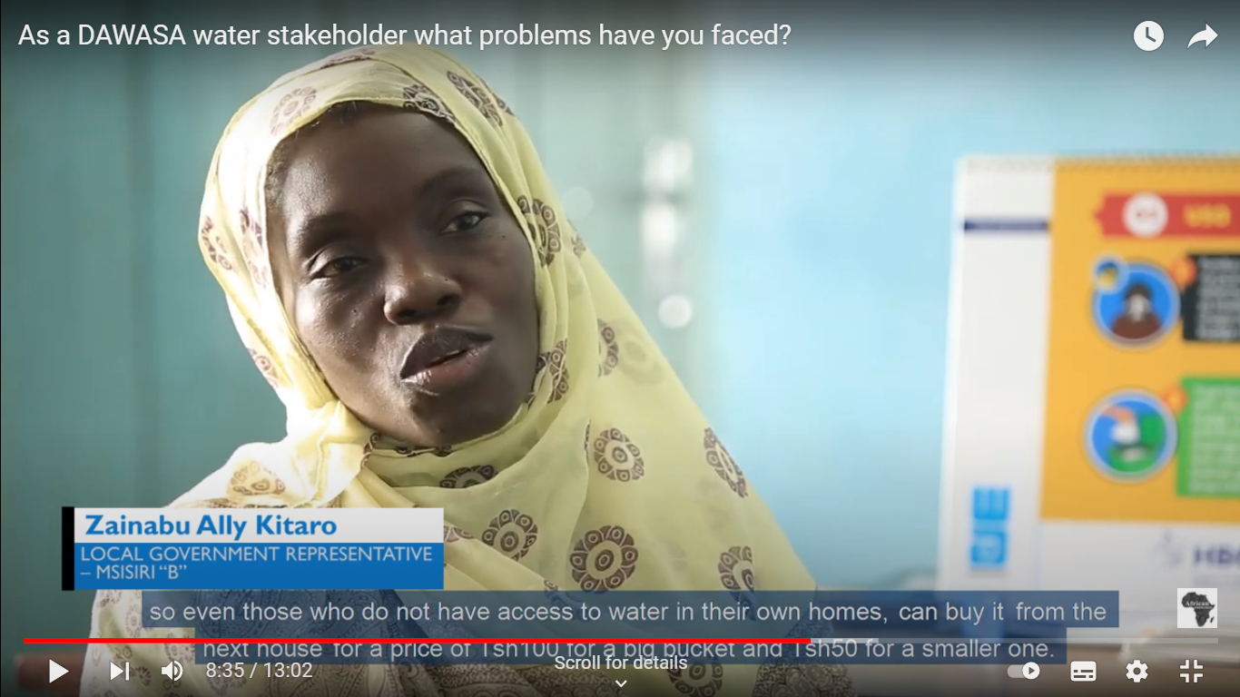
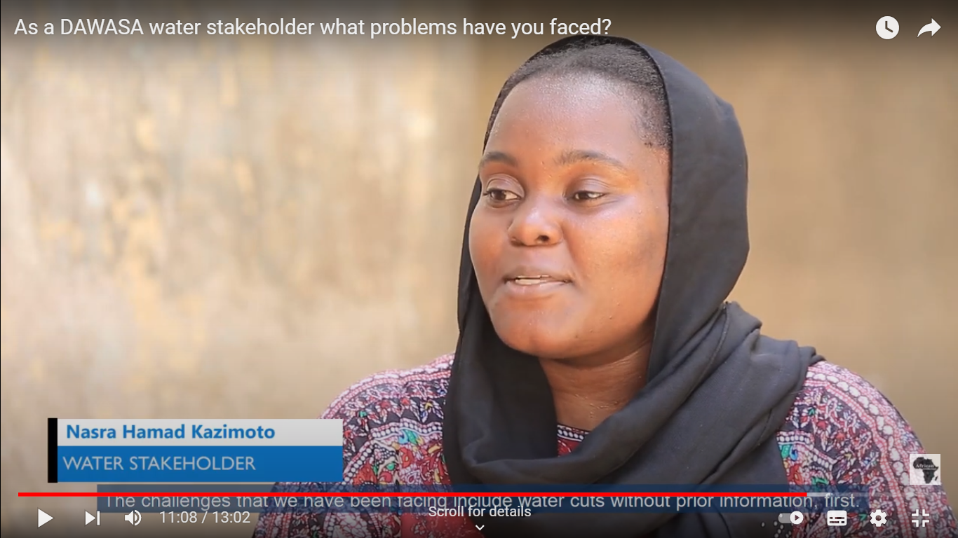
Thank you to all our interviewees and participants!

