Slide 1
LEADS CPD Series: SoTL
Preparing to do scholarship: writing an ethics application
Dr Michael McEwan
Head of Subject ADD
Dr Nathalie Sheridan
Senior Academic and Digital Development Advisor

Slide 2
Outline
The importance of preparation
The ethics of educational research and SoTL enquiries;
Ethics in your subject area.

Slide 3
Adequate Preparation
Glassick’s Framework for evaluating scholarship presents several ‘stages’
Clear Goals
Adequate Preparation
Appropriate Methods
Significant Results
Reflective Critique
Effective Presentation
Adequate preparation refers to ‘knowing the field’.
Have you read the literature, do you know the appropriate methods to collect data, are you building on the work of others?
Notes:
The importance of preparation cannot be overstated. Many SoTL projects struggle because the enquirers realise that their work doesn’t ‘fit’ with their intentions, or the tools they have used or adapted to collect data don’t work as they intended, or that their goals are, in fact, not well defined. And so when it comes to writing about their work and applying the learning from their work to their practice, it’s a struggle to make it ‘fit’.
I’m drafting a reflective paper right now that highlights this very issue: a complex statistical analysis where, on reflection, the tools used weren’t quite right, the questions asked weren’t quite right and we didn’t quite know enough about the field to convince ourselves that our approach was ‘informed’. All of this has been realised at the end of the project because ‘collecting data’ drove the project and therefore the preparation stages (including 1 and 2 and, to some extent 3) weren’t quite thorough enough.

Slide 4

The ethics of SoTL
A teacher’s enquiry into their practice is a legitimate academic practice and therefore normally exempt from a requirement to get ethical approval.
But, if such enquiries are to be made public, then ethical approval is required.
Cleaver, E., Lintern, M., McLinden, M., & Askews & Holts Library Services. (2014). Teaching and learning in higher education: Disciplinary approaches to educational enquiry. London: SAGE Publications Ltd, pp. 54 – 71.
Notes:
[MVLS] Course Evaluation or Evaluation of Teaching Methods
This is considered good practice and a normal part of academic life. Such projects do not require MVLS Ethics Committee review but should be authorised by the appropriate authority within Schools / Institutes. Such projects could include interviews with staff members provided it is within their area of professional competence and the intent is to inform teaching methods. However, as with Audit (above), if publication is the primary intent of the project, it is likely you are seeking to generate novel data and the project would be considered research. In the case of uncertainty or where projects carry ethical risks then advice can be obtained from the MVLS Ethics Committee.
Chapter 4 of the illustrated book provides support on ethics.

Slide 5

BERA and ethics
In principle, research, scholarship and professional enquiry are all governed by the same standards of ethical practice.
If you think of ethics as ‘ticking a box’ then you are missing the point
Ethics and research design are not mutually exclusive. They impact on each other, and must be considered simultaneously
British Educational Research Association (BERA) (2018) Ethical guidelines for educational research. Available at: https://www.bera.ac.uk/researchers-resources/publications/ethical-guidelines-for-educational-research-2018
(Accessed: 2nd August 2018).
Notes:
The pragmatically ideal research instrument and research design may not be ethically implementable, so it is necessary to make compromises

Slide 6
Ethical considerations
Issues of risk
Openness/disclosure
Voluntary informed consent
Right to withdraw
Children/vulnerable others
Incentives
Privacy/confidentiality/anonymity
Dependent relationships
Notes:
This little framework provides some key prompts when considering the design of a SoTL project and should help you ‘risk assess’ your project in terms of ethics. There are issues are data security (GDPR) that are not mentioned here, but rather this governs to overarching theme of ethical enquiry and research design.
Once you have a set of clear goals and have undertaken adequate preparation then you should consider ethics and design simultaneously, and with a mindset for adapting your design as you move through the ethics process. So, as a brief discussion, what are the issues that you envisage in your current SoTL ideas around the following framework?

Slide 7
Ethical considerations
Issues of risk
Openness/disclosure
Voluntary informed consent
Right to withdraw
Minimising harm and maximising benefit
Avoid deception unless required
Why me? What’s the point and what do I have to do?
Withdrawal at any time, for any reason
Children/vulnerable others
Incentives
Privacy/confidentiality/anonymity
Dependent relationships
Implications in gaining consent
Commensurate and with good sense
Confidentiality and anonymity is the norm, but not always possible
Is participation influenced in any way?
Notes:
The Declaration of Helsinki (1964) relaxed the notion of informed consent to ‘if at all possible’ and consent by proxy was allowed.
The Nuremberg Code made informed consent ‘absolutely essential’ but the DoH adapted this to allow research involving some degree of deception if absolutely required; it also addressed the fact that not all subjects were capable of informed consent (e.g. vulnerable groups, minors, etc.). Consent by proxy (initially legal guardian, subsequently, responsibly relative). DoH was revised in 1975 to ensure that the subject took priority over the experiment, and publication ethics were introduced (e.g. confidentiality, anonymity, preservation of results). Similarly, the concept of ‘placebo’ in medical research was scrutinised… (the ‘best available care’ is assured).
Placebo remains a tricky concept in medical research… if you think an intervention is better than a placebo… er…

Slide 8
Common issues
Issues of risk
Openness/disclosure
Voluntary informed consent
Right to withdraw
Unnecessary/uneven risks for participants
Lack of details regarding potential involvement
Sufficient information including risks and benefits
Explicit, with details of process (contact details)
Children/vulnerable others
Incentives
Privacy/confidentiality/anonymity
Dependent relationships
Not explicitly considered
Implicit coercion; inappropriate incentives
Confidentiality and anonymity but what if you have concerns?
Is participation influenced in any way?
7

Slide 9




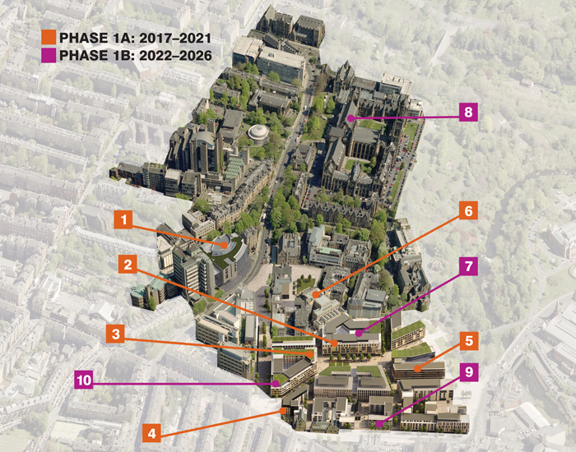
Ethics at Glasgow
College of Arts?
Notes:
Ethics is a devolved process at UoG. Colleges have responsibility, through College Ethics Committees (reporting to an University Ethics Committee) for granting ethical approval for projects. This process differs in each college due to typical disciplinary differences. At present, only MVLS has paid specific attention to SoTL, and CoSE has some streamlined processes that some SoTL projects can take advantage of. CoSS and CoA both require SoTL projects to meet the same benchmarks as ‘research’. This doesn’t mean CoSE and MVLS are ‘easy’ but they do have processes allowing for a ‘lighter touch’.
Ethics form to be submitted at least 6 weeks before data collection!
Retrospective ethical approval cannot be given
Online Research Ethics system (may need to request access) in UofG Business Systems (available through MyGlasgow Staff)
If you make changes (e.g. data collection methods), can submit an amendment form
Nathalie: different colleges, different rules and different processes! Ultimately the underpinning ethical considerations are similar… next slide.

Slide 10
Ethics Examples
What is the relationship between the amount of time level 1
History students’ in my tutorial group report that they spend
on tutorial preparation and the number and quality of
comments they make in a tutorial?
An exploration of level 3 Pharmacology students’ perceived
engagement in response to a lecture with problem solving
activities in comparison to lectures without such activities
Notes:
In twos/threes, collaboratively design one of the following studies, or one of your own choosing:
How is Moodle used to support learning and teaching at UofG?
What is the impact of staff engagement in LEADS CPD on learning and teaching?
How does introduction of a flipped classroom approach impact on learning and/or teaching?
How does lecture recording impact on student learning?
How does continuous assessment impact on student performance and retention?

Slide 11
The Process (and the forms)
1: Applicant details | Who is making the application?
2: Ethical risks | What could go wrong?
3: Researchers with access to the data | Who will have access to the data (including transcription company)?
4: External funding details | Who funded the research? (Why is this important?)
5: Project detailed (start & end dates) | When will the study take place? (implications for how long the data should be retained)
6: Justification for the research | Why do this research at all?
Notes:
Vicki to lead on the process of turning your risk assessment into an ethics application… Use the forms as a handout at this point.

Slide 12
The Process (and the form)
7: Research methodology and data collection | Methods of data collection, why you chose these methods, time commitment for participants, how data will be analysed
8: Confidentiality & data handling | How will you protect the privacy of your participants? What degree of anonymity will you offer? How/where will your store the data? Who has access? Plans for retention and disposal of *personal* data? (relates to GDPR)
9: Dissemination of results | How will you report findings to participants, peers/colleagues? Will you store anonymised datasets for future research?
10: Recruitment of participants | How/who will you recruit? How many? What incentives? In a dependent relationship (e.g. teacher/student)?
11: Permission to access participants | If UofG staff/students, Head of School (if in one school), or Dean of Graduate Studies (if >1 school) or Clerk of Senate (if >1 college)
12: Informed consent | Have you included PLS/information sheet?

Slide 13
The Process (and the form)
13: Monitoring | How will you ensure the research is progressing as planned?
14: Health and safety | Risks for you, the participants or other researchers?
15: Risk | Lone working? Minimising distress to participants, sensitive topics or vulnerable groups?
16: Insurance | Needed for e.g. work overseas, participants > 5000
17: Protection of Vulnerable Groups (PVG) | Children and protected adults (note students under 18 constitute a PVG group)
18: UK and Scottish Government Legislation | GDPR (2018)
19: Declarations by researchers (and supervisors) | Acceptance of code of conduct for research and responsibility for managing project risks

Slide 14
Useful References
Cleaver, E., Lintern, M., McLinden, M., & Askews & Holts Library Services. (2014). Teaching and learning in higher education: Disciplinary approaches to educational enquiry. London: SAGE Publications Ltd.
Cohen, L. M., & Manion, L. (1979). L. & Morrison, K.(2011) Research methods in education. UK: Routledge.
Glassick, C. E., Huber, M. T., & Maeroff, G. I. (1997). Scholarship Assessed: Evaluation of the Professoriate. Special Report. Jossey Bass Inc., Publishers, 989 Market Street, San Francisco, CA 94103.
College ethics guidance:
Arts: www.gla.ac.uk/colleges/arts/research/ethics/
CoSE: www.gla.ac.uk/colleges/scienceengineering/staff/committees/ethicscommittee/
CoSS: www.gla.ac.uk/colleges/socialsciences/students/ethics/forms/
MVLS: www.gla.ac.uk/colleges/mvls/informationforstaff/researchadministration/collegeethicscommittee/
If in any doubt, contact college ethics officers with your questions.

