Slide 1
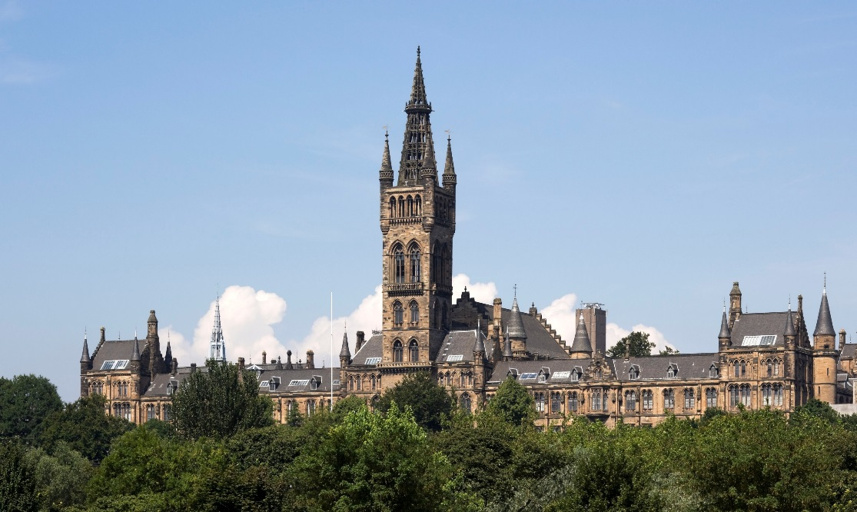
Connecting Real-world Experiences with Real-world Challenges
Kerry Trewern Rhona McNair
15th Annual University of Glasgow Learning & Teaching Conference
Tuesday 29 March 2022

Slide 2
What is the Diploma in Professional Legal Practice?
PEAT One
Bridge: academia to practice
Simulated environments
Tutors: practising solicitors
Student cohort

Slide 3
Sample PEAT One Outcomes - Interviewing
Meets and greets the client
Explains the structure of the interview
Demonstrates a courteous attitude to the client
Uses listening techniques
Can focus on a fact pattern without losing sight of the whole
Conduct a client-centred interview
Draws the interview to an appropriate close

Slide 4
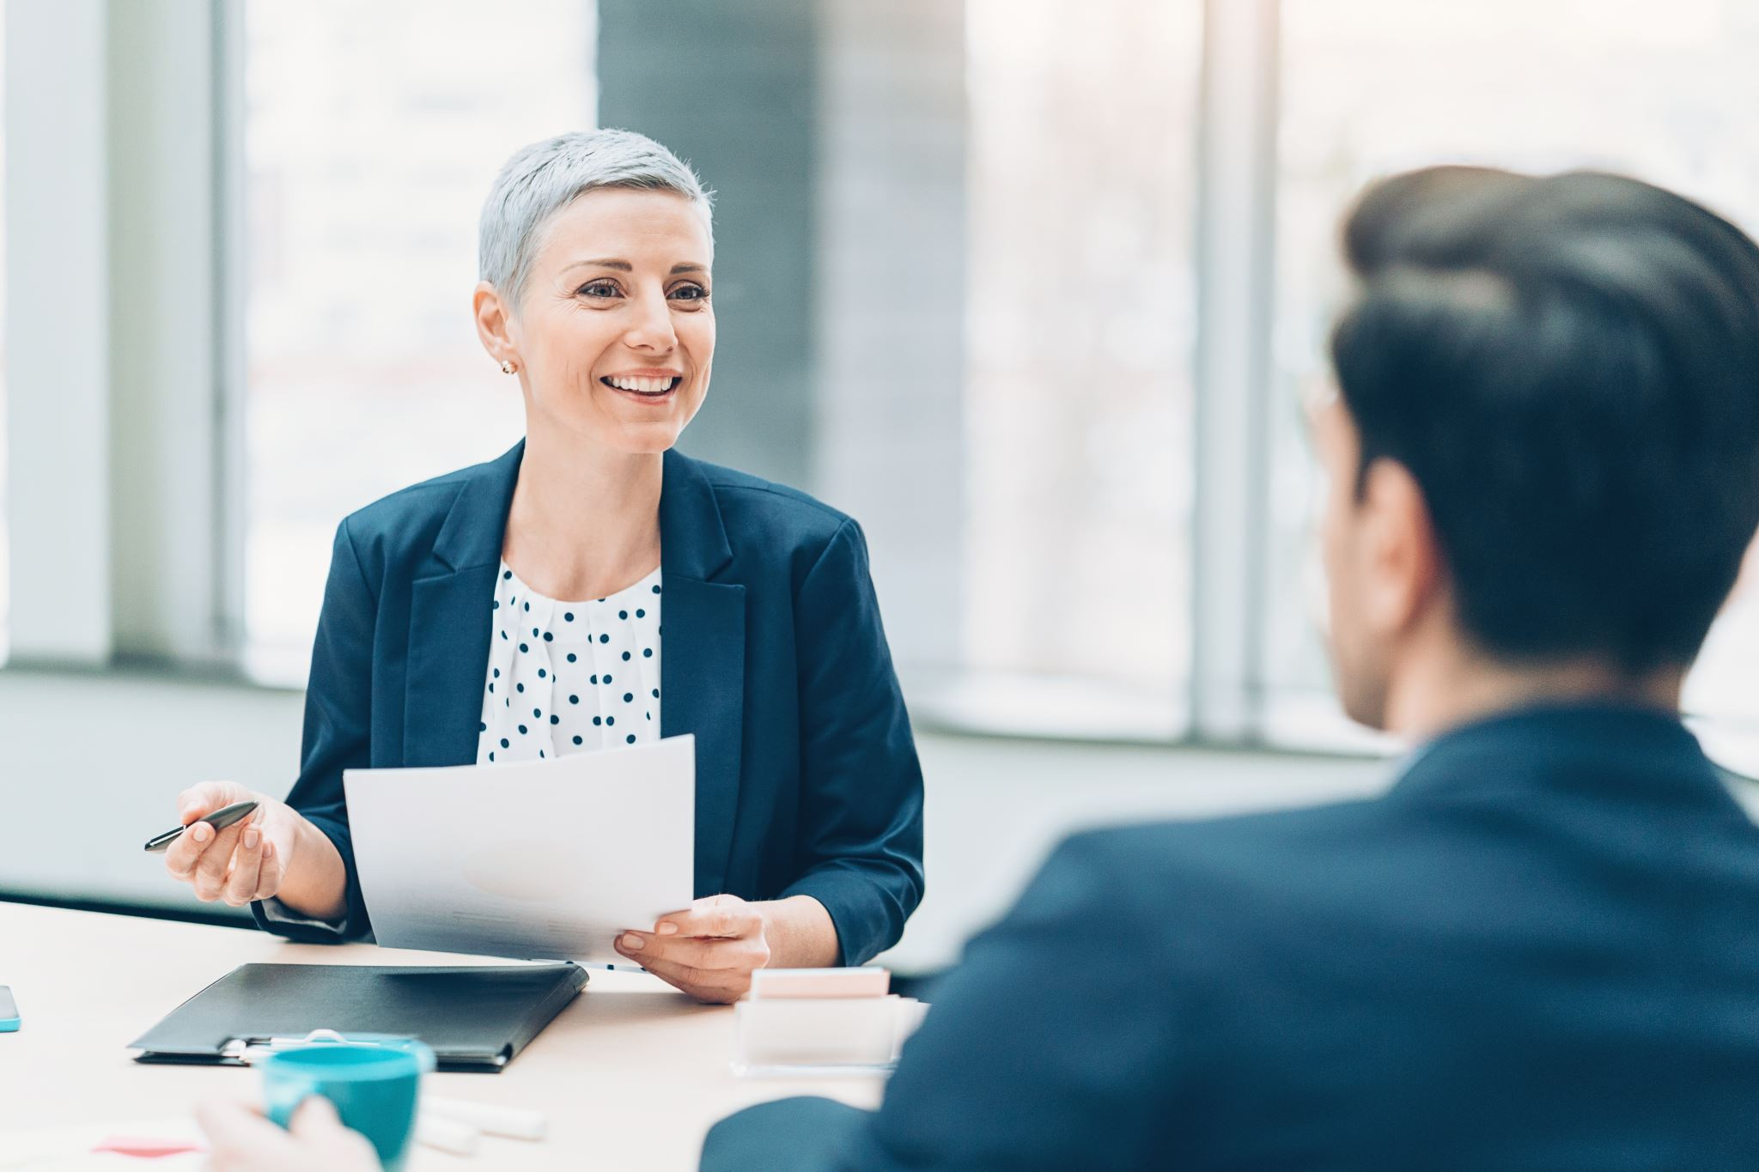
Mock Client Interviewing
Lecture and guide
Groups of three
Actor
Observing solicitor / feedback
Scenarios
Transferable skills
Real-world experiences
Competition

Slide 5
Notes:
KT

Slide 6
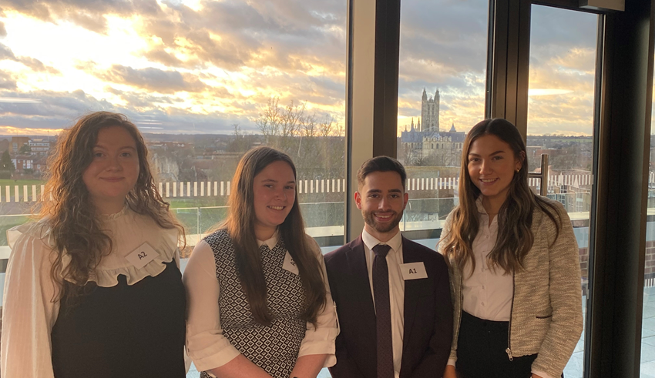
Questions?
Kerry Trewern, Director:
kerry.trewern@glasgow.ac.uk
Rhona McNair, Deputy Director:
rhona.mcnair@glasgow.ac.uk

