Slide 1
Validation of skills
Career
Development
CPD
Peer Recognition
Networking
Job
prospects
Confidence
building
Outside prospects
Society engagements

Slide 2
Benefits of registration
Validation of skills: The competency report looks at and accredits all aspects of working practice not just technical
proficiency and this validation is reflected in post nominal or “letters after your name”
Confidence Building: The competency report is typically 3000 words or so long and completion of this and registration
culminating in post nominal can spur registrants to go on and try other things, including other certifications based on
the mind set that they now think they can do it
Networking and outside opportunities: Joining a Licenced body and subsequently becoming professionally registered links
you to other registrants and exec members associated with the Licenced body and Science Council. This can result in other
out of work opportunities that are, at the very least, interesting and count towards your CPD (when for example you renew
your registration each year). In my case for example I became an assessor for the IST and then began to run registration
workshops at their annual conferences and trade shows. As a result I was awarded a Fellowship and subsequently in the
3 years I have become an exec member of the IST and “Assistant Registrar”; Special Registration Advisor to the NTDC and
Applicant support member for the Science Council. This has resulted in opportunities to speak and travel, paid for by these
bodies and in the case of the ASM role, remuneration for the actual workshops as well as travel. Furthermore, a big part of
my CPD I have submitted to retain my CSci award over the past 4 years has been based on these “extracurricular activities”
(in my case) at least as much as activities within my day job workplace
Networking and in house opportunities: My persons who become registered have gone on to involve themselves in
technician commitment initiatives within their workplaces. In my case for example I now have a new job description (from
December 1st ) that gives over 10% of my working day to registration duties Associated with Leicester
Improved Job prospects at selective institutions: Possession of post nominals is taken as a sign in general of commitment
and improves your chances of getting to interview. I know of one line manager who will always take the candidate who is
registered over those that are not. What is more, I know of another manager who will take technicians with registration
even over those with a PhD (but no registration) as registration accredits your proficiency as a practicing technician. Some
jobs even specify registration in the desirable or Essential spec (true of Government institutes like MRC Harwell or LMB)
Exercise in CPD and PPD: The act of compiling evidence of reflective practice is useful for CPD and also PPD as part of an annual appraisal

Slide 3
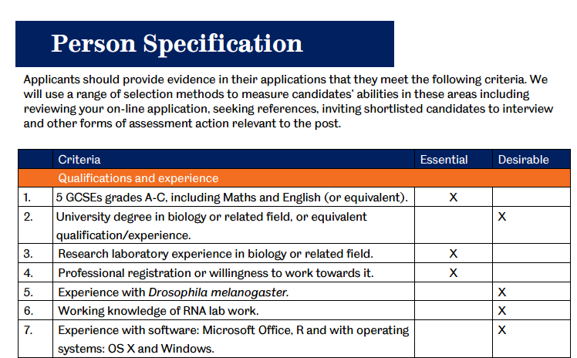
Registration Impacts
_{www.sciencecouncil.org}

