Slide 1
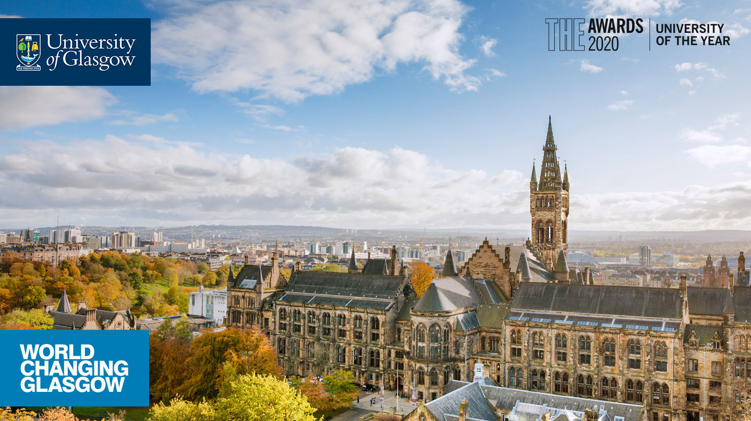

Welcome to the MA (Social Sciences​)
Choosing your courses​
How these relate to degree structure​
Varied options
Notes:
Welcome to the start of what we hope will be an exciting 4 years for you as a student at UofG. ​
What is the MA (Social Sciences)? ​
Undergraduate (UG) 4-year Honours programme, not a Masters degree (PGT), and is offered only in the ancient universities of Scotland.

Slide 2
MA (Social Sciences) - About the Degree
Our students can undertake studies in several Schools.
The two main ones in the College of Social Sciences (CoSS) are the Adam Smith Business School and the School of Social and Political Sciences.
​
However, many of you will be part of other Schools across the University as you enrol in subjects that interest you in the College of Arts or the College of Science and Engineering.​
Adam Smith Business School​
Economics – degree plans are: ​
  a) Economics b) Business Economics​
Management​
School of Social and Political Sciences​
Central and East European Studies​
Economic and Social History ​
Politics and International Relations – degree plans are: ​
  a) Politics b) International Relations​
Sociology​
Social and Public Policy​
Each plan in this School can be done with Quantitative Methods​
​
College of Arts – too many subjects to list!​
College of Science and Engineering – Psychology, Geography, Maths, Computing Science
Notes:
The MA (Social Sciences) degree sits in the College of Social Sciences, one of the four Colleges which comprise the University of Glasgow. ​
​
The seven main subjects in Social Sciences are in the two main Schools. Additionally the MA (Soc Sci) offers single Honours in Geography and in Psychology. ​
​
NB no joint Geog/Psych is available due to a timetable clash, so don’t enrol in level 1 of both subjects in first year​
​
It is important to remember that you are a student on this programme, because the degree regulations are different in each College.

Slide 3
How should I structure my First-Year curriculum?​
Three subjects: Level 1 courses (each potentially leading to Honours)​
  120 credits – MAXIMUM – 60 in each semester​
  No clash between subjects in Year 1 or Year 2​
​
Important MyCampus terminology: ​
Programme refers to the degree (e.g. MA (Soc Sci))​
Plan refers to the combination of subjects (e.g. Sociology/Politics)​
Subjects are disciplines (e.g. Sociology)​
GPA refers to the Grade Point Average.
MA (Soc Sci) students are expected to complete 160 of 240 ​Group A Social Sciences credits over 1st and 2nd years. ​
Notes:
The Chief Adviser/MA (Soc) Support team, may be able to agree to irregular curricula (i.e. not strictly adhering to the requirements of a plan). ​
​
However, these instances are exceptional, rather than the norm. Irregular curricula will be discussed later.

Slide 4
Degree structures: ​The MA (Soc) degrees
Year 4
Year 3
Year 2
Year 1
Subject 1
Senior Honours (Level 4)
Subject 2
Senior Honours (Level 4)
Subject 1
Junior Honours (Level 4)
Subject 2
Junior Honours (Level 4)
Subject 1
Level 2
Subject 2
Level 2
Subject 4
Level 1
Subject 1
Level 1
Subject 2
Level 1
Subject 3
Level 1
Notes:
You’ve entered UofG on an Honours programme with a significant degree of flexibility and choice – BUT there are limitations. ​
All Year 1 subject choices must lead to honours, with no timetable clashes.
Q-Step: take methods courses as Subject 4 in Year 2, as well as 40 credits in Year 3 and 20 credits in Year 4.
​
You should all by now be enrolled in 120 credits, in all required elements (usually A and B) of three subjects. If you’re not – you need to get help with this ASAP. ​
​
If you use “add by requirements” in MyCampus, you will be directed to the correct courses. ​
​
If you want to do something different you must check with the central support team – you must have at least three routes to a Level 2 subject, from your First-Year choices. ​
​
The MA (Soc Sci) support team will be checking all students over the next two weeks with advice if your choices are not correct, BUT it is YOUR responsibility to make sure your enrolments are correct. ​
​
If you see in your Student Centre that you are meeting your requirements, this means your enrolments match your plan and all is well. ​
​
Some of the combinations which cannot be taken: ​
You cannot take level 1 Psychology and Geography in first year – timetable clash in year two​
Psychology/English Lit – timetable clash​
​
Business Management and CEES teach at the same times in both Level 1 and Level 2. ​
​
If a combination is not in the list of degrees offered by UofG, the timetable clash is the usual (but not only) likely reason.​

Slide 5
Group A Subjects: What are they?
​The main subjects are:-
Business and Management
Central and East European Studies ​
Economic and Social History ​
Economics ​
Politics and International Relations​
Social and Public Policy​
Sociology ​
Geography​
Psychology ​
Quantitative Methods
Other permitted Group A subjects: ​
Mathematics ​
Philosophy
​
There are courses that do not lead to Honours which are NOT permitted in first year.
These courses are suitable for 2nd year non-honours subjects and Ordinary Degree students ONLY.
These courses will not appear in your Year 1 available course in MyCampus.
​
Notes:
Reminder: it is your responsibility as a student, to ensure that you are enrolled on the correct courses – if in doubt seek advice from the MA (Soc Sci) Advising team.

Slide 6
Progression on the Ma (Social Sciences)
Minimum Progression Requirements From Year 1 to Year 2: ​
Students must pass 80 credits at D3 or better​.
Must be able to continue two subjects at Level 2 each of which could be taken into Honours​ (Level 4).
Where you are refused credit (CR) in a course, you will be required to take extra credits in the next year to make these up.​
If you are refused more than 40 credits, you will be referred to the Progress Committee​ for review.
Notes:
All students are subject to the progress regulations relating to their degree programme, in this case the MA (Social Sciences) degree programme.​
Remind students of the 22-point marking scale and corresponding letter/numerical grades; more detail is given in other induction presentations.​
​
Level 1 Progression: ​
The normal grade required for progression is D3. Some subjects have higher progression requirements to be guaranteed progression (notably Psychology B3)​
​
It is your responsibility to check your subjects’ requirements). If in doubt – CHECK​
​
The requirements are usually stated clearly in your Student Centre in MyCampus, in course description and in your plan. You can check this any time. ​
​
Progression from Year 2 to Junior Honours ​
New requirements in Economics: Level 1 Stats and Maths – 10 credits each – to be taken in second year​ (some exemptions if specific courses have been completed).
Students are allowed to “fail” – i.e. gain credit between an H grade and an E1 grade, in 40 level 1 credits over first and second years. ​
Honours entry is C3 average at first attempt in all Social Sciences subjects; however you should note that Psychology has a higher requirement.

Slide 7
Progression to HONOURS (From Year 2)
Honours entry to the majority of subjects requires a GPA of 12.0 (C3) at first attempt​. Each subject will publish its own requirements which may differ.
You must:
Achieve a grade of D3 or better in 200 credits (failing only up to 40 level 1 credits)
  AND​
Achieve a minimum of 40 credits at Level 2 at a GPA of 12.0 (C3)* in each subject of your intended Honours programme at the first attempt.
  AND
Have at least a D3 in your other Level 2 courses (re-sits permitted in non-Honours subjects). ​
Notes:
All students are subject to the progress regulations relating to their degree programme, in this case the MA (Social Sciences) degree programme.​
Remind students of the 22-point marking scale and corresponding letter/numerical grades; more detail is given in other induction presentations.​
​
Level 1 Progression: ​
The normal grade required for progression is D3. Some subjects have higher progression requirements to be guaranteed progression (notably Psychology B3)​
​
It is your responsibility to check your subjects’ requirements). If in doubt – CHECK​
​
The requirements are usually stated clearly in your Student Centre in MyCampus, in course description and in your plan. You can check this any time. ​
​
Progression from Year 2 to Junior Honours ​
New requirements in Economics: Level 1 Stats and Maths – 10 credits each – to be taken in second year​
Students are allowed to “fail” – i.e. gain credit between an H grade and an E1 grade, in 40 level 1 credits over first and second years. ​
Honours entry is C3 average at first attempt in all Social Sciences subjects; however you should note that Psychology has a higher requirement. ​
​
Subjects in Arts with higher requirements include: English Literature and History. You are responsible for knowing the requirements for your subjects. ​
​
Subjects often ask students to “apply” for Honours – what they are trying to find out is how many students are likely to take Honours. ​
​
In almost all subjects, even if you don’t apply, you will be able to take Honours, IF you meet the entry requirements. ​
​
The progress regulations are detailed in the University Regulations (formerly University Calendar). ​
​
However, for ease of interpretation you will be subject to consideration by the MA (Social Sciences) Progress Committee in years 1 and 2 if:​
​
You have not achieved 80 credits, of which at least 60 must be at Grade D or better, and you have not achieved a grade point average (GPA) of at least 8 by the end of your first year.​
or​
You have not achieved 160 credits, of which at least 120 must be at grade D or better and 40 of which must be at level 2, and you have not achieved a grade point average (GPA) of at least 8 by the end of your second year​
​
Ordinary degree students in Year 3 and Honours Students in Years 3 and 4 are also considered if they have not made appropriate progress in their studies or achieved the degree requirements to graduate during the session. ​
​
The MA (Social Sciences) Progress Committee meets in June/July for Honours students and for all other students in September each year. ​
​
Students subject to the progress regulations have the opportunity to submit a statement to the Committee. The Progress Committee has wide powers and may make any recommendations including:​
​
Transfer to part-time study​
Repeat a year​
Repeat of specific courses​
Discontinuation of studies (which means a student cannot be readmitted to the MA (Social Sciences) degree programme)​
​
The MA (Social Sciences) Progress Committee consists of the Convenor and two other academic members of staff. ​
​
The Chief Adviser of Studies also attends to provide reports and information.​
Students may submit a statement to the Progress Committee outlining any problems they may have had during the year using the MA (Social Sciences) Progress Committee Student Statement Form.‌​
Students retain the right to appeal to the College Appeals Committee about any decision of the MA (Social Sciences) Progress Committee.​
​

Slide 8
Irregular Combinations (Year 1 to Year 2)
If you want to deviate from your plan rules as defined in MyCampus, you must seek approval from the MA (Soc) Advising team. ​
Economic & Social History: Students who have passed Economics 1A OR 1B OR a History Level 1 course are permitted to enter Economic & Social History Level 2 courses. Note: Taking Economic and Social History does NOT give entry to History Level 2. ​
A pass in any Social Sciences “cognate” subject at Level 1 allows entry to Central and East European Studies Level 2 courses.​
Politics and International Relations (PIR): Entry to Politics or International Relations Level 2 is only permitted if a student has completed Politics 1A and 1B. Students are not permitted to transfer onto International Relations plans; they must have been admitted through UCAS.​
Level 2 Social Sciences students are not permitted (by the College of Arts) to enrol in beginners’ languages in their second year. If you want to try a new language, enrol in your first year. In your second year, you can consider the Languages for International Mobility.​
Notes:
To students: please consult the Advising Office for advice.​
​
Students on plans in Politics and in International Relations must take Politics 1A and 1B. This means a change from our earlier practice. Both plans have the same pre-honours courses. There is NO joint Politics and IR degree plan.​
​
Students may enter level 2 ESH, with 20 credits from level 1 ESH, level 1 Economics, or level 1 History and it is important to note that this arrangement is NOT reciprocal, students intending Honours in Economics and/or History must complete 40 level 1 and 40 level 2 in the relevant subject. ​
​
There are other subjects, notably in the College of Arts, which will permit entry to level 2, with a pass in only 20 credits of Level 1 – consult the MA (Soc Sci) team.​
​
Languages: ​
Beginners’ languages should be taken in first year and we recommend taking the relevant culture courses as they will be needed if you decide to continue with level 2 language. ​
​
A good language alternative for second year would be the Languages for International Mobility. They are designed to prepare students with the basics to help them should they decide to do a semester or year abroad. They are also good as basic language skills. NOTE: they do not lead to a degree in the language, they can be the optional level 1 credits in year two – you may NOT take them in first year.

Slide 9
JOINT HONOURS COMBINATIONS NOT AVAILABLE- ENROLMENT PROHIBITED
The general rule is that if the degree is not offered as a joint combination, it is because of a timetable clash. (https://www.gla.ac.uk/undergraduate/degrees/ )
The MA (Soc) Advising Team will contact you if you have enrolled in a non-available combination of subjects.
Examples of combinations not available:
Geography and Psychology
CEES and Business & Management
Spanish and CEES
Social and Public Policy and Philosophy
Economics and Computing Science
Notes:
Geography/Psychology – you should NOT enrol in both because there is a timetable clash in second year. You are reducing your second-year choices. ​
​
If things don’t go well with your studies, you may find yourself in a position where you cannot progress and would potentially require a repeat year. ​
​
If you are currently enrolled in both, you are strongly advised to drop one and choose another subject. ​
​
CEES & Business and Management teach at the same time​
​
Search the degrees offered using the link to find out which combinations are available. ​

Slide 10
Your Study Load: What does this mean for you?
120 credits means you have 1200 hours of ‘notional’ learning ​
What does this mean in “real” terms?​
  Your academic “term” covers 2 x 11 weeks of study, plus exams​ at the end of each semester.
  Lectures, tutorials/seminars etc. will take approximately 15 hours per week​
  This leaves you some 35 hours per week to organise private study and prepare for assessment​
  Remember it is important to take time away from your desk​/study to focus on your wellbeing.
  Use Services provided by the university to support your Academic Writing (LEADS)
The key to success is planning. Don’t leave things until the last minute​
N.B. First attempts and reassessments will take place during the summer (August)
Notes:
You will have very few contact hours, leaving much unstructured time. Unstructured time is NOT free time. ​
​
Take advantage of time between classes to prepare and read for future classes. ​
​
Expect to spend over 20 hours in the library or studying elsewhere.

Slide 11
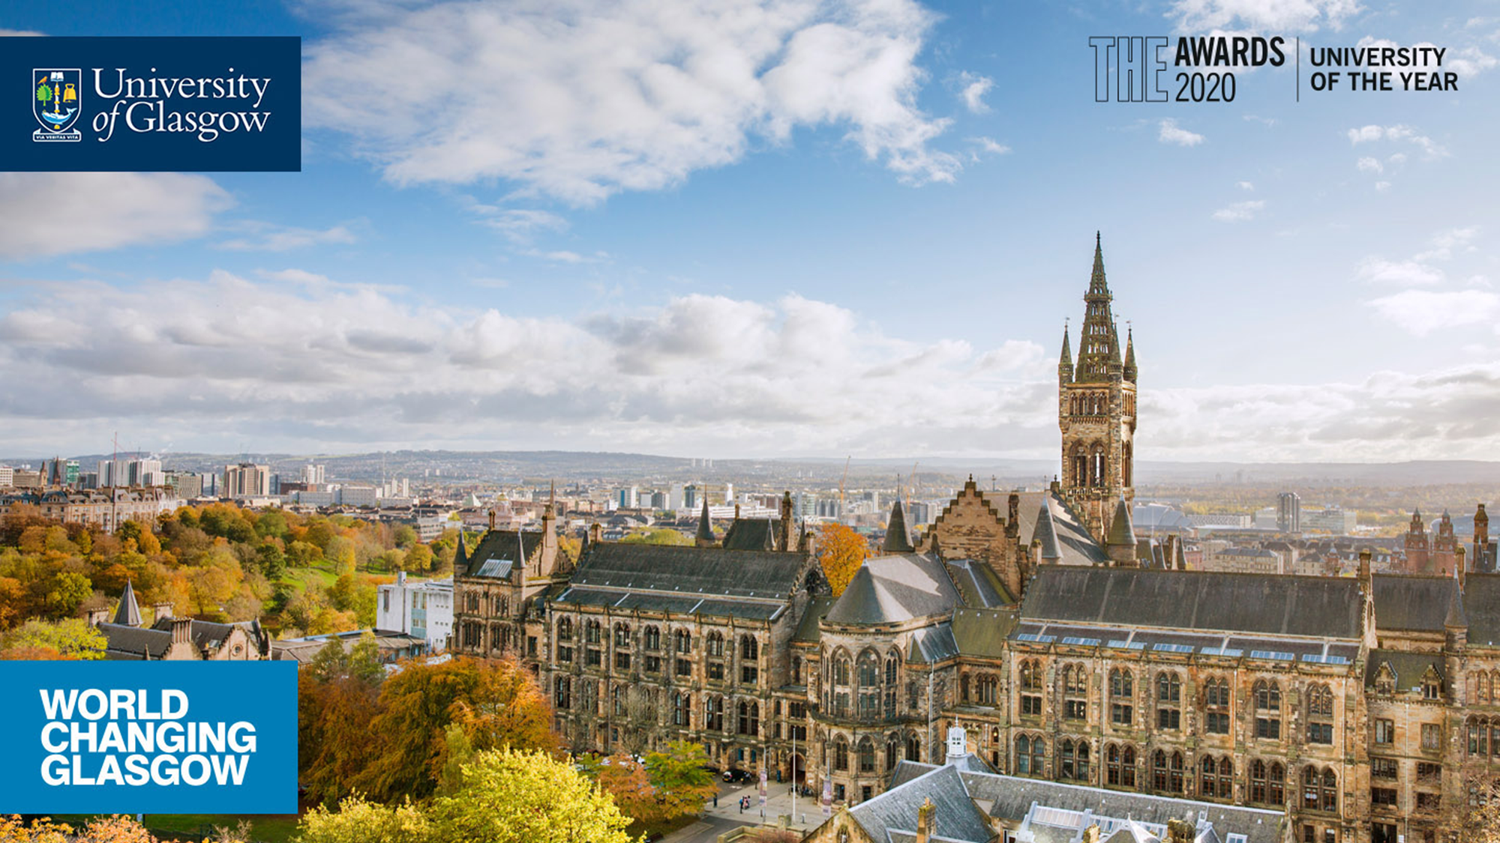


Get in touch with your questions!​ socsci-ma@Glasgow.ac.uk
#UofGWorldChangers
@UofGlasgow

