Slide 1

Driving & Releasing Change
Template: Case for Change

Slide 2








Make it essential – a case for change
Listen! ☺
A good change story captures the hearts and mind...
A change story offers
Context, rationale and A clear and compelling A personal message
explanation aspiration
When it works
It helps people make
sense of the changes
Leaders role model their
commitment
It engages staff at a personal level, both rationally and emotionally

Slide 3
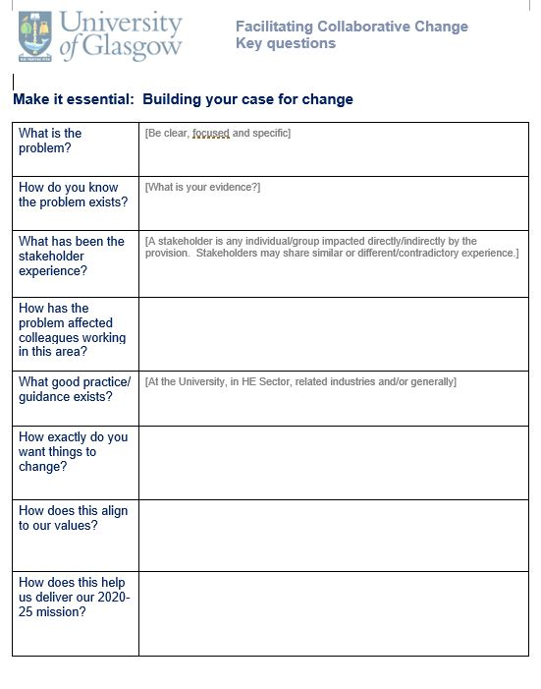


Make it essential
Listen! ☺
Contact us
Questions or comments about this resource?

