Slide 1
Guidance notes – delete slide before presenting
These UofG marketing slides are intended to support staff who are making presentations about the University. These slides are pre-populated with marketing messages and full screen images, as well as some image-only slide layouts ready for your own text. You will be able to see the options by scrolling down the left hand side.
A selection of the University’s brand colours has been pre-loaded for your text and tables. These are the eight top colours (‘Theme colours’) plus black & white in the font colour drop-down menu.
These slides have been designed to be accessible to all, meeting our legal requirements on digital accessibility. You will have to add your own text (title and body text) to make these pages comply with accessibility guidance. For more information see glasgow.ac.uk/myglasgow/digitalaccessibility/documents/powerpoint

Slide 3
About the University
Established in 1451
Ranked in the top 100 of the world’s universities
Ranked 13th in the world in the QS World Sustainability Rankings and the THE Impact Rankings
Member of the Russell Group of research-intensive UK universities
Eight Nobel Laureates connected to the University

Slide 4
Student experience
Our students are taught by dedicated and passionate academics in a flexible and innovative learning environment.
43,000 students from 140 countries
Ranked in the UK's top 20 for graduate employability (QS Graduate Employability Rankings 2022)
300+ student clubs and societies
Study abroad opportunities in 200 destinations worldwide

Slide 5
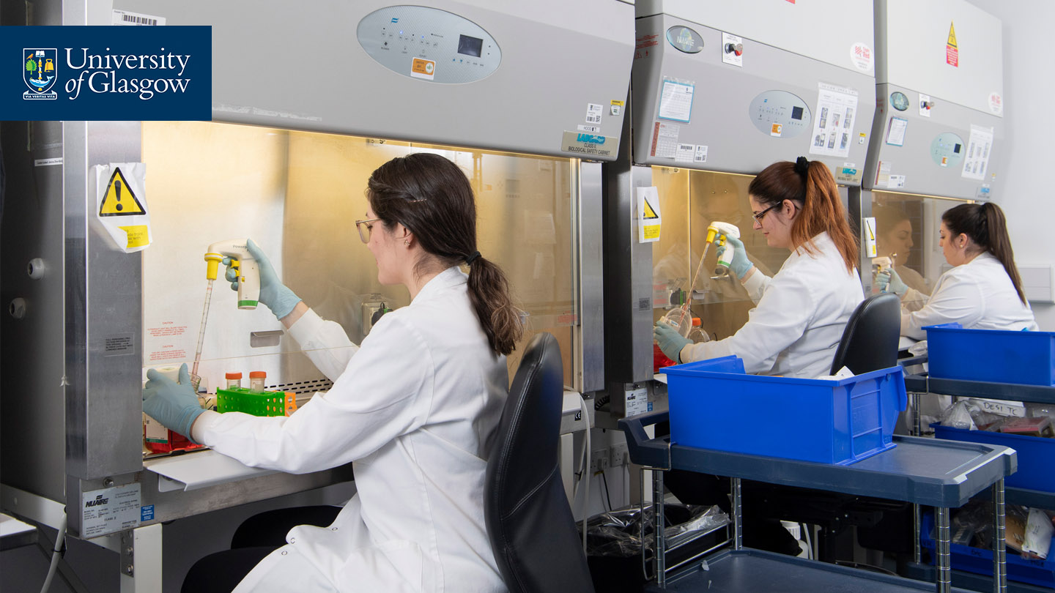
Research with impact
The University of Glasgow has been recognised for its world-leading research and the positive impact it has on society, by the Research Excellence Framework (REF) 2021.
1st in Scotland for Grade Point Average
1st in Scotland for research outputs
13th in the Russell Group for research power
5th in Russell Group for 4* research outputs, up from 20th in 2014

Slide 6
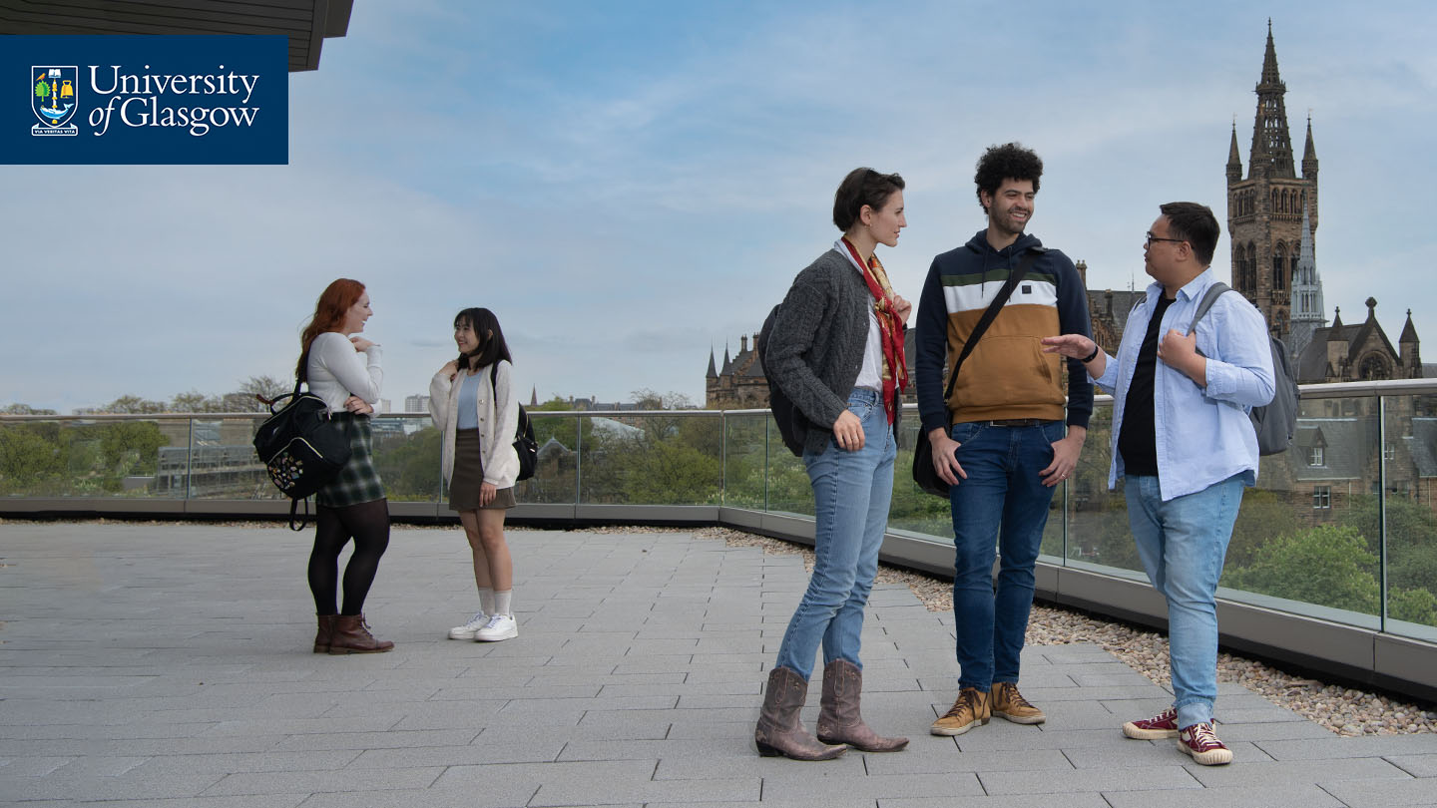
Inclusive Glasgow
The University of Glasgow is committed to building an inclusive and welcoming community for all.
Through our widening participation work we encourage, prepare and support students who are under-represented in higher education to achieve entry to university.
Our University of Sanctuary status recognises the safe and welcoming environment we provide for refugees and asylum seekers.

Slide 7
UofG and the SDGs
We are committed to working towards the United Nations' Sustainable Development Goals.
As a reflection of our commitment to the SDGs, we
were the first university in the UK to declare we would divest from fossil fuels within a decade
were the first university in Scotland to declare a Climate Emergency
committed to a significant plan of action to achieve carbon neutrality by 2030.

Slide 8
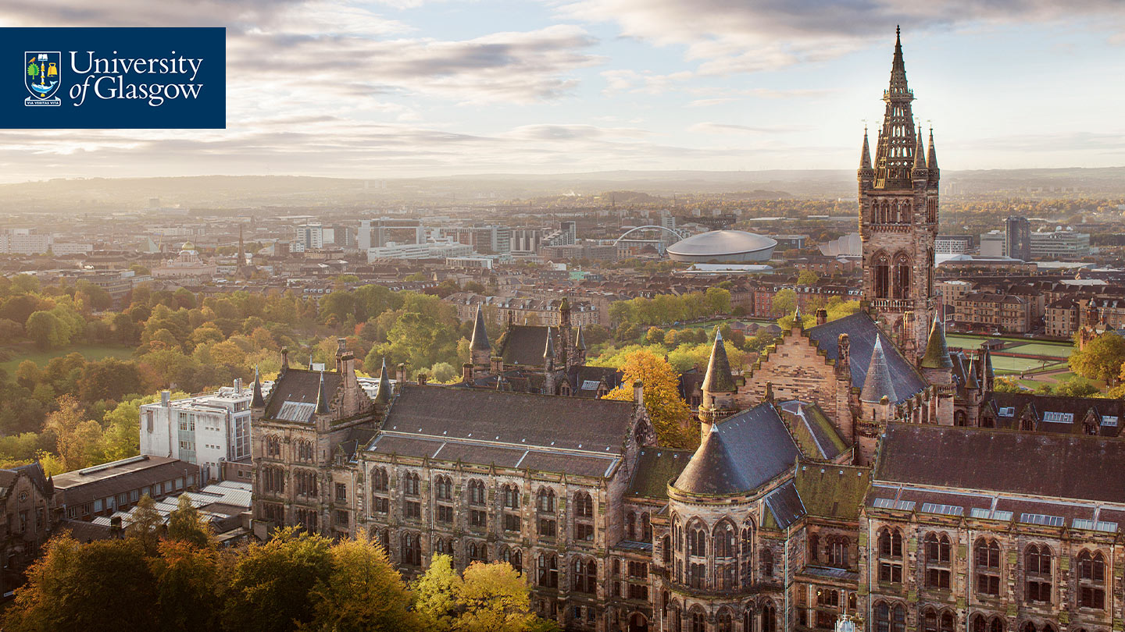
Our city, our partner
The University was founded for the benefit of the city and its people.
Our staff and students are engaged in strong, enduring research and community partnerships to improve health, boost the economy, and build a better future for those living in Glasgow.
The University is a key player in the city’s ambitious plans for the regeneration of the River Clyde and in the development of a Glasgow Riverside Innovation District.

Slide 9
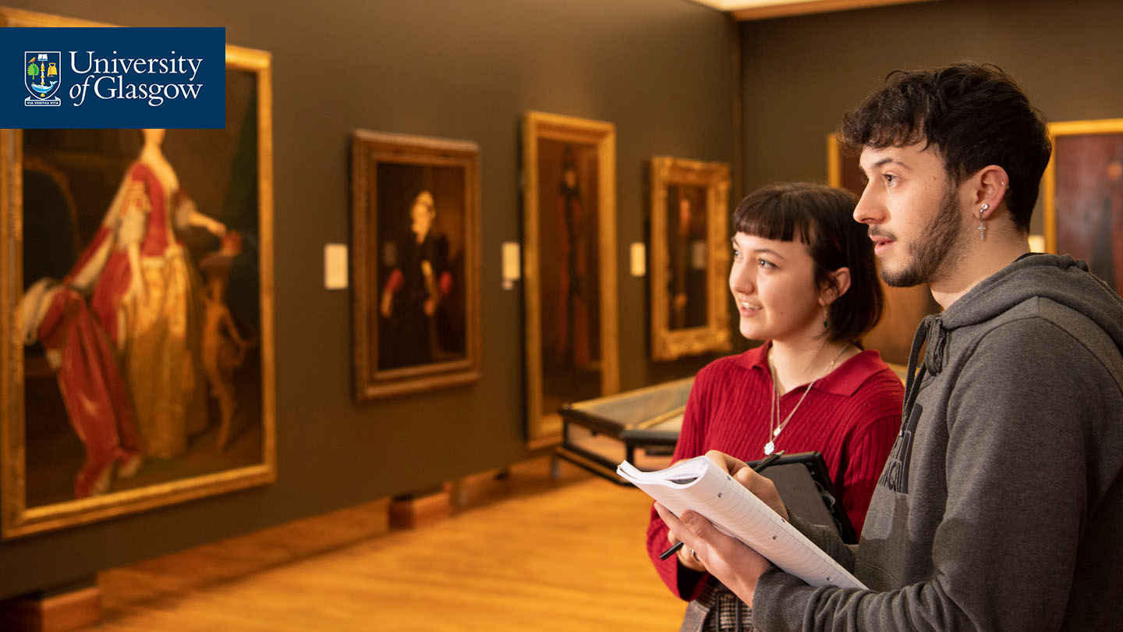
Collections
Founded in 1807, The Hunterian is Scotland's oldest public museum and home to one of the largest collections outside the National Museums.
Collections include the world’s largest display of James McNeill Whistler and Charles Rennie Mackintosh.
Around 1.5 million items relocated to purpose-designed study and storage facilities at Kelvin Hall.

Slide 10
Connecting globally
We have established partnerships with institutions across the world, including the Universities of Columbia, Hong Kong, Leuphana, McGill, Radboud and Sydney, and with Nankai University, the Singapore Institute of Technology, and UESTC.
We are a founding member of Universitas 21 and the Guild of European Research Intensive Universities.
We are associate member of CIVIS, a European Civic University formed by the alliance of leading higher education institutions across Europe.

Slide 11
Our expanding campus
We have delivered one of the most significant expansions of a UK university city campus for over a century. Over the last decade, we have invested in our estate to expand our world-class campus and facilities.
James McCune Smith Learning Hub
Mazumdar-Shaw Advanced Research Centre
Clarice Pears Building
Adam Smith Business School & Postgraduate Teaching Hub

Slide 12
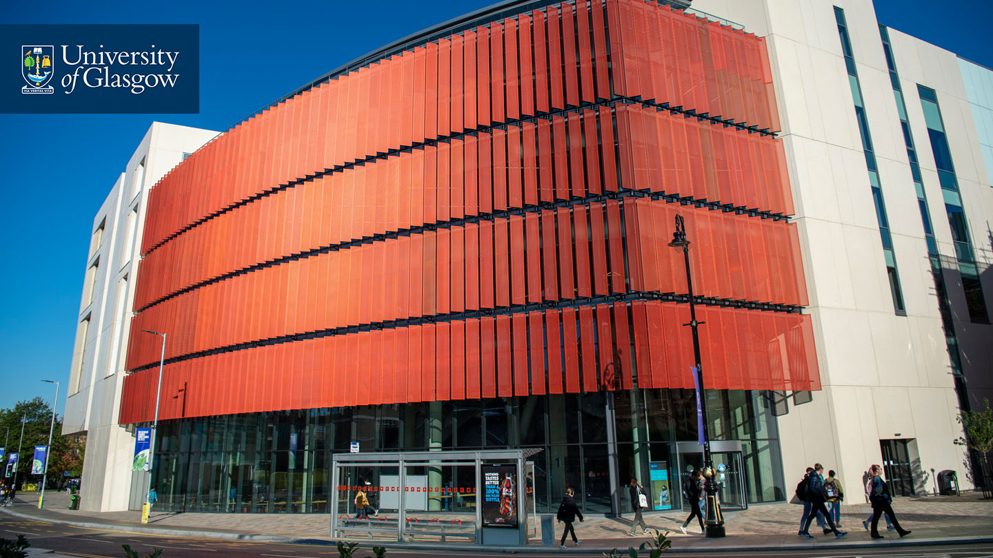
The James McCune Smith Learning Hub
The James McCune Smith Learning Hub provides state-of-the-art teaching facilities, with flexible study spaces and interactive teaching for students to help create a more immersive learning experience.

Slide 13
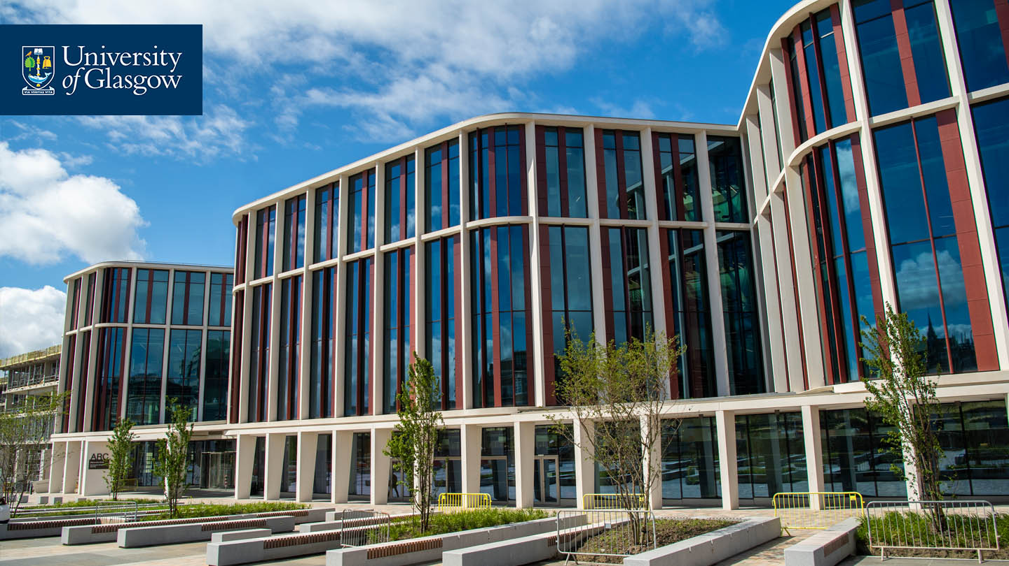
The Mazumdar-Shaw Advanced Research Centre (ARC)
The ARC is the creative and collaborative heart of research at the University of Glasgow. The building bridges the boundaries between research, cross-subject collaboration and true societal impact.

Slide 14
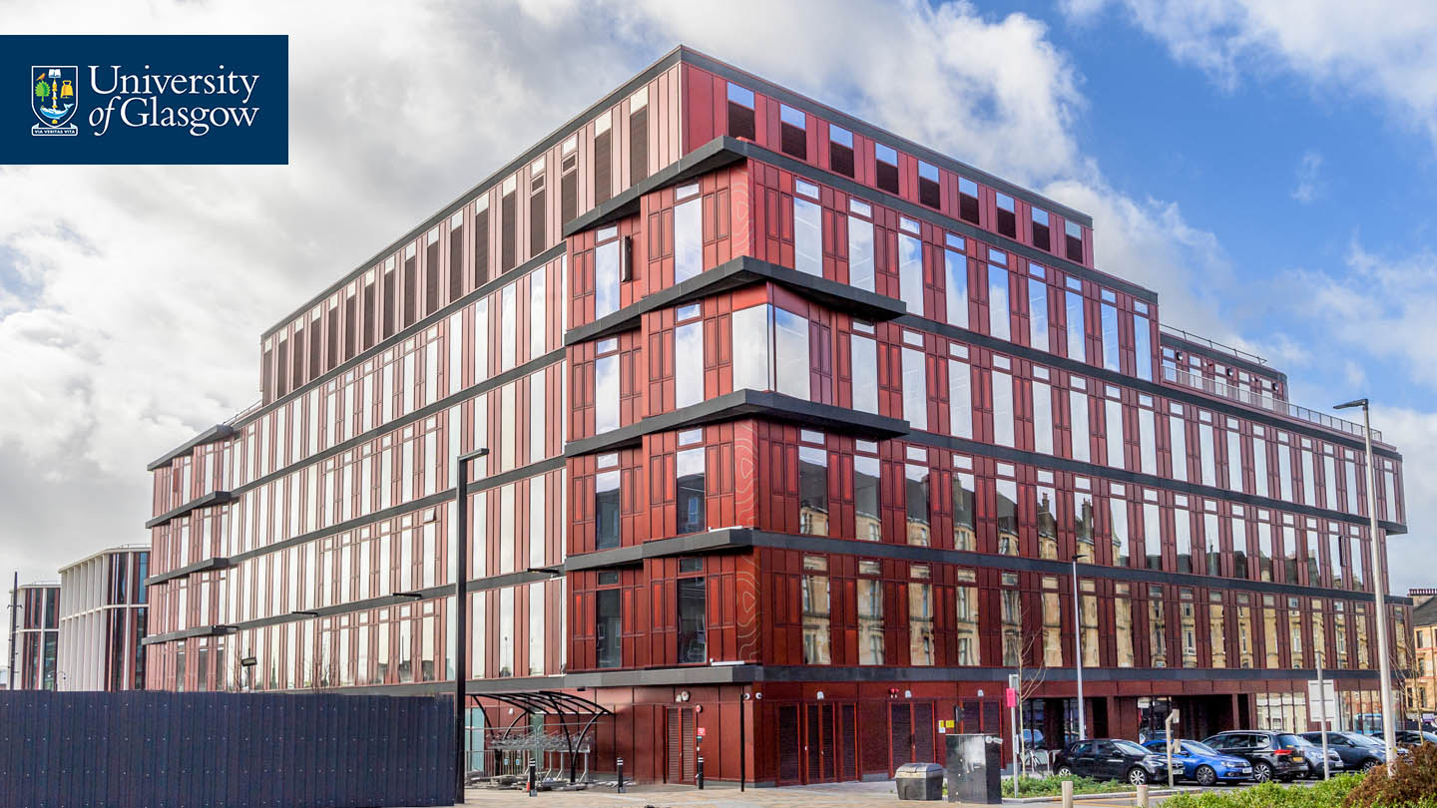
Clarice Pears Building
The Clarice Pears building brings together academic leaders from public health, medicine, epidemiology, psychology and health data science to address some of the world's greatest health challenges.

Slide 15
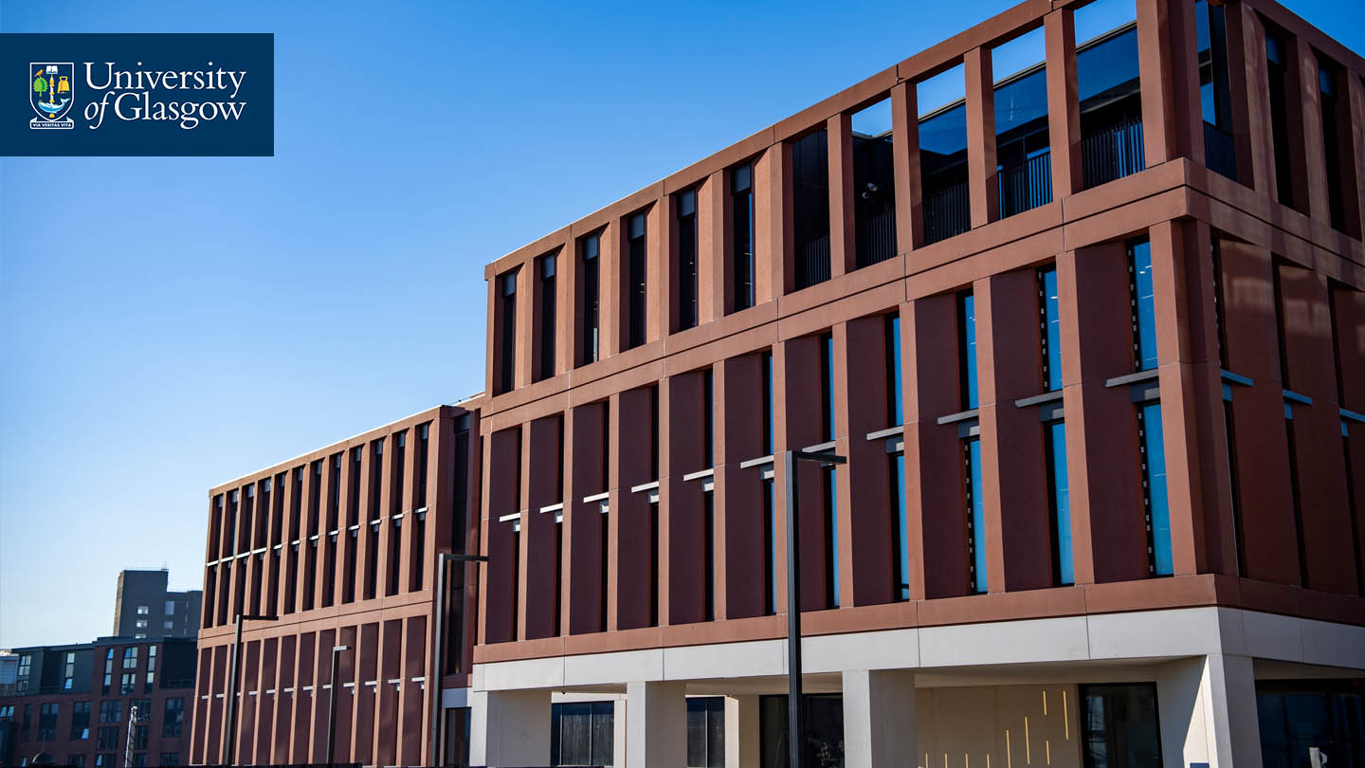
Adam Smith Business School & Postgraduate Teaching Hub
The building will be a multidisciplinary home for students of our postgraduate masters’ degrees and provide world-leading facilities for the Adam Smith Business School.

Slide 16
We recommend that you use headings or bullet points.
Your audience want to hear and see you present not read from a slide.
To insert an image, right-click (ctrl + click Mac) and select ‘send to back’, to place it behind the University marque at the top.

Slide 17
We recommend that you use headings or bullet points.
Your audience want to hear and see you present not read from a slide.
To insert an image, right-click (ctrl + click Mac) and select ‘send to back’, to place it behind the University marque at the top.

Slide 18
We recommend that you use headings or bullet points.
Your audience want to hear and see you present not read from a slide.
To insert an image, right-click (ctrl + click Mac) and select ‘send to back’, to place it behind the University marque at the top.

Slide 19
We recommend that you use headings or bullet points.
Your audience want to hear and see you present not read from a slide.
To insert an image, right-click (ctrl + click Mac) and select ‘send to back’, to place it behind the University marque at the top.

Slide 20
We recommend that you use headings or bullet points.
Your audience want to hear and see you present not read from a slide.
To insert an image, right-click (ctrl + click Mac) and select ‘send to back’, to place it behind the University marque at the top.

Slide 21
We recommend that you use headings or bullet points.
Your audience want to hear and see you present not read from a slide.
To insert an image, right-click (ctrl + click Mac) and select ‘send to back’, to place it behind the University marque at the top.

Slide 22
We recommend that you use headings or bullet points.
Your audience want to hear and see you present not read from a slide.
To insert an image, right-click (ctrl + click Mac) and select ‘send to back’, to place it behind the University marque at the top.

Slide 23
We recommend that you use headings or bullet points.
Your audience want to hear and see you present not read from a slide.
To insert an image, right-click (ctrl + click Mac) and select ‘send to back’, to place it behind the University marque at the top.

Slide 24
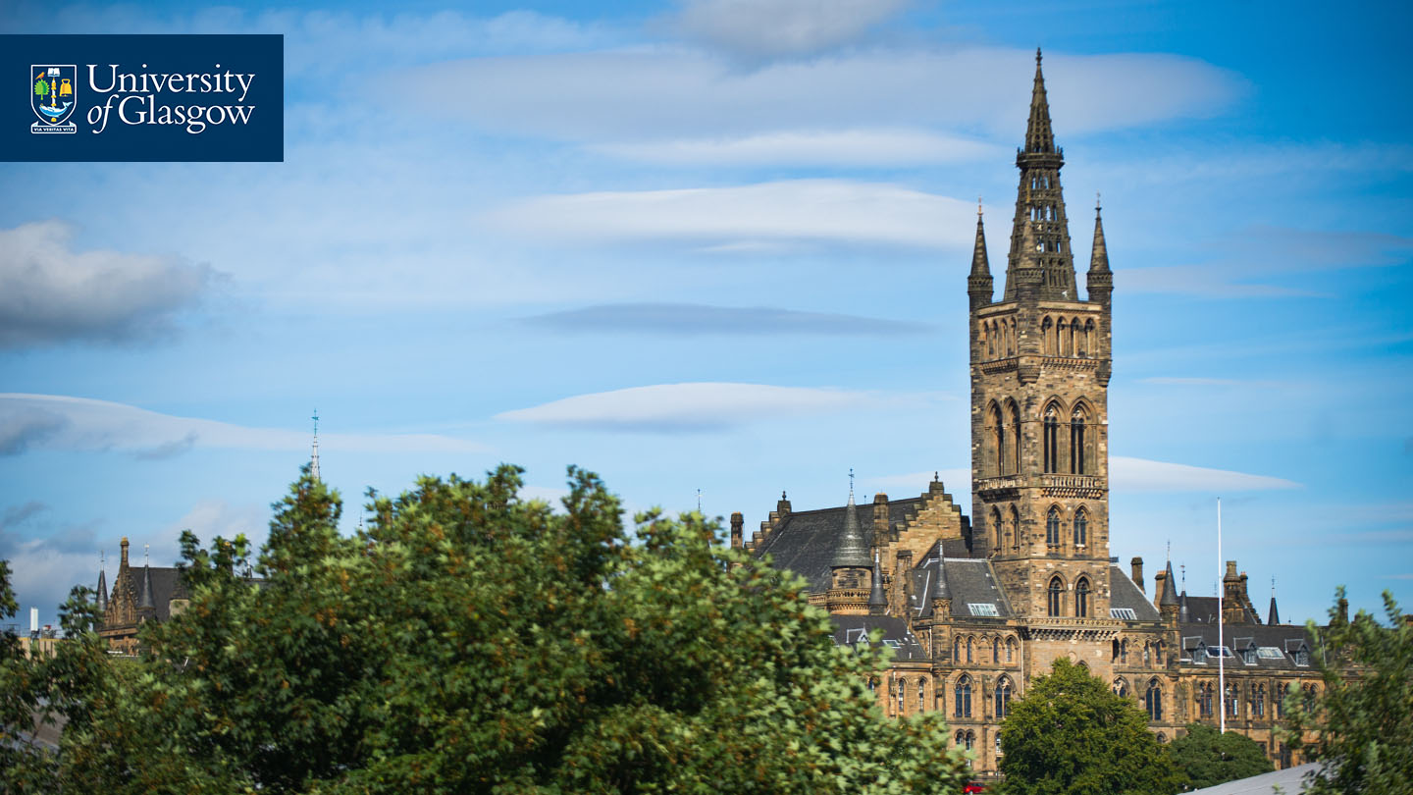
We recommend that you use headings or bullet points.
Your audience want to hear and see you present not read from a slide.
To insert an image, right-click (ctrl + click Mac) and select ‘send to back’, to place it behind the University marque at the top.

Slide 25
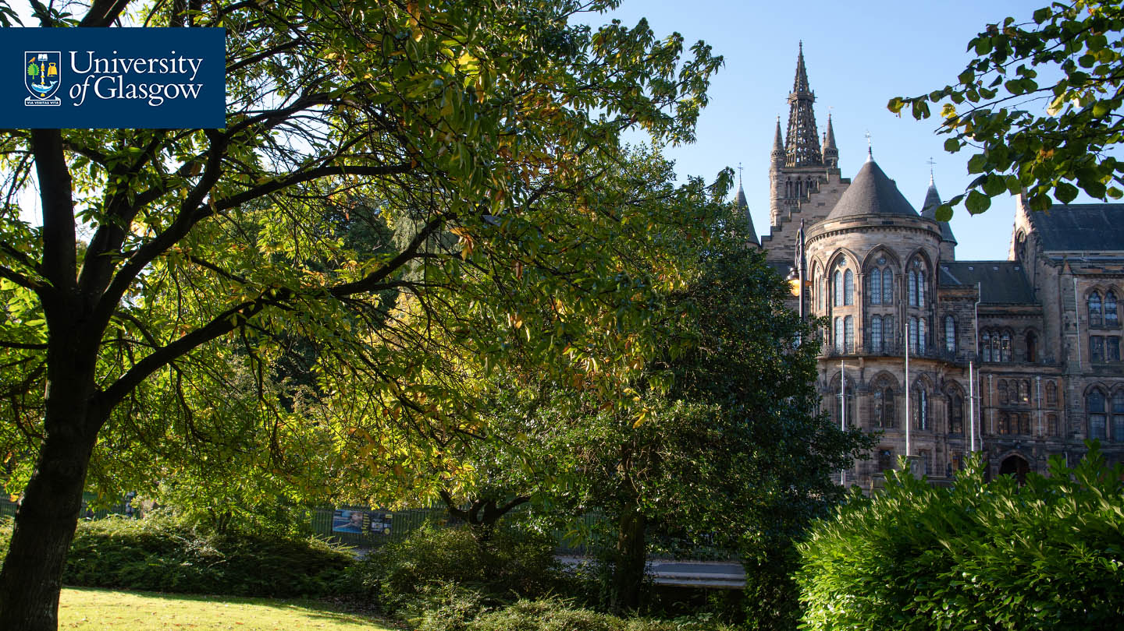
We recommend that you use headings or bullet points.
Your audience want to hear and see you present not read from a slide.
To insert an image, right-click (ctrl + click Mac) and select ‘send to back’, to place it behind the University marque at the top.

Slide 26
We recommend that you use headings or bullet points.
Your audience want to hear and see you present not read from a slide.
To insert an image, right-click (ctrl + click Mac) and select ‘send to back’, to place it behind the University marque at the top.

Slide 27
We recommend that you use headings or bullet points.
Your audience want to hear and see you present not read from a slide.
To insert an image, right-click (ctrl + click Mac) and select ‘send to back’, to place it behind the University marque at the top.

Slide 28
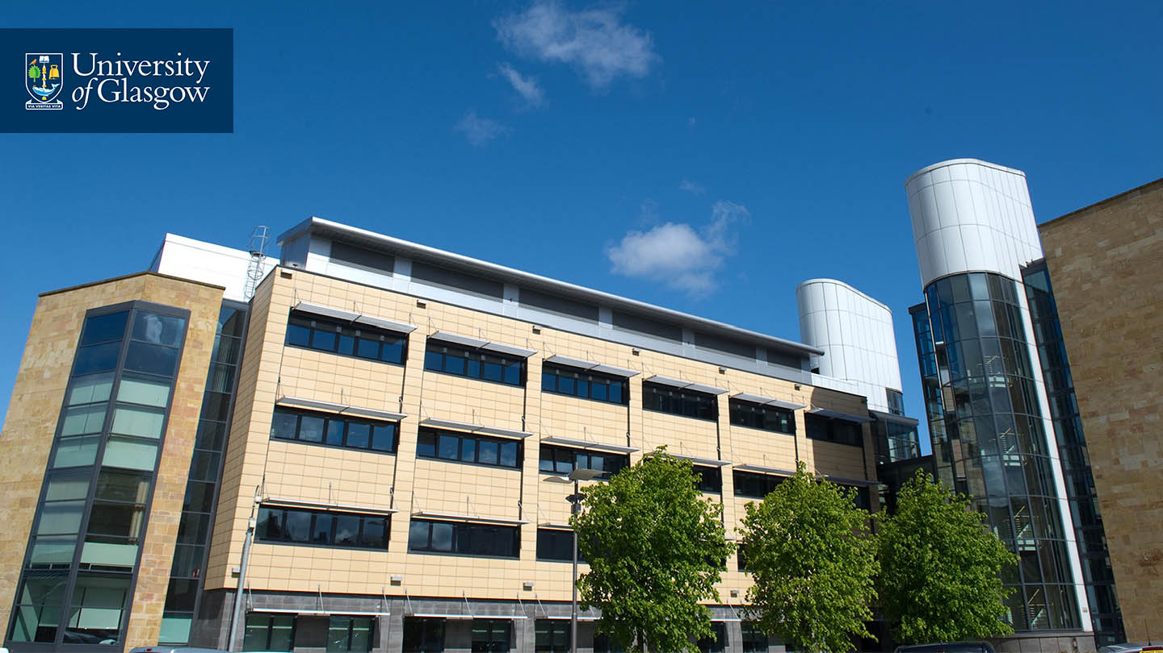
We recommend that you use headings or bullet points.
Your audience want to hear and see you present not read from a slide.
To insert an image, right-click (ctrl + click Mac) and select ‘send to back’, to place it behind the University marque at the top.

Slide 29
We recommend that you use headings or bullet points.
Your audience want to hear and see you present not read from a slide.
To insert an image, right-click (ctrl + click Mac) and select ‘send to back’, to place it behind the University marque at the top.

Slide 30
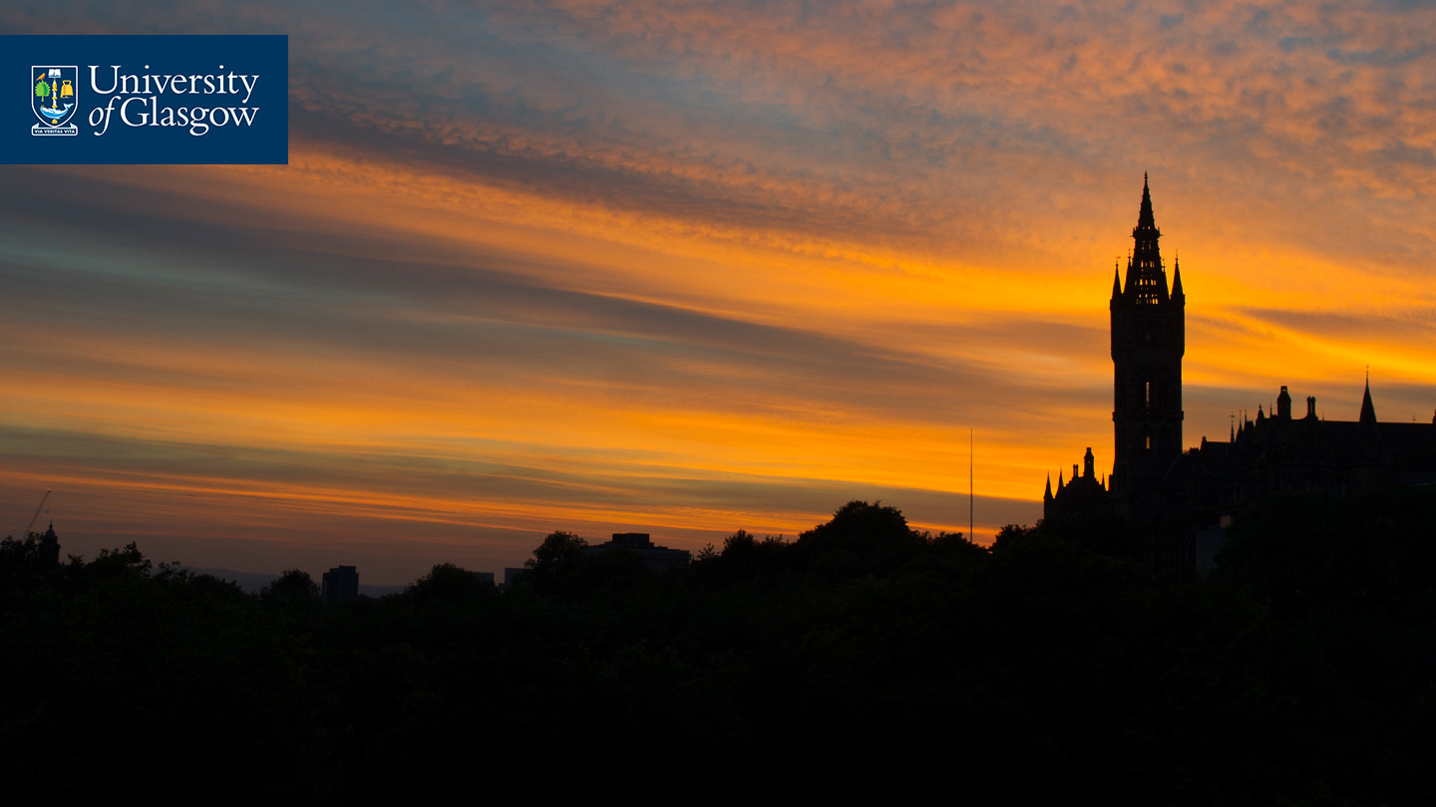
Closing slide – You can add contact details, a call to action or a simple thank you.
#UofGWorldChangers
@UofGlasgow

