Slide 1
INSTITUTIONAL ETHICAL APPROVAL AND your Dissertation
Susan A. Batchelor
School Ethics Convenor
Notes:
Hello everyone. My name is Susan Batchelor and I am the ethics convenor for the School of Social and Political Sciences.
Today I am going to be giving a short presentation on the ethical review process in the School, as well as giving you an update on the School position on face-to-face research in the context of the ongoing pandemic.
This review process applies to all UG and PGT students undertaking research as members of the University of Glasgow, and primary relates to dissertation research.

Slide 2
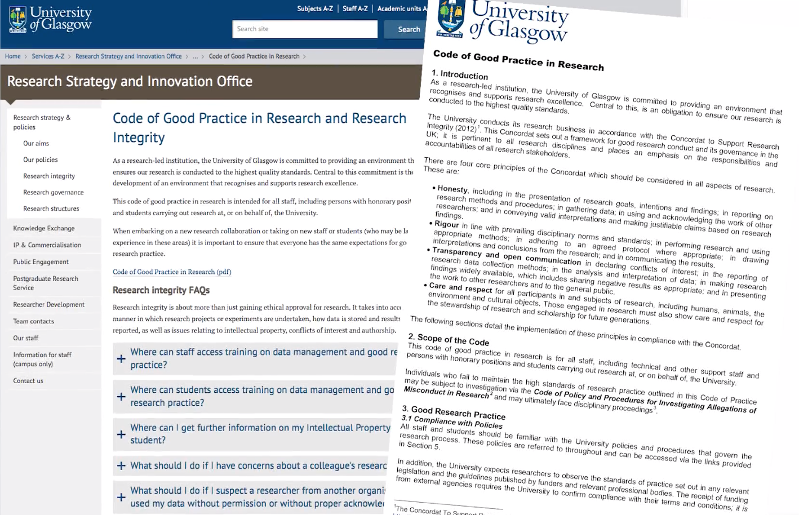
Research governance
The principles and processes by which standards are set in research
Intended to improve research and safeguard the public
- Research data management
- Research integrity
- Research ethics
Notes:
Before I introduce the University of Glasgow’s institutional procedures for ethical approval, it is probably useful is I say something brief about research governance, the principles and processes intended to improve research quality and safeguard the public - of which institutional ethical procedures are part.
Research ethics and research governance are sometimes confused, since both are concerned with protecting the rights, dignity, safety and wellbeing of those involved in research. However, the remit of research governance is broader, encompassing research ethics - alongside research integrity and data management.
Research integrity means conducting research in a way which allows others to have trust and confidence in the methods used and the findings that result from this. Within the University, conducting research with integrity also means meeting the professional standards set out in the Code of Good Practice in Research.
Research data management refers to the organisation, storage and preservation of data created during a research project. It covers initial planning, day-to-day processes and long-term archiving and sharing.
You can find out more about research governance, integrity and data management by searching on the University website. The Code of Good Practice in Research is a particularly helpful document, which will probably help you fill in your ethics application.

Slide 3
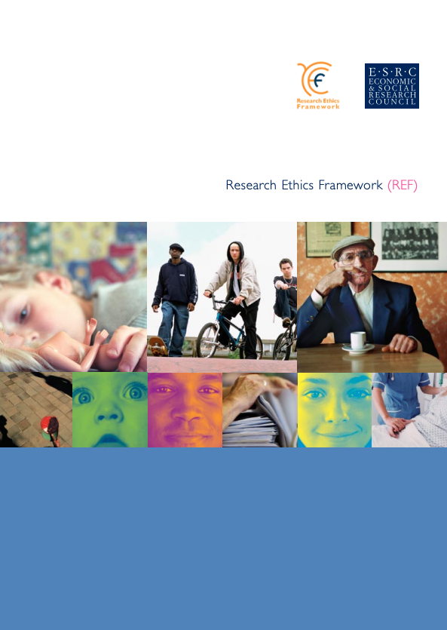
ESRC Research Ethics Framework
Research should be designed, reviewed and undertaken to ensure integrity and quality
Research staff and subjects must be informed fully about the purpose, methods and intended possible uses of the research, what their participation in the research entails and what risks, if any, are involved.
The confidentiality of information supplied by research subjects and the anonymity of respondents must be respected
Research participants must participate in a voluntary way, free from any coercion
Harm to research participants must be avoided
The independence of research must be clear, and any conflicts of interest or partiality must be explicit
Notes:
Research ethics are the moral principles that govern how researchers should carry out their work throughout the research process - from the initial idea, through data collection, reporting and dissemination.
Within the social sciences, standards for research ethics are set out in the Economic and Social Research Council Research Ethics Framework, as follows:
Research should be designed, reviewed and undertaken to ensure integrity and quality
Research staff and subjects must be informed fully about the purpose, methods and intended possible uses of the research, what their participation in the research entails and what risks, if any, are involved.
The confidentiality of information supplied by research subjects and the anonymity of respondents must be respected
Research participants must participate in a voluntary way, free from any coercion
Harm to research participants must be avoided
The independence of research must be clear, and any conflicts of interest or partiality must be explicit

Slide 4
ESRC Research Ethics Framework
The responsibility for conduct of the research in line with relevant principles rests with the principal investigator.
The responsibility for ensuring that research is subject to appropriate ethical review, approval and monitoring lies with the institution seeking or holding an award with the ESRC and which employs the researchers performing it, or some of the researchers when it is acting as the co-ordinator for collaborative research involving more than one organisation. Institutions should have clear, transparent, appropriate and effective procedures in place for ethical approval whenever it is necessary.
Ethical review should always be proportionate to the potential risk, whether this involves primary or secondary data. Whilst the secondary use of some datasets may be relatively uncontroversial, and require only expedited ethical review, novel use of existing data and especially data linkage may, in some contexts, raise ethical issues. Research involving primary data collection will always raise ethical issues that must be addressed.
Breaches of good ethical practice in ESRC-funded research will be treated as a very serious matter by the Council. They could result in the immediate suspension of the individual project and other projects based at or under the coordination of the contracting institution, and a halt to the consideration of further applications from that institution.
Notes:
To implement these principles…
Within a dissertation context, overall responsibility for good research practice lies with the Research Supervisor – which is why they need to sign off your ethics application before submitting it to the committee.
It is the responsibility of the University to review and monitor research projects – and so most Colleges and Schools will have their own dedicated ethics committees.
In reviewing applications, committees level of scrutiny should be proportionate to the risk involved, which is why so-called ‘high risk’ applications are scrutinised by more than one reviewer.
Finally, it is worth noting that breaches to ethical procedures are taken very seriously by the University and can, for example, result in a non-award.

Slide 5
UNIVERSITY OF GLASGOW PROCEDURES
All research involving human data is subject to University of Glasgow ethical approval
You must apply for and be awarded ethical approval prior to formal recruitment and data collection
University Ethics Committee
College Research Ethics Committee
School Ethics Forum
Notes:
It’s really important then, no matter what your research topic or method, to check with your Supervisor whether ethical review is needed before you start your research – and if in doubt your Supervisor can contact the School Forum for advice.
You MUST apply for and be awarded ethical approval prior to formal recruitment and data collection. Given that the review process can take some time it is important to plan your work accordingly – and not leave everything to the last minute.
In terms of institutional procedures, then, at the University of Glasgow, review of research involving human subjects, whether undertaken by University staff or students, or external researchers using University facilities or participants, is overseen by the University Ethics Committee, or UEC.
The UEC do not consider applications for ethical approval, however, and these are dealt with at the College level for staff and PGR students and the School level for undergraduate and postgraduate taught students.

Slide 6
School Ethics Forum (SEF)
Convenor | Susan Batchelor
Central & East European Studies | Federica Prina
Economic & Social History | Felicity Cawley
Politics | Louis Bujnoch Maurizio Carbone Chris Claassen Jenny Morrison Neil Munro Tim Peace
Sociology | Susan Batchelor Ashli Mullen Giovanni Picker Gerda Reith Kristina Saunders Francesca Scrinzi
Urban Studies | Sohail Ahmad Michelle McGachie Dave McKeever Tunbosun Oyedokun Anastacia Ryan Qunshan Zhao
Undergraduate applications & support | Lesley Scott
Postgraduate applications & support | Mhairi Cargill
We are a group of 20 academic staff from across the School of Social and Political Sciences, supported by two admin colleagues, responsible for the ethical review of research within the School.
In practice, this involves reviewing UG & PGT ethics applications, as well as providing guidance and training on research ethics and the institutional ethics review process.
Notes:
So as I said at the outset, I am the Convenor of the School Ethics Forum for Social and Political Sciences and my role primarily involves overseeing the review of undergraduate and postgraduate taught applications, but I am also a member of the College Committee where I review staff and PGR applications.
On the School Forum, I am joined by 21 other colleagues – 19 reviewers and 2 admin staff. You can see your local ethics contacts on the current slide. These details are available at the bottom of the School ethics page.

Slide 7
SEF Application Process
Student drafts ethics form in discussion with Supervisor and emails to Supervisor for submission
Supervisor checks form and accompanying documentation, completes ‘Ethical risks’ section, and submits final application to SEF administrator
High-risk applications:
SEF administrator allocates to two reviewers, 15 day review
(Three working weeks)
Revisions required –
Student responds to reviewer comments/makes required revisions in consultation with their Supervisor, who re-submits application
Reject –
Student may not undertake research, but can resubmit another application after further discussion with their Supervisor
Approve –
Student may commence data collection immediately
Low-risk applications:
SEF administrator allocates to one reviewer, 10 day review
(Two working weeks)
Notes:
Ok, so on to the nuts and bolts of preparing and submitting an actual ethics application for your dissertation. The next slide provides an overview of the SEF review process, which starts after you have finalised your research proposal in conversation with your supervisor. As part of that process you should have already discussed the potential ethical issues raised by your proposed study.
The application form asks for quite a bit of detail on research design, as well as copies of interview themes/questionnaire etc., and so your project needs to be advanced to this stage before completing your ethics application. This should be done in consultation with your supervisor who will rate the application as low or high risk and include a signed supervisor statement outlining the key ethical concerns (alongside and the methods identified to address these). In that sense, they need to do the hard bit – but you also need to fill in quite a bit of information relating to confidentiality and anonymity, consent, data security and storage etc as well as information sheets and consent forms where required. So it is a fair amount of work.
Once you and your supervisor have finalised the application, it is submitted by the supervisor to one of the two ethics administrators, who will then allocates it to one or two anonymous reviewers, who should provide a response within two or three working weeks (depending on whether it is a low or high risk application). That said, most applications will go through some revision stages, so we recommend leaving at least SIX WEEKS before you plan to start fieldwork to allow time for any changes to be resubmitted and re-reviewed.

Slide 8
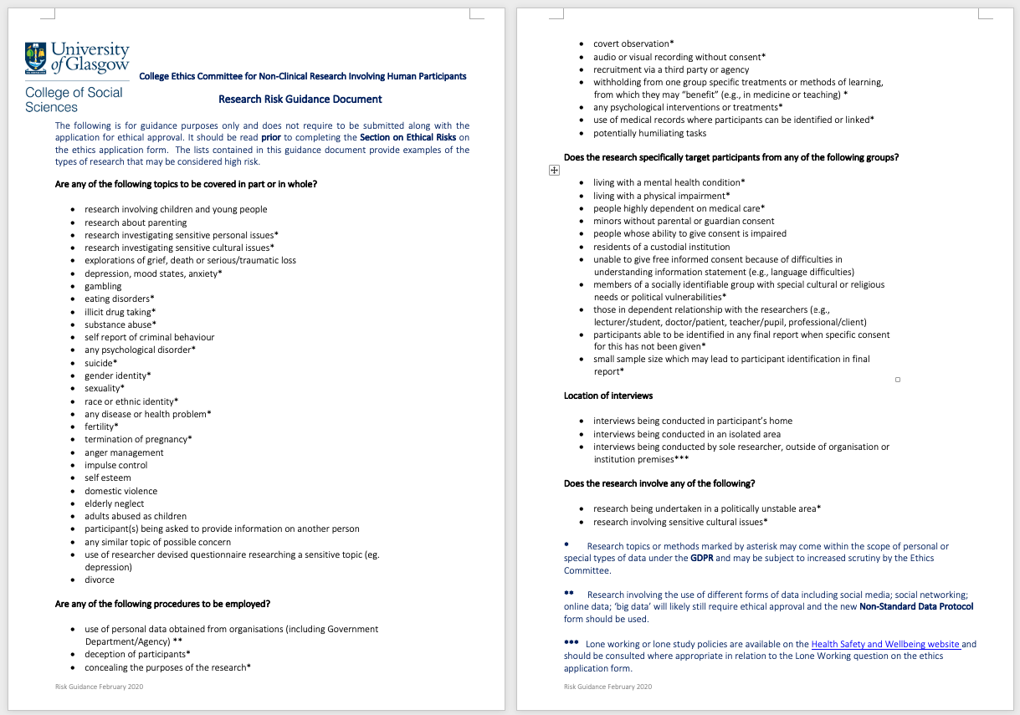
What counts as ‘high risk’ research?
Notes:
Generally speaking ‘high risk’ refers to any project that requires heightened ethical scrutiny because of the ethical issues raised, so for example my own research on victim/survivors of violence not only focuses on a sensitive topic but involves research with vulnerable participants.
Because it involves potentially vulnerable groups, there are concerns around gaining valid informed consent and ensuring that no harm is caused as a result of participating in the research. Given the focus on violence, there are important ethical issues around how to balance confidentiality and anonymity with the obligation to inform relevant services should a participant disclose information about abuse, or an intention to harm themselves or others. These concerns do not make the research inherently unethical, but rather they mean that we have develop more stringent measures to safeguard the safety of our participants – and also ourselves as researchers.
In other words, just because a project is flagged as ‘high risk’ doesn’t mean that it is any less likely to gain ethical approval, but rather that the review process needs to be more stringent – and in the case of the School Forum that involves two reviewers looking at your application rather than just one.
To guide their assessment of your project, Supervisors will need to consult the College Risk Guidance, which as you can hopefully see actually covers very broad range list of points. These need to be addressed by your supervisor in the ethical risks section – even if only to make the case that this feature does not qualify as high risk for whatever reason.

Slide 9
How Do I Apply?
Students seek ethics approval by completing an application form, which their Supervisor then submits to the School Ethics Forum (SEF) on their behalf:
Discuss research ethics issues with your supervisor.
Download and complete the appropriate Ethics Application Form from the College Research Ethics page and ensure that you have included the required supporting documentation (for example: Plain Language Statement, Consent Form, Privacy Statement, Interview schedule etc.)
Send the form to your supervisor and ask for the comments. Remember that your supervisor MUST complete the ‘Ethical Risks’ section.
Your supervisor must submit the application by email for you:
Undergraduate: socpol-ug-ethics@glasgow.ac.uk
Postgraduate: socpol-pgt-ethics@glasgow.ac.uk
Notes:
Ok, so returning to the practicalities of how to apply for ethical approval, you need discuss ethics issues with your supervisor and then complete an ethics application form and accompanying documentation.
Your supervisor then checks everything over for you, completes their section of the form, and submits it to the appropriate ethics administrator.

Slide 10
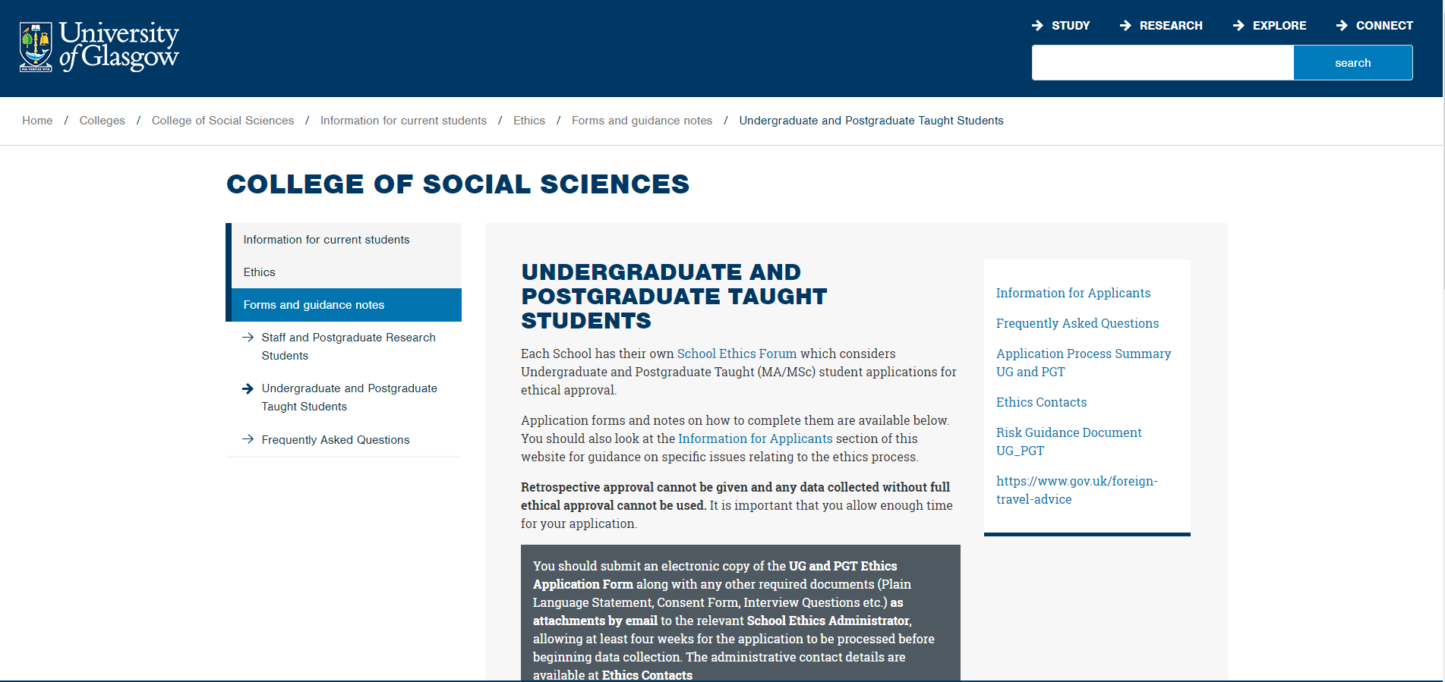
Visit the College Research Ethics page for detailed guidance and advice, including templates for the plain language statement, consent form and privacy statement:
https://www.gla.ac.uk/colleges/socialsciences/students/ethics/forms/undergraduateandpostgraduatetaughtstudents/#ethicsformsandguidancenotes:ugandpgt
Notes:
All the application forms and templates you need to help you with preparing your application are available on the College Research Ethics page. But be warned, the sheer amount of information contained here can be a little overwhelming, so remember you don’t need to read everything – and if you get lost then ask your supervisor for help.

Slide 11
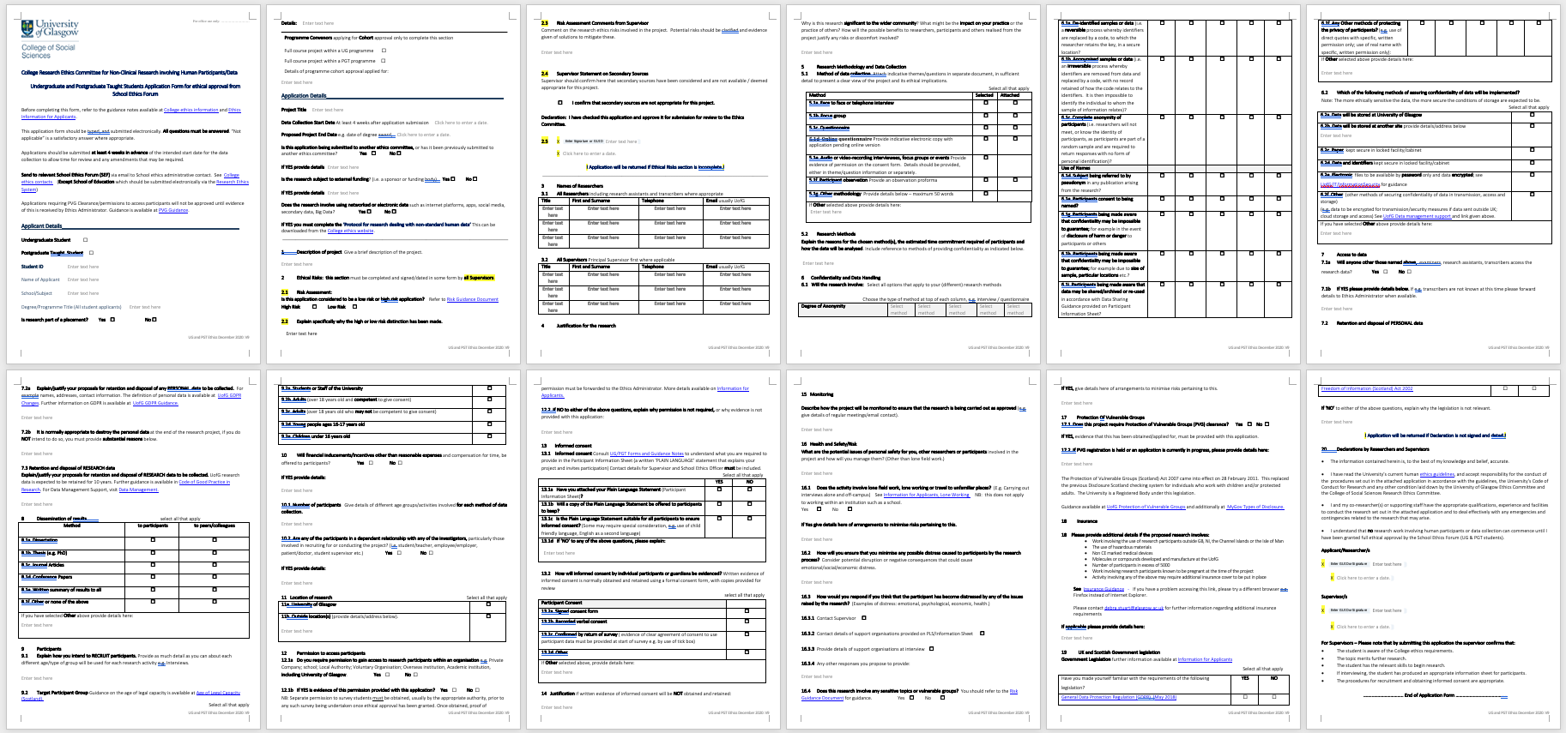
The Standard Application Form
Notes:
Here is the standard ethics application form.
Now I know you can’t see the details in this image, but I included it in this format as a means to forewarn you about the length of the document – which again can be quite overwhelming. This is another reason why you should approach the application as a collaborative exercise with your supervisor, who should be able to guide you through all the various information requested.
This includes: (5) details of research methodology and data collection methods, (6) confidentiality and data handling, (7) storage of and access to data, (9) details of participants, (11) the location of research, (12) access and permissions, (13) informed consent procedures, and (16) health and safety. As a student, when you first draft this form there will be some sections that you will be unable to fill in yourself – and this is where you should expect supervisor support to be forthcoming, approaching the process as a learning opportunity and not just an administrative chore. (Although it is, inevitably, a bit of a chore!)
Its worth noting that we also have shorter ‘Non-standard data’ application form that is used if you are only doing secondary analysis or social media analysis etc. But I’ll return to that in a moment.

Slide 12
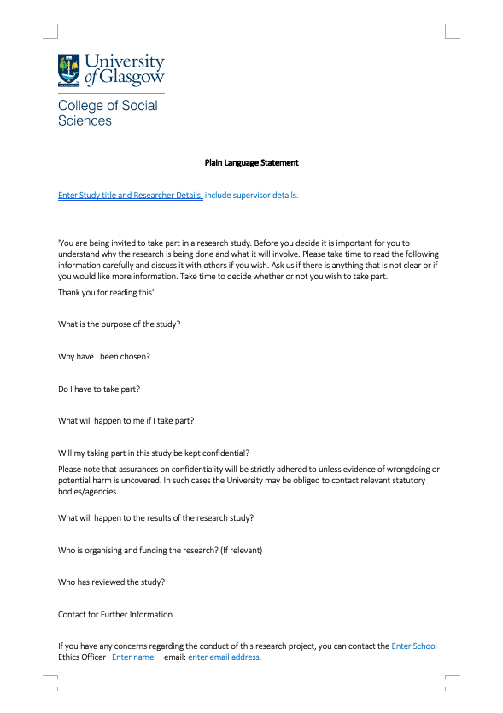
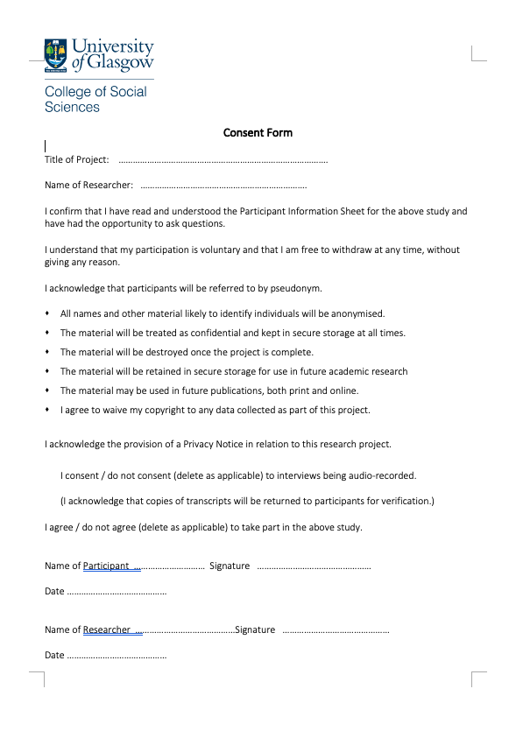
ACCOMPANYING DOCUMENTATION
Notes:
If you complete the standard ethics application form, you will probably also require an information sheet (or plain language statement) for participants, alongside a consent form and a privacy notice. Templates for all of these are provided on the College website, alongside notes for their completion.

Slide 13
Do I need to apply for ethical approval?
Many students do desk-based dissertations that do not need to go through the approval process (e.g. literature review, content analysis etc).
If you will be creating new data with humans (e.g. interviews, observations, questionnaires) you need to go through the ethical approval process, using the Standard Application Form.
Unless it is open access, research involving social media data (e.g. Facebook, Twitter, blog posts etc.) and secondary data analysis needs to go through the ethics review process but utilises a different, shorter form – the ‘Non-Standard Data’ application form
Notes:
Pause. Ok, so after hearing all of that you may Be wondering whether you *have* to apply for ethical approval, especially if you are using desk-based methods or secondary data analysis.
As a general rule, if you are doing a desk-based analysis involving published sources then you probably don’t need to go through the ethics review process. However, data within the public domain does sometimes require ethical review because of concerns over privacy and anonymity. This relates specifically to social media data, as well as secondary data that is not already anonymised.
Research involving primary data collection will always raise issues of ethics that must be addressed.

Slide 14
Is Primary Data Collection Permitted, Under Current Covid19 restrictions? (last Updated 30/09/21)
Face-to-face data collection is now permitted for UG and PGT students, subject to risk assessment by the Supervisor. But please note:
- If you intend to conduct face-to-face research, you must comply with all relevant Scottish Government or relevant local government social distancing measures in place at the time of the proposed research.
- The SEF will expect to see evidence of relevant social distancing requirements and compliance measures before any research is approved.
- If lockdowns need to be introduced or re-instated at any point, face-to-face research may not be permitted and so you should develop a contingency plan for your research.
All research proposals involving human subjects must be approved by the SEF before data collection commences. This includes both standard first person data collection and nonstandard data collection using social media and other online fora. The benefits of the research must clearly outweigh the risks and burden of research participation for approval to be granted.
Notes:
Important Information in relation to Coronavirus and Research Ethics (Last updated 30 September 2021)
Face-to-face data collection is now permitted for UG and PGT students, subject to risk assessment by the Supervisor.
Please note:
If you intend to conduct face-to-face research, you must comply with all relevant Scottish Government or relevant local government social distancing measures in place at the time of the proposed research.
The SEF will expect to see evidence of relevant social distancing requirements and compliance measures before any research is approved.
If lockdowns need to be introduced or re-instated at any point, face-to-face research may not be permitted and so you should develop a contingency plan for your research.
Students should continue to audit secondary data sources as part of their dissertation planning part of their dissertation planning, as the benefits of primary research must clearly outweigh the risks and burden of research participation for ethical approval to be granted. In your ethics applications, you will be expected to: (i) consider the appropriateness of using primary methods in the context of the ongoing pandemic and (ii) address the specific ethical and data protection issues involved in remote methods

Slide 15
CONDUCTING FACE-TO-FACE RESEARCH
Establish the current level of risk of COVID-19 in the country and specific location where the research will take place and note any relevant travel restrictions and/or social distancing measures.
Identify the specific COVID-19 risks associated with the various aspects of your particular activity - and the measures you will take to mitigate these, e.g. minimising infection risk via use of screening questionnaire when scheduling research appointments, adhering to social distancing/hygiene measures, conducting fieldwork in places that are well-ventilated etc.
Consider how you will communicate these measures to potential participants and how you might accommodate participants who feel uncomfortable with face-to-face fieldwork.
Notes:
It is the responsibility of Supervisors to ensure that the risks associated with COVID-19 are considered and, where relevant, steps taken to mitigate these. The Undergraduate and Postgraduate Taught Students Application Form for ethical approval has been updated to reflect this.
Undergraduate and taught postgraduate students are not required to submit a Fieldwork/Project Risk Assessment Template to do face-to-face research, but Supervisors may find the form useful to plan, assess and record control measures that may be needed to mitigate risk during proposed fieldwork or project activities, including risks associated with COVID-19.
Any amendments to an already approved SEF project, e.g., moving from remote data collection to face-to-face data collection, must be approved via an Amendments Request Form before the change can be actioned. Evidence of compliance with social distancing measures will be required, alongside a Supervisor risk assessment statement.

Slide 16
Conducting Online interviews
Consider carefully if the topic is appropriate for an online interview, or if it poses potential risks. If the interview is on a sensitive, traumatic or intrusive topic, you will need to think about the implications this may have for well-being of the participant during and after the interview.
How will you ensure (and evidence) informed consent? In most cases, the participant should receive the PIS in advance of the interview, complete an electronic consent form, and email it to the researcher.
Consider carefully the setting of the interview so that both interviewer and interviewee have privacy on their devices.
Consider carefully how the interview will be recorded, where the recording will be stored, and whether any specific settings will be applied to ensure meetings’ security.
Notes:
‘Online’ interviews (including focus groups) can be conducted on a wide range of different platforms, and can be a very useful tool for interviewing when face-to-face interviews are not possible, but it is important to consider carefully if the topic you wish to explore is appropriate for an online interview, or if it poses potential risks. For example, if the interview is on a sensitive, traumatic or intrusive topic, then you need to consider the implications this may have for well-being of the participant during and after the interview.
Issues relating to accessibility, informed consent and confidentiality would also need to be addressed in your application, alongside data protection issues and management. For example:
How will you ensure (and evidence) informed consent?
How will ensure that both interviewer and interviewee have privacy on their devices?
Where will interview recordings be stored?

Slide 17
video conferencing TOOLS
Make sure the tool you use is compliant with GDPR requirements.
Do not record confidential data to a cloud server if it is outside the European Union or adequate safeguarding is not in place.
If you use the University of Glasgow’s Zoom service make sure you enable local recording and that you continue to follow the University’s guidance on handling confidential data.
Zoom is not recommended for highly confidential or sensitive data; you should use UofG Microsoft Teams instead.
Notes:
University guidance on the use of video conferencing software is currently as follows:
Make sure the tool you use is compliant with GDPR requirements.
Do not record confidential data to a cloud server if it is outside the European Union or adequate safeguarding is not in place.
If you use the University of Glasgow’s Zoom service make sure you enable local recording and that you continue to follow the University’s guidance on handling confidential data.
Zoom is not recommended for highly confidential or sensitive data; you should use UofG Microsoft Teams instead.

Slide 18
ONLINE SURVEY TOOLS
SurveyMonkey, Google Surveys and other commercial survey tools are not supported for University work.
If you wish to use an electronic survey tool to conduct your research, the University of Glasgow has an institutional licence for the Online Surveys tool that may be used by PGT (but not UG) students. Please see the University Research Strategy and Policies page on Use of Online Survey Tools for Research for guidance on how to apply to use this. Access is free but by application only. Ethical approval for your research project is required before this access will be granted.
The School of Social and Political Sciences also has an institutional licence for Qualtrics, which has advanced functionality (e.g. randomised treatments), which is available to all UG and PGT students in the School with ethical approval for their project. Requests for access should be sent to the SPS Qualtrics Administrator, Christopher Claassen.
Microsoft Forms is another supported service that can be used to create simple browser-based surveys, provided under the University's Office365 contract.

Slide 19
Use of data in the public domain
Published biographies, newspaper accounts of an individual’s activities, and published minutes of a meeting would not be considered ‘personal data’ or sensitive personal data requiring ethics review, nor would interviews broadcast on radio, television, or online and diaries or letters in the public domain.
Information provided in forums or spaces on the Internet that are intentionally public may be valid to consider ‘in the public domain’, but usually needs to go through formal ethical review to ensure that the relevant ethical issues have been considered and addressed.
Ethics review may also be required for analysis of secondary datasets, unless they are open access and do not contain any identifying or sensitive personal data.
Whilst material in public archives can be considered to be in the public domain, there may be issues about ownership, publication and confidentiality that require ethical review.
If in doubt, approval should be sought using ‘Non-standard data’ protocol.
Notes:
As previously discussed, the use of data already in the public domain does not normally need to go through ethical approval.
And ethics review is not required for anonymised data sets that exist in the public domain. This includes, for example, datasets available through the UK Data Service where appropriate permissions have already been obtained and where it is not possible to identify individuals from the information provided.
However you may have to seek approval for certain forms of social media analysis and other secondary datasets where anonymity and ethical approval are not established.

Slide 20
Social media research
One of the main ethical issues involved in social media research relates to whether consent of participants is required. The answer is often (but not always) no, and depends upon extent to which data should be considered within the public or private domain.
A distinction is usually made between users that have posted information on freely accessible asynchronous forums versus those engaging in synchronous forms of communication and/or using online platforms that accessed through a password or other safeguard.
When there is any ambiguity, researchers should consider the extent to which disclosure may have potentially damaging effects for participants, before making a decision about whether or not consent is necessary.
As a general rule, the privacy of participants should be respected by removing any potential identifiers and paraphrasing, although an exception is sometimes made in relation to public figures/those posting in an official capacity.
If in doubt, approval should be sought using ‘Non-standard data’ protocol.
Notes:
In relation to social media research, one of the main issues relates to consent – and whether participants can reasonably expect their data to be used for research purposes. So, for example, a distinction is usually made between users that have posted information on freely accessible asynchronous forums versus those engaging in synchronous forms of communication and/or using online platforms that accessed through a password or other safeguard.
Where there is any ambiguity, then you need to consider the extent to which disclosure may be potentially damaging to participants – and respond proportionately. Options include: testing the traceability of a tweet, using quote but not user name, paraphrasing instead of verbatim quotes, seeking informed consent to use verbatim quotes, images or video.
As a general rule, the public nature of any communication or information on the Internet should always be critically examined and the identity of individuals protected unless it is critical to the research - such as in statements by public officials.

Slide 21
Key points to take away
Ethics review is about heightening risk awareness – not preventing ‘high risk’ research;
Ethical review is about encouraging researchers to think through potential ethical challenges;
Each research project is considered on a case by case basis but there are key principles;
An ethically robust research project may still encounter unexpected ethical challenges;
Conducting research involving participants is not an exact science - nor is the ethics review process
If you are in doubt, please ask!
Notes:
Summing up, then, the key point that I would like you to take away from this presentation are that that the review process should be approached as a collaborative and supportive process, intended to encourage you to think through the potential issues arising in your research – as well as ways that you can address these to safeguard the interests of your participants. It is not intended to prevent ‘high risk’ research.
That said, even the most ethically robust project may still encounter challenges along the way – and one of the limitations of institutional review processes are that they tend to frontload ethical considerations and support. It is perhaps important to finish then by saying that the School Ethics Forum is also here to support during the process of doing your research – and so if you have any queries or concerns, please just ask!
Thanks for your attention today, everyone. And best of luck with your research!

Slide 22
Further Information and Guidance
School ethics pages
www.gla.ac.uk/schools/socialpolitical/students/studentinfo/researchethics/
College ethics pages
www.gla.ac.uk/colleges/socialsciences/students/ethics/
UG/PGT Ethics Officer:
Susan Batchelor – Susan.Batchelor@glasgow.ac.uk
UG Ethics Administrator:
Lesley Scott – socpol-ug-ethics@glasgow.ac.uk
PGT Ethics Administrator:
Mhairi Cargill – socpol-pgt-ethics@glasgow.ac.uk

