Slide 1
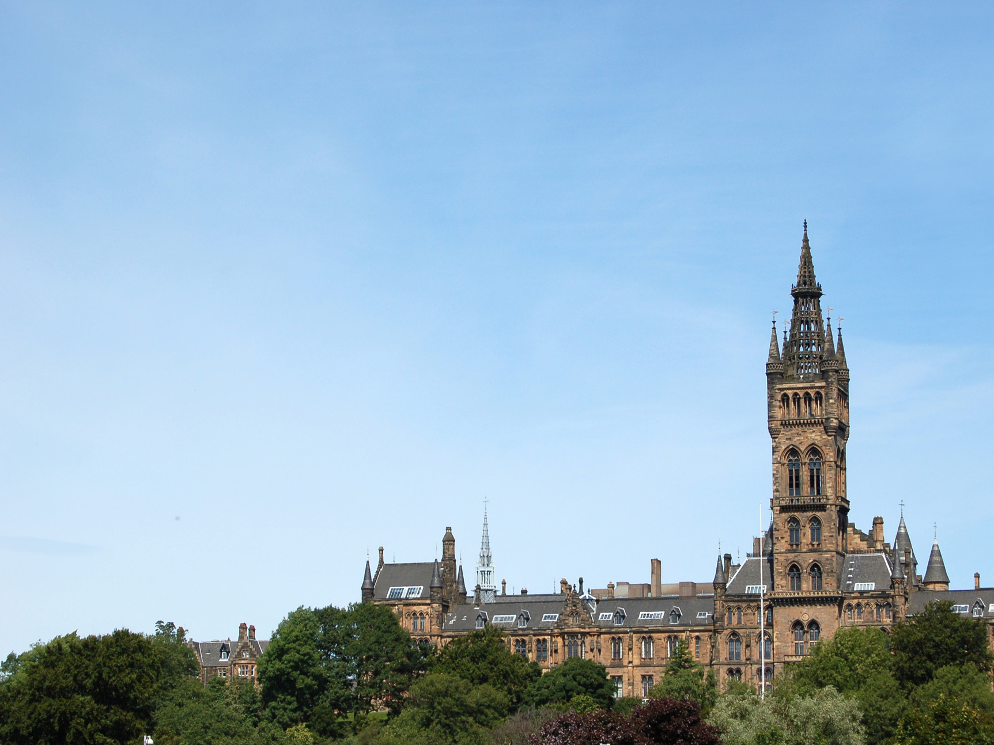
Exploring Data
Dr Lito Tsitsou
Glasgow Politics Summer School, 1 July 2019

Slide 2
Introduction
What is Q-Step?

Slide 3
Introduction
Why Quantitative Methods (QM) Programme at Glasgow?
Focus on answering social science questions with data
Hands-on data analysis approach; limited maths
Skills learned mirror social science PhD training
Small class sizes
Paid research internships
Access to additional QM training opportunities
Increased employability/grad school competitiveness

Slide 4
Introduction
Why Quantitative Methods (QM) Programme at Glasgow?
First group just graduated (~10):
Adam Smith Prize Winner (2018)
MSc/PhD placements:
Glasgow
Exeter
Stirling
Sheffield

Slide 5
Introduction
Quantitative Methods (QM) Programme at Glasgow:
A ‘With Quantitative Methods’ degree for 5 Honours programmes:
Politics with QM
Sociology with QM
Social & Public Policy with QM
Economic & Social History with QM
Central & Eastern European Studies with QM

Slide 6
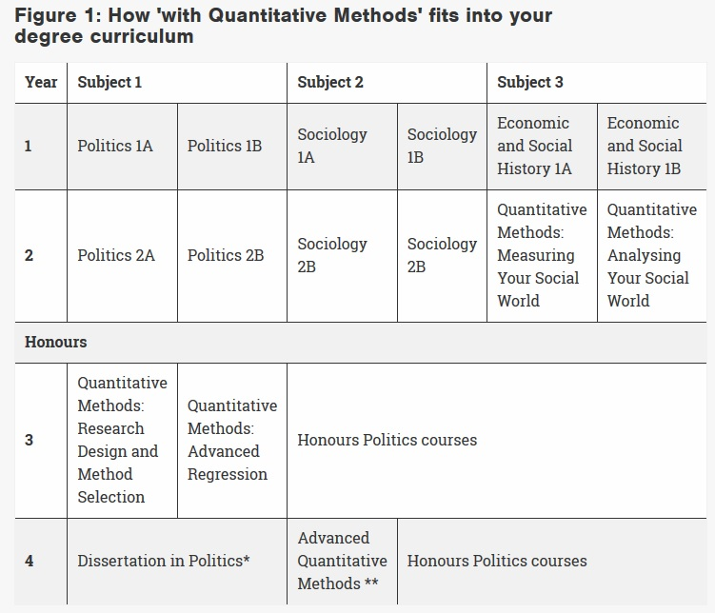
Introduction

Slide 7
2014 SCOTTISH INDEPENDENCE VOTE
What was it?
What made the vote special for “young people”?
What was the outcome?
Let’s explore some data visualisations

Slide 8
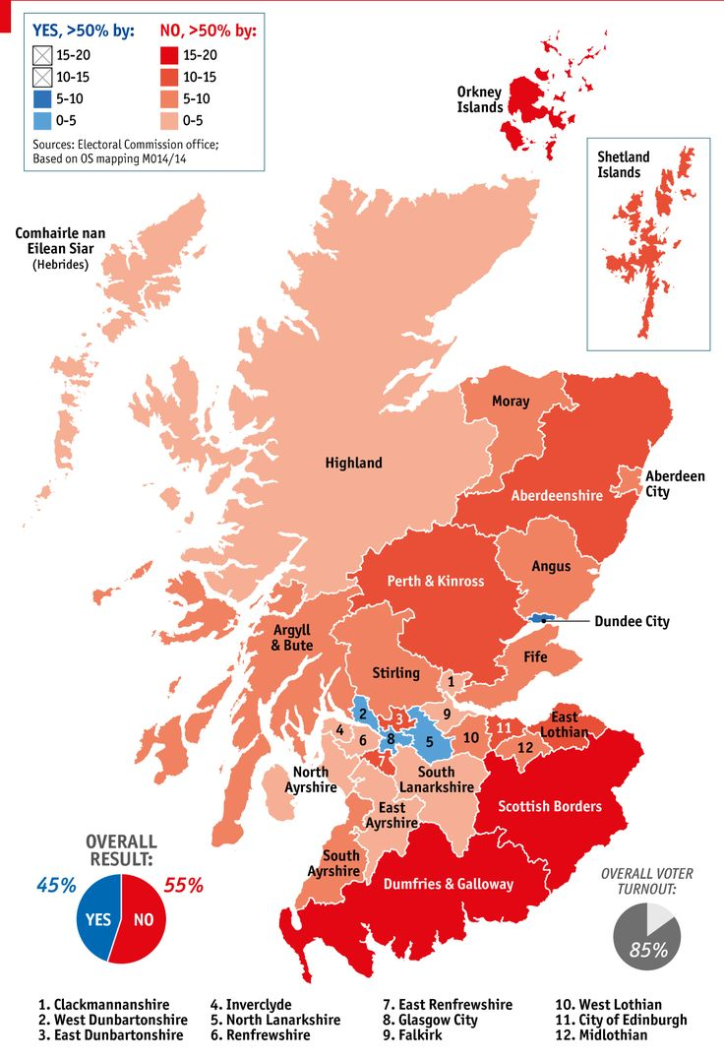

Slide 9
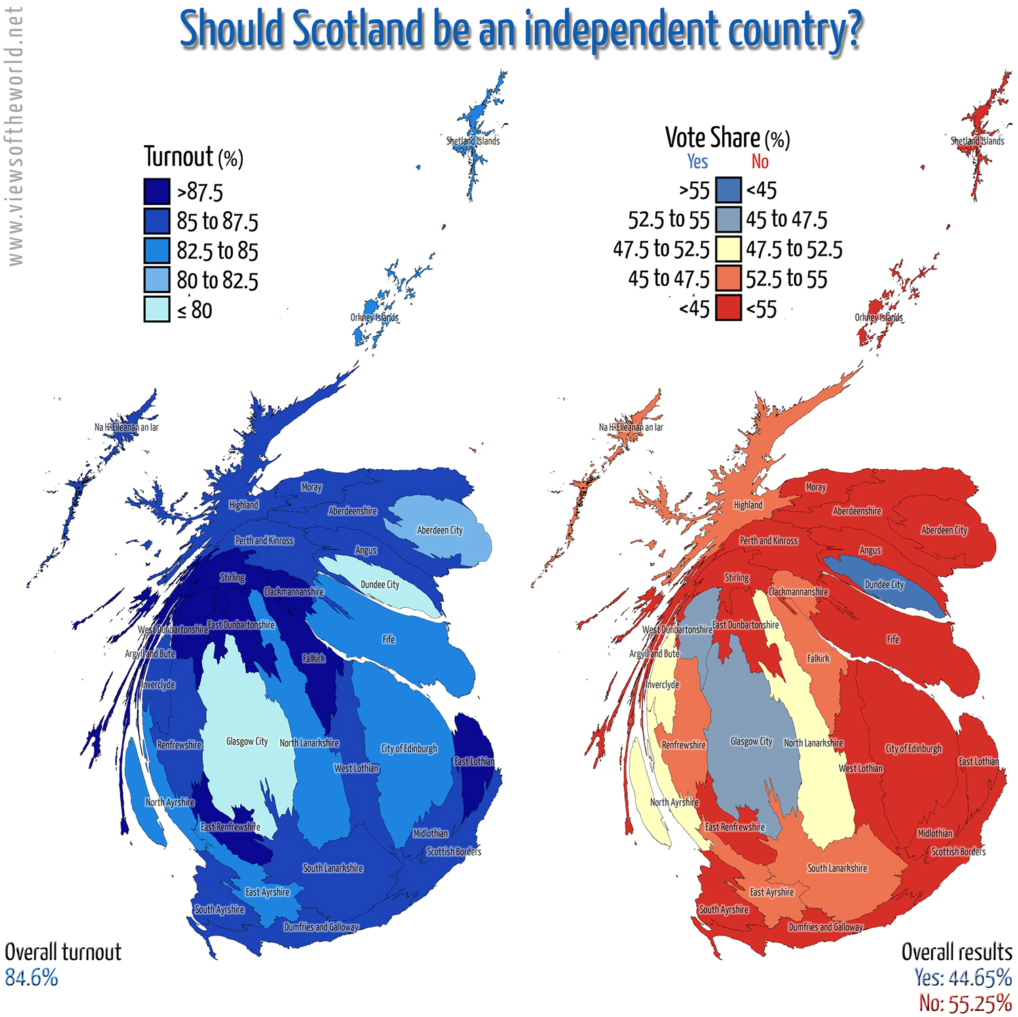

Slide 10
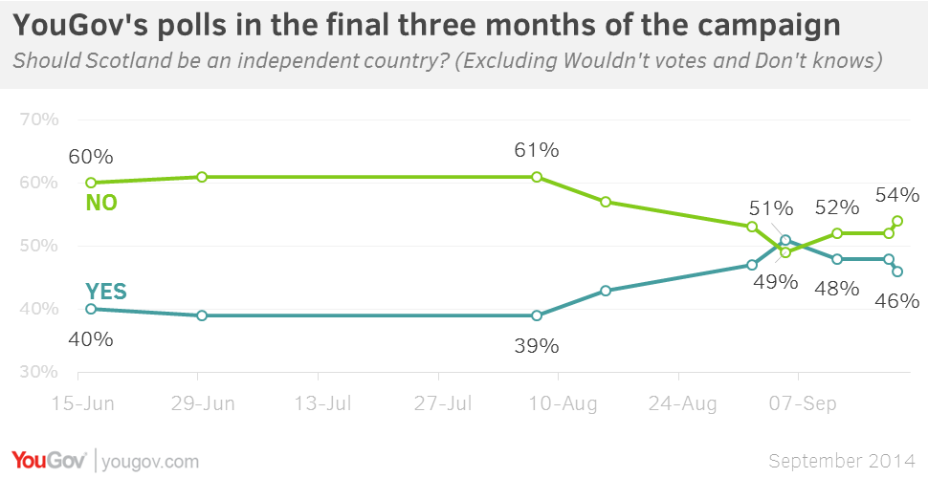

Slide 11
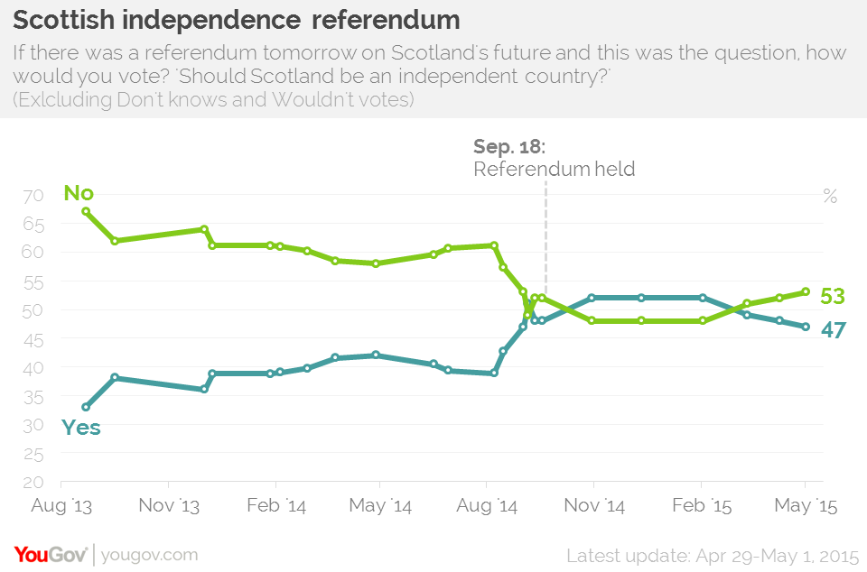

Slide 12
UNDERSTANDING THE VOTE
Want to understand why people voted the way they did
What matters & what doesn’t matter?
First, briefly, variables

Slide 13
VARIABLES
Numeric data
Assigns numeric values to each case/observation
Person
City
Country

Slide 14
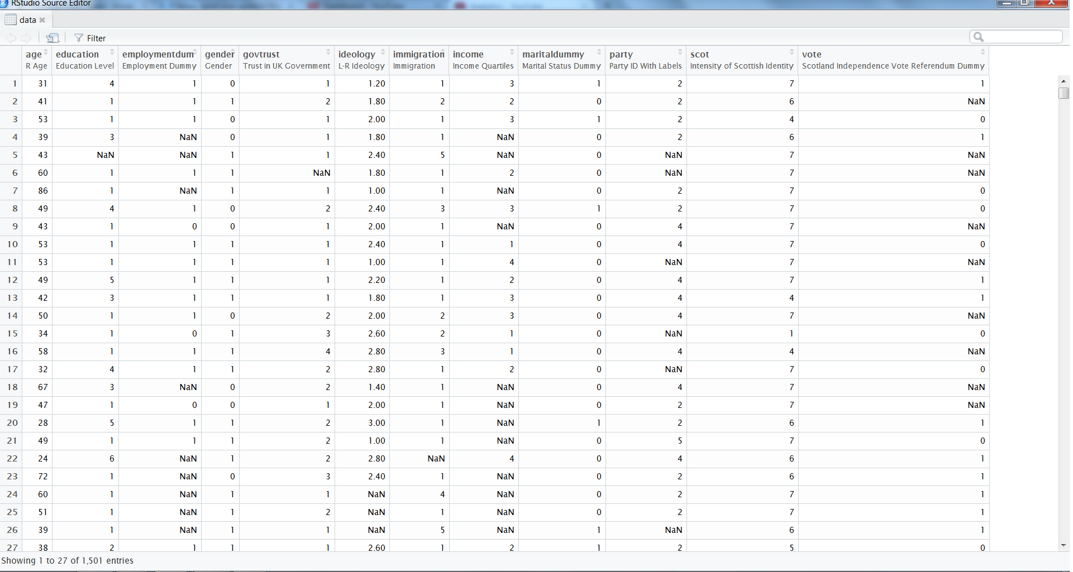

Slide 15
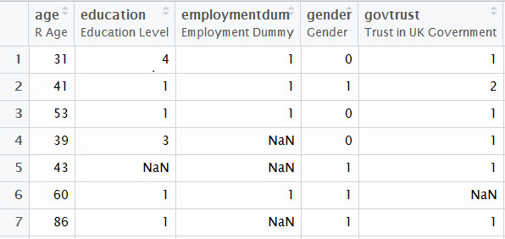
VARIABLES
RESPONDENTS

Slide 16
VARIABLES
Dependent Variables:
Variables we are interested in explaining
Independent Variables:
Variables we use to explain dependent variables

Slide 17
2014 SCOTTISH SOCIAL ATTITUDES SURVEY – REFERENDUM EDITION
Dependent variable:
Vote – plan to vote “yes” or “no” for independence
Independent variables:
Age – 18-92
Education – 7 values; no quals to post-grad
Employment – employed or not
Gender
Trust Gov’t – 4 values; “never trust” to “always trust”

Slide 18
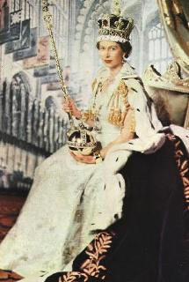
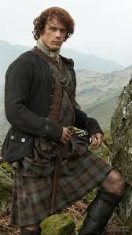
2014 SCOTTISH SOCIAL ATTITUDES SURVEY – REFERENDUM EDITION
Independent variables continued:
Political Ideology – 1 to 5; 1=very liberal, 5=very conservative
Immigration – 5 values; ‘reduce a lot’ to ‘increase a lot’
Income – increasing quartiles
Married – yes or no
Strength of Scottish Identity – 7 values

Slide 19
2014 SCOTTISH SOCIAL ATTITUDES SURVEY – REFERENDUM EDITION
Now, WORKSHEET & SMALL GROUPS

Slide 20
2014 SCOTTISH SOCIAL ATTITUDES SURVEY – REFERENDUM EDITION
LET’S EXPLORE THE DATA:
https://shiny.maths-stats.gla.ac.uk/nd29c/BESapp/

Slide 21
SCOTTISH INDEPENDENCE VOTE
What about more recently?
Do people want another independence referendum?
Do people think Scotland should be an independent country?
Let’s look at some visualisations

Slide 22
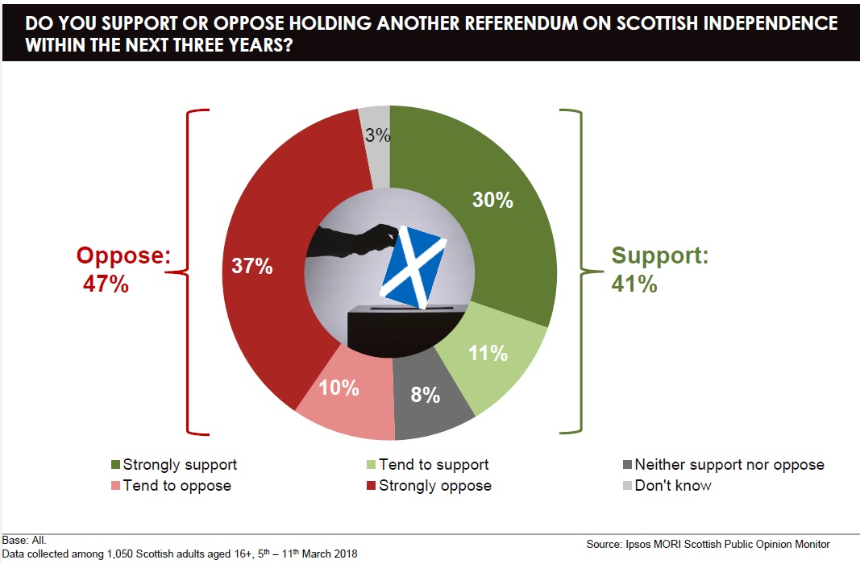

Slide 23
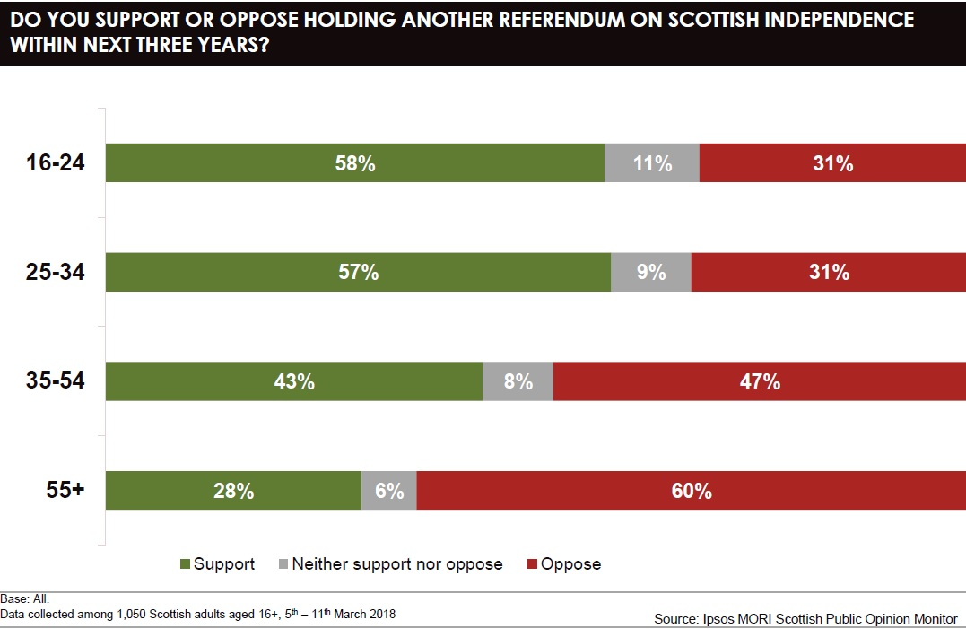

Slide 24
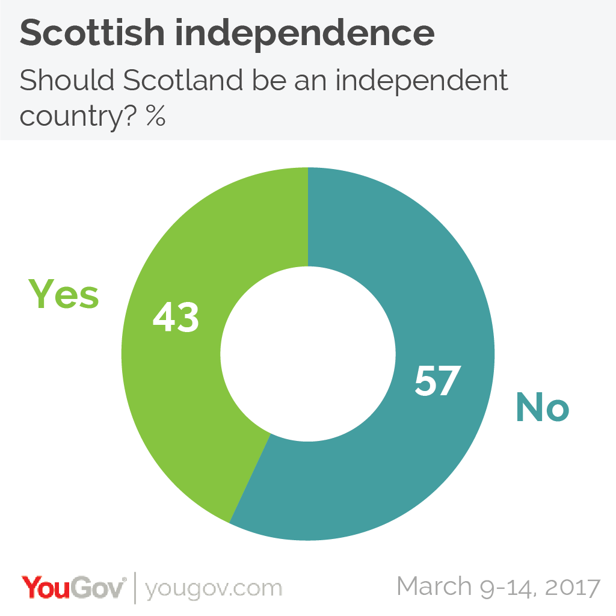

Slide 25
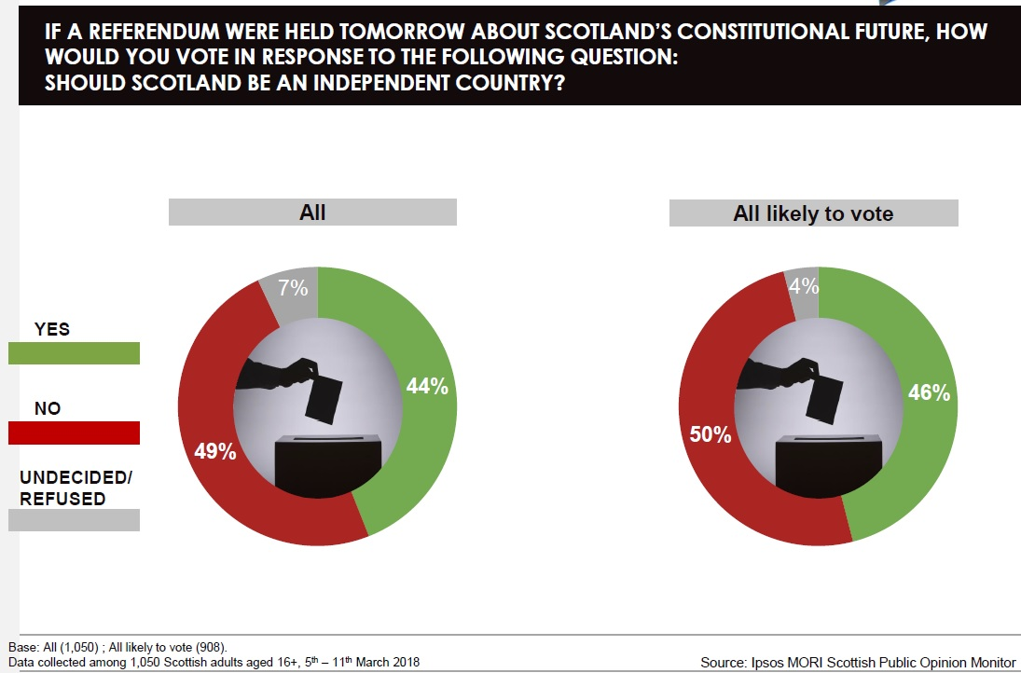

Slide 26
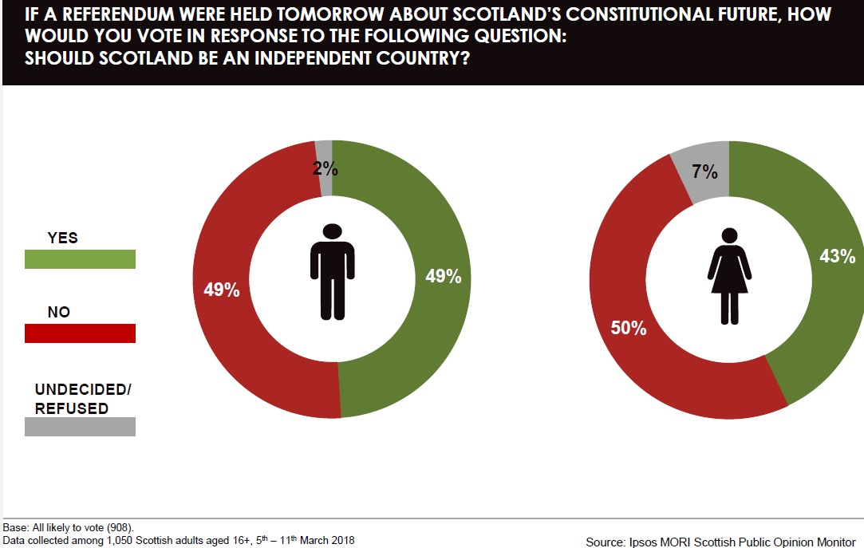

Slide 27
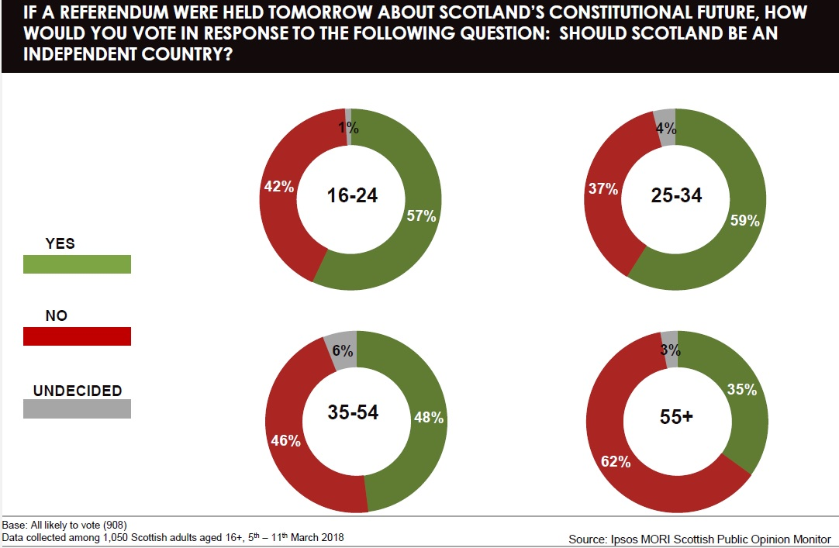

Slide 28
BREXIT & SCOTTISH INDEPENDENCE VOTE
How did Scotland vote in the EU Referendum?
Let’s look at some visualisations

Slide 29
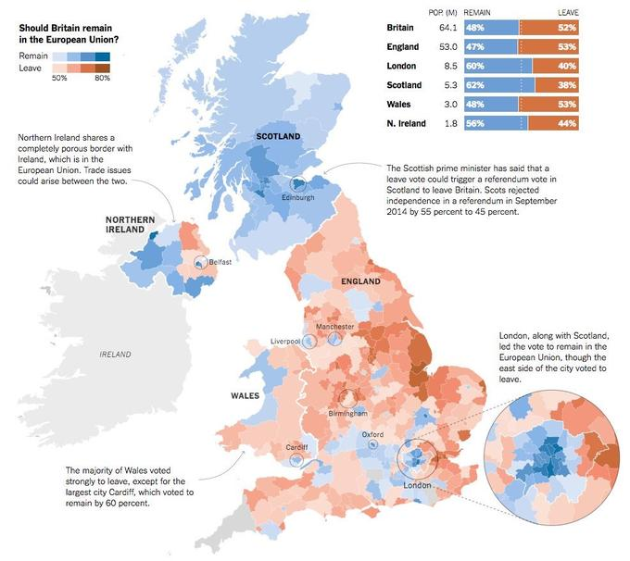

Slide 30
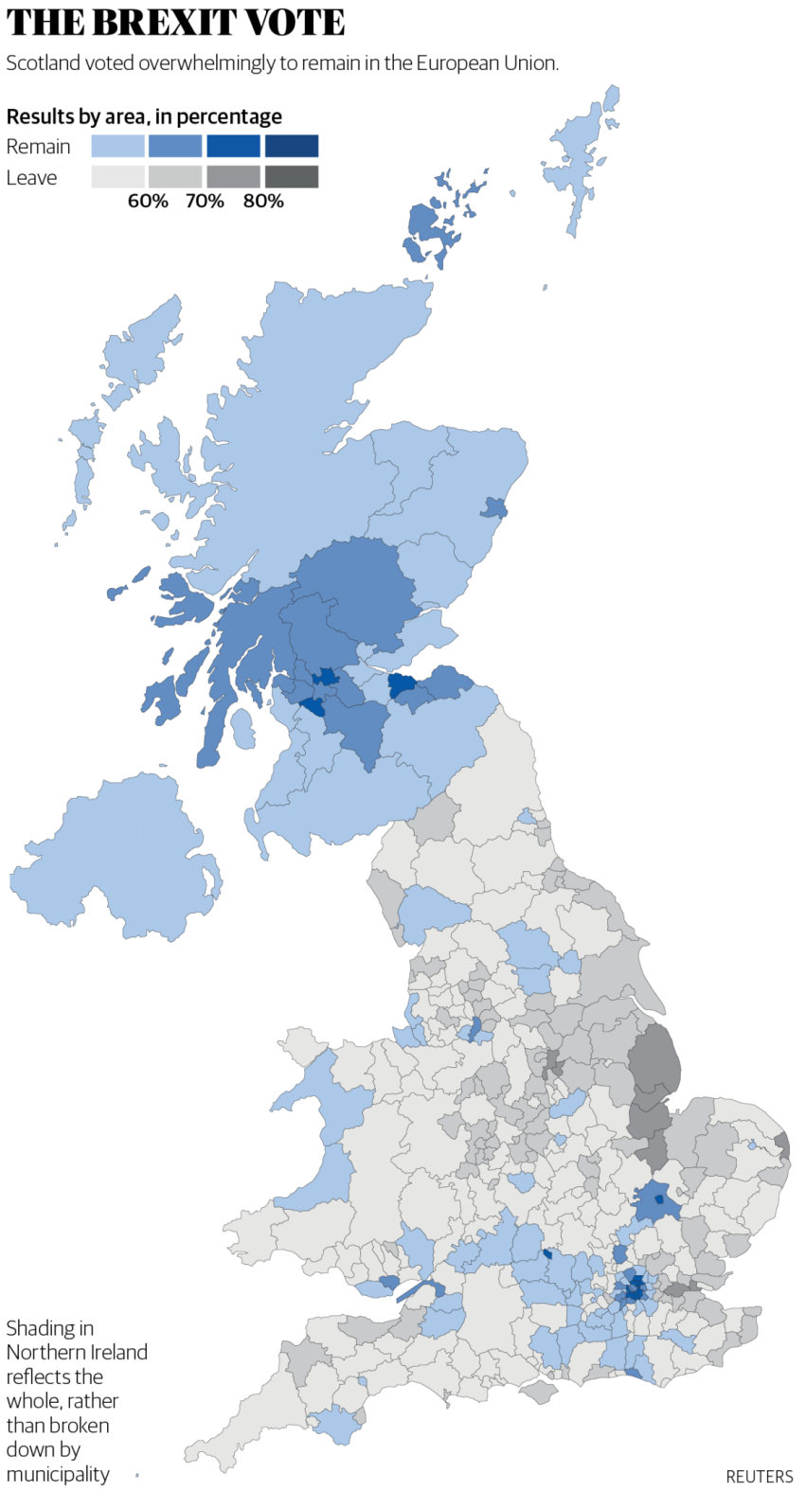
There’s the islands
But, horrible colour contrasts

Slide 31
BREXIT & SCOTTISH INDEPENDENCE VOTE
What role might BREXIT have on a second Scottish Independent vote?
Will Scottish voters how voted REMAIN be more in favour of INDEPENDENCE due to BREXIT?
WORKSHEET & SMALL GROUPS
Let’s look at some visualisations

Slide 32
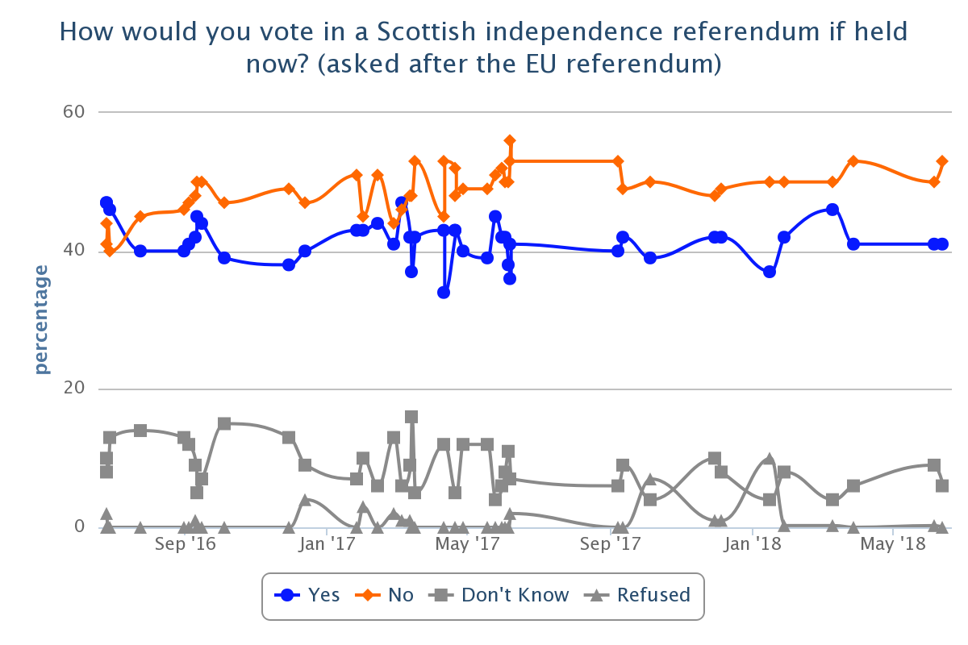

Slide 33
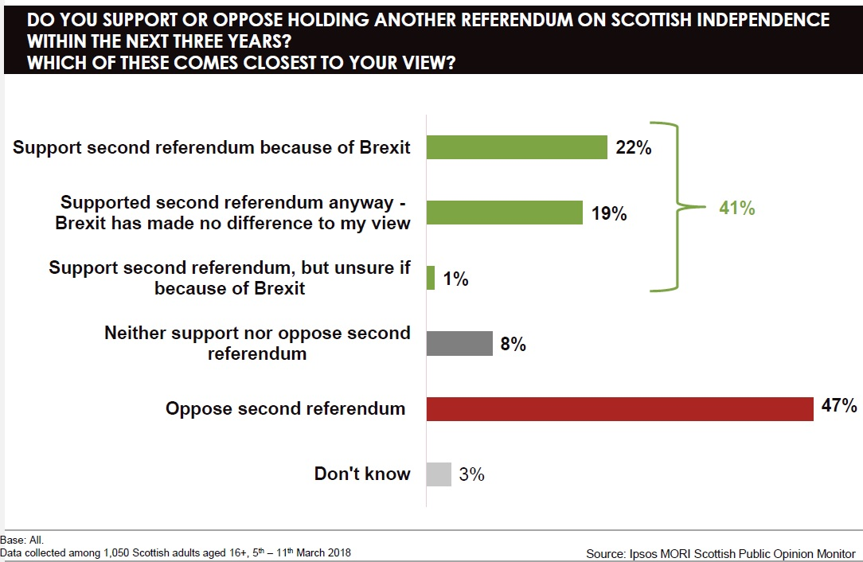

Slide 34
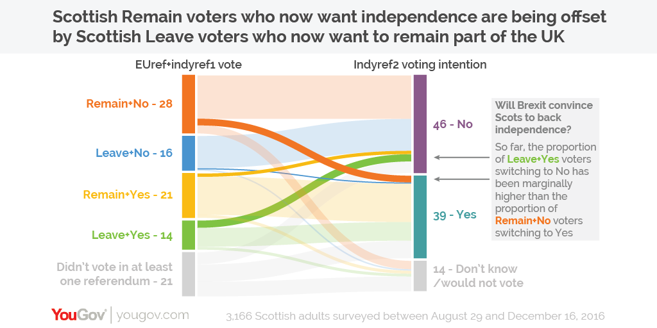

Slide 35
CONCLUSION
Answer social science questions with data
Opinions with data are better than opinions without data
Glasgow Q-Step (@GlasgowQStep)

