Slide 1
Examine and Predict Election Results under your own steam
Exploring Data: Social Characteristics and Voting Behaviour
University of Glasgow Q-Step Centre

Slide 2
Quantitative Data and the Social Sciences
What is a social scientist? What do social scientists do?
Part of our work is to collect information about the social world or otherwise known as data.
How do you understand the term data?
What types of data do social scientists work with?
Qualitative data: what is this?
Quantitative data: what is this?

Slide 3
Quantitative Data and the Social Sciences
Where does quantitative data come from?
Primary data : collecting sample data through surveying and questionnaires
Secondary data: data already collected- available publicly to be reused.
Data are organised in categories called variables

Slide 4
Quantitative Data and the Social Sciences
What do we do with that data?
Attempt to understand a social phenomenon
Why events happen
When events happen
What traits matter more/less

Slide 5
Today’s Data
British Elections Survey data using our online application to look at the voters’ characteristics and link these attributes to voting intention/behaviour using our online application: https://shiny.maths-stats.gla.ac.uk/nd29c/BESapp/
  Identifying key characteristics of voters
  Locating potential relationships between voter characteristics and voting intentions/behaviour
  Generating hypotheses about relationships between voter traits and voter preferences
variables/characteristics included: check your handout/ the app (3 mins)

Slide 6
Variables
Party Vote: Which Party you voted for
General party Vote: which party do you affiliate with politically
Brexit Vote: How did you vote in the EU Referendum
Second Brexit Vote: if there was a second referendum
Scottish Referendum: How did you vote?
EUview: Which of these comes closest to your own views on a scale from 1-10 Britain Should: 1= do all it can to fully unite with Eu 10 =do all it can to protect its independence.
Gender
Region
Political Ideology: on a scale from 1- 10 where 1 is left and 10 is right, where do you place yourself on the political spectrum.
Immigration & Economy: on a scale from 1-7 where 1 bad for the economy and 7 is good for the economy, what is your opinion on Immigration and Economy.
College Education: What Qualifications do you have
Average Income: What is your average income
Age: age bands

Slide 7
How do we use data
To talk about our sample ( what is a sample?):
What do we see happening based on the data we have access to:
Are there any relationships/connections/patterns?
What is the most likely outcome? Can we predict what happens?
What traits help us predict different outcomes
To talk about the population (all possible observations) :
Using probability, we can talk about how likely it is that different traits influence all our observations

Slide 8
Measures of Central Tendency
Mode, Median, Mean
Your best guess of what an observation will look like is the most commonly/frequently observed value: Mode
Why might we care?
(1 observation versus 20 versus +200)

Slide 9
Modal Value
Modal Value
How do you locate it?
Count the number of cases in each category See which category has the most values

Slide 10
Calculating the Mode
Respondent 1 Yes
2 Yes
3 No
4 No
5 Yes
6 No
7 Yes
8 No
9 Yes
10 No
11 Yes
12 Yes
13 No
14 Yes
15 Yes
16 Yes
17 Yes
18 Yes
19 No
20 No
21 No
22 No
23 Yes
24 No
25 No
What is the modal case?
Take 2 minutes to locate it in the following list: check your handout also

Slide 11
Yes:15, No:12

Slide 12
Mean Value
Average Value for a set of observations:
A common technique we use on a day-to-day basis Comparing prices; what is expensive what is cheap
Is a particular salary low or high
On average, what do you expect to see?
Examples: Life Expectancy
Unemployment Rate
Voter turnout
Government Spending
Seasonal or regional temperatures

Slide 13
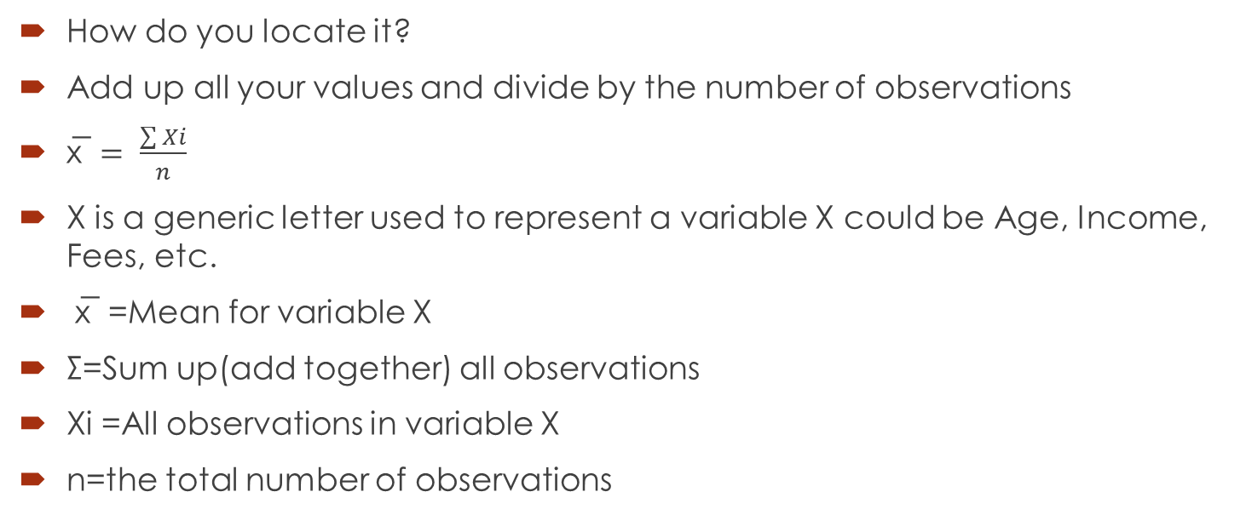
Calculating the Mean
How do you locate it?
Add up all your values and divide by the number of observations
$\text{x}\text{̅} = \frac{\sum{Xi}}{n}$
X is a generic letter used to represent a variable X could be Age, Income, Fees, etc.
x̅ =Mean for variable X
Σ=Sum up(add together) all observations
Xi =All observations in variable X
n=the total number of observations

Slide 14
Mean Value Calculation Example
Respondent Age
18
18
24
20
25
19
18
19
27
20
19
18
19
18
46
26
35
37
18
19
19
20
23
19
33
Example: Mean age of a class
What is the mean value?
Take two minutes to calculate
Check your handout

Slide 15

$\frac{577}{25}$=23.29
23.29

Slide 16
Mean Value Warning
Mean values can be biased
How? Mean values can be made larger or smaller based on a few atypical observations
Example- Annual Income

Slide 17
Example- Annual Income
Observation
1 20,000
2 25,000
3 18,000
4 30,000
5 28,000
6 500,000
What is the mean value? £103,500
Why is this misleading?

Slide 18
Median Value
Value that is in the middle
It is the value that cuts your observations into two halves, 50% of your observations will be above and below
It is not biased by extremely large or small values
How do you locate it?
Order cases from largest to smallest Find the value that is halfway

Slide 19
Calculating the Median Value
Example-Liberal Conservative Self-Placement Scale
Ranges from 1-7 (1 Very Liberal, 7 Very Conservative)
What is the median value?
4, 1, 3, 4, 5, 6, 3,
Arrange Values from smallest to largest 1, 3, 3, 4, 4, 5, 6
Locate the middle observation 1, 3, 3, 4, 4, 5, 6

Slide 20
1, 3, 3, 4, 4, 5, 6

Slide 21
Lets check at the app.
Find the median and mode of the variables age and education
Now look at the EU view? What is the median, and mean?
What do these numbers show?

Slide 22
Range
Example-UK Expenditures on Social Protection
Year Expenditure £
2000 144,540
2001 155,124
2002 164,924
2003 177,209
2004 188,248
2005 197,597
2006 203,847
2007 215,446
2008 229,984
2009 250,932
2010 262,563
Mean Value= $199,128.55
What is the range?
Differences between smallest and largest observation
Range = MaximumValue – MinimumValue
What is the range?
262,563-144,540=118,023
Why can it be useful?

Slide 23
Visual Guide to Looking at Data
You can examine your data numerically
Measures of Central Tendency
Or, you can examine your data visually
Bar Charts

Slide 24
Distribution of Data
Let’s take the example of Party Vote on our app;
Are observations clustered together?
Are observations spread out over the range of possible values?
Which values are observed the most?
In groups check the charts for variables income, Immigration and Economy and Political ideology, what can you see? Is visual representation useful? Why?

Slide 25
Hypotheses
Research usually is not just about individual variables, traits, or concepts
We are interested in how things interact with each other
Based on research, observation, and even intuition we develop ideas about how things work
These ideas are our hypotheses
Then using data we test, if these hypotheses hold up and how well an idea works

Slide 26
Hypotheses
Hypotheses come in a variety of forms
Equations, Words
Hypotheses can indicate different types of expectations:
Two things are related to one another
Two things are related in a positive-way
Two things are related in a negative way
Time spent studying and exam scores
Many other possible outcomes

Slide 27
Tasks
Looking at the set of variables in the app, think about which concepts/variables you think might be related to one another ?
Then decide if you have any reasonable expectation about how these concepts are related
Positive Relationship/ Negative Relationship
What types of relationships do you think might exist?

Slide 28
Tasks
Using the comparison tab examine the bar -charts for paired relationships you listed in the above question.
Does the pattern in the chart support the direction of the relationship you expected to see between the variables?
How strong is the relationship between the variables?
Overall, do you believe you found evidence to support your hypothesised relationships?

Slide 29
Extra Task
Click on the Brexit comparisons Tab
For the first set of comparison chose Brexit Vote and Gender
Add percentages
Explain what you see? Do you think there is significant difference between how me and women voted?
Second set of comparisons: Vote Pty and Vote EU
Any patterns there?

