Slide 1
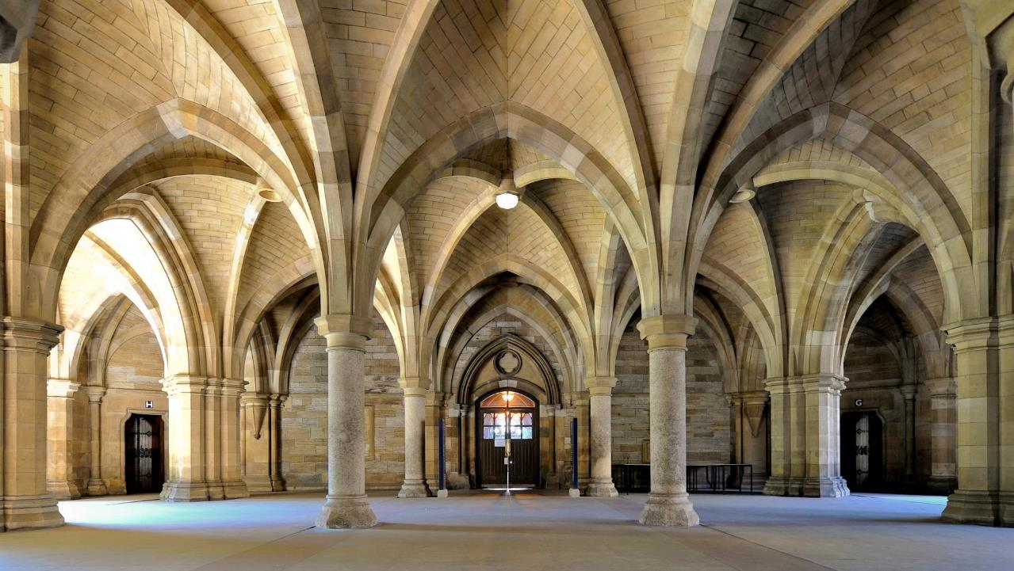
World-Changing Glasgow Transformation Programme Board Summary
Chris Green Chief Transformation Officer September 2019

Slide 2
Introduction A couple of things to ensure you get the most out of the information
Here is a summary of what our projects are setting out to achieve
The University uses a traffic light system to indicate how well each project is progressing against the plan:
Our primary objective is to improve the staff and student experience. We will do that by reducing unnecessary bureaucracy and improving the way our systems and processes work.
Creating a world-changing, connected and vibrant university campus, with social, technological and economic impact for the city of Glasgow.
Significant issues, immediate action needed
Smart Campus
This project was initiated in response to student and staff feedback, with the aim of improving the experience for all those involved in assessment and feedback work at the University
Assessment & Feedback
Some issues, being managed
Enhancing the Year 1 and beyond student enrolment experience and enable effective decision-making and course selection
Student Forecasting & Enrolment
On track
Improving the way we provide services to our students and staff. This includes the new UofG Helpdesk.
Student & Staff Service Delivery
Creating a simpler, more consistent approach to how we manage the end-to-end recruitment process
HR Recruitment Process
Designing services to meet staff and student needs while eliminating unnecessary bureaucracy
Professional Services

Slide 3
Overview of projects A quick and easy way to understand progress and any issues
Student & Staff Service Delivery
HR Recruitment Process
Assessment & Feedback
The Vision and Principles for the Assessment and Feedback Practice Model have been finalised.
We have completed an initial draft of the Academic and Operating Models detailing how the Vision and Principles drive practice, policy and process at UofG.
Reach Out successfully launched on 9th September. ESMS has had 34,979 service requests and incidents logged, 918 staff have been trained and 878 knowledge articles have been written. The project is on track to ‘complete’ by the end of September and the team is working to complete any remaining actions.
The final process and system design has been signed off at the Project Board. The engagement and training campaign launches in October. The go-live of the new process and updated system is on the 23rd December.
Student Forecasting & Enrolment
Smart Campus
Professional Services
The Initiation phase is now complete and all workstreams (Forecasting, Process, User Experience) have now had their individual kick-off meetings. We have some issues around capacity/capability constraints and the need to get an agreed plan and business case in place.
The initial work for this project is progressing well, and we are on track to deliver the findings of our initial investigation into options. The current focus is on developing a Digital Masterplan and preparation for a potential procurement phase.
We have drafted documents with proposals about what each project within professional services should look at and we have also held workshops with Estates. A survey was issued to staff and we have received over 700 responses. Our next action is to analyse this data and present this back to the Portfolio Board.

Slide 4
Overview of key indicators Understand how we are doing from a plan, resources and risks viewpoint
Plans | Resources | Risks | Overall Status
We are reporting Amber because several next stage plans are under construction or not agreed by the relevant Project Board.​
The core WCGT team currently has 22 roles made up of: 12 ‘permanent’ staff; 6 secondees; and 4 contractors. We have 1 offer pending and 4 vacancies we are recruiting.​
We have started to onboard the WCGT College Design Team to add capability and capacity to the team.​
Currently, we believe our risks are manageable and have been stable over the past few months with realistic mitigations in place.
The Amber rating reflects the degree of confidence we have in delivering all of the changes intended by the WCGT Programme. It takes into account progress against plans, the resources – people and money – needed and our risks. ​This rating reflects growing challenges around the current scale of activity as most projects move into design and the ability to plan for and resource the next stage. ​
We have actions in place to make sure the plans and resources align and are achievable and where relevant, the business cases are completed to inform key decisions.
Sarah Quinn, our Head of Portfolio Management Office (PMO) has joined the team and our focus is to complete all of the planning activity by the time of the next WCGT Board in October to identify where the real challenges lie in terms of outcomes, resources and impact.​
Next steps
As two of the six projects ‘complete’ and roll out new ways of supporting staff and students, our next big challenge is to make sure all of the design activity for the other four projects is planned out with the right mix of skills and experience to support the development of those designs. That includes supporting our colleagues in the WCGT College Design team who have made a great start.

