Slide 1

Teaching Excellence Initiative
Marking Rubrics
Sarah Honeychurch
Teaching Fellow
Adam Smith Business School
Sarah.Honeychurch@Glasgow.ac.uk

Slide 2
What is a rubric?
A rubric is an assessment tool that lists the criteria for a piece of work or what counts (for example, purpose, organization, details, voice, and mechanics often are what count in a written essay) and articulates gradations of quality for each criterion, from excellent to poor. (Andrade 2005)
Criteria
Definitions
Grading strategy
(Dawson 2017)

Slide 3
Teacher and learner motivations
Why are you using a rubric?
Teacher marking
Teacher feedback
“A good rubric allows me to provide individualized, constructive critique in a manageable time frame.” (Andrade 2005)
Understanding a task
Self assessment
Peer assessment
Using to teach

Slide 4
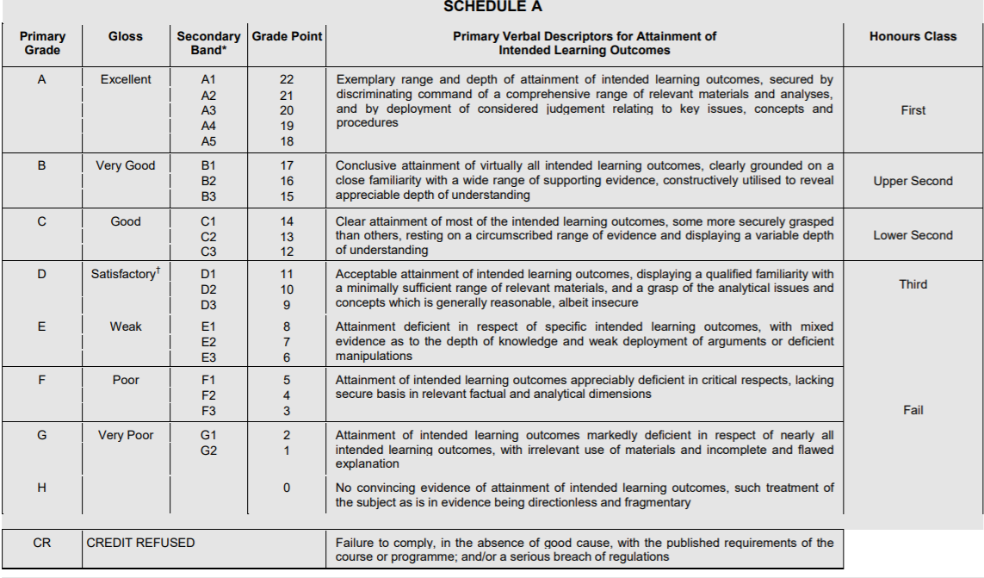
Writing rubrics

Slide 5
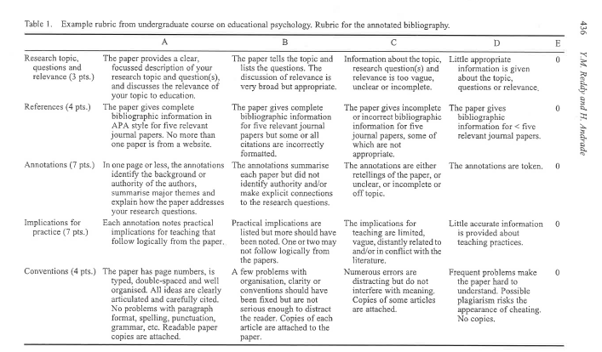
Writing rubrics: Reddy & Andrade

Slide 6
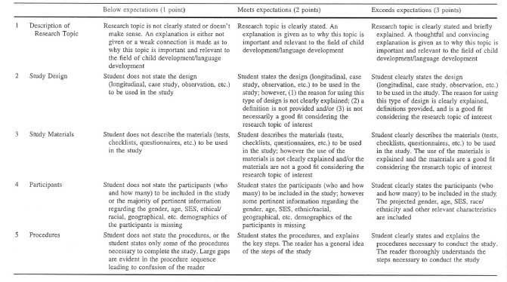
Writing rubrics: Lipnevich

Slide 7
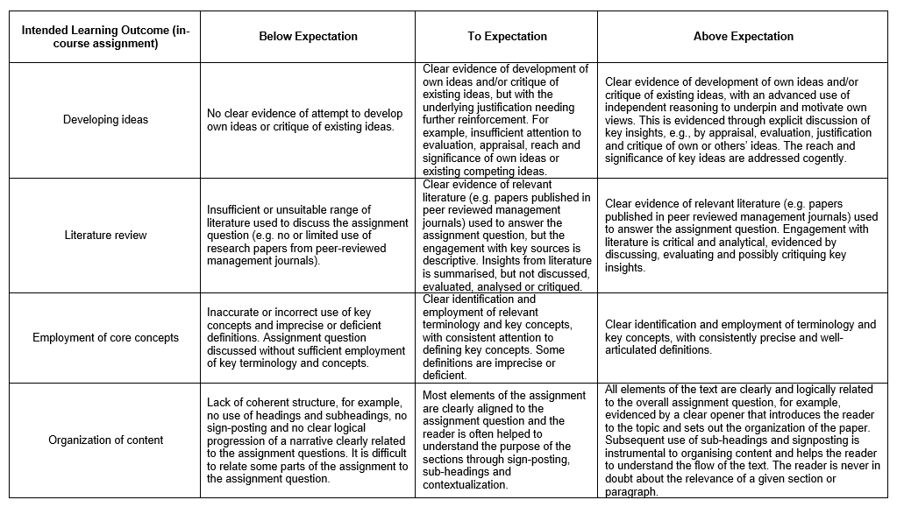
Writing rubrics: Anker

Slide 8
Writing rubrics: process
Look at models of previous student work
Look at course ILOs
List criteria
Pack and unpack criteria
Articulate levels of quality
Create a draft
Test the draft
Hand out the rubric with the assignment
Develop an exercise for students to co-create a rubric in class
Develop a peer review/self assessment exercise using a rubric

Slide 9
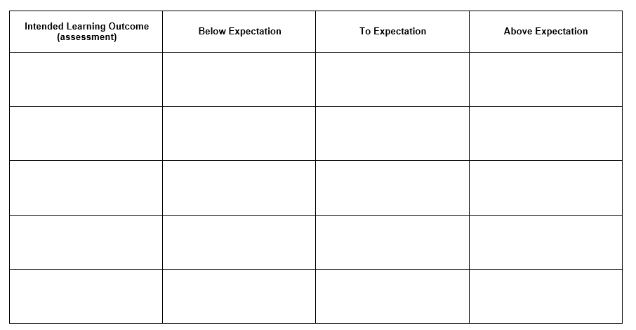
Writing rubrics: Proforma

Slide 10
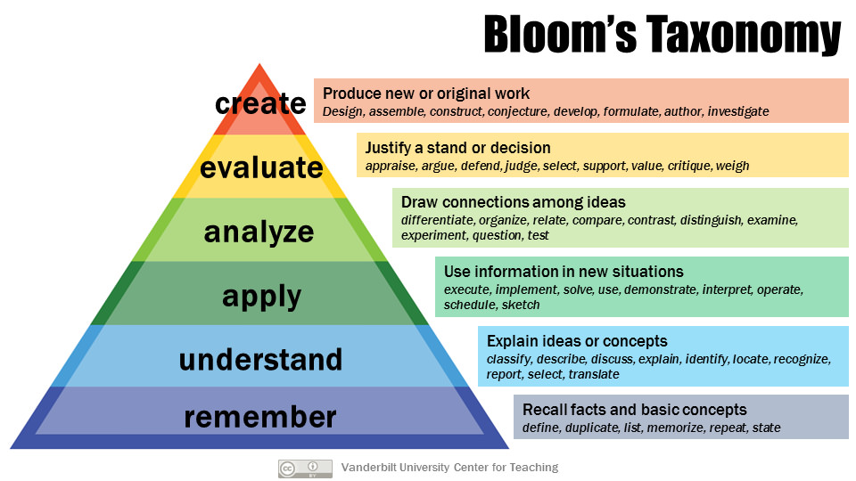
Blooms Taxonomy

Slide 11
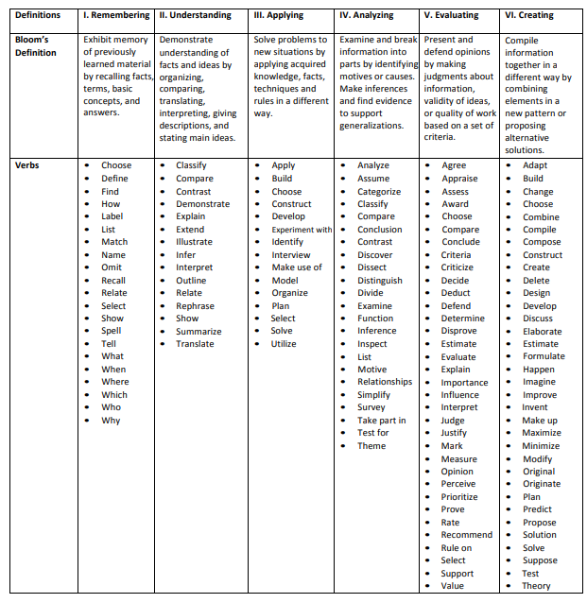
Blooms Taxonomy

Slide 12
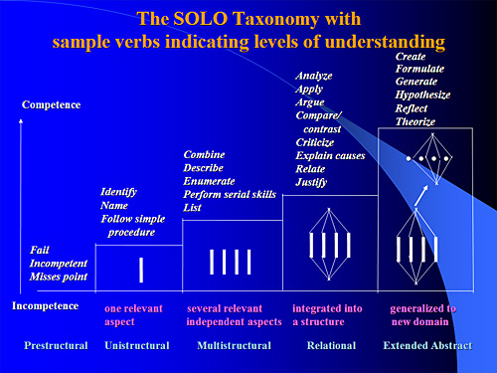
Biggs: SOLO

Slide 13
Biggs: SOLO
The SOLO taxonomy classifies understanding into five levels:
Prestructural: at this level the learner is missing the point
Unistructural: a response based on a single point.
Multistructural: a response with multiple unrelated points.
Relational: points presented in a logically related answer.
Extended abstract: demonstrating an abstract and deep understanding through unexpected extension.

Slide 14
References
Heidi Goodrich Andrade (2000) Using Rubrics to Promote Thinking and Learning Educational Readership 57:5 13-18
Heidi Goodrich Andrade (2005) Teaching With Rubrics: The Good, the Bad, and the Ugly, College Teaching, 53:1, 27-31, DOI: 10.3200/CTCH.53.1.27-31
Phillip Dawson (2017) Assessment rubrics: towards clearer and more replicable design, research and practice, Assessment & Evaluation in Higher Education, 4
2:3, 347-360, DOI: 10.1080/02602938.2015.1111294
Anastasiya A. Lipnevich, Leigh N. McCallen, Katharine Pace Miles and Jeffrey K. Smith (2014) Mind the gap! Students' use of exemplars and detailed rubrics as formative assessment. Instructional Science 42:4 539-559 https://www.jstor.org/stable/43575435
Y. Malini Reddy & Heidi Andrade (2010) A review of rubric use in higher education, Assessment & Evaluation in Higher Education, 35:4, 435-448, DOI: 10.1080/02602930902862859

Slide 15
Teaching Excellence Initiative
Marking Rubrics
Sarah Honeychurch
Teaching Fellow
Adam Smith Business School
Sarah.Honeychurch@Glasgow.ac.uk

Slide 16
Principles of Assessment and Feedback
Good assessment and feedback practice that promotes self-regulation requires that students gain practice in:
formulating goals for learning and identifying standards
making evaluative decisions about their own and others' work
generating explicit feedback for self and others
responding to and/or acting on feedback
discussing work and its evaluation with others (e.g. with peers and teachers)

