Slide 1


Augmenting assessment and feedback for 21st-century employability through a staff-student partnership itle (box resizable)
Miranda Broom & Dzachary Zainudden
2238047b@student.gla.ac.uk

Slide 2
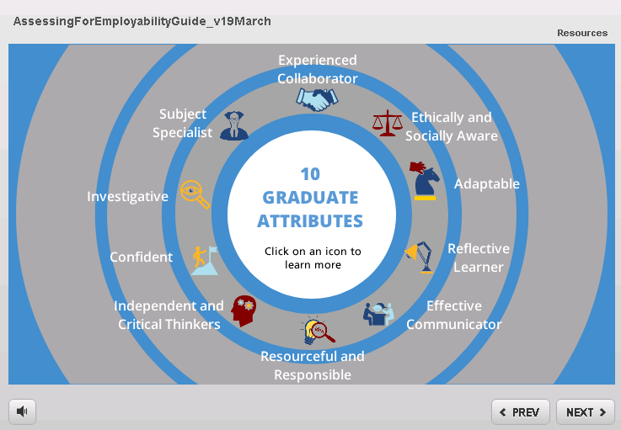
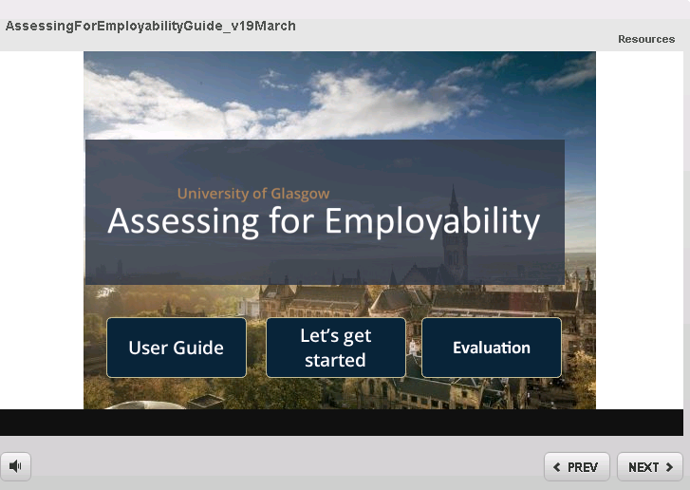
Project Goals
Aim: Enhance the strategy of embedding employability skills into assessment and feedback in a Level 2 course
Focus group to investigate:
The most effective way to deliver employability skills
Motivation/Drivers behind student engagement with employability sessions
How to use feedback on assessments to enhance skills development
Development of digital resources to support student learning, reflection and feedback
Delivering a workshop linking assessment & feedback to employability supported by an ‘Assessing for Employability’ tool

Slide 3
Progress & Lessons learned
Focus Group outcomes:
A) Guest speakers from industry from experts in the field
B) Learn about external opportunities; short sessions integrated into practical lab sessions
C) Improve communication so students receive feedback in the first place; feedback needs to be written in a style associated with skills development & feedforward
Lessons learned:
-Communication via Moodle not effective!
-MCQ assessments-no skills learned
Next:
-Development of an Assessment/ Feedback ‘Fact or Fiction’ tool
-Digital revision resources

Slide 4
Student-Staff Partnership:
Miranda Broom
Dzachary Zainudden
Nicola Veitch
Anna McGregor
Fiona Stubbs
School of Life Sciences
Funded by:
LEADS Learning & Teaching Development Fund 2018-19
12th Annual University of Glasgow Learning & Teaching Conference
Nicola.Veitch@glasgow.ac.uk

