Slide 1
The Flipped Classroom
Team-Based Learning
Dr Simon Tweddell
Senior Lecturer in Pharmacy Practice
s.j.tweddell@bradford.ac.uk
@simontweddell

Slide 2
Exploring the Benefits and Challenges of using TBL

Slide 3
Outcomes
Learning Outcomes - by the end of this session you will be able to:
Explain how and why team-based learning works.
Discuss the benefits and challenges of team-based learning at programme level.
Describe solutions for overcoming these challenges.

Slide 4
Programme
Why TBL?
What is TBL?
Team Formation
Readiness Assurance Process
Application exercises
Our Experiences of TBL
Discussion and Q&A

Slide 5
Pharmacy C2012
Drivers for Change
Growing student numbers
Surface learners
Disengaged learners
Disruption and absenteeism
New UG MPharm Programme
Engaging L&T Strategy

Slide 6
What we liked about TBL
Benefits of small-group learning but scalable
Accountability to self and team
Removes passivity
Removes anonymity

Slide 7
What we wanted students to do:
Prepare for class
Come to class
Participate and engage
Apply knowledge
Take a deep approach to their learning
Enjoy classes

Slide 8
What is TBL?
“A special form of collaborative learning using a special sequence of individual work, group work and immediate feedback to create a motivational framework in which students increasingly hold each other accountable for coming to class prepared and contributing to discussion”.

Slide 9
Four Key TBL Design Principles
Teams must be properly formed and managed
Diverse resources
Permanent teams formed transparently
Students must be motivated to come to class prepared
Students must learn to use course concepts to solve problems
Students must be truly accountable

Slide 10
A Team-Based Learning Unit
Content
Pre-class
Individual Study
Directed to Learning Resources

Slide 11
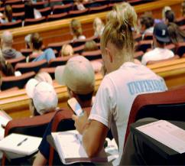
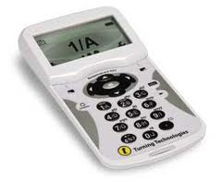
A Team-Based Learning Unit
Content
Pre-class
Readiness Assurance Process (RAP)
20-30% of class time
Individual Study
Directed to Learning Resources
iRAT

Slide 12
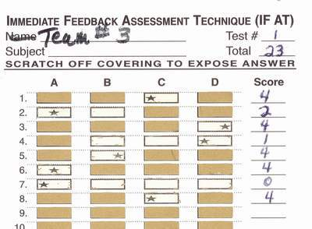
A Team-Based Learning Unit
Content
Pre-class
Readiness Assurance Process (RAP)
20-30% of class time
Individual Study
Directed to Learning Resources
iRAT
tRAT
IF AT cards
Same Test as a team

Slide 13
A Team-Based Learning Unit
Content
Pre-class
Readiness Assurance Process (RAP)
20-30% of class time
Individual Study
Directed to Learning Resources
iRAT
tRAT
Challenges

Slide 14
A Team-Based Learning Unit
Content
Pre-class
Readiness Assurance Process (RAP)
20-30% of class time
Individual Study
Directed to Learning Resources
iRAT
tRAT
Challenges
Corrective Instruction (Feedback)

Slide 15
A Team-Based Learning Unit
Content
Pre-class
Readiness Assurance Process (RAP)
20-30% of class time
Application Exercises
70-80% of class time
Individual Study
Directed to Learning Resources
iRAT
tRAT
Challenges
Corrective Instruction
4S criteria
Significant
Same
Specific Choice
Simultaneous

Slide 16
A Team-Based Learning Unit
Content
Pre-class
Readiness Assurance Process (RAP)
20-30% of class time
Application Exercises
70-80% of class time
Individual Study
Directed to Learning Resources
iRAT
tRAT
Challenges
Corrective Instruction
4S criteria
Significant
Same
Specific Choice
Simultaneous
Intra-team discussion
Inter-team discussion, debate and justification

Slide 17
Peer Evaluation
Formative
Summative

Slide 18
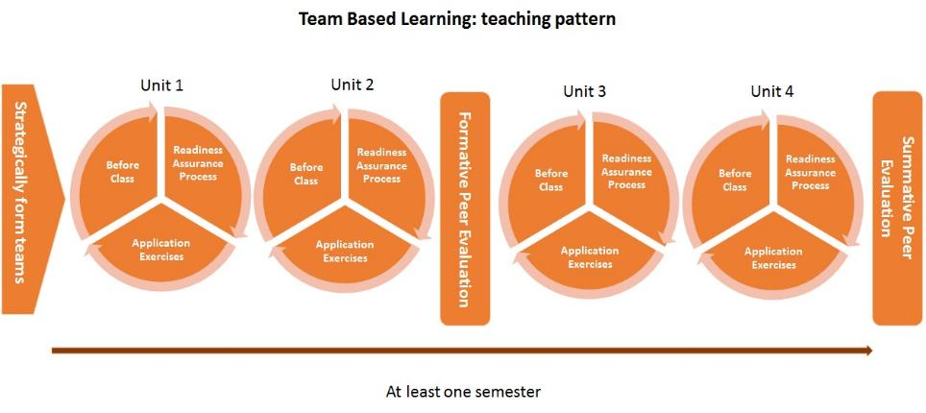
How does Team Based Learning Work?

Slide 19
At a unit level…
Individual test (iRAT)
Team test (tRAT)
Appeals & instant feedback
Readiness Assurance Process (RAP)
Application Exercises
Pre-work
What used to be covered in lectures
Videos & reading you MUST complete before class
You solve authentic problems
Develops both academic & employability skills

Slide 20
Let’s have a go!
Team Formation
Diverse Teams
Team formation
Used TBL?
Attended a TBL workshop?
Completed the Advanced Assignment
Student Study Guide - An Introduction to TBL
Rank your self from
5 - I fully understand it
to
1 – I still haven’t got a clue

Slide 21
Readiness Assurance Process
iRAT
Complete the test
Closed Book
Individual
TP
tRAT
Closed book
Team
IF-ATs
Appeals
Corrective Instruction (Corrective Feedback)

Slide 22
Application Exercise 1
From a staff perspective, which of the following do you believe is the most important benefit of TBL to students? – 10 minutes
A Increased breadth of content covered
B Enhanced student attendance
C Increased student engagement
D Reduction in staff workload
E Increased student attainment
F Enhanced student motivation
G Promotes deeper approaches to learning
H Development of skills to enhance employability

Slide 23
Application Exercise 2
Which of the following aspects of TBL do you feel that you (as teachers) will find the most challenging skill? – 10 minutes. Rank these in order
A. Writing the Student Study Guide
B. Writing the RAT questions
C. Writing application exercises
D. Facilitating application exercises
E. Giving the corrective feedback after the RAP
F. Mastering the technology
G. Managing the timings of application exercises
H. Managing the appeals process
J. Managing the peer evaluation process

Slide 24
Application Exercise 3 – why does TBL Work? – 10 minutes
Which of the following is the most important reason that TBL works?
Students receive immediate feedback in the tRATs
Students work on challenging and authentic applications
Students are held accountable to their teams
Students are actively applying knowledge to solve problems
Students are able to challenge staff and other student teams
Students relate new knowledge to, and integrate it with, pre-existing knowledge (constructivist learning theory)

Slide 25
Reference
Hrynchak, P. (2012). The educational theory basis of team-based learning. Medical Teacher, 34(10), 796–801. doi:10.3109/0142159X.2012.687120
Van der Vleuten, C. P. M., & Driessen, E. W. (2014). What would happen to education if we take education evidence seriously? Perspectives on Medical Education, 3(3), 222–232. doi:10.1007/s40037-014-0129-9

Slide 26
Are they really just multiple-choice questions?
Complex data, complex decisions, simple report

Slide 27
A patient come into emergency with the following symptoms... (ADD appropriately COMPLEX SCENARIO HERE)
What is the first thing you would do? And why?
B. What is the first test you would order? And why?
C. What would be the worst thing to do? And why?

Slide 28
Small Whiteboards

Slide 29
Post-it-Notes

Slide 30
You are consulting for a new business owner who wants to open a dry-cleaning store in Norman, Oklahoma. Where would you recommend locating a new dry-cleaning business (and why)?

Slide 31
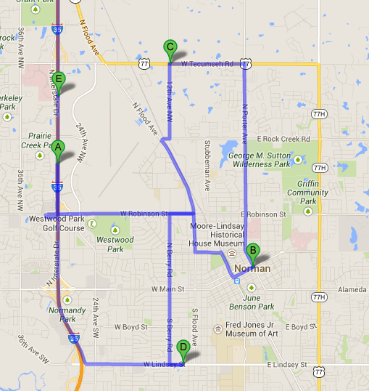
Push Pin in Map

Slide 32
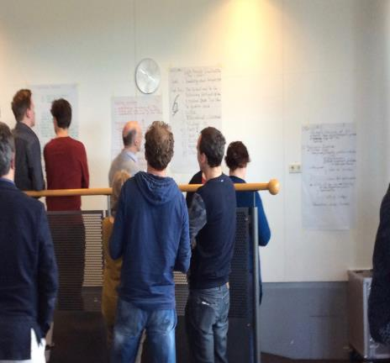
Gallery Walk

Slide 33
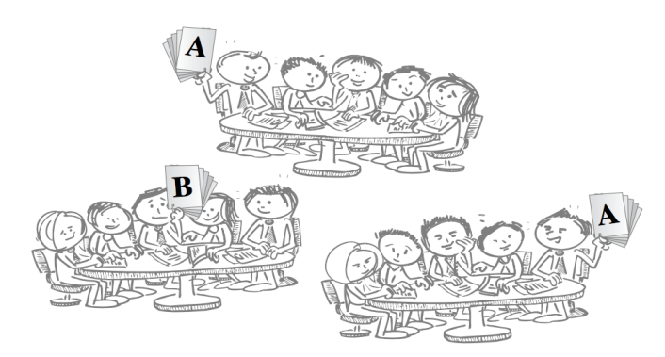
Decisions give visible form to students thinking and use of knowledge
Text from Bill Roberson

Slide 34
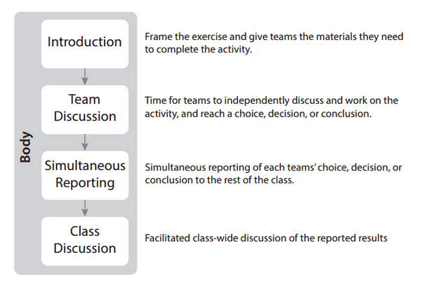
Structure of Application Activities

Slide 35
Our Experiences of TBL
Benefits
Challenges
Staff and Student Positives and Negatives
Quantitative data
Qualitative data
Employability skills
Summary of Lessons Learned
Estate

Slide 36
Outcomes - Benefits
“TBL has been so good and rewarding to the point that I am suggesting that we use it within the optional modules. It almost makes me want to be a first year again.” – 4th year Student
Students
Mostly very positive
Enjoyable experience
4th years helped explain to 1st years
Staff
Students come prepared
Students engaged in learning
Students are more confident
Students are less needy and less pastoral issues
“The power of instant feedback, the students totally on topic, talking, engaged, coming prepared, it is unbelievable.” Staff
“I would definitely recommend TBL because you get the chance to apply your knowledge. It stays in your mind a lot more and you find your performance is a lot better” –Student
“100% never going back.” Staff

Slide 37
“Some staff need to improve the way they ask the questions” - Student
Outcomes - Challenges
Large scale change
Human resource
Managing Expectations
Staff
Students
Facilitation skills
Application exercises
Authentic, integrated and
challenging
Timings
Difficult concepts
Student Support Sessions
Age/experience?
Orientating students
“You definitely need more preparation time and to learn how to facilitate discussions” Staff
“They need to be stricter with timings, you’re often waiting for everyone to finish when you could move on to the next exercise.” Student
“For me the most difficult part of TBL is writing application exercises that challenge them as a team” Staff

Slide 38
Employability Skills
Collaborative
Communication
Critical thinkers
Independent learners
Confidence
Teaching

Slide 39
Outcomes – Comparative data
Performance in written assessment
7% increase in a stage 4 60 credit module (1 cohort of 200 students)
13% increase in stage 4 20 credit module (2 cohorts of 100 students)
Heidi Mennenga’s Team-Based Learning Student Assessment Instrument (TBL-SAI)
Subscale | Accountability Score | Preference for TBL | Satisfaction with TBL | Total Score
Range | 8-40 | 16-80 | 9-45 | 33-165
Neutral | 24 | 48 | 27 | 99
MPharm | 33.2 | 57.6 | 36.5 | 127.2

Slide 40
Research study
2 Pharmacy Schools (US and UK)
Qualitative Research
Thematic analysis
Benefits
Challenges

Slide 41
Research Study
Area of Enquiry | Emergent Themes
Experience of Previous Teaching Methods | Poor Student Engagement
Initial Perceptions of TBL | Feelings of anxiety Feelings of excitement Lack of understanding of logistics Faculty recruitment in US
Development Needs | Understanding the TBL Process Developing effective facilitation skills Writing effective application exercises
Benefits | Enhanced student engagement Peer Learning Faculty/Staff benefits Enhanced transferable skills

Slide 42
Research Study
Area of Enquiry | Emergent Themes
Challenges | Workload Facilitating student-centred classes
Lessons Learned | Writing effective application exercises Managing the readiness assurance process Managing content Staff teamwork is key Consistency

Slide 43
Benefits
Engagement
The most tangible positive is 100% attendance. That’s pretty impressive; you can’t get that almost anyway else. Having students there is a good starting point
Absolute student engagement. When you walk in the room, [the students] are awake and they’re there.
I love the engagement. The most positive thing is the ability to actually hear them reason. They think it through and you know that they’ve either mastered or struggled with the material before they leave the classroom. You also have that immediate assessment of where they’re learning is at

Slide 44
Benefits
Peer Learning
I hear [students] talking about the issues and teaching each other in ways that I couldn’t do because it’s individualized between the students
Teams are together all the time so they don’t feel bad saying “well I don’t understand, how did you guys get there? Show me!”

Slide 45
Benefits
Teamwork
For some students it increases their ability to speak with others and come to common solutions, to have differences of opinion but then find one best answer to a problem. I think it’s pivotal for healthcare providers to be able to come together with different opinions on what is best for the patient, but then come out with one solution in a relatively timely fashion.

Slide 46
Challenges
Workload
Workload is substantially higher than normal lecturing
The first time [faculty] teach it’s a lot of work, but the second time you have all this data on which applications went well, which didn’t, how long did they took. So each year it is less work

Slide 47
Challenges
Facilitation Skills
I still find myself talking too much. When you’re not getting the answers you want then it’s in our nature to say “let me just tell you”. If [faculty] can hold back and try to get the students to get there themselves, then that’s [the sign of] a really good TBL facilitator

Slide 48
Challenges
Application Exercises
Coming up with applications that take a team to figure out is challenging. You want to keep [students] engaged by developing diverse types of applications and ensure they’re relevant to practice
I want students to be able to justify their answers. So I’ll ask a question, more often now than I did before, where I have multiple correct answers. I force [teams] to make a choice and then they have to justify their decision.

Slide 49
Summary quotes
I really enjoy this style of teaching. I really feel that our students are grasping the concepts a lot earlier and to a deeper level. For my job satisfaction I really enjoy the way that we teach. I don’t know if I could go to a school that was purely lecture-based
Wherever I’m teaching, whatever I’m doing for the rest of my life I will always be, to some degree, using team-based learning

Slide 50
Summary Quotes
I don’t think we’re perfect or the students are perfect or TBL’s perfect, but I think it’s far better for student learning, enjoyment and satisfaction, and the same for faculty. It’s much more enjoyable to go into class, even though you’re more vulnerable. There’s more satisfaction in the interactions you have and knowing immediately that students are understanding what you’re talking about and what you want them to learn.

Slide 51
Benefits
Attendance
Engagement
Peer Learning
Peer Support
Improved satisfaction
Improved results
Fun

Slide 52
Lessons Learned
Help and support invaluable
Don’t drop any one aspect of TBL
Don’t underestimate the preparation time
Peer review of TBL resources
Writing effective application exercises that are authentic and challenging
Taster sessions at interview

Slide 53
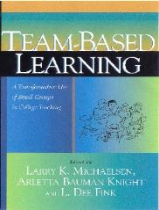
References and Further Resources
Books (Michaelsen and Sibley)
TBLC
www.teambasedlearning.org
Contact
s.j.tweddell@bradford.ac.uk

Slide 54
TBLC Membership
Communities of Practice
Discounted events
Resources
Research and collaboration
Developmental opportunities
ETBLC
Masterclasses –
University of Dundee – 26th June

Slide 55
OfS Catalyst Project
Scaling up the use of Active Learning for Student Success
NTU/ARU/UoB
Outcomes
Attainment Gap
Project Conference
Friday 28th June

Slide 56
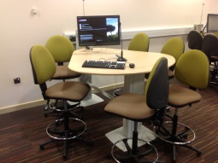
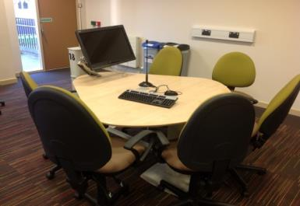
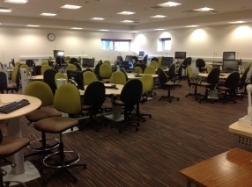
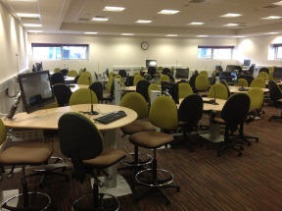
Estates and Facilities

Slide 57
Questions?

Slide 58
Reality: students are assessment driven

Slide 59
Why active learning?
“I hear and I forget.
I see and I remember. I do and I understand.”
Confucius

Slide 60
Why active learning?
Students were 1.5 times more likely to succeed with active learning than traditional lectures (Freeman et al 2014)
Students prefer and more likely to complete courses with interactive and communicative learning (Rienties & Toetenel 2016)

Slide 61
Why collaborative learning?
“If you want to go fast, go alone.
If you want to go far, go together”
African proverb

Slide 62
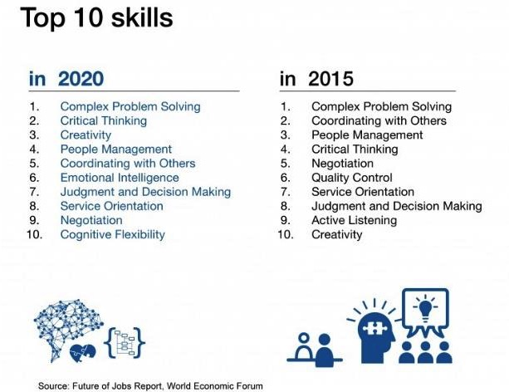
Why collaborative?

Slide 63
Key points for teams
5-7 people
Instructor formed
Long term
Maximise diversity
Embed Peer Evaluation

