Slide 1

Teaching for Active Learning
ASBS L&T seminar, 1st Nov 2018
Dr Vicki Dale, Sr. Academic & Digital Development Adviser
vicki.dale@glasgow.ac.uk

Slide 2

Overview
Definition of active learning
Teaching methods
Teaching tips as case studies
TEAL spaces
Putting it into practice…
Design your preferred active learning and teaching spaces for world-class business education

Slide 3
What is active learning?
What does it mean to you? Discuss at your tables, and come up with a definition each…
“Any instructional method that engages students in the learning process … [it] requires students to do meaningful learning activities and think about what they are doing.”
(Prince, 2004, p.233, citing Bonwell and Eison 1991)
“A hybrid form of teaching in which class sessions include a combination of formal lecturing, collaborative group work by students, and discussions between student and lecturer.”
(Spaeth et al., 2017)

Slide 4
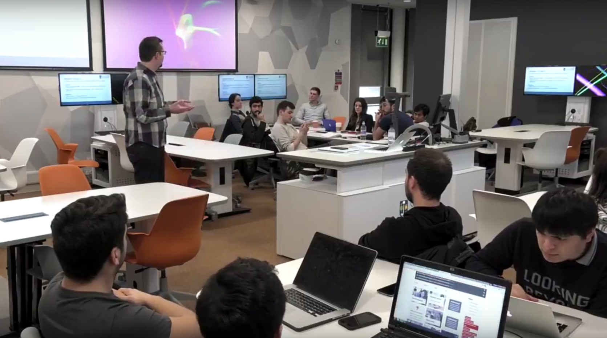
The evidence for active learning
Active learning enhances learning (reduces misconceptions, leads to deeper learning)
(Gibbs 2010; Michael 2006)
Interaction between staff and students enhances learning and student satisfaction
(Huxham 2005; Kuh & Hu 2001)
Active learning spaces enhance academic performance (Chiu & Cheng 2016)

Slide 5
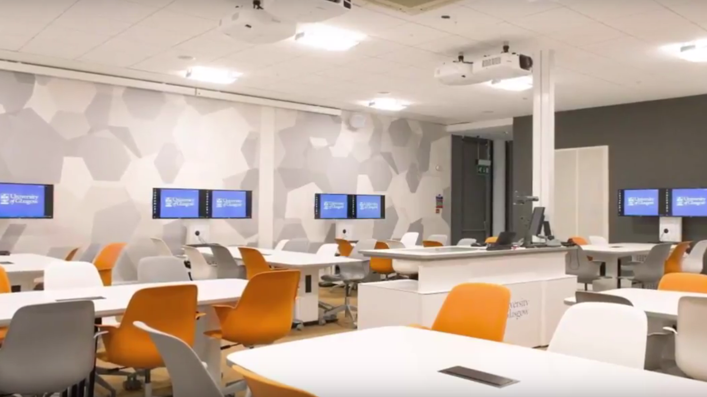

What is a TEAL space?
Working UofG definition:
A TEAL space is one where there is a concentration of technology for both staff and students that goes beyond that found in a "traditional" teaching space.
The flexibility of the technology and furniture facilitates different arrangements of teaching during a single session, and the student access to technology engages students as active learners, which leads to a rich, collaborative learning experience

Slide 6
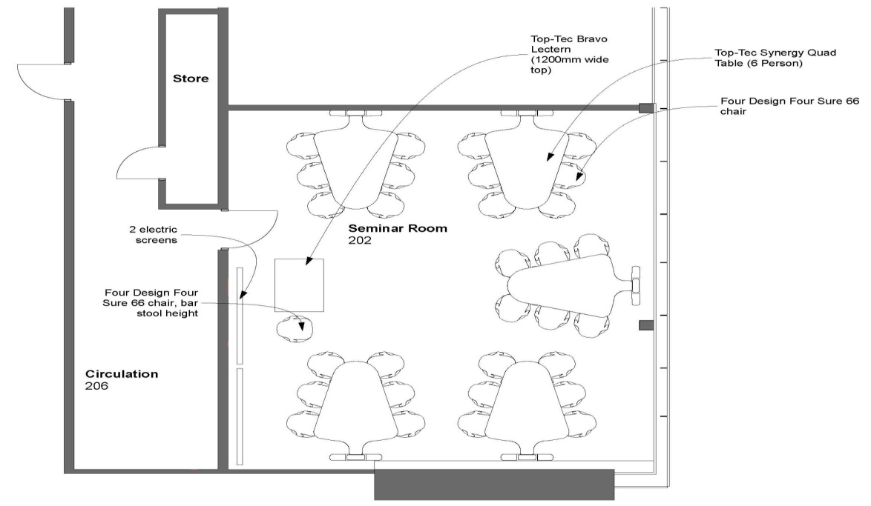

TEAL: St Andrews Building 202 (30)
TEAL: St Andrews Building 202 (30)

Slide 7
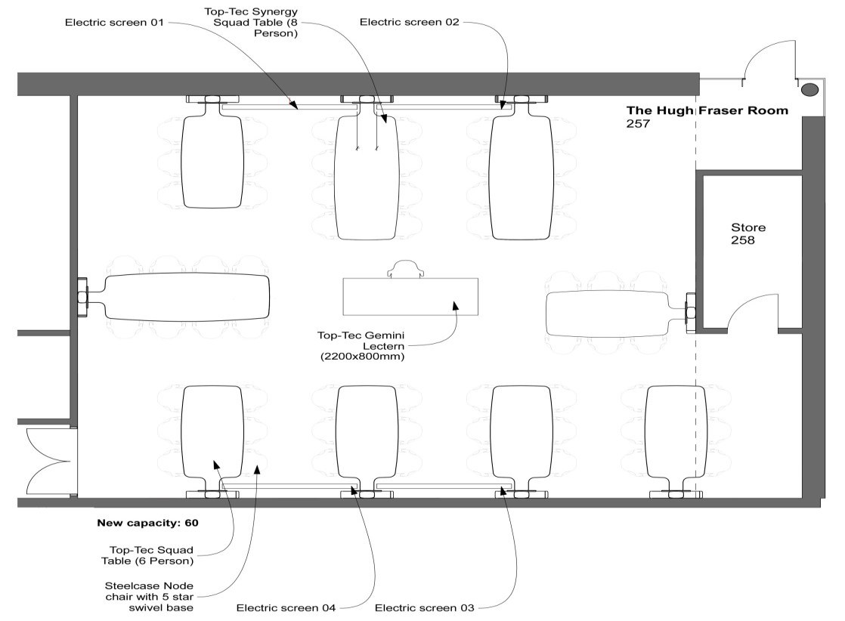


TEAL: Wolfson Medical School – Hugh Fraser (60)

Slide 8
Reflections on using TEAL spaces
“I would say definitely this encourages, even if you weren’t planning to do so, I think this kind of room would encourage you to do more group based or discussion based activities.”
“Sometimes in traditional classes I would say to students, would you get into groups, and it’s that moment of getting into groups, there’s a pause, like, … before they start to discuss, whereas going into the TEAL room, they’re already facing each other, they’ve already got eye contact and they’re talking, and they’ve got used to being in small rooms, so it was just straightaway, get them talking, working in groups.”
“It was one of my best teaching experiences I’ve had.”
(University of Glasgow teaching staff)

Slide 9
Teaching methods
Method | Overview | References
Think-pair-share | To overcome social anxiety and encourage participation. Ask students to think about a problem on their own, then discuss in pairs, then feed back to class. | Kothiyal, A., R. Majumdar, S. Murthy and S. Iyer (2013). “Effect of think-pair-share in a large CS1 class: 83% sustained engagement.” Proceedings of the ninth annual international ACM conference on International computing education research, ACM.
Jigsaw classroom | Students divided into small groups to complete investigate task. Each person assigned a subtopic (1,2,3,4,5). All the 1s/2s/3s etc. group, research the problem, then bring it back to original group. | Voyles, E. C., S. F. Bailey and A. M. Durik (2015). "New pieces of the jigsaw classroom: increasing accountability to reduce social loafing in student group projects." The New School Psychology Bulletin 13(1): 11-20.

Slide 10
Teaching methods
Method | Overview | References
Flipped classroom | Also called the inverted classroom. Students work through e.g. acquisition tasks before class e.g. online. Class time used for discussion and problem-solving. | Bishop, J. L. and M. A. Verleger (2013). The flipped classroom: A survey of the research. ASEE National Conference Proceedings, Atlanta, GA.
Team-based learning | Incorporates element of flipped classroom; comprises four stages: Strategically formed, permanent teams Readiness assurance Application tasks Peer evaluation | Michaelsen, L. K. and M. Sweet (2011). "Team-based learning." New Directions for Teaching and Learning 2011(128): 41-51.

Slide 11
Teaching methods
Method | Overview | References
Problem-based learning | Origins in medical education. Students work in groups to define the problem and assign tasks to each other. | Carvalho, A. (2016). "The impact of PBL on transferable skills development in management education." Innovations in Education & Teaching International 53(1): 35-47.

Slide 12
Case studies of active learning
Discuss the teaching tip assigned to your table.
What works well in this case, that you could apply to your own teaching practice?
How might you modify this approach to suit your own teaching context?
Notes:
Ideally in business education but may need to stick with what can find in the time available…

Slide 13
Group task: Design teaching spaces for the ASBS building
Refer to the guidelines by Finkelstein et al. (2016) in the handout (‘Principles for designing learning and teaching spaces’)
What would your ideal teaching and learning space look like?
Produce an annotated schematic of this space.

Slide 14
References
Bishop, J. L., & Verleger, M. A. (2013). The flipped classroom: A survey of the research. Paper presented at the ASEE National Conference Proceedings, Atlanta, GA.
Chiu, P.H.P. and Cheng, S.H. (2016) Effects of active learning classrooms on student learning: a two-year empirical investigation on student perceptions and academic performance. Higher Education Research and Development Onlinefirst: http://www.tandfonline.com/doi/full/10.1080/07294360.2016.1196475?scroll=top&needAccess=true
Cuseo, J. (2007) The empirical case against large class size: adverse effects on the teaching, learning and retention of first-year students. The Journal of Faculty Development 21 (1) 5-21.
Finkelstein, A., Ferris, J., Weston, C., & Winer, L. (2016). Research-Informed Principles for (Re)designing Teaching and Learning Spaces. 2016, 5(1).
Gibbs, G. (2010) Dimensions of Quality. York: Higher Education Academy. https://www.heacademy.ac.uk/sites/default/files/dimensions_of_quality.pdf
Huxham, M. (2005) Learning in lectures. Do interactive windows help? Active Learning in Higher Education 6 (1) 17-31.

Slide 15
References
Kothiyal, A., Majumdar, R., Murthy, S., & Iyer, S. (2013). Effect of think-pair-share in a large CS1 class: 83% sustained engagement. Paper presented at the Proceedings of the ninth annual international ACM conference on International computing education research.
Kuh, G. & Hu, S. (2001) The effects of student-faculty interaction in the 1990s. The Review of Higher Education 24 (3) 309-332.
Michaelsen, L. K., & Sweet, M. (2011). Team-based learning. New Directions for Teaching and Learning, 2011(128), 41-51. doi:10.1002/tl.467
Prince, M. (2004). Does Active Learning Work? A Review of the Research. Journal of Engineering Education 93(3): 223-231.
Michael, J. (2006) Where’s the evidence that active learning works? Advanced Physiology Education 30 159-167.
Spaeth, D., Chan, A., Bohan, J., Fischbacher-Smith, M., Magennis, E., & O'Dell, K. (2017). Developing a Strategy for Supporting Active Learning Pedagogies: report of an LTDF-funded project.
Voyles, E. C., Bailey, S. F., & Durik, A. M. (2015). New pieces of the jigsaw classroom: increasing accountability to reduce social loafing in student group projects. The New School Psychology Bulletin, 13(1), 11-20.

Slide 16









Questions? Contact us
Sarah.Honeychurch@glasgow.ac.uk
Moira.Fischbacher-Smith@glasgow.ac.uk
Vicki.Dale@glasgow.ac.uk
/glasgowuniversity
@UofGlasgow
@UofGlasgow
UofGlasgow
Search: University of Glasgow

