Slide 1
Designing and using world-class business education (spaces)
Learning and Teaching Seminar 1st November 2018
Sarah Honeychurch, teaching fellow, asbs
Moira fischbacher-smith, Assistant Vice-Principal (Learning & Teaching
Vicki dale, senior academic and digital developer, leads

Slide 2
Seminar aims
To think about how we can design and use world class teaching and learning spaces in the context of the ASBS new building project
To discover the range of learning and teaching spaces in existence within the university
To explore teaching techniques that can facilitate active learning within such L&T spaces
To have the opportunity give your input into the types and style of L&T spaces you would like to see in our ASBS new building.

Slide 3
agenda
L&T in a Business school
Update from the ASBS New Building project
Refurbished Spaces within the university
Techniques for active learning
Designing L&T spaces for our new business school

Slide 4
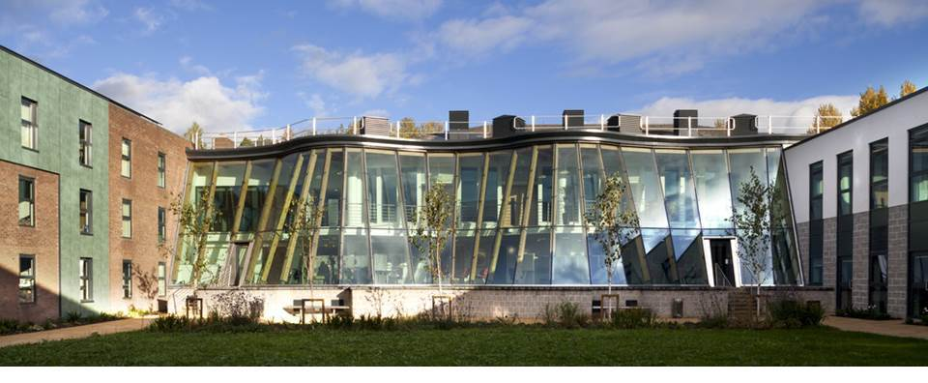
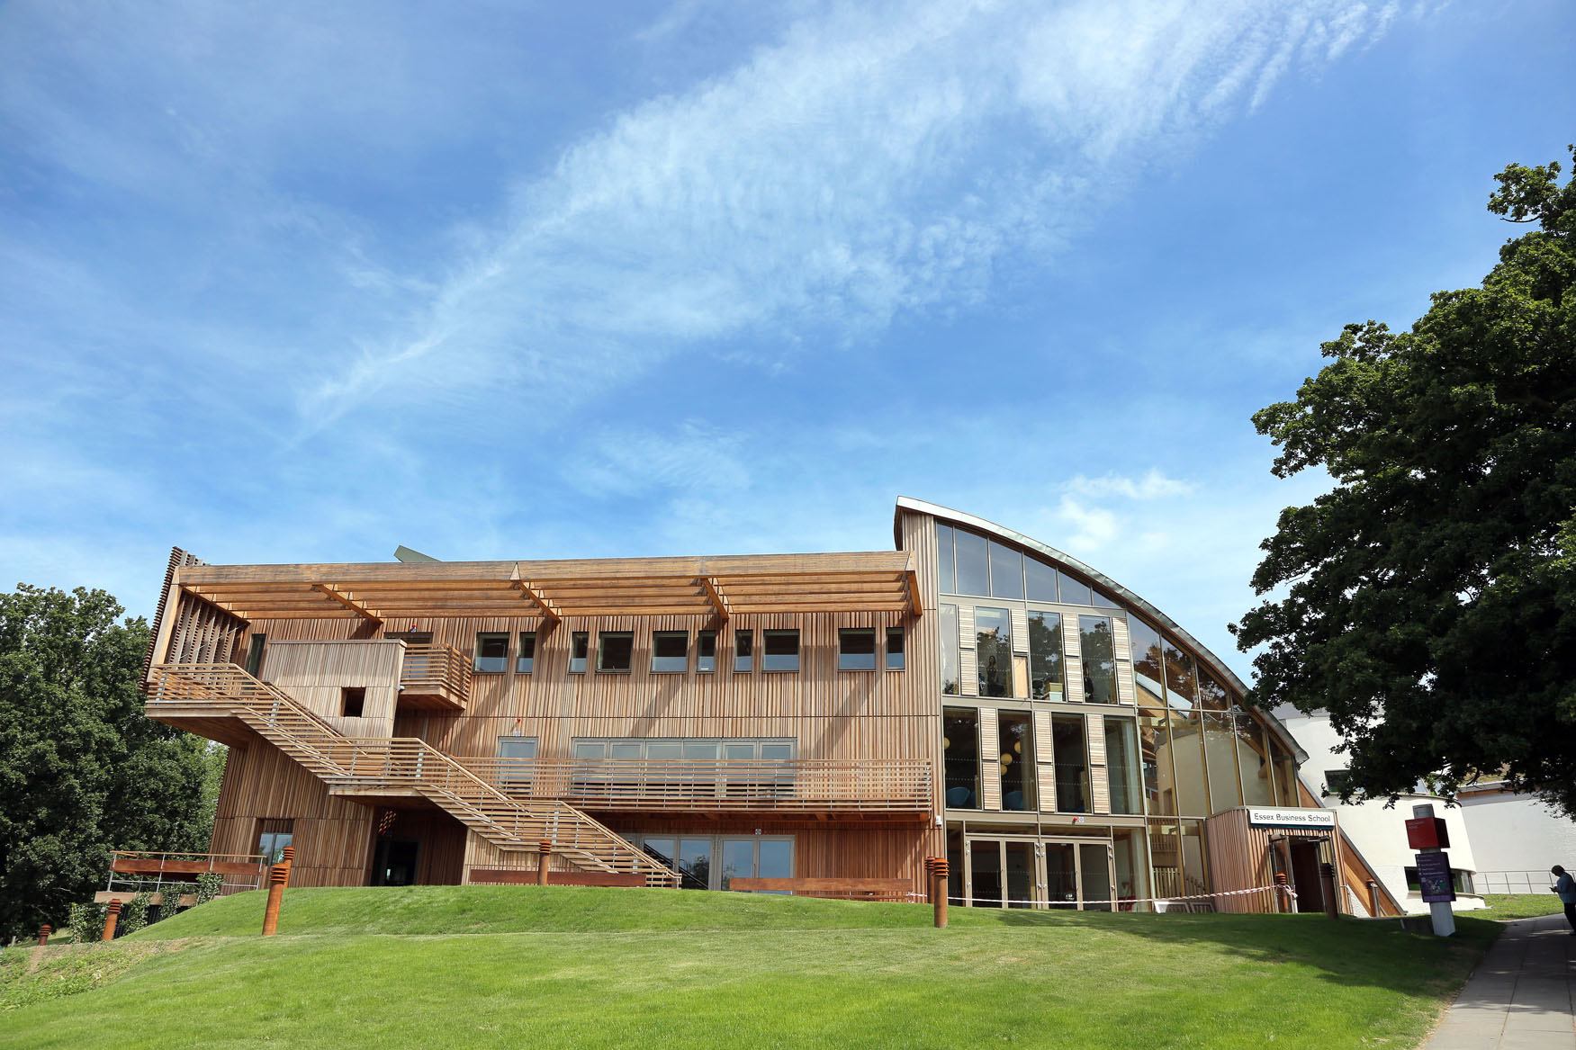
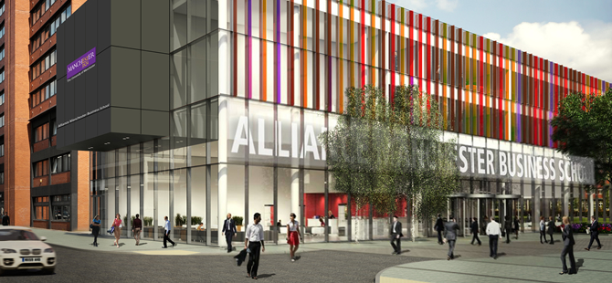

Slide 5
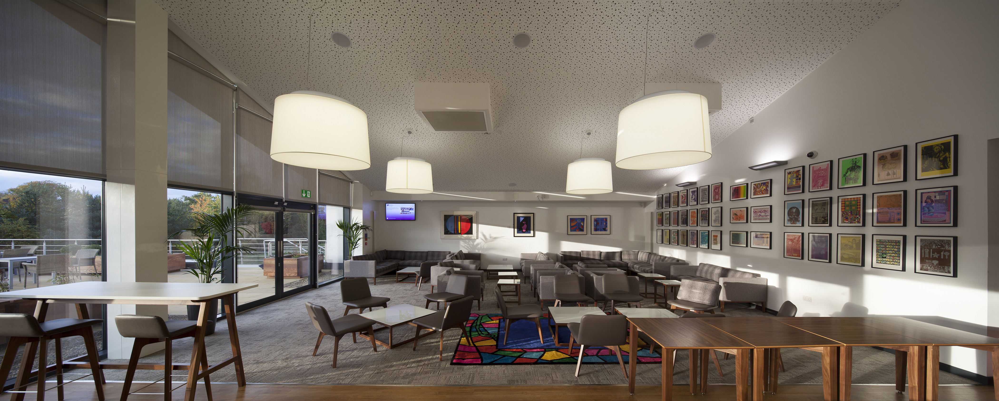
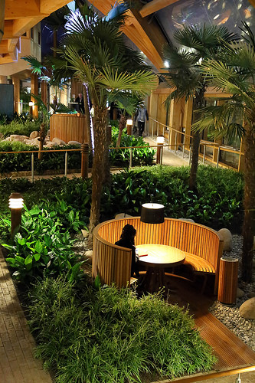

Slide 6
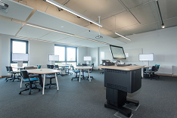
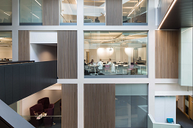
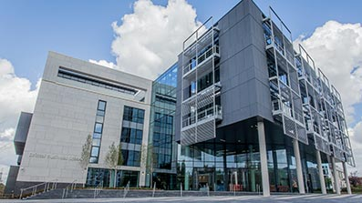
"Our building is a world class game changer for Bristol Business School and Bristol Law School and provides real opportunities for the business world to engage with our staff and students."
Donna Whitehead, Pro Vice-Chancellor and Executive Dean, Faculty of Business and Law, UWE

Slide 7
Our new Business School: the story so far..
Stage 2 to be completed….
Stage 3 design (likely to start around January 2019).
The objective is to agree all room sizes and locations and prepare for ongoing/Stage 3 discussions about the future of teaching and learning in the Business School.

Slide 8
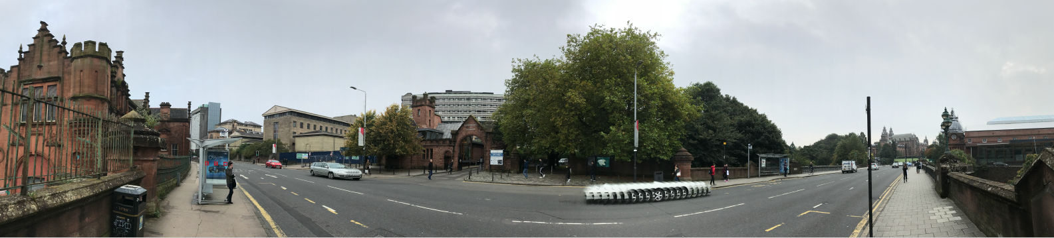
HoW IT LOOKS NOW

Slide 9
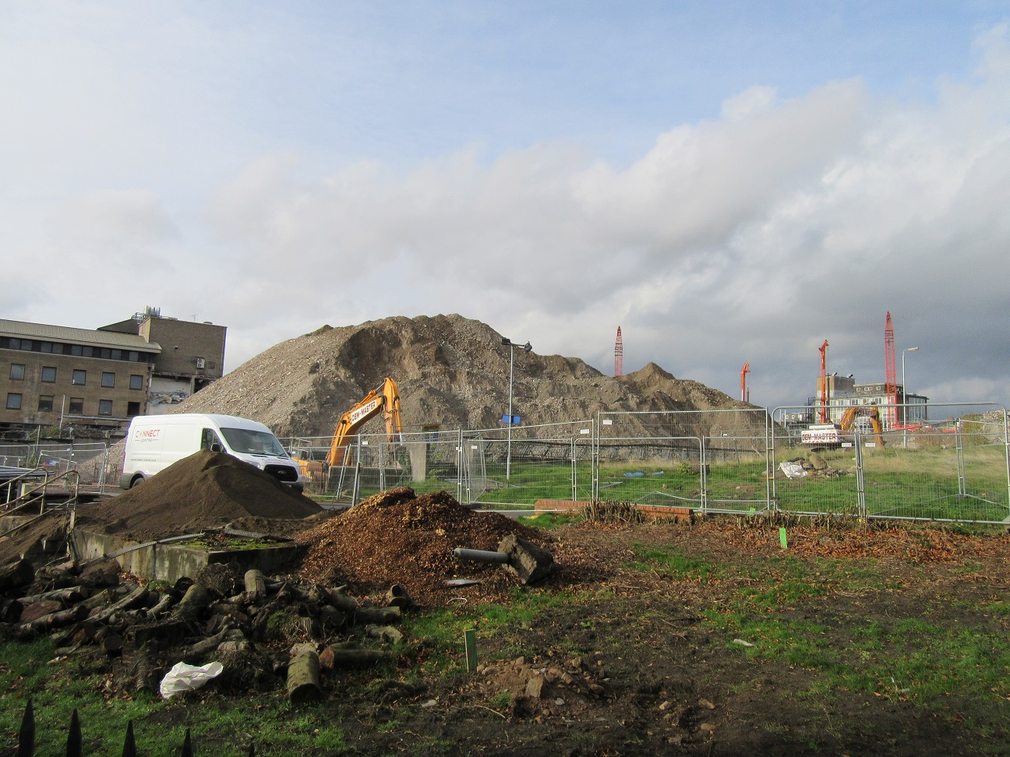
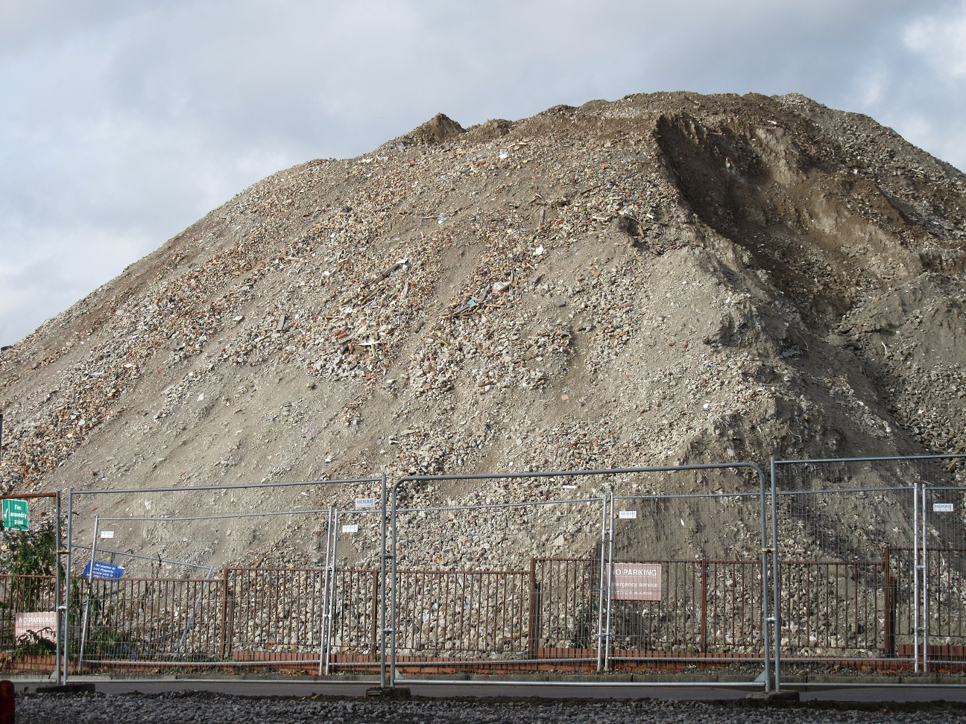

Slide 10
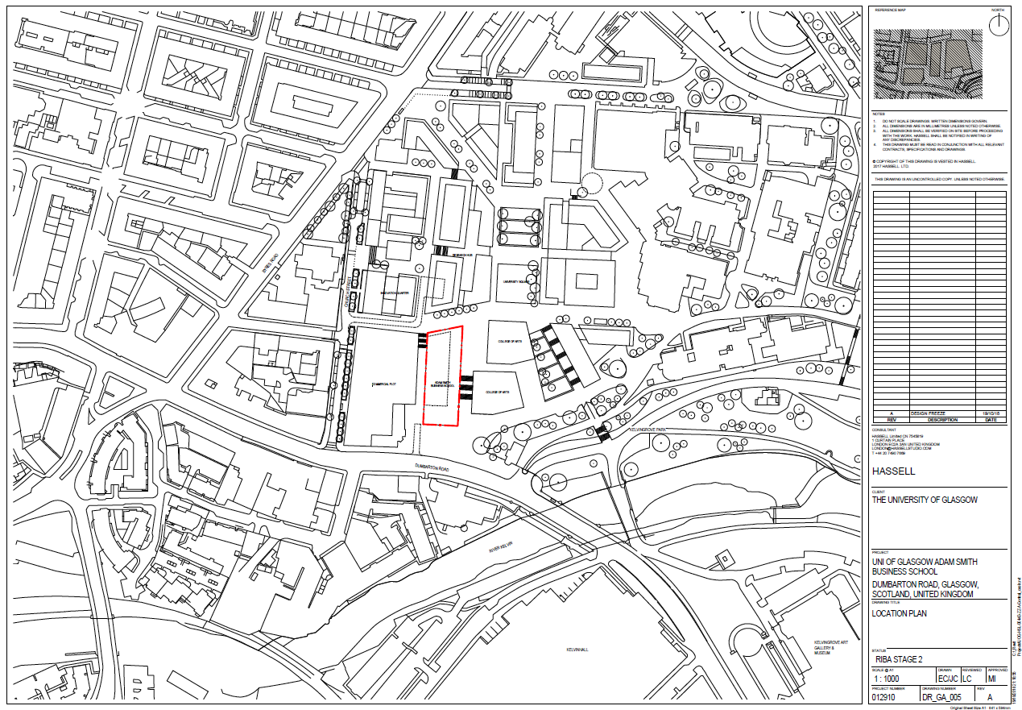

Slide 11
Learning and teaching spaces
Classrooms: largest capacity 60 devisable 30/30 20/40
Most popular size of classes around 20 so several of this size
All classrooms to be sized for active learning
Classes less than 10 to use informal spaces
Lecture theatres
Project rooms (x4) bookable (digital signage)level 1 non enclosed level 2 enclosed
Informal study areas/study booths (corridors levels 1&2)
Bloomberg site – impact entrance
Hothouse: multi use space ground floor – show case (not formal teaching space
IT labs?
Laptop loan scheme for flexible learning?

Slide 12
Activity
Working in groups design a poster…
represent what you want to see and don’t want to see in the new building…
with ‘active learning’ and ‘world class’ business education in mind.

