Slide 1

Toolbox Talk: General Safety
GEN01: Responsibility and Liability

Slide 2
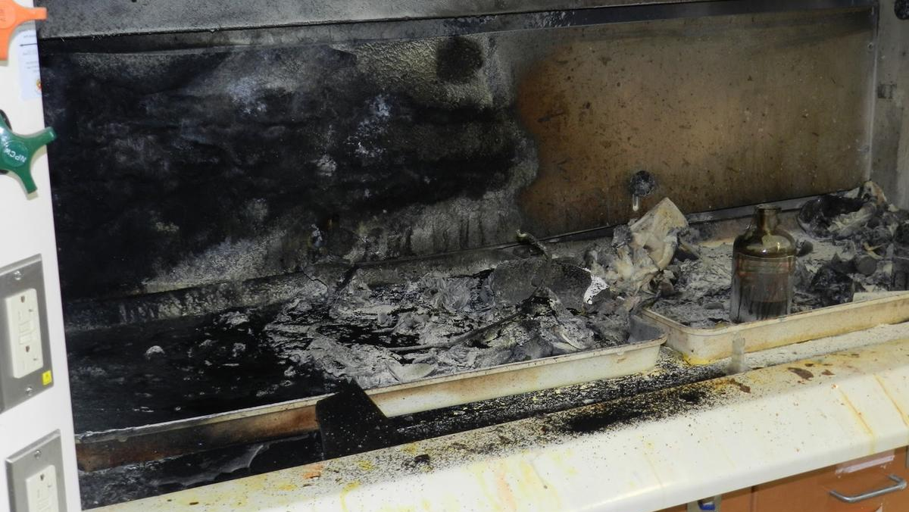

General Introduction
Responsibilities and duties of individuals in higher education institutions
Possible consequences / outcomes following an accident, injury or fatality
Powers of enforcing authorities
Examples of serious incidents in higher education

Slide 3
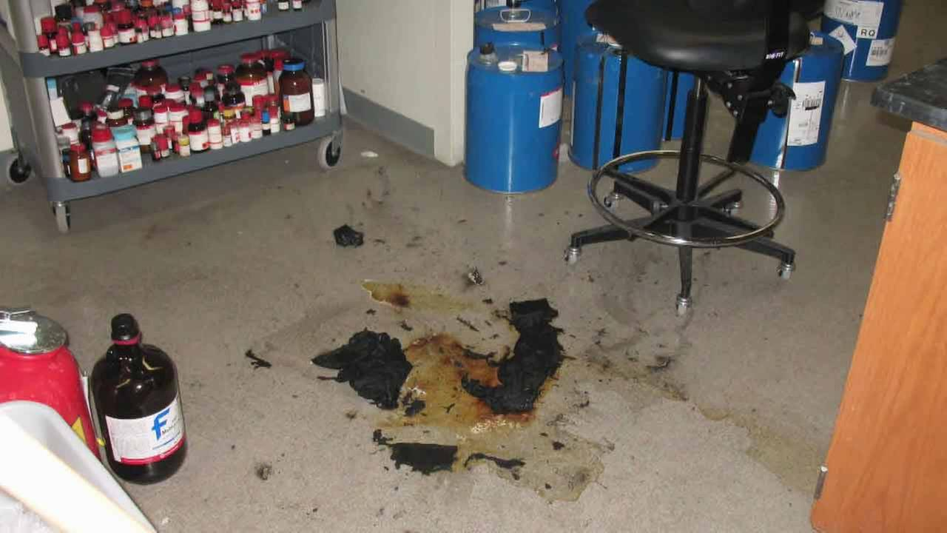
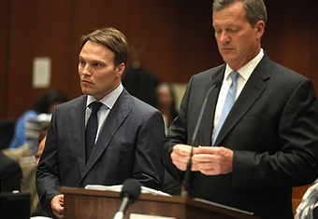
UCLA Fatality, December 2008
Sheri Sangji,23
Staff research associate working with Professor Patrick Harran
Severely burned following an accident involving t-Butyllithium
Safety glasses but no lab coat worn, synthetic clothing caught fire
Died 18 days later in hospital
Consequences
Criminal prosecution (failure to provide suitable training / PPE)
Prosecution of Prof Harran deferred for 5 years (community service)
Charges against UCLA dropped following spend of $20M on improved procedures / scholarship
Fellowship from American Association for Advancement of Science dropped
Negative publicity for university and individuals
Notes:
XXX

Slide 4
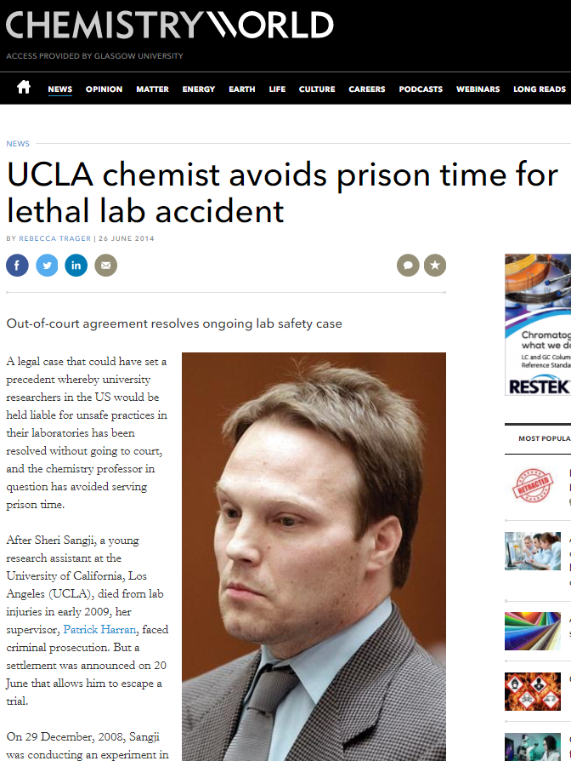
Consequences of an accident?
Moral / Personal
Risk of distress, illness, injury or death to individuals
Financial
Lost time, replacement of equipment / personnel
Fines imposed by courts
Cost of civil claims
Legal
Risk of enforcement action
Possibility of prosecution
Social
Damage to reputation (both personal and that of the University)

Slide 5
Key levels of responsibility
Governing Body
Executive Team
Senior Managers
Line Managers
Supervisory Staff
University Court
Chief Operating Officer / Head of College
Subject / Divisional Lead (Head of School)
Principal Investigators / Senior Administrators
Laboratory Manager
Leadership and management of health and safety in higher education institutions (USHA)
Five levels of responsibility*
Governing body
Executive team
Senior managers
Line managers
Supervisory staff
What about everyone else?
*Tasks can be delegated but not responsibility
Notes:
XXX

Slide 6
Responsibilities of Head of School
Implement local safety management arrangements and manage risks and ensure you have a clear understanding / oversight of operations and activities
Align school health and safety plan to the strategy of the institution
Plan arrangements to ensure health and safety of all persons
Put in place processes to ensure all activities are risk assessed and controls implemented
Ensure tasks are delegated appropriately and understood
Check that agreed health and safety training objectives are being met
Keep staff informed by monitoring progress and actively seek their views on improvements
Review risk management processes regularly
Take action to implement recommendations from your review
Plan
Do
Check
Review
Notes:
XXX

Slide 7
Responsibilities of Principal Investigators
As a line manager you are expected to implement your local health and safety management arrangements, monitor and check their effectiveness
Set reasonable objectives to cover your area of responsibility (e.g. allocation of RA)
Develop / use existing communication processes to keep your team informed
Ensure risk assessments are undertaken and recorded and that staff / students follow them
Take appropriate action when health and safety is likely to be compromised
Check statutory examinations are carried out within prescribed timescales
Monitor completion of actions arising from audits / inspections
Embed learning points from accidents and incidents
Respond to external influences e.g. regulatory body visits / changes in legislation
Plan
Do
Check
Review
Notes:
XXX

Slide 8
Responsibilities of Laboratory Supervisor
As a staff member with supervisory responsibility you are expected to monitor and check that local arrangements / rules are being followed.
Ensure you understand local safety policy and procedures
Think about how procedures based on risk assessments can be effectively communicated
Ensure staff and students are aware of (and follow) safe systems (raise issues of non-compliance)
Develop clear and concise procedures and include key safety information in them
Ensure risk assessments have been carried out, are up to date, recorded and understood
Ensure actions from local (school level) audits and inspections have been completed
Provide feedback on H&S performance via line management
Review accidents / incidents and embed learning points in procedures
Plan
Do
Check
Review
Notes:
XXX

Slide 9
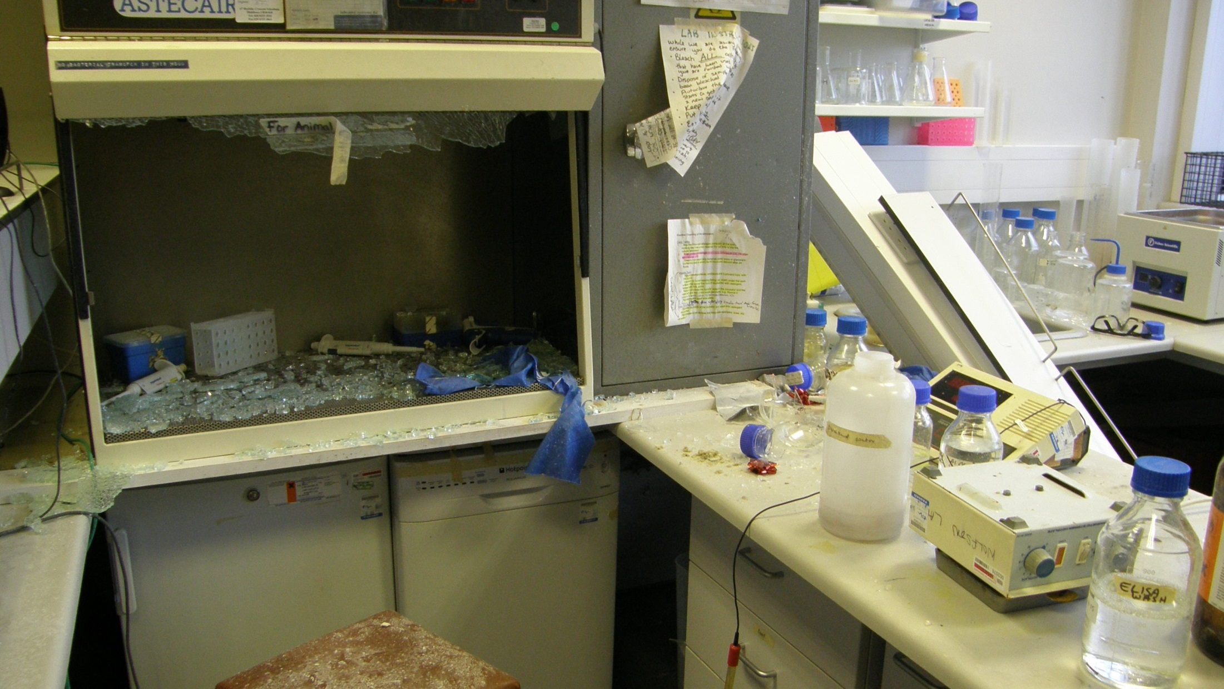

Slide 10

Powers of an HSE Inspector
Enter any premises at any reasonable time
Examine, investigate and require premises / equipment to be left undisturbed
Take, measurements, photographs, recordings and samples
Dismantle or test and dangerous article or substance
Conduct interviews under caution and require a signed statement
Inspect and take copies of documents
Give written advice*
Issue improvement notices and prohibition notices*
Initiate prosecutions in the criminal courts*
*Under the Fee for Intervention Scheme where a material breach of health and safety law has occurred the HSE has a duty to recover their costs (at £129 per hour).
Notes:
XXX

Slide 11
When will the HSE prosecute?
HSE Prosecution Guidelines
When a workplace death is caused by a breach of the law
If there has been reckless disregard of health and safety requirements
The offenders standard of H&S management is far below what is required
Considerations
Management chain and role played by individual managers
Action should be taken where an offence is committed with consent, complicity or neglect
If a manager / supervisor has done everything possible to comply with the law and taken all reasonable steps to ensure safety it is unlikely they will be prosecuted
Notes:
XXX

Slide 12

Penalties (Criminal and Civil)
Criminal Penalties
Unlimited fine (largest fine issued to date in the UK was £15M, Transco)*
Up to 2 years imprisonment for individuals
Criminal prosecutions potentially open the door to civil claims
Publicity order for corporate homicide
Civil Penalties
Claims for compensation (financial)
Injunction
*Fines imposed by criminal courts are not covered by Employers Liability Insurance
Notes:
XXX

Slide 13
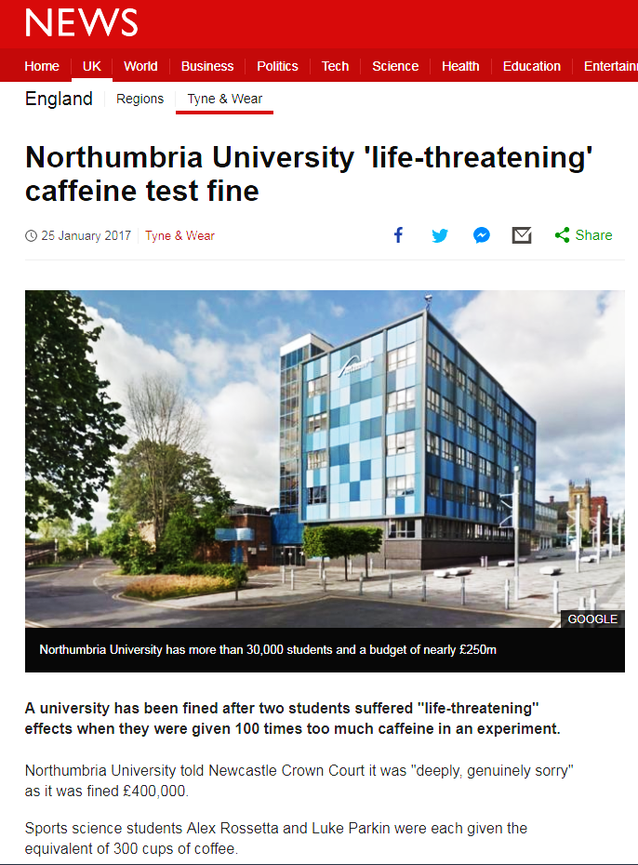
Northumbria University, March 2015
Caffeine Overdose
Two sports science students became seriously ill after being given 100 times the intended dose of caffeine (30g vs 0.3g)
No risk assessment, training or supervision of staff carrying out the experiment was in evidence
Breach of Section 3(1) of the Health and Safety at Work Act 1974
University pleaded guilty at the earliest opportunity
Fined £400,000 plus costs of £26,468.22
“All organisations who engage in experiments where people are given chemical substances should ensure that the risks are fully identified and strict procedures are devised and followed to ensure that the experiments can be undertaken safely.” – HSE Statement
Notes:
Section 3(1) Duty to ensure so far as is reasonably practicable the health and safety of people other than employees (i.e. students, visitors and members of the public)
Lethal dose of caffeine around 18g (170mg/kg)

Slide 14
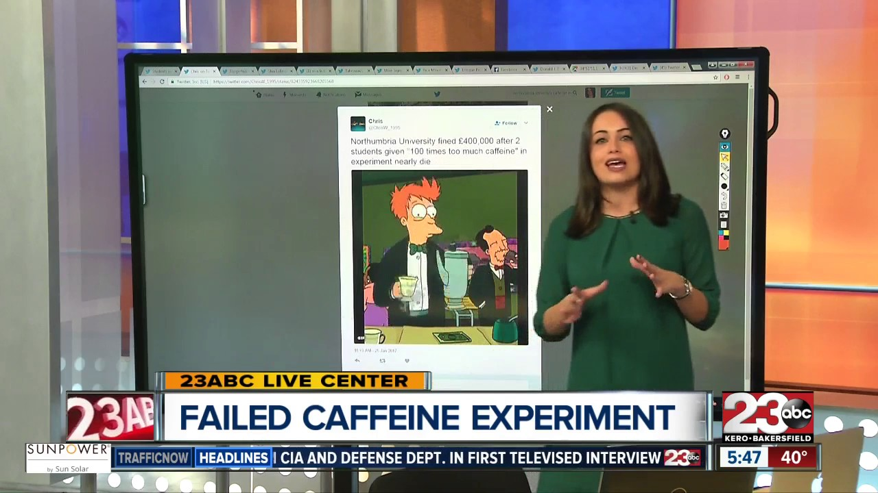






Slide 15
Summary
Health and safety is everyone’s responsibility but those in managerial and supervisory roles carry additional responsibilities
The more senior the person, the higher their level of responsibility
The level of responsibility also relates to the level of control exercised
Each manager / supervisor is responsible for those people and activities they are expected to control
Tasks / activities can be delegated but not accountability
Tasks should only be delegated to those who are competent to complete them
Training and development to ensure suitable and sufficient levels of knowledge is critical
Demonstrating due diligence is a key responsibility of management
The HSE can (and do) prosecute both individuals and organisations
Leadership and management of health and safety in higher education institutions
SEPS Website (Safety management for heads of management units)
Notes:
XXX

Slide 16

For Further Information Contact:
Dr. Phil Rodger (Chemical Safety Adviser)
E: Philip.Rodger@glasgow.ac.uk
T: 0141 3302799

