Slide 1
The Edinburgh Edition of the Selected Works of John Galt
General Editor:
Angela Esterhammer (University of Toronto)

Slide 2
Key Features:
It makes Galt’s work available in modern critical editions for the first time, including hitherto uncollected and in some cases unpublished texts
It gives students, scholars, and general readers access to entertaining and historically important Scottish literature
Each volume includes an introduction, annotations, and other textual apparatus such as glossaries and maps to contextualize Galt’s fiction for a twenty-first-century audience

Slide 3
The range of Galt’s fiction:
Scottish tales, humorous and serious
Transatlantic settings
Mediterranean and Near Eastern travels
Gothic
Historical fiction; mediaeval settings
Political commentary
Hoaxes and “postmodern” play with fictional worlds
Experiments with short fiction, narrative perspective, voice, temporality, metafiction

Slide 4
Editorial Board:
Gerard Carruthers (Glasgow)
Ian Duncan (Berkeley)
Penny Fielding (Edinburgh)
Suzanne Gilbert (Stirling)
Regina Hewitt (South Florida) Alison Lumsden (Aberdeen)
Katie Trumpener (Yale)

Slide 5
Projected volumes:
The Ayrshire Legatees (1820-1821) and The Steam-Boat (1822)
Annals of the Parish (1821)
The Provost (1822)
Sir Andrew Wylie, of that Ilk (1822)
The Entail (1823)
Three Short Novels: Glenfell (1820), Andrew of Padua (1820) and The Omen (1825)
The Gathering of the West and Other Scottish Tales
Transatlantic Tales
Miscellaneous Short Fiction, including European and Gothic Tales
Ringan Gilhaize (1823)
The Last of the Lairds (1826)
Lawrie Todd; or, The Settlers in the Woods (1830)
Bogle Corbet; or The Emigrants (1831)
The Member: An Autobiography (1832) and The Radical (1832)

Slide 6
Features of individual volumes:
Authoritative, collated texts based on comparison of extant versions and research into their history
Annotations to explain specialized vocabulary and geographical, historical, literary, and philosophical allusions
Introduction by the volume editor to illuminate the text’s history and relevant contexts of genre, print culture, and reception
Other critical apparatus: Galt chronology; bibliography of relevant primary and secondary reading; maps; excerpts from reviews
A glossary of Scots words and expressions

Slide 7
Planned volumes to date, with projected year of publication:
2020 – Annals of the Parish, ed. Robert Irvine
2020 – Three Short Novels: Glenfell; Andrew of Padua, the Improvisatore; The Omen, ed. Angela Esterhammer
2020 – Sir Andrew Wylie, of that Ilk, ed. Sharon Alker
2021 – The Provost, ed. Caroline McCracken-Flesher
2021 – The Entail, ed. Mark Schoenfield and Clare Simmons
2022 – The Ayrshire Legatees and The Steam-Boat, ed. Mark Parker
2023 – Bogle Corbet, ed. Katie Trumpener

Slide 10
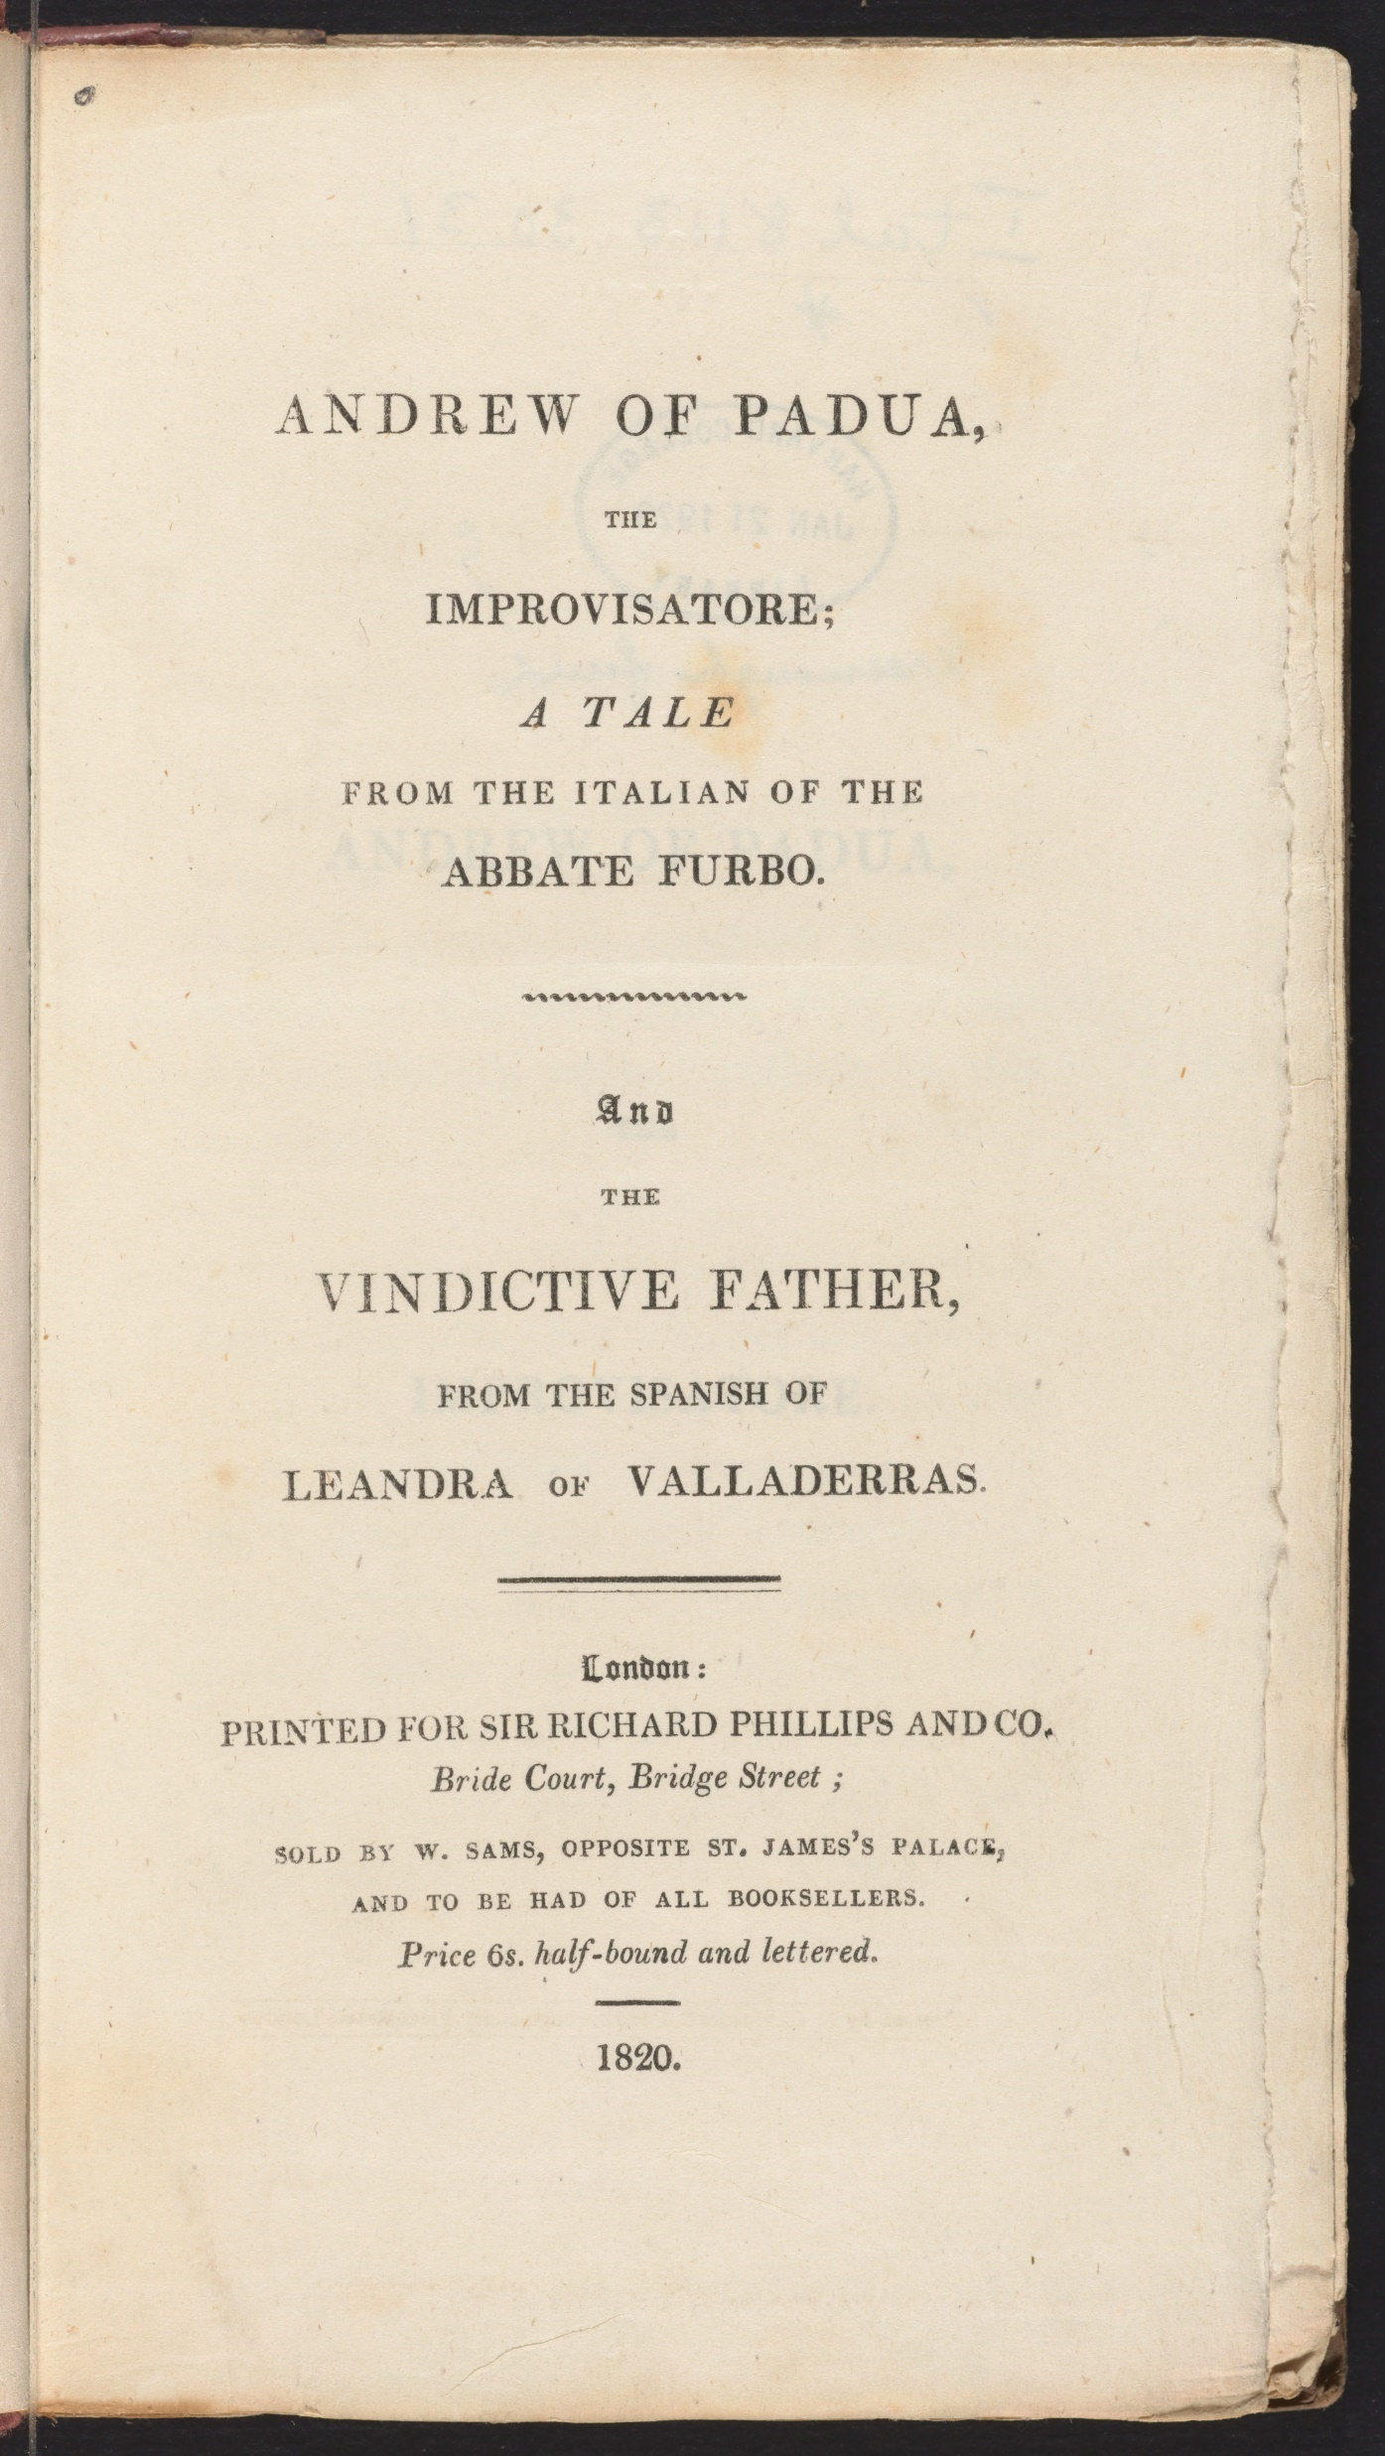

Slide 13
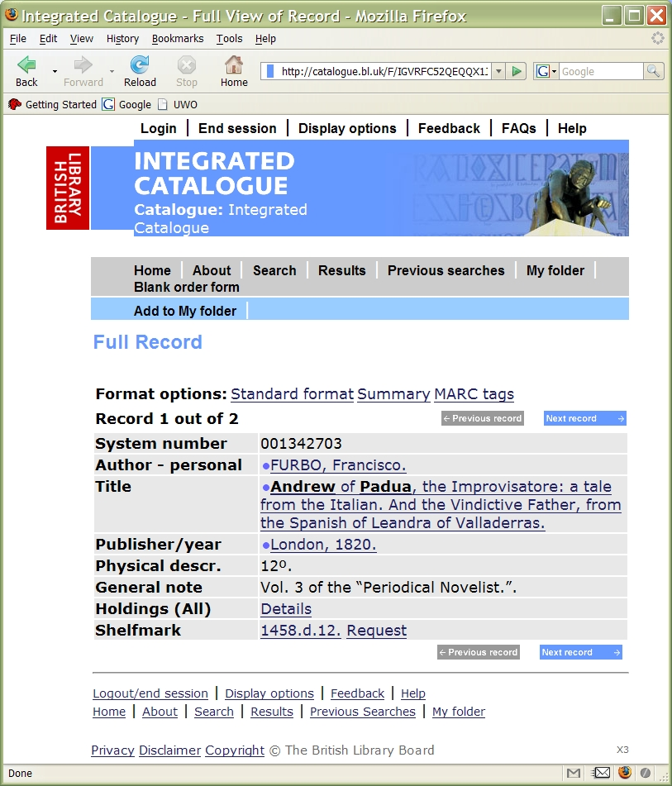

Slide 14
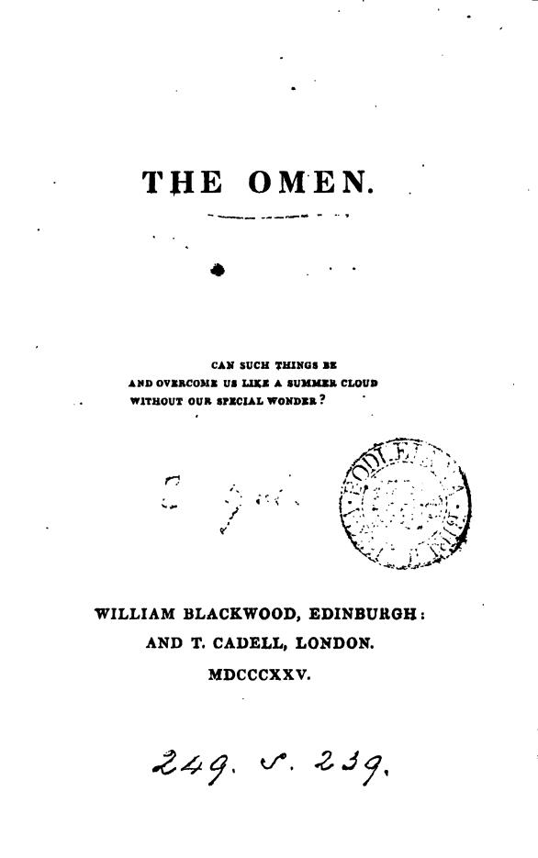

Slide 16
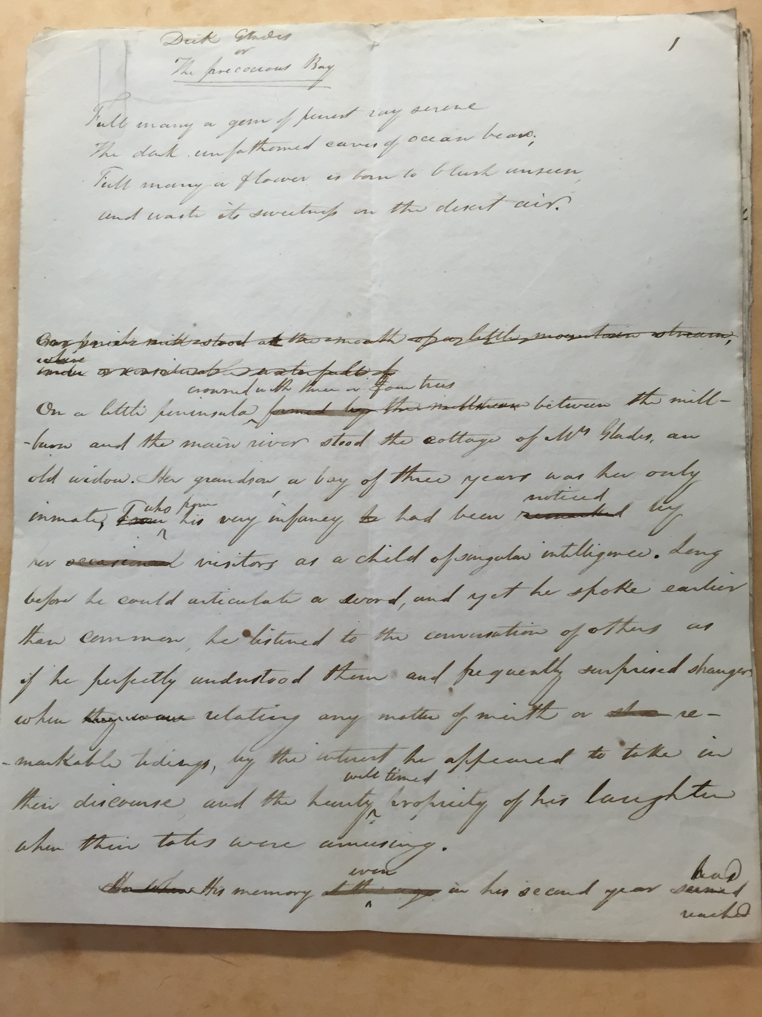

Slide 17
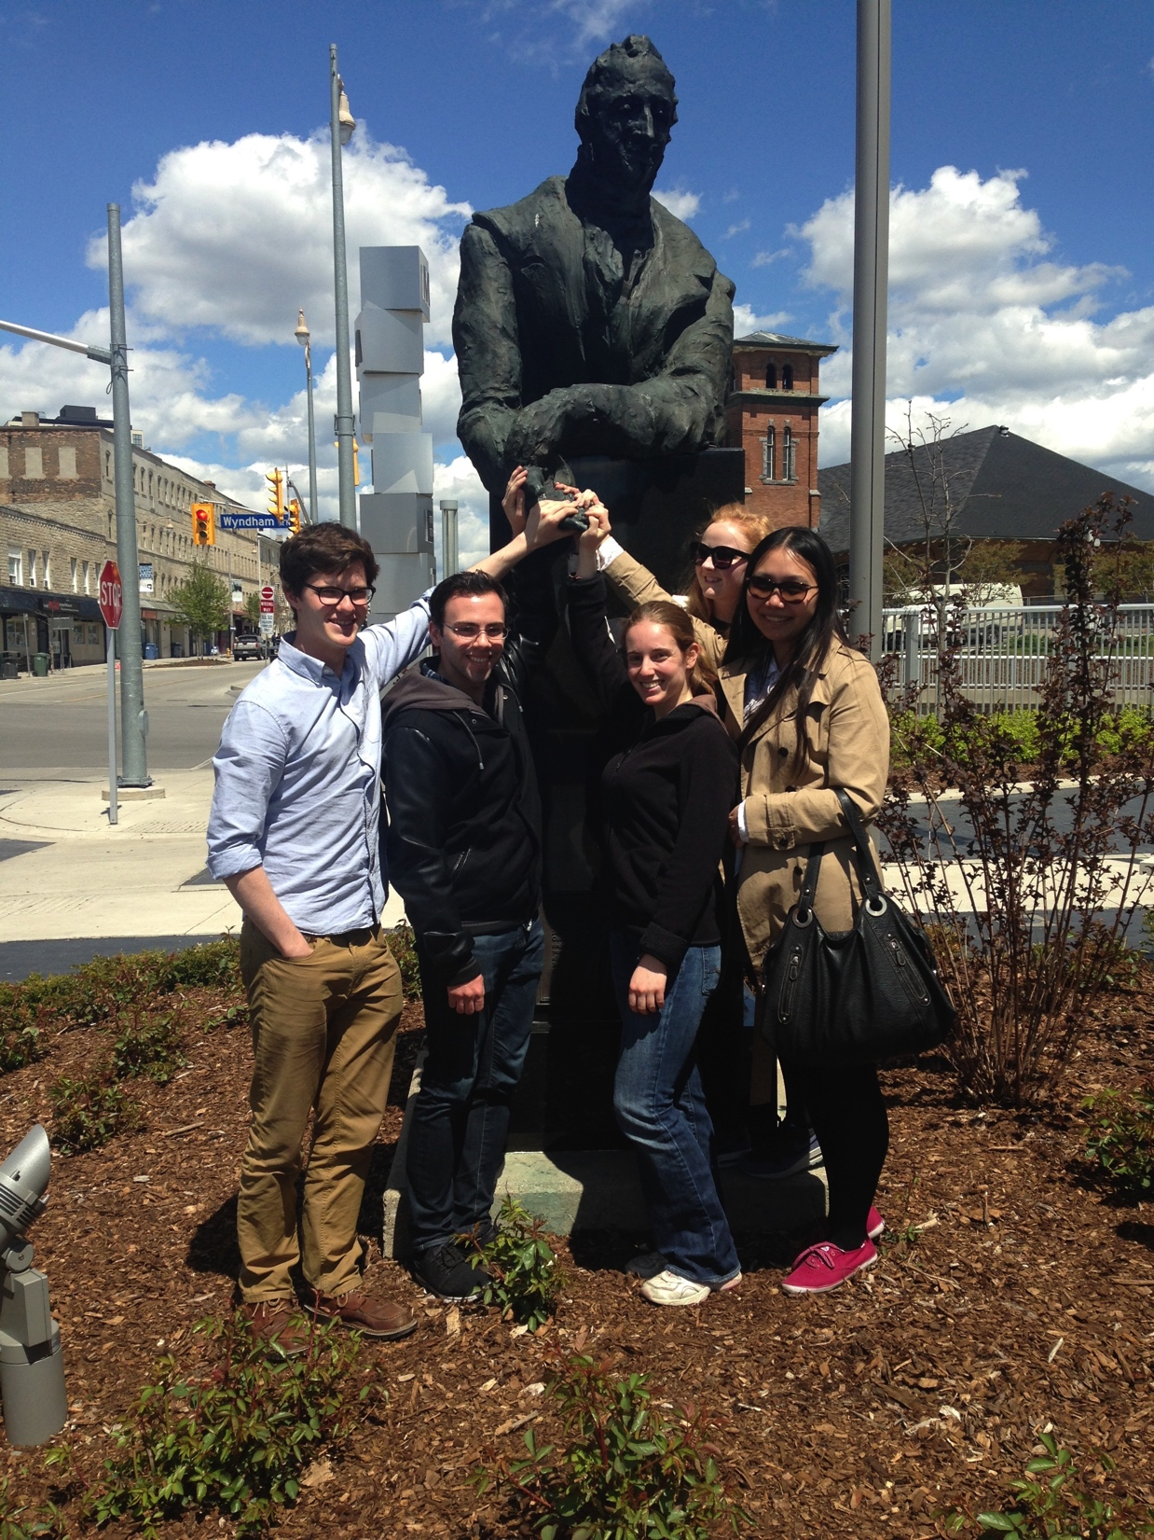
The John Galt Project, Victoria College in the University of Toronto
https://johngaltproject.wordpress.com/

