Slide 1
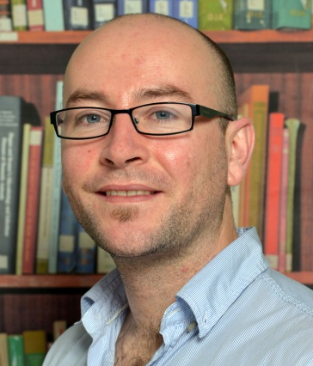
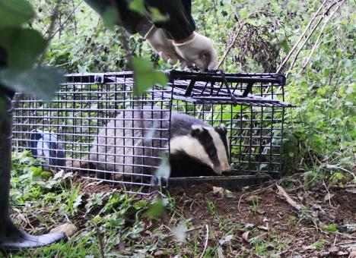
Dr. Andrew Byrne Veterinary Epidemiologist @AgriFood and Biosciences Institute (AFBI), Belfast
Veterinary epidemiologist with a background in ecology
Current/forthcoming research projects @AFBI includes:
1. The impact of concurrent infections on bTB disclosure in cattle
2. The impact of “problem” herds on bTB epidemiology in NI – chronic and recurrent breakdowns
3. bTB diagnostics – INF-g and serological tests
Also involved in continuing work on badger ecology (in collaboration with University College Dublin, DAFM, University of Guelph, Colorado State University; PhD student: Laura Martin)
Cattle and badger dynamics in relation to the potential transmission of Mycobacterium bovis (in collaboration with Queen’s University Belfast; PhD student: Emma Campbell)
Developing agent based model of badger bTB (with Wageningen University (Netherlands); MSc student: Marwa Ali)
Workshop goals: learn more about molecular epi, especially WGS, and it’s potentialities for further research and practical tool development.

