Slide 1
Challenging conventions: Towards ‘discipline-grounded’ ethical reflexivity in new media research
Dr Filippo Trevisan
MRC/CSO Social and Public Health Sciences Unit
University of Glasgow
25th April 2014
@filippotrevisan • www.filippotrevisan.net

Slide 2
To research or not to research?
Social networking sites: public or private? Is it OK to lurk, scrape, archive and, possibly, reproduce their content simply because it is publicly available?
Back to basics: what is the research trying to achieve? Benefit-cost analysis.
Two ethical ‘bottlenecks:’
Research design & data collection
Results presentation

Slide 3
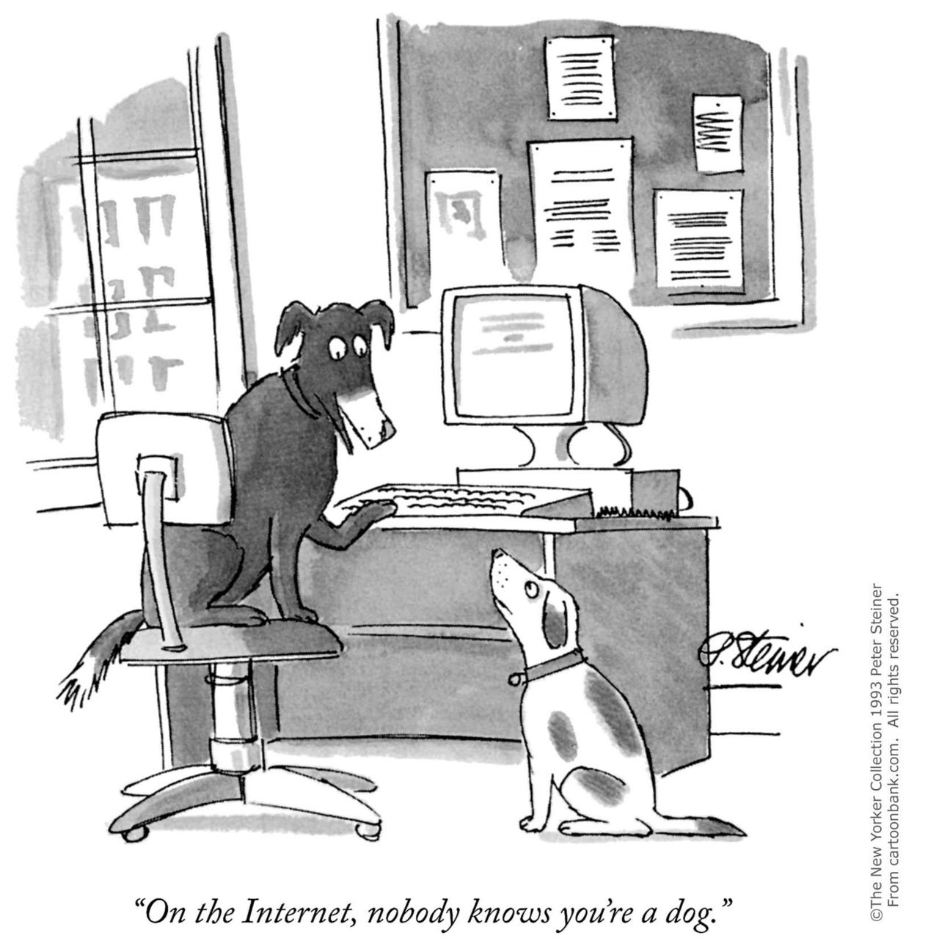
Collecting social media data
Are established ethical conventions still fit for purpose?
In disability research: ‘vulnerable groups’ concept:
Patronising and exclusionary
Ineffective in the context of online research
Generates an illusion of ethical compliance
Focus on what people are saying rather than trying to establish who said it: sensitive issues (e.g. individual daily routines; medical records; emotional accounts; financial details; discrimination and abuse episodes; suicidal thoughts; etc.) to be granted additional attention.

Slide 4
Presenting social media data
Key aim: project participants’ voices while protecting them from harm
Traditionally, anonymised quotes to contextualise content analysis: is this a safe system in new media research?
Problem: virtually impossible to guarantee anonymity, especially in the long term (technological changes may over-ride current privacy settings)
Innovative ways around verbatim quotes: fabrication (Markham, 2012) – controversial and potentially distortive

Slide 5
Read more: Trevisan, F. and Reilly P. (2014) Information, Communication and Society’s article on ethics and sensitive issues research online (FREE ACCESS): http://www.tandfonline.com/eprint/zxVn8JahxJ2whDSbwvxd/full#.U293VsfY9QI
Filippo Trevisan
MRC/CSO Social and Public Health Sciences Unit
University of Glasgow
Email: filippo.trevisan@glasgow.ac.uk
Web: www.filippotrevisan.net
Twitter: @filippotrevisan

