Slide 1






Popular strategies for dealing with non-fiduciary prescribing: a policy-centred analysis
Dr Neil Munro
Lecturer in Chinese Politics
China’s Health Reforms after Four Years: Public Evaluations
Peking University
16 September 2013.
School of Social and Political Sciences, University of Glasgow,
Adam Smith Building, Bute Gardens, Glasgow G12 8RT.
Email: Neil.Munro@glasgow.ac.uk www.gla.ac.uk/petu

Slide 2
Key Issue
Non-fiduciary prescribing: driven by needs of the doctor rather than of the patient, wastes the patient’s limited resources
Policy responses so far have focussed on changing incentive structures, e.g. use of treatment protocols and case-based payment to prevent costs of diagnosis and treatment from escalating, expanding the list of medicines covered by insurance.
These policies may be enhanced if we understand:
  how ordinary people respond to non-fiduciary prescribing AND
  the relationship of their responses to performance evaluations and trust in the health care system and health care professionals AND
  the distribution of responses across different social and economic categories.

Slide 3
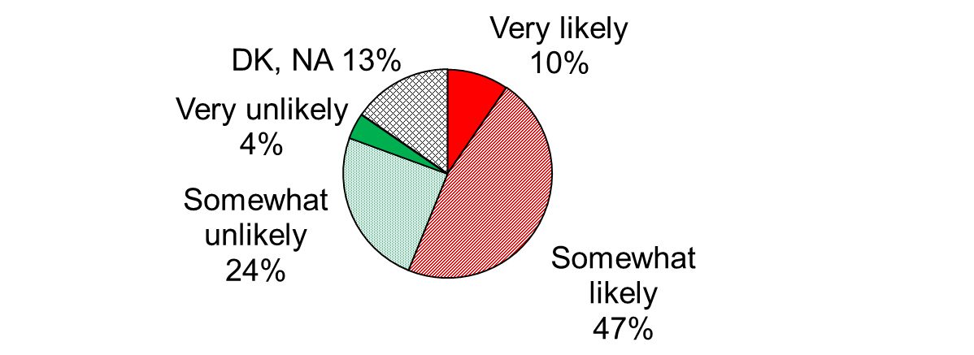
Figure 1. Perceived Prevalence of Non-Fiduciary Prescribing
C21. Some people say medical ethics is a big problem in this country, but others say such reports are just exaggerated. Judging from your own personal experience, how likely do you think it is that you would encounter the following types of situations in city or county hospitals around here? a) Prescribing medicines not covered by insurance even when effective alternatives covered by insurance are available.
Source: Performance Evaluations, Trust and Utilization of Health Care in China Survey, 2012-13, fieldwork 1 November 2012-17 Jan 2013, N=3,680

Slide 4
Key concepts
Exit: a strategy for responding to an unsatisfactory service by changing the doctor or health care provider for another one, presumed to be more loyal to the patient’s interests.
Voice: a strategy for responding to an unsatisfactory service by speaking or acting to influence the behaviour of the doctor or health care provider.
Particularism: a strategy for responding to an unsatisfactory service which helps a particular patient but not others in a similar situation. Universalism, its opposite, helps not just the particular patient, but all others who receive a similarly unsatisfactory service.

Slide 5
Table 1. Three Dimensions of Strategy
 | Universalistic |  | Particularistic
 | Voice | Exit | Voice | Exit
Proactive | Make a formal complaint | Change provider | Pay a bribe, Ask the provider to change their decision | Use connections to find another provider
Passive | Accept the treatment without resolving the dilemma, Don’t know, Give up treatment
Source: adapted from Hirschman, A. O. (1970). Exit, Voice and Loyalty: Responses to Decline in Firms, Organizations and States. Cambridge, MA, Harvard University Press.

Slide 6
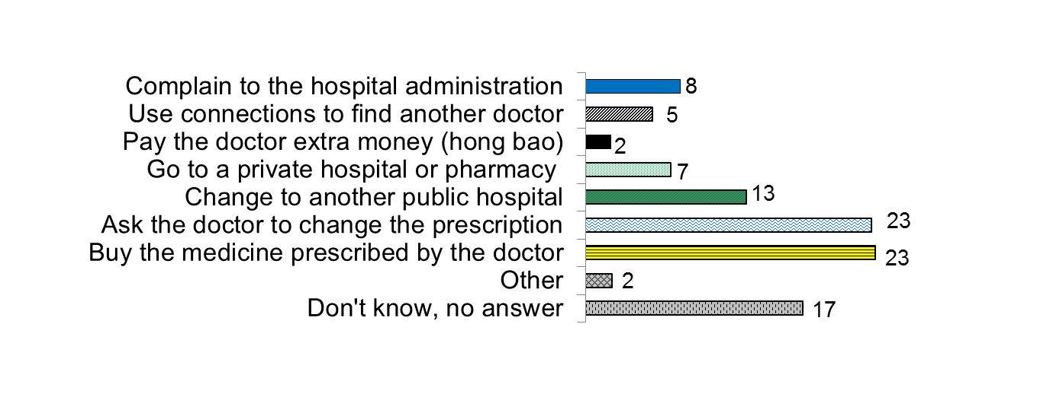
Figure 2. Preferred Strategies for Dealing with Non-Fiduciary Prescribing
B22. What would you advise your friend to do if the doctor at a public hospital prescribes a lot of expensive medication which is not covered by insurance even when cheaper alternatives are available? (One answer).
(% replies)
Source: Performance Evaluations, Trust and Utilization of Health Care in China Survey, fieldwork 1 November 2012-17 January 2013, N=3680.

Slide 7
Explanation of method
In the analysis below, the reference category is “buy the medicine prescribed by the doctor” that is, the passive strategy described above. The other strategies are pro-active strategies.
In tables below, the dependent variables is log (probability of choosing a given proactive strategy/probability of choosing the passive strategy)
These “odds ratios” compare the probability of adopting a particular active strategy (such as asking the doctor to change the prescription or changing hospitals) to the probability of adopting the passive strategy.

Slide 8
Relationships to be tested
Dependent variable: which strategy does respondent prefer?
Key independent variables:
  Performance evaluations:
    health system as a whole
    skills & competence of doctors
    comparing public and private service & treatment
  Trust in health care institutions (global trust)
  Perceived likelihood of unethical practices (non-fiduciary prescribing, unnecessary diagnostic tests, taking hongbao)
Controlling for: age, gender, education, urbanization, hukou, self-assessed health, difficulty paying health bills, local government spending per capita

Slide 9
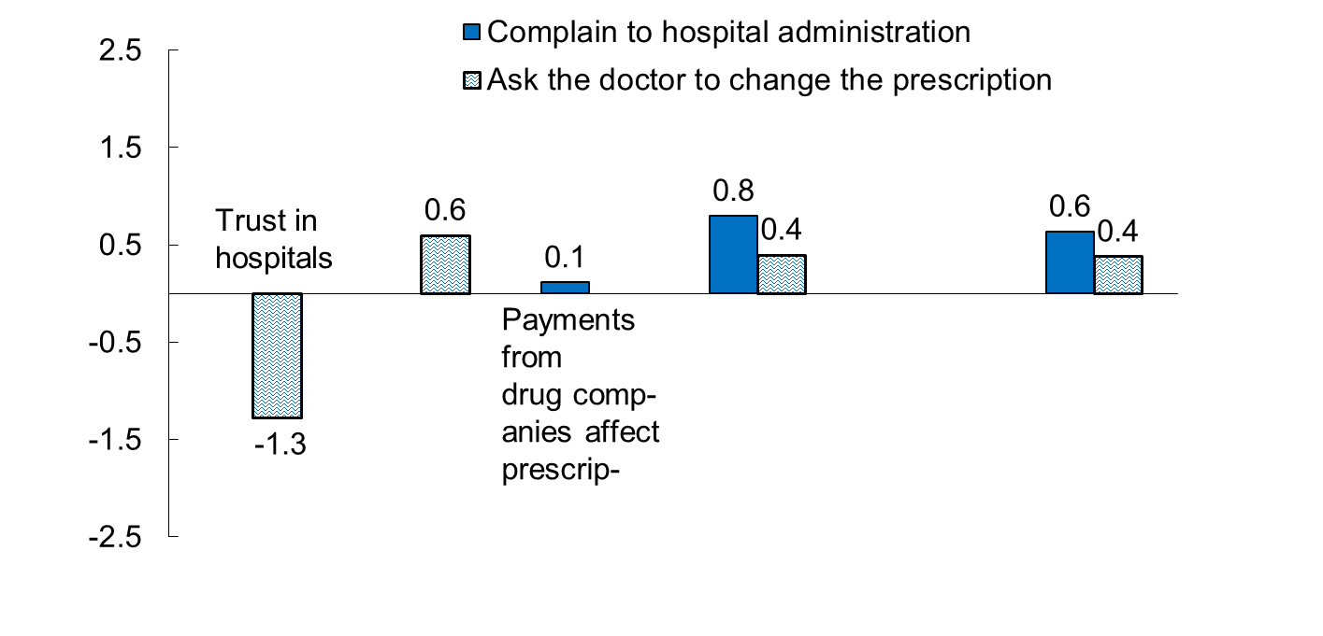
Figure 3a. Impacts of Independent Variables on Odds of Using Voice
Impact*
Unethical
practices
likely
Private
treatment
better
Local gov’t
expenditure
per capita
* Impact on logged risk ratio relative to reference category, computed by multiplying multinomial logistic regression coefficients by the mean of the independent variables. Impacts not significant at .05 level are not shown.
Source: Generalized linear mixed model for data in Figure 1, N=3,446.

Slide 10
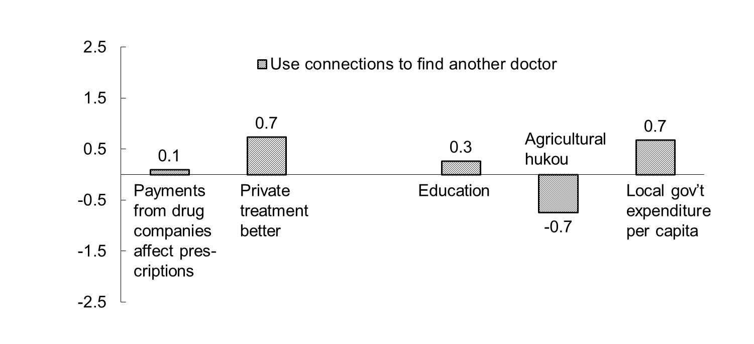
Figure 3b. Impacts of Independent Variables on Odds of Using Connections
Impact*
* Impact on logged risk ratio relative to reference category, computed by multiplying multinomial logistic regression coefficients by the mean of the independent variables. Impacts not significant at .05 level are not shown.
Source: Generalized linear mixed model for data in Figure 1, N=3,446

Slide 11
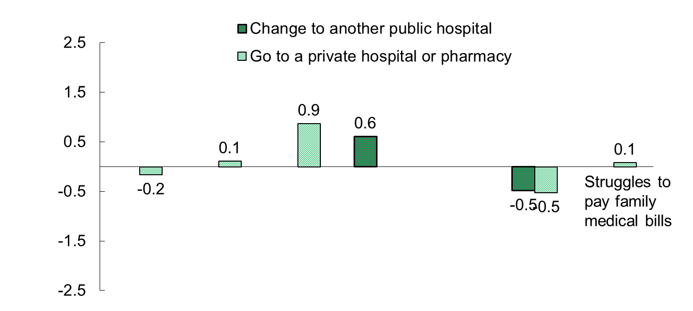
Figure 3c. Impact of Independent Variables on Odds of Using Exit Strategies
Impact*
Health care
system
needs
fundamental
reform
Agricultural
hukou
Payments from
drug comp-
anies affect
prescriptions
Unethical
practices
likely
Private
treatment
better
* Impact on logged risk ratio relative to reference category, computed by multiplying multinomial logistic regression coefficients by the mean of the independent variables. Impacts not significant at .05 level are not shown.
Source: Generalized linear mixed model for data in Figure 1, N=3,446.

Slide 12
Key Findings
Agricultural hukou discourages exit strategies (including connections, changing hospitals, going private). People in richer locations are more active in terms of voice (both complaining and asking) and also use of connections to get a referral. Favourable views of private treatment encourage proactive responses including both voice and exit, but these do not include going to a private hospital or pharmacy for a prescription. Trust in hospitals discourages voice (asking the doctor to change the prescription). Awareness of unethical medical practices encourages proactive responses including both voice (asking the doctor to change the prescription) and exit (going to a private hospital or pharmacy).

Slide 13
Policy points for discussion
Policies should make use of patients’ capacity for voice, e.g. by institutionalizing complaints offices (ombudsmen) which operate at arms-length from hospital administrations and are empowered to investigate and punish unethical practices.
Market mechanisms work better with better information. The authorities should monitor (survey) and publish tables of patient satisfaction with medical ethics alongside other performance criteria for each hospital.
Those with agricultural hukou may face some restrictions on choice of hospitals (eg. tied hospitals). This may make them captives to poor ethical practices in their local area.

