Slide 1
Thermodynamics 1 (ENG1066)
School of Engineering
Dr Manosh Paul
Dr John Howell
http://moodle2.gla.ac.uk/course/view.php?id=1237

Slide 2
Glasgow History behind the Subject
Prof. Lord Kelvin discovered Thermodynamics Scale.
Prof. William Rankine founder of the subject and wrote first Thermodynamics book.
James Watt invented Steam Engine.
Robert Stirling invented Stirling Engine.
John Logie Baird - Inventor of the world's first television, "The father of television”.
Prof. Ian Donald first used diagnostic ultrasound in medicine.

Slide 3
Course & Exam Formats
Course Format:
Total Lecture: 20
Tutorial Number: 3
Lab Number: 2
Course Credit: 10
Exam Format:
Thermodynamics 1 (ENG1066)
Semester 2
Exam length: 1 hr 30 mins
Compulsory Question: 6

Slide 4
What to expect?
This course is designed to give students an introduction to engineering thermodynamics.
It concentrates upon basic principles, so that students can apply their understanding to a wide range of thermodynamics problems relevant to modern engineering.
To demonstrate the principles lecturers on the course will provide examples of relevance to aerospace, biomedical, civil, electrical and mechanical engineers.

Slide 5
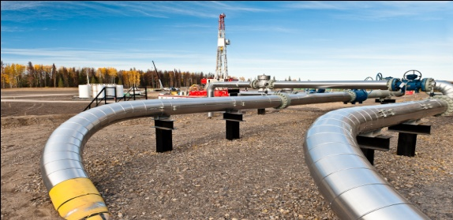
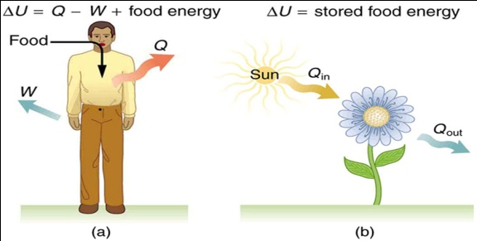
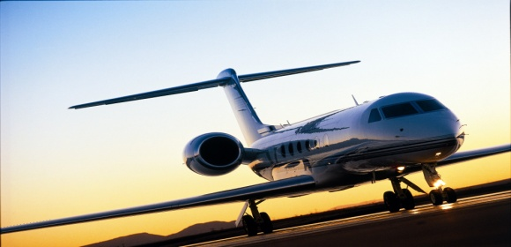
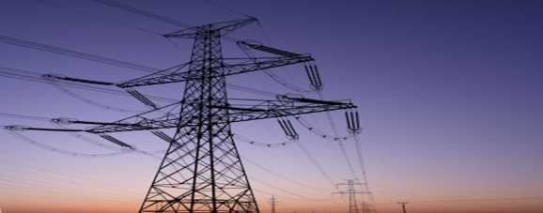
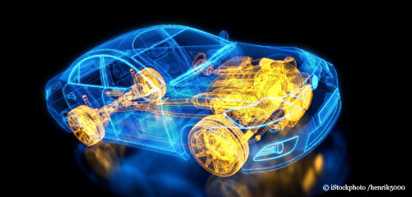
Topics Covered
Introduction to Thermodynamics
Heat, Mass & Power
Mechanisms of Energy Transformation
Renewable and Non-renewable Energy
Energy Conservation
Chemical Processes
Heat Engines and Pumps
Turbines, Compressors, Pumps, Windmills, Car and Jet Engines
Healthy Lifestyle
Heat Transfer from Human Body

