Slide 1
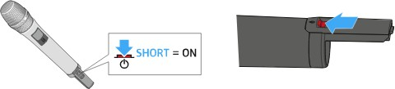
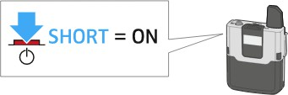
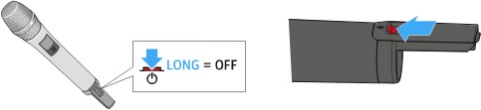
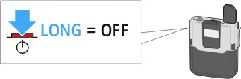
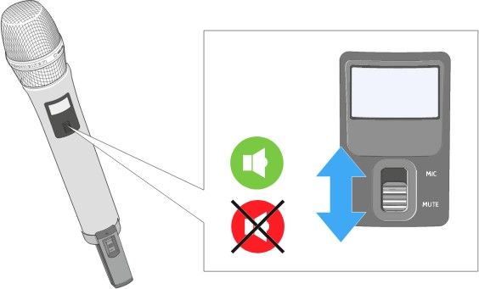
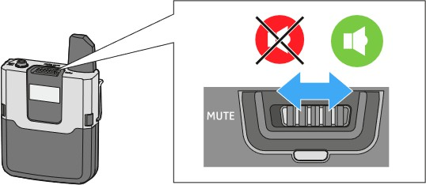
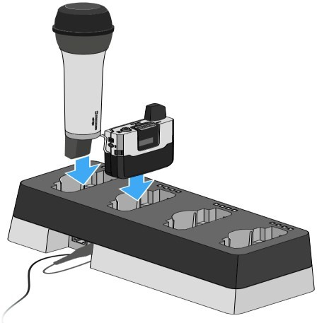
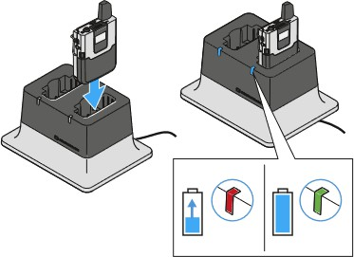
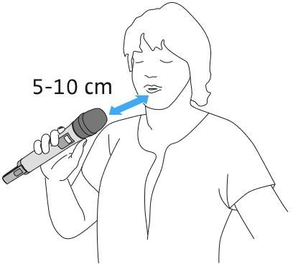
Using microphones in Learning spaces guide
-The microphones should turn on after 3—5 seconds when they are removed from the charger.
Switch On:
Short-press the ON/OFF button.
Switch Off:
Press the ON/OFF button for ap-prox. 3 seconds.
Microphones should be used at all times in teaching sessions to support accessibility and lecture recording - even if you feel your voice can be heard without one.
To mute the microphone:
Slide the MUTE switch to the position MUTE.
To unmute:
Slide the MUTE switch to the position MIC.
Charging the microphone:
Insert the microphone into the charger’s charging slots.
Make sure the charging contacts face downward.
The microphone fits into the charger in only one direction.
For the best audio experience
Hold the handheld microphone approx. 5-10 cm in front of your mouth
NOTE: Please DO NOT turn the microphones OFF after use.
Please leave them ON and place in charger.
Attach the lapel microphone 25 cm in front of your mouth.

Slide 2
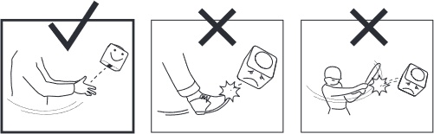
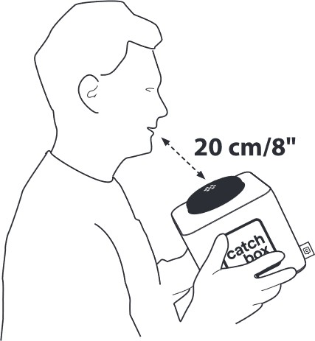


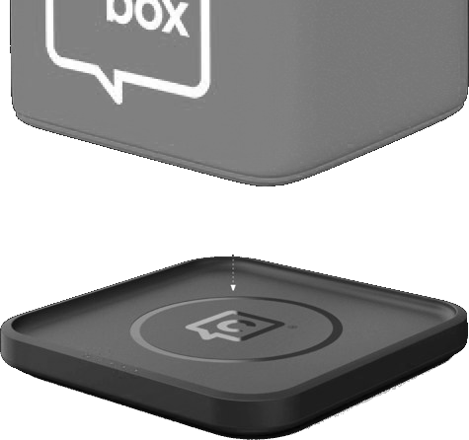

After use, place the Catchbox back on the charger.
Throwing the Catchbox.
To throw the Catchbox microphone, find someone in the audience who wants to ask a question or make a comment. Make sure that person and those around him or her are aware of the situation and are prepared to catch.
Usingthe Catchbox.
To use the Catchbox, simply speak into the foam cap located on top of the Transmitter. An optimal dis-tance of 20 cm / 8 in will provide the clearest sound while not blocking the face of the person speaking.
Short, underhand passes of up to 5m / 16 ft distance are recommended.
If someone farther away has a question, try to get the entire audience involved by having members pass the Catchbox short distances to the person who wants it. This is a great way to activate the crowd.
Using the Catchbox near loudspeakers can cause audio feedback.
Improper throwing and use of the device can lead to serious injury and/or property damage.
Do not throw at people’s heads and always make sure everyone is aware of the situation before throwing.
Do not use in situations with fragile objects, liquids, or people susceptible to injury.
Do not kick or hit the Catchbox.
Support
Please visit
Glasgow.ac.uk/microphones

