Slide 1

Guidance notes – delete slide before presenting
This deck of slides is intended to support staff who are making presentations about the University.
Slides 3 to 15 are pre-populated with text and images that provide information and promote the University.
Slides 17 to 27 provide various layout options ready for your own text and images.
Slide 28 is a suggested closing slide.
These slides have been designed to be accessible to all, meeting our legal requirements on digital accessibility. You will have to add your own text (title and body text) to make these pages comply with accessibility guidance and also provide alt text for any images, graphics or videos. For more information see https://www.gla.ac.uk/myglasgow/digitalaccessibility/documents/#tab=tab-3

Slide 2

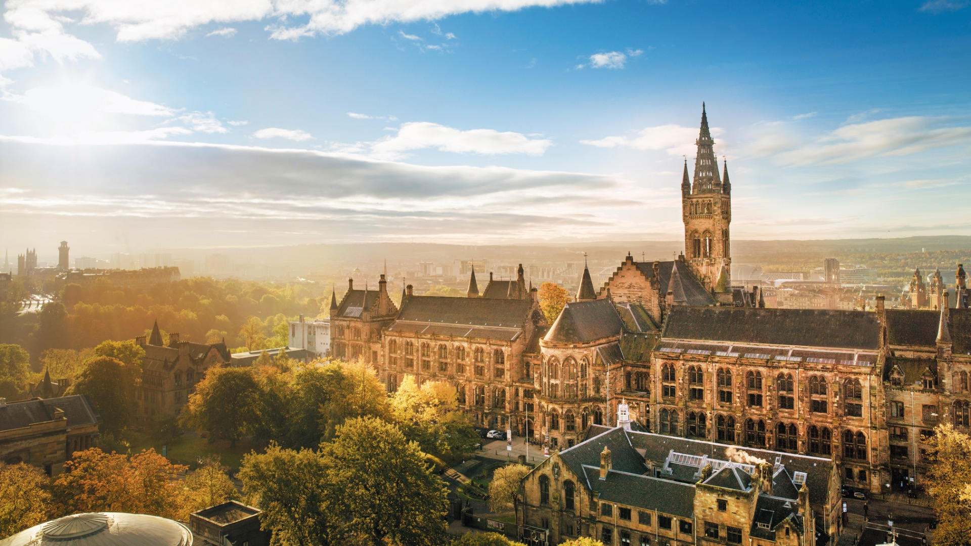


Slide 3
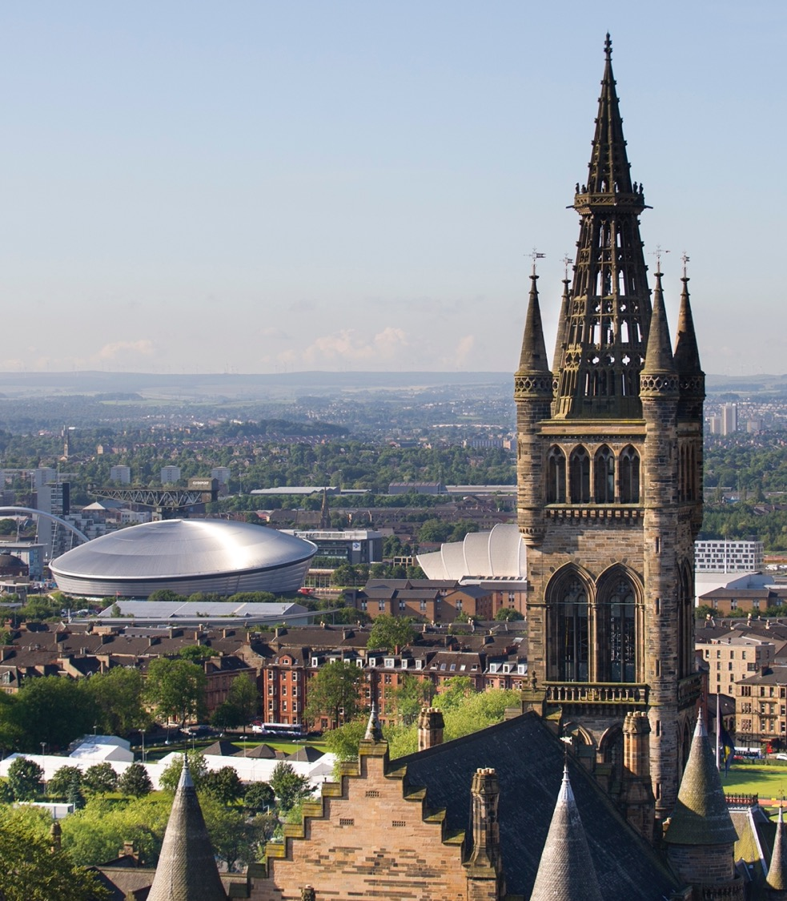
About the University
Established in 1451
Ranked in the top 100 of the world’s universities
Ranked in the top 30 universities in the world for sustainability
Member of the Russell Group of research-intensive UK universities
Eight Nobel Laureates connected to the University

Slide 4

Student experience
35,000 students from 140 countries
350+ student clubs and societies
Study abroad opportunities in 180 destinations worldwide
95% of our graduates are in work or further study 15 months from graduation (Graduate Outcomes Survey 2022/23 cohort)

Slide 5
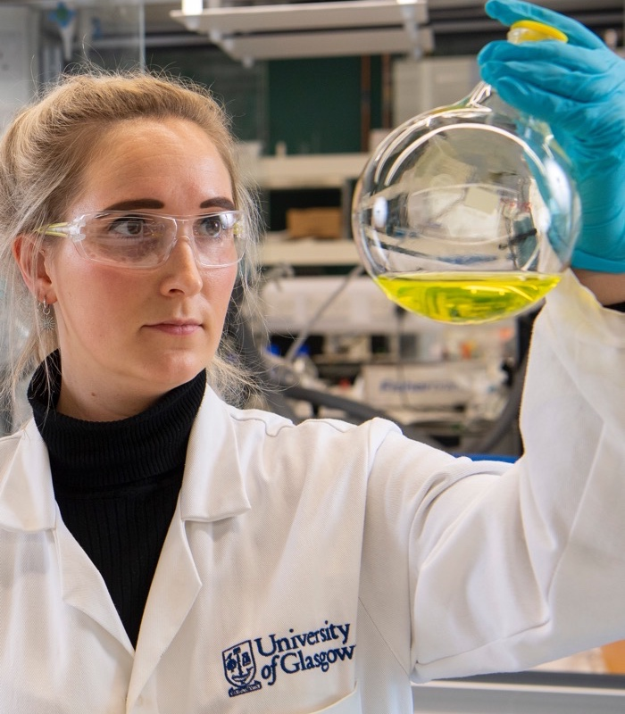
Research with impact
We have been recognised for our world-leading research and the positive impact it has on society, by the Research Excellence Framework (REF) 2021.
1st in Scotland for Grade Point Average and research outputs
13th in the Russell Group for research power and 5th in Russell Group for 4* research outputs

Slide 6
Inclusive Glasgow
The University of Glasgow is committed to building an inclusive and welcoming community for all.
We encourage, prepare and support students who are under-represented in higher education to achieve entry to university.
Our University of Sanctuary status recognises the safe and welcoming environment we provide for refugees and asylum seekers.

Slide 7
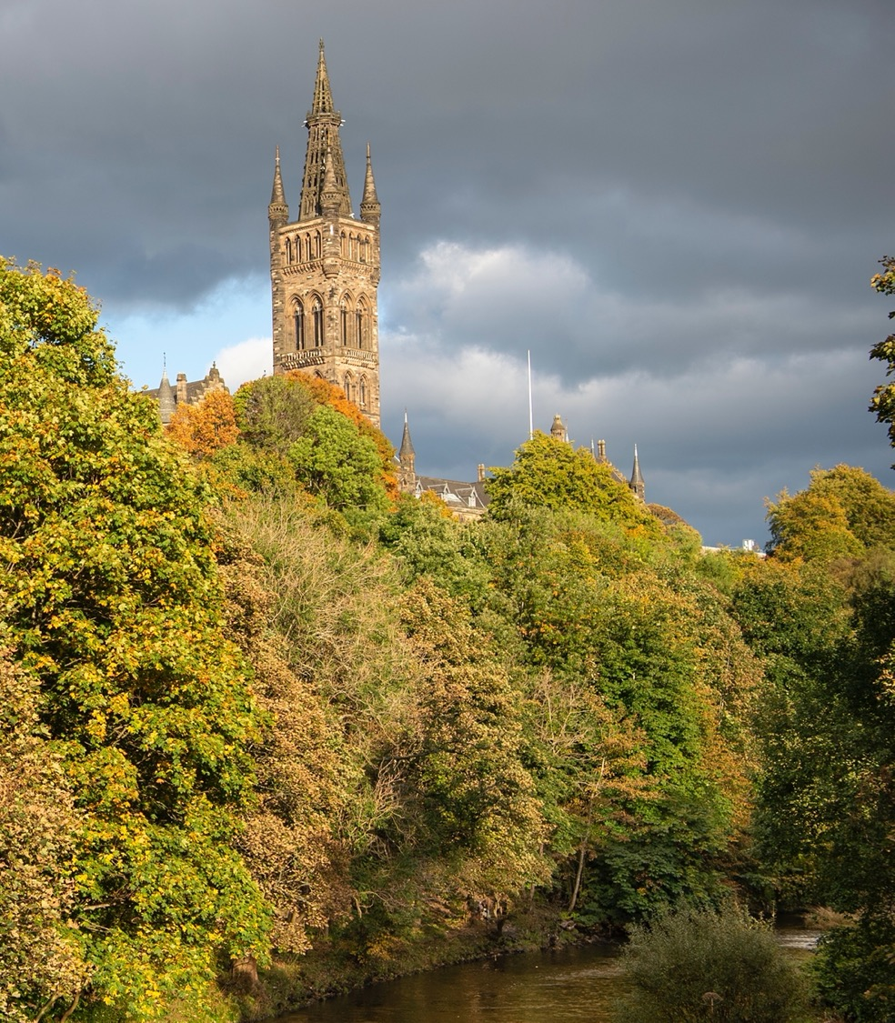
UofG and the SDGs
We are committed to working towards the United Nations' Sustainable Development Goals.
In 2014 we were the first UK university to declare we would divest from fossil fuels by 2024
We were the first university in Scotland to declare a Climate Emergency
We have committed to achieve carbon neutrality by 2030

Slide 8
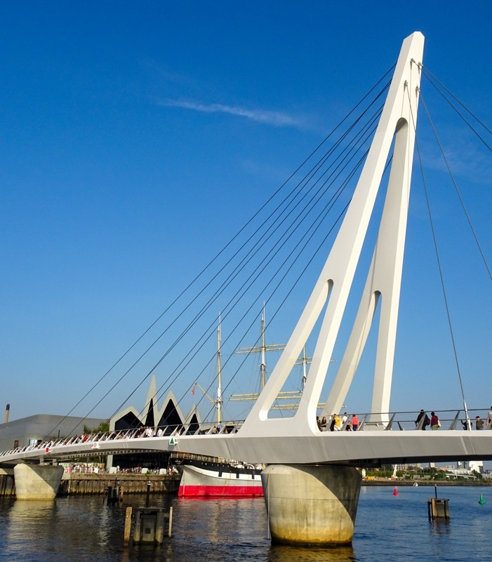
Our city, our partner
We are engaged in strong, enduring research and community partnerships to improve health, boost the economy, and build a better future for those living in Glasgow.
The University is a key player in the city’s ambitious plans for the regeneration of the River Clyde and in the development of a Glasgow Riverside Innovation District.

Slide 9
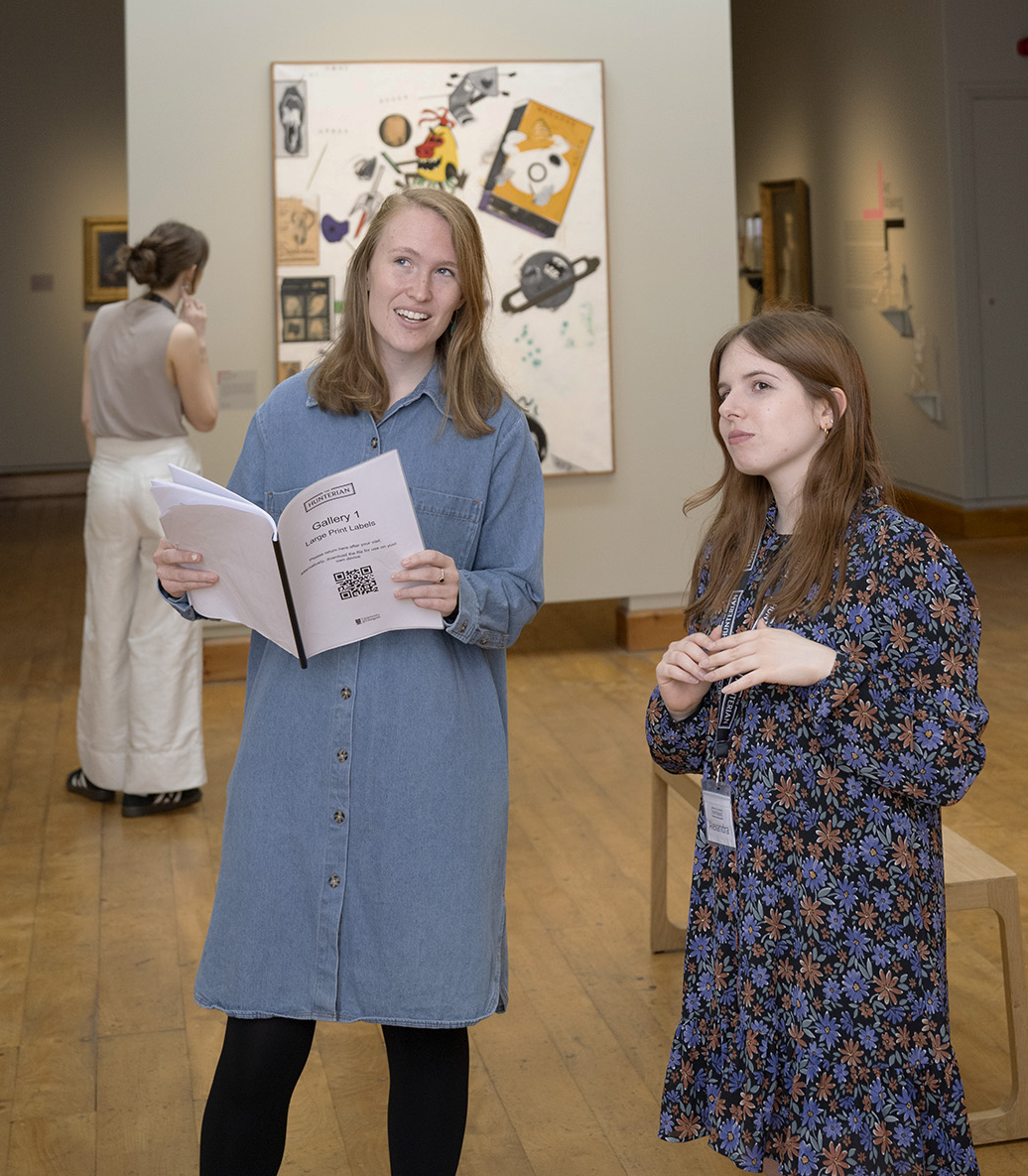
Collections
Founded in 1807, The Hunterian is Scotland's oldest public museum and home to one of the largest collections outside the National Museums.
Collections include the world’s largest display of James McNeill Whistler and Charles Rennie Mackintosh.
Around 1.5 million items relocated to purpose-designed study and storage facilities at Kelvin Hall.

Slide 10

Connecting globally
We have established partnerships with institutions across the world.
We are a founding member of Universitas 21 and the Guild of European Research Intensive Universities.
We are associate member of CIVIS, a European Civic University formed by the alliance of leading higher education institutions across Europe.

Slide 11
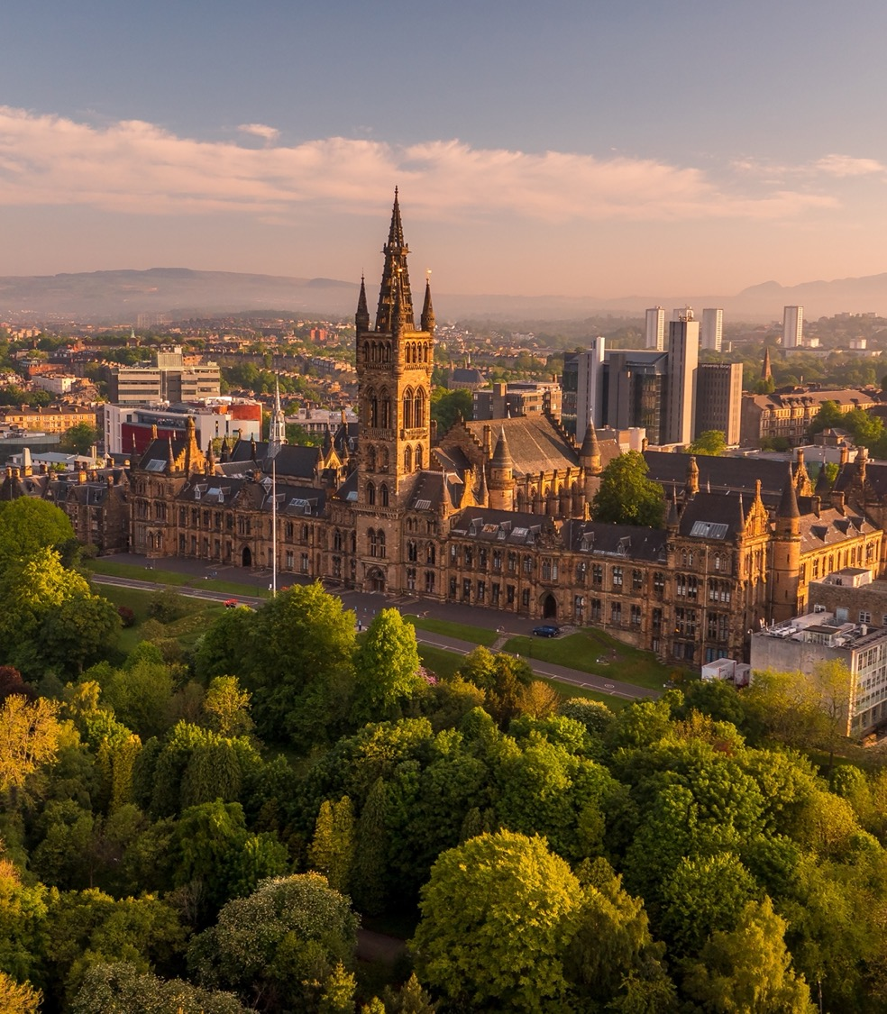
Our expanding campus
Over the last decade, we have invested in our estate to expand our world-class campus and facilities.
James McCune Smith Learning Hub
Mazumdar-Shaw Advanced Research Centre
Clarice Pears Building
Adam Smith Building

Slide 12
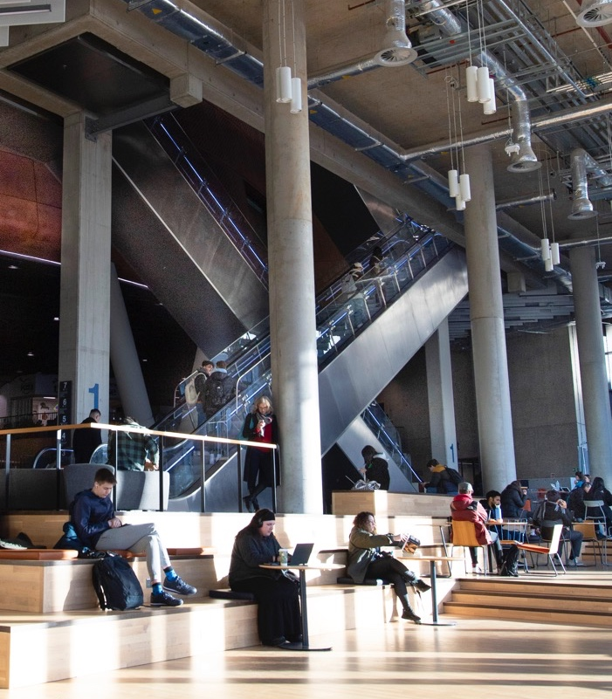
The James McCune Smith Learning Hub
The James McCune Smith Learning Hub provides state-of-the-art teaching facilities, with flexible study spaces and interactive teaching for students to help create a more immersive learning experience.

Slide 13
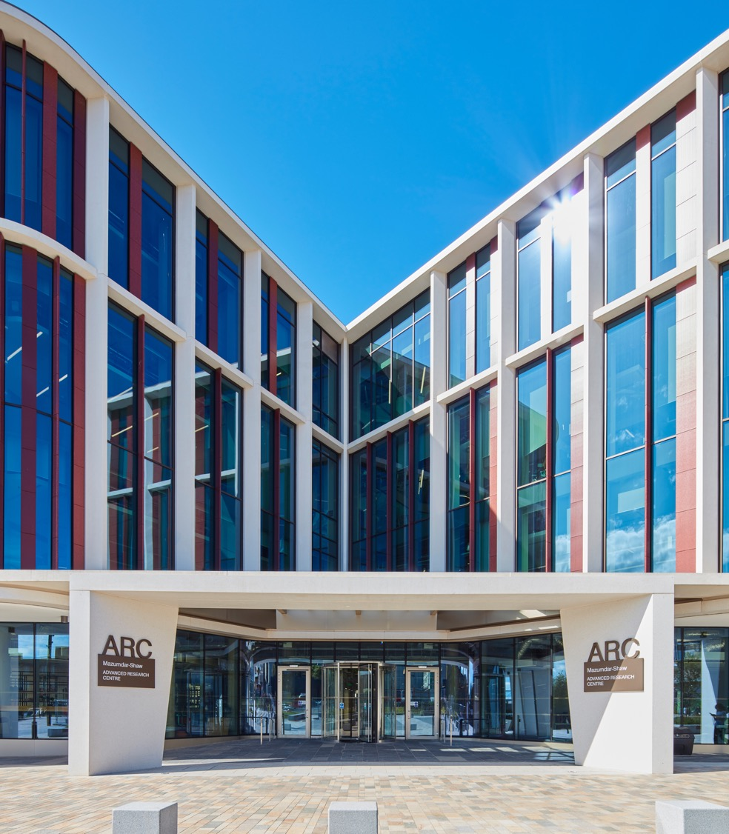
The Mazumdar-Shaw Advanced Research Centre (ARC)
The ARC is the creative and collaborative heart of research at the University of Glasgow. The building bridges the boundaries between research, cross-subject collaboration and true societal impact.

Slide 14
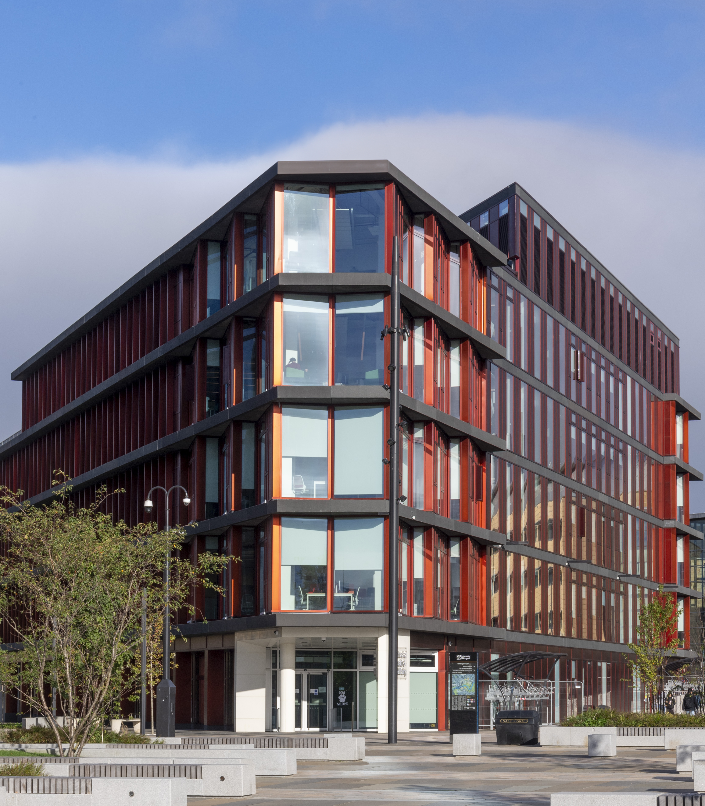
Clarice Pears Building
The Clarice Pears building brings together academic leaders from public health, medicine, epidemiology, psychology and health data science to address some of the world's greatest health challenges.

Slide 15
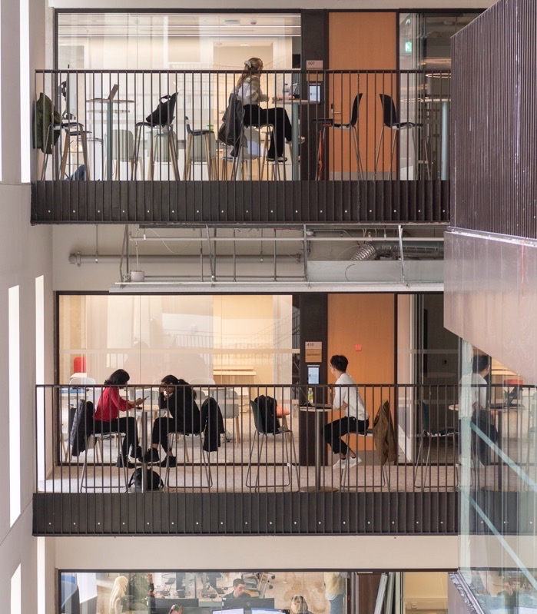
Adam Smith Building
The Adam Smith Building provides world-leading facilities for the Adam Smith Business School.
The building also supports a community of postgraduate students across a wide range of disciplines and professional focus, with the aim of transforming learning experiences.

Slide 16
Guidance notes on blank layouts – delete before presenting
Slides 17 to 27 provide various layout options ready for your own text and images.
To change the crop of the image select the image and then using the ‘Crop’ tool from the menu to adjust the placing/scale, or just right-click the image and select ‘Crop’ from the list. Do not stretch or skew the image by moving the handles on the image box about.
If you need to create a new text box, make sure that "Do not autofit" is selected by going to Format> More options>Text options>Do not autofit - this will prevent that the text formatting changes when the files is transferred to another user.
These slides have been designed to be accessible to all, meeting our legal requirements on digital accessibility. You will have to add your own text (title and body text) to make these pages comply with accessibility guidance and also provide alt text for any images, graphics or videos. For more information see https://www.gla.ac.uk/myglasgow/digitalaccessibility/documents/#tab=tab-3

Slide 28


