Slide 1

A&F Practice Enhancement Tool
Guide

Slide 2

What is the A&F PET?
The Practice Enhancement Tool is an annual survey to support teaching staff. It will feed back your experiences of embedding the Learning Through Assessment (LTA) pillars in your teaching.
The results of this survey is displayed in School and College view on dashboards, to support evidencing of best practice and areas where further support can be offered.

Slide 3
When is the A&F PET taking place?
The Practice Enhancement Tool will launch on the 26th March 2025.
The survey will stay open for one month, and close on the 26th April 2025.
The survey can be completed via individual Qualtrics survey links, which will be emailed directly to all teaching staff members.

Slide 4




What’s the process of the A&F PET?
Access A&F PET through personalised email from Qualtrics
Answer the questionnaire & save your responses
After the survey closes, you will receive an email link to the A&F PET dashboard

Slide 5

How do I use the dashboard?
Reflect on your results and compare them to your School/College dashboard
Refer to the Assessment &
Feedback Resources Hub and the LTA framework for guidance
Engage with the A&F PET annually for continuous reflection and improvement
Talk to your colleagues about success / improvement areas

Slide 6


Why should I engage?
See improvement in my own practice and changes in my School
Allows you to help highlight areas of strength in your School
You will gain access to support resources and workshops aligned to the LTA

Slide 7
Due to the considerable engagement with the A&F PET in 2024, further support for colleagues was rolled out across the University:
Introduction of a Learning Through Assessment Hub; to enhance the support for teaching staff to change assessment and feedback practices.
Assessment Changes Workshops led by Academic and Digital Development to support assessment changes at a College level.
The LTA has been embedded in learning on the PGCAP, with 120 staff in 2023 benefitting from learning on it.

Slide 8
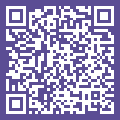
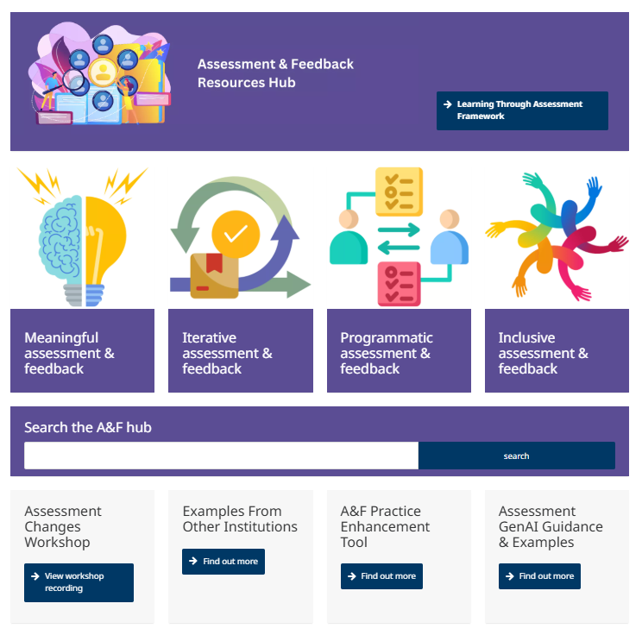
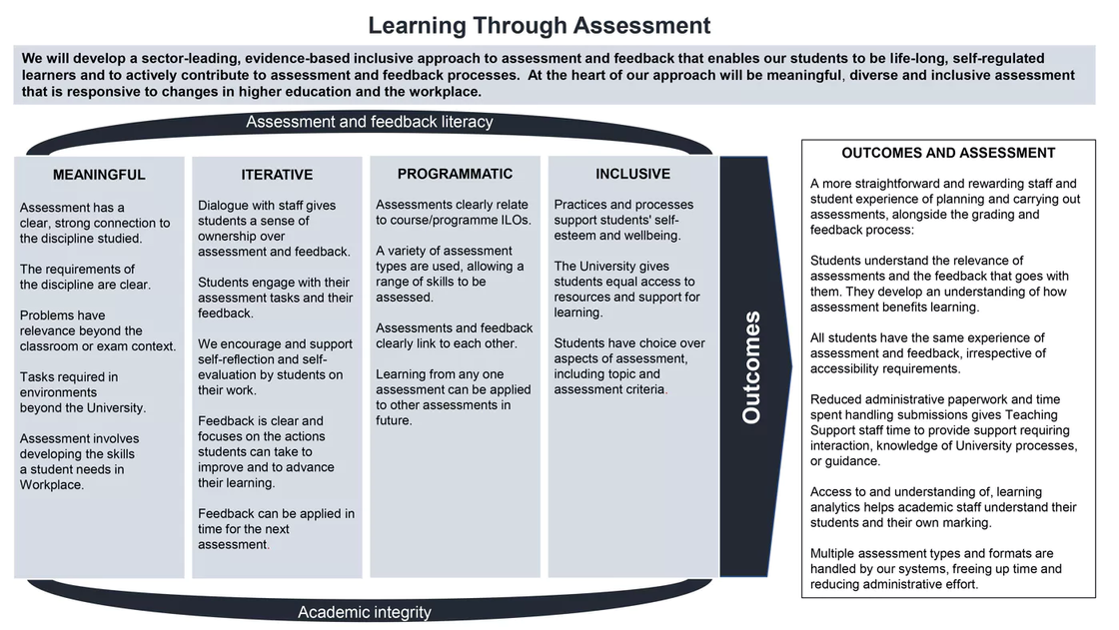
Access the A&F Hub for further information here:
www.gla.ac.uk/myglasgow/learningandteaching/afresourceshub/

