Slide 1



P&DR LTS Track
Professor Moira Fischbacher-Smith
Vice Principal Learning and Teaching

Slide 2
Focus of the Presentation
Distinctiveness of the LTS role
Focus and meaning of the criteria
Scholarship of Teaching and Learning
Nature of evidence
Support for LTS colleagues’ development
Some questions to consider in P&DR – framing objectives

Slide 3
Learning, Teaching & Scholarship
Education focused track
Distinctive from R&T in terms of emphasis
All activities should ultimately feed back into education of our University students
The role is intended to support the advancement of our University’s educational agenda and ambitions through:
  Engaging with and adding to the evidence base of what is effective (Scholarship of Teaching and Learning)
  Curriculum design, learning experience, assessment design, experiential learning, skills development

Slide 4
Promotions & Professional Development
Promotions Criteria
Learning & Teaching Practice
Scholarship, Knowledge Exchange & Impact
Leadership and Management
Esteem
APP – Account of Professional Practice

Slide 5
Clarifying Scholarship of Teaching and Learning (SoTL)
“The normal expectation of candidates applying for promotion on the LT&S track would be that their output is increasingly characterised by scholarship, i.e. work that relates to the study and practice of learning and teaching within an HE setting.” (Source: Guidance Information)

Slide 6
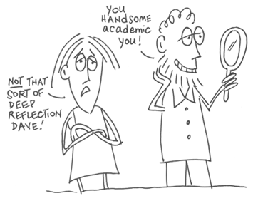
Scholarly or Scholarship?
“…all faculty have an obligation to teach well, to engage students and to foster important forms of student learning…
“…when it entails as well, certain practices of class room assessment and evidence gathering, when it is informed not only by the latest ideas in the field but by current ideas about teaching in the field, when it invites peer collaboration and review, then that teaching might rightly be called scholarly, or reflective or informed.. (contd.)
www.slideshare.net

Slide 7
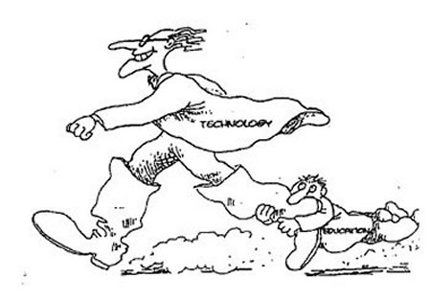
Scholarly or Scholarship?
“(contd)…But in addition to all of this, yet another good is needed, one called a scholarship of teaching... described as having three additional features of being public (‘community property’), open to critique and evaluation, and in the form others can build on.”
(Schulman and Hutchings, 1999 cited in McCarthy 2008)

Slide 8
Evidencing Scholarship
“Scholarship of Teaching and Learning (SoTL), expressed through external-facing outputs. Disciplinary outputs can be included where they are shown in the APP to influence teaching and assessment of the discipline. Outputs can include: peer-reviewed journal publications of international standing; external policy and professional reports; monographs, text books, book contributions; professional guidance on learning and teaching (such as QAA, Advance HE reports/ guidance); dictionaries, scholarly editions; catalogues; contributions to major databases; or other corpora of knowledge.
validated by peers and influence others beyond the institution e.g. through professional recommendations, evidence of citation, adoption of guidance or materials by other institutions, and other similar indications that the outputs are high quality.

Slide 9
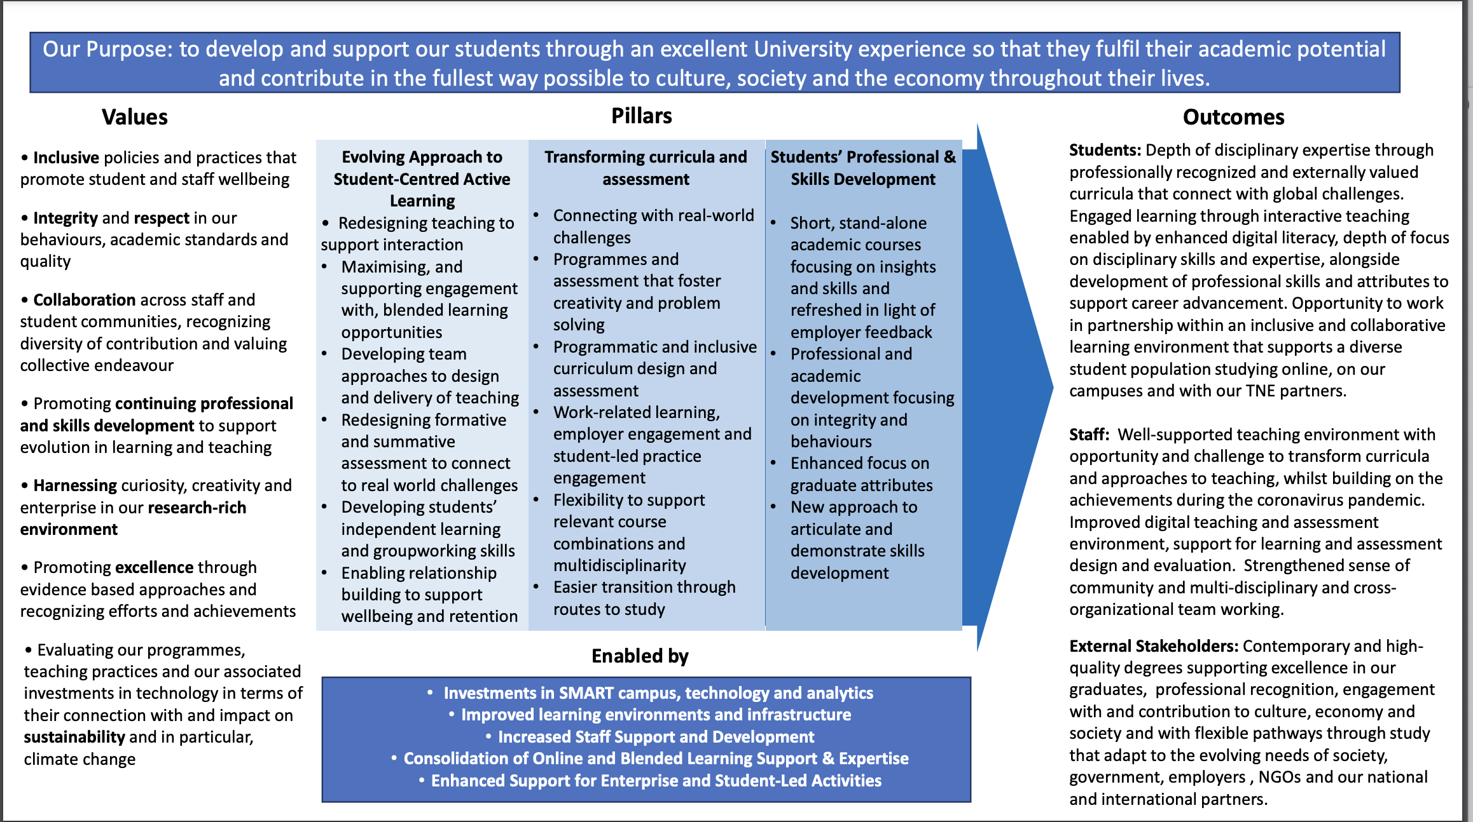
A Distinctive Contribution Through SoTL – some definitions
SoTL …
Should be a natural activity where enquiring people reflect on, share insights about, and look for evidence of effectiveness of concerning their professional practice
Essential building a case for change
Crucial means of sharing with others who are seeking to adopt approaches that are meaningful and effective
Expressed through community of scholars within disciplines and across disciplines

Slide 10

Evidencing Learning & Teaching Practice (1)
Source: Simon Bates, “Personalized Learning”, Universitas 21 Educational Innovation Conference, Sydney 2014

Slide 11
Evidencing Learning & Teaching Practice contd..
Course evaluations
Students’ engagement with online forums
NSS, Student Experience Survey results and open comments (obviously not individualized)
Examples of impact of interventions might be demonstrated through:
  more engagement with students; greater numbers of students going to study abroad; increased reflexivity amongst the cohort; comments from students, external examiners and partners.
Examples (mini cases) are helpful for people to express what they are doing to implement the L&T strategy in their own and others’ practice.
Teaching Excellence Awards
Student Teaching Awards

Slide 12

Support, Development & Engagement
Masters in Educational Development
L&T Leadership Programme (not just for LTS staff)
Recognising Excellence in Teaching (RET)
Teaching Excellence Network
Internal Funding Schemes: Learning Teaching Development, SoTL Fund, Student Staff Partnership schemes

Slide 13
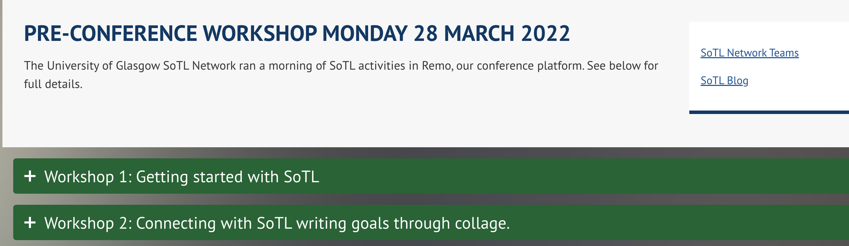

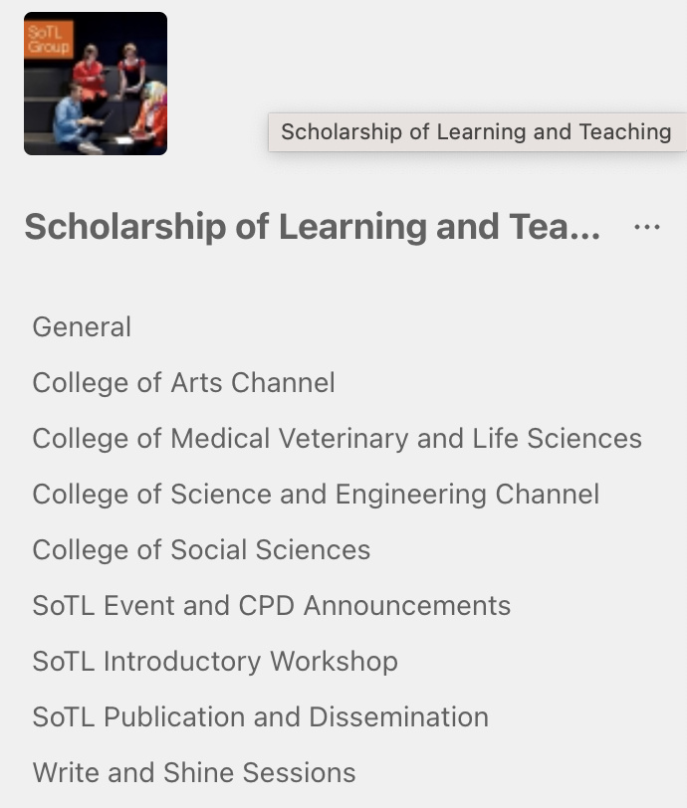
Developments Contd…
Support for SoTL
  Evaluation approaches
  Confidence
  Funding
  Mentoring
  Ethical approval
  Write and Shine Sessions

Slide 14
Questions for reviewees to consider…
How can you best align your priorities and activities across the full range of tasks within your job role, with local and University priorities and L&T strategy?
What plans do you have for evaluating your own (or others’) learning and teaching and for associated scholarship of teaching and learning outputs?
What development needs do you have, are there others you can work with to meet them?
Would CPD and/or mentoring be beneficial? Where might that come from?
Can you contribute to or form a community of scholars that would help achieve goals of your own and of others?

Slide 15

How can we think about P&DR Objectives?
Start with the questions we all need answers to from the L&T strategy (as represented in our disciplines). For example:
  How do we implement the LTA (Learning Through Assessment) Framework in ‘our/my’ discipline?
  How will GenerativeAI alter how we teach, how our students learn, and how we assess?
  What are the learning designs needed for inclusive learning in ‘my’ disciplines?
  How do we support digital literacy in our students?
  What models work best for embedding sustainability in the curriculum?
  How can we evidence employability skills for students through assessment?

Slide 16




Thank You
#UofGWorldChangers
@UofGlasgow

