Slide 1
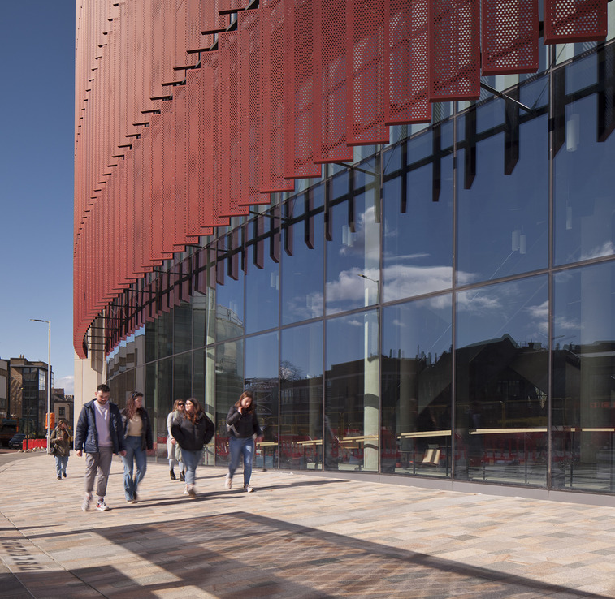
AY24/25 Timetabling Project
Un-roomed Events and Change Requests
College of Arts and Humanities

Slide 2
AY24/25 Plan
CMIS closes
Friday 26th April
Central Rooming
May
Un-roomed Event Resolution
June
Change Request Process
July-onwards
Reg/Enrol & Start of Semester 1
August
First Week of May
All Disability data returned
Tuesday 18th June
Timetable published
CMIS re-opens for Local Teaching Space allocations
Un-roomed events identified with SMTT leading on large and critical un-roomed events
Local Timetabler resources leading solutions for smaller un-roomed events
Change Request process opens (specific CR reasons for Un-roomed Events)
Weekly College Sessions Engagements continue with focus on un-roomed events
W/c 15th July
Change Request process opens (All essential changes)
All course data, including new and additional to be extracted to MyCampus
Facility data extracted to MyCampus
Meetings schedule extracted to MyCampus
Monday 29th of July
Checkpoint on opening space for non-teaching events
Monday 5th August
Registration & Enrolment opens
Tuesday 6th August
Online booking open for Local Non-Teaching Space

Slide 3
Un-roomed Events
Resolution Calls
Proces
All un-roomed events identified by Tuesday, 18th June . SMTT will split the events into two categories
Large Events & Time Critical Events
(greater than 50 in size, events in the first 1 month of teaching)
A resolution call will be scheduled with the identified roles within each of the schools
The calls will be led by SMTT who will suggest potential solutions, we do not anticipate all the identified roles will be required to attend every call however we do expect decision makers to be available.
SMTT will update the event in real time if a suitable option has been agreed.
2. All Other Un-roomed Events
(less than size 50)
Led through the coordinating TT resource already identified. The Timetabling and Enrolment Coordinator/ L&T Assistants should review local space first to resolve.
Should a Timetabling and Enrolment Coordinator/ L&T Assistants need to change the event (e.g. time/day) to find a central room, they should:
  Liaise with the L&T Convener, Head of School or Head of Course to be aware of potential clashes and explore available options to resolve.
  Raise a “Central Room Request” to SMTT to room the event via the Change Request process
The CR will be updated when a room has been allocated
In the event there is no resolution that can be accommodated the Timetabling and Enrolment Coordinator/ L&T Assistants should escalate through the identified roles listed for Category 1 events.

Slide 4
Escalation Process
Un-roomed Events
Un-roomed Event identified
Category 1
Category ?
Category 2
Identified Roles (School Dependant)
Roles involved in these calls have been identified for each school.
Un-roomed Events list provided to L&T Admin​
SMTT to set up call with College representatives to resolve
Identified Roles (School Dependant)
Roles involved in these calls have been identified for each school.
Can Event be roomed ?
Can local space resolve the event?
No, Central Space required
Identified Roles (School Dependant)
Roles involved in these calls have been determined by the Advisory Group at a school level.
Please see slide 6 to 11 for details on the roles identified for each school.
Yes
Yes
No
L&T Admin to set up a call with College representatives
College representatives to own ‘unresolved event’ offline before setting up call with SMTT
Event Roomed Locally (as per local process)
Can Event be roomed ?
Can Event be roomed ?
Yes
No
Yes
No
Event updated by L&T Admin, submit request to SMTT for rooming
Senior L&T Admin escalates issue to the roles for resolution as per Escalation Point 1.
Event Updated by SMTT
Note
Larger events will always take priority over smaller events. Therefore a move of a set of Lectures, may impact a series of smaller seminars.
Escalated Call
Final decision
Call organised with Deans of L&T, Student Ops Manager and if appropriate Frank and Moira.
End
End
End
End
End

Slide 5
Escalation Process
Critical Studies
Resolution Calls:
Large Events & Timetable Critical Events (greater than 50 in size, events in the first 1 month of teaching) – calls will be organised by SMTT on a daily, ad-hoc basis. The events will be prioritised by size. SMTT will update the event in real time if a suitable option is agreed. If a solution cannot be found, the School will escalate as per the agreed Escalation Process.
All Other Un-roomed Events (less than size 50) - led by the Senior L&T Admin/Lead Timetablers who will liaise with the Course Convenors, Heads of Subjects and Arts Advising Team to be aware of potential clashes and explore available options to resolve. When a solution is identified, they will raise a “Central Room Request” to SMTT to room the event via the Change Request process. If a solution cannot be found, the School will escalate as per the agreed Escalation Process.
Escalation Process:
If a resolution cannot be found for the event, this should be escalated within the School/College to the following roles (not all of these roles will need to be included, this will be dependent on the event and reason for non-resolution; Head of Subject will be involved if not previously involved):
Escalation Process | Critical Studies | Course
Name | Role | Course
Multiple | Head of Subject | All
Simon Kovesi | Head of School | All
Ronnie Young Marc Alexander from June 2024 | School Learning & Teaching Convenor | UG
Alison Wiggins (where applicable) | School PGT Convenor | PGT
Adele Redhead (where applicable) | Dean of PGT | PGT
Sarah Richardson | Dean of Learning & Teaching | UG
Resolution Call |  | Course
Name | Role | Course
Multiple (L&T Admin to identify) | Course Convenor | All
Multiple (Date & Time Changes Only) | Head of Subject | All
arts-advising@glasgow.ac.uk | Arts Advising Team | All
Maeve Houston | L&T Administrator | All
Multiple (L&T Admin to identify) | Lead Timetabler | All

Slide 6
Escalation Process
Culture & Creative Arts
Resolution Calls:
Large Events & Timetable Critical Events (greater than 50 in size, events in the first 1 month of teaching) – calls will be organised by SMTT on a daily, ad-hoc basis. The events will be prioritised by size. SMTT will update the event in real time if a suitable option is agreed. If a solution cannot be found, the School will escalate as per the agreed Escalation Process.
All Other Un-roomed Events (less than size 50) - led by the Senior L&T Admin/Lead Timetablers who will liaise with the Course Convenors, Heads of Subjects and Arts Advising Team to be aware of potential clashes and explore available options to resolve. When a solution is identified, they will raise a “Central Room Request” to SMTT to room the event via the Change Request process. If a solution cannot be found, the School will escalate as per the agreed Escalation Process.
Escalation Process:
If a resolution cannot be found for the event, this should be escalated within the School/College to the following roles (not all of these roles will need to be included, this will be dependent on the event and reason for non-resolution; Head of Subject will be involved if not previously involved):
Escalation Process | Critical Studies | Course
Name | Role | Course
Multiple | Head of Subject | All
Karen Lury | Head of School | All
Michael Bachmann | School Learning & Teaching Convenor | UG
Sabine Weber (where applicable) | School PGT Convenor | PGT
Adele Redhead | Dean of PGT | PGT
Sarah Richardson | Dean of Learning & Teaching | UG
Resolution Call |  | Course
Name | Role | Course
Multiple (L&T Admin to identify) | Course Convenor | All
Multiple (Date & Time Changes Only) | Heads of Subject | All
arts-advising@glasgow.ac.uk | Arts Advising Team | All
Michael Bristow | Senior L&T Administrator | All
Multiple (L&T Admin to identify) | Lead Timetabler | All

Slide 7
Escalation Process
Humanities
Resolution Calls:
Large Events & Timetable Critical Events (greater than 50 in size, events in the first 1 month of teaching) – calls will be organised by SMTT on a daily, ad-hoc basis. The events will be prioritised by size. SMTT will update the event in real time if a suitable option is agreed. If a solution cannot be found, the School will escalate as per the agreed Escalation Process.
All Other Un-roomed Events (less than size 50) - led by the Senior L&T Admin/Lead Timetablers who will liaise with the Course Convenors, Heads of Subjects and Arts Advising Team to be aware of potential clashes and explore available options to resolve. When a solution is identified, they will raise a “Central Room Request” to SMTT to room the event via the Change Request process. If a solution cannot be found, the School will escalate as per the agreed Escalation Process.
Escalation Process:
If a resolution cannot be found for the event, this should be escalated within the School/College to the following roles (not all of these roles will need to be included, this will be dependent on the event and reason for non-resolution; Head of Subject will be involved if not previously involved):
Escalation Process | Critical Studies | Course
Name | Role | Course
Multiple | Head of Subject | All
Ian Forrest | Head of School | All
Robert Cowan | School Learning & Teaching Convenor | UG
Tanya Cheadle (where applicable) | School PGT Convenor | PGT
Adele Redhead (where applicable) | Dean of PGT | PGT
Sarah Richardson | Dean of Learning & Teaching | All
Resolution Call |  | Course
Name | Role | Course
Multiple (L&T Admin to identify) | Course Convenor | All
Multiple (Date & Time Changes Only) | Heads of Subject | All
arts-advising@glasgow.ac.uk | Arts Advising Team | All
Alan McConnell | Senior L&T Administrator | All
Multiple (L&T Admin to identify) | Lead Timetabler | All

Slide 8
Escalation Process
Modern Languages & Cultures
Resolution Calls:
Large Events & Timetable Critical Events (greater than 50 in size, events in the first 1 month of teaching) – calls will be organised by SMTT on a daily, ad-hoc basis. The events will be prioritised by size. SMTT will update the event in real time if a suitable option is agreed. If a solution cannot be found, the School will escalate as per the agreed Escalation Process.
All Other Un-roomed Events (less than size 50) - led by the Senior L&T Admin/Lead Timetablers who will liaise with the Course Convenors, Programme Directors and Arts Advising Team to be aware of potential clashes and explore available options to resolve. When a solution is identified, they will raise a “Central Room Request” to SMTT to room the event via the Change Request process. If a solution cannot be found, the School will escalate as per the agreed Escalation Process.
Escalation Process:
If a resolution cannot be found for the event, this should be escalated within the School/College to the following roles (not all of these roles will need to be included, this will be dependent on the event and reason for non-resolution; Programme Director will be involved if not previously involved):
Escalation Process | Critical Studies | Course
Name | Role | Course
Multiple | Programme Director | As relevant
Nathanial Gardner | Assistant Head of School | Italian, Portuguese, Spanish
Jordi Cornella-Detrell | Assistant Head of School | Chinese, Comp Lit, Translation Studies, Czech, Polish
Vicente Perez de Leon | Assistant Head of School | French, German, Russia
Anneli Williams/Carole Macdiarmid | EAS | EAS
Stephen Forcer | Head of School | All
Greg Kerr | School L&T Convenors | UG
Elwira Grossman (Research leave cover) | School PGT Convenor | PGT
Adele Redhead (where applicable) | Dean of PGT | PGT
Sarah Richardson | Dean of Learning & Teaching | UG
Resolution Call |  | Course
Name | Role | Course
Multiple (L&T Admin to identify) | Course Convenor | All
Multiple (Date & Time Changes Only) | Programme Directors | All
arts-advising@glasgow.ac.uk | Arts Advising Team | All
Cara Graham | Senior L&T Administrator | All
Multiple (L&T Admin to identify) | Lead Timetabler | All

Slide 9
Essential Change Requests
Reasons for AY 24-25
No approval required for submitting a Change Request
Clear description of change required in “Change Description” section of Change Request Form
No. | Essential Reason | Description
1 | Room no longer required | If a room is no longer required due to an event being cancelled, changed to online, or roomed locally
2 | Central room request | For existing un-roomed events that you have found a solution for.
3 | Use of another area's local space | If you have agreed to use another School’s local space. Include the evidence of the agreement with the local space manager in the Supporting Documents field
4 | Data quality issue | To rectify data entry issues in CMIS, for example updating the contact, swapping like-for-like courses or subgroups on events, changing the Source on events, etc.
Un-roomed events period
New
No. | Essential Reason | Description
5 | Accessibility requirement | If an accessibility requirement was not identified during Edit & Prep or if the requirement has changed. Include information on the nature of the accessibility that needs to be accommodated, e.g. wheelchair access, hearing assistance, etc.
6 | Change in size | If the number of students enrolled differs from the allocated space and the room is no longer suitable. Update the size of associated subgroup(s) before submitting a change request.
Change request period – additional reasons
7 | New course/event | New courses approved after the end of Edit & Prep or new events on existing courses. The timing of events should be checked against availability of spaces before submitting a request.
8 | Time/Day change | If the date, time, or duration of an existing event needs to be changed. The timing of events should be checked against availability of spaces before submitting a request.
9 | Equipment/Features change | If the room allocated does not have the required equipment and/or features, Include details of the requirement. For accessibility requirements use the separate reason for this purpose.
10 | 'Opt-out' of lecture recording (as per policy) | If the event has been tagged for lecture recording, but the academic wants to opt-out of recording. Where possible please ensure the lecturer’s name is attached to the event in CMIS.

Slide 10
Escalation Process
Change Requests
Change Request submitted to SMTT
Yes
Sufficient/ accurate detail added for the type of CR?
No
Can we accommodate ?
Yes
No
Yes
Change Required ?
No
Event Updated by SMTT
Escalate via Un-roomed Process (Class size less than 50)
Reject CR
End
End
End
End

Slide 11








Un-roomed Events & Change Requests
Project Communications Campaign – to be updated
April
Central Rooming
May
Un-roomed Event Process
June
Change Request Process
July-onwards
Forums
28th May
SMG
Monday 3rd June
CMG one-pager
Monday 1st July
CMG and SMG
Comms
26th April
CMIS closes (CMIS users + HoPS)
w/c 3rd June
Project update and video message from Project Sponsors (+ specific role comms for Un-roomed Events and Change Requests)
18th June
Timetable released
email
w/c 15th July
Change Requests opens
Reporting
w/c 24th June >
Weekly Un-roomed Progress Reporting
w/c 15th July >
Weekly Change Request Reporting
Bi –weekly College Engagement Sessions

