Slide 1
Unibuddy Digital Ambassadors

Slide 2
What is Unibuddy?
Unibuddy is a platform that allows prospective students to speak one-to-one with a member of the UofG community (student, staff, alumni) in a chat format.
Notes:
Why is Studying Arts & Humanities important?
Arts and Humanities have been taught at this university since its inception in 1451.
Arts Research:
The Historical Thesaurus of the OED tells us as much about speakers of English as it does about the language itself –What are people interested in, what are they doing? How many words for Love, for Faith, for Hate… when did words appear or disappear.
This year it won the Queens Anniversary Prize, one of the most respected awards in Higher Education Research.

Slide 3
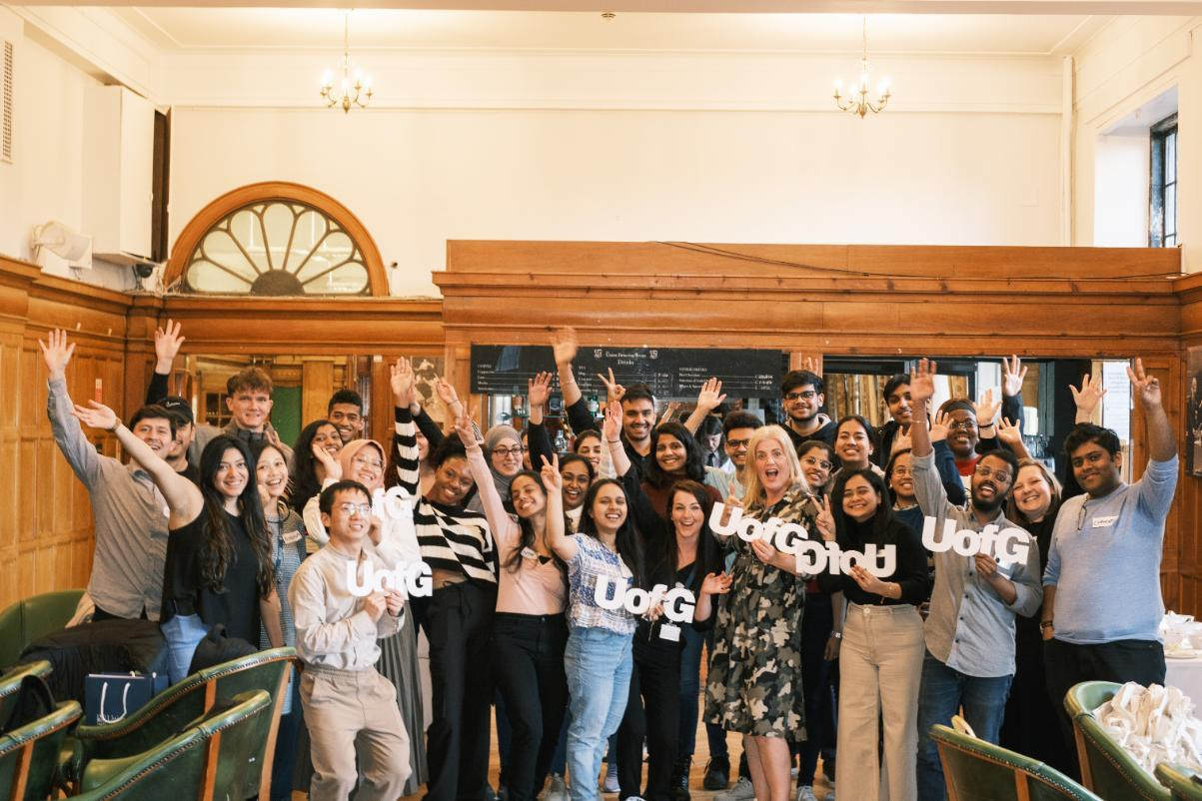
Apply to be a Unibuddy Digital Ambassador
Would you like to gain experience as a volunteer as well as helping others? We are looking for happy and enthusiastic current students and alumni to join our wonderful Unibuddy peer-to-peer community.
Notes:
Why is Studying Arts & Humanities important?
Arts and Humanities have been taught at this university since its inception in 1451.
Arts Research:
The Historical Thesaurus of the OED tells us as much about speakers of English as it does about the language itself –What are people interested in, what are they doing? How many words for Love, for Faith, for Hate… when did words appear or disappear.
This year it won the Queens Anniversary Prize, one of the most respected awards in Higher Education Research.

Slide 4
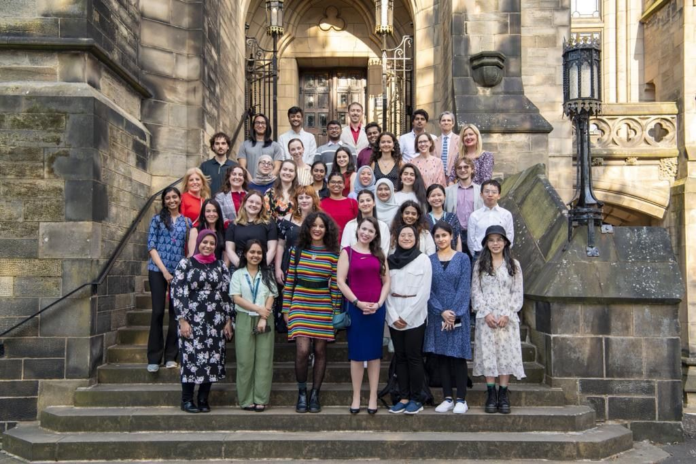
What are the benefits for you?
The work on Unibuddy is recognised by the University and is added to your Higher Education Academic Report (HEAR). Please note that you must have volunteered more than 20 hours to be eligible for this to be added to your HEAR
We will act as a referee for you
Enhance your CV and professionalism to support your future employment
Acquire new skills
Fully flexible
Join our social events
Meet other volunteers
Scan the QR code to find out more
https://www.gla.ac.uk/study/studentlife/askastudent/apply/
Notes:
Why is Studying Arts & Humanities important?
Arts and Humanities have been taught at this university since its inception in 1451.
Arts Research:
The Historical Thesaurus of the OED tells us as much about speakers of English as it does about the language itself –What are people interested in, what are they doing? How many words for Love, for Faith, for Hate… when did words appear or disappear.
This year it won the Queens Anniversary Prize, one of the most respected awards in Higher Education Research.

Slide 5
How to sign up
If you are interested in becoming a Unibuddy volunteer, please scan the QR code below and select one of the training sessions.
This week’s event - Wednesday 4 October 16:00 – 17:00
If no training sessions are listed or the dates don’t work for you, tick the 'Add me to the waiting list' box.
https://www.gla.ac.uk/study/studentlife/askastudent/apply/
Notes:
Why is Studying Arts & Humanities important?
Arts and Humanities have been taught at this university since its inception in 1451.
Arts Research:
The Historical Thesaurus of the OED tells us as much about speakers of English as it does about the language itself –What are people interested in, what are they doing? How many words for Love, for Faith, for Hate… when did words appear or disappear.
This year it won the Queens Anniversary Prize, one of the most respected awards in Higher Education Research.

