Slide 1
Student Learning Development (SLD) 2023-24 Induction
Dr Stuart Purcell
stuart.purcell@glasgow.ac.uk

Slide 2
What is SLD? (Student Learning Development*)
*Formerly known as LEADS for Students
Effective Learning Advisers
RLF Writing Fellows
Maths
& Stats
Advisers
Peer Learning
Advisers

Slide 3
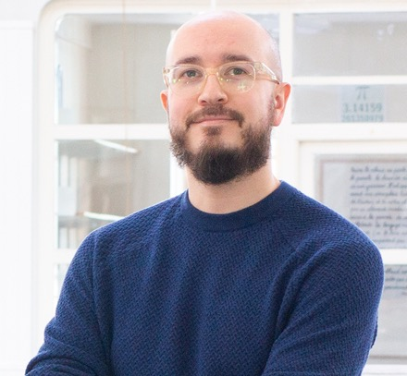
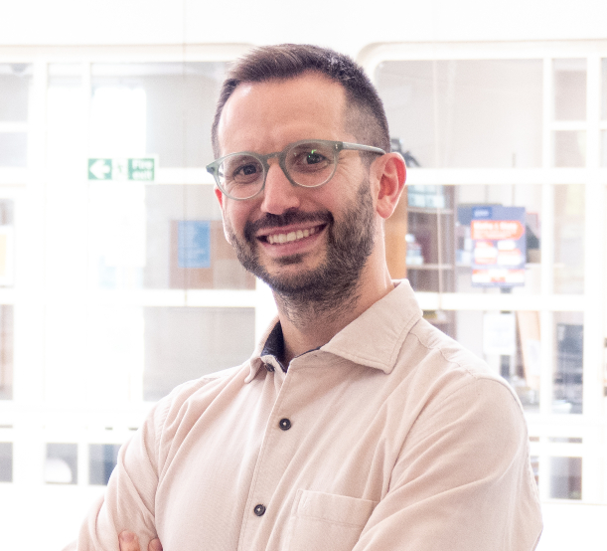
Effective Learning Advisers (Arts & Social Sciences)
gla.ac.uk/myglasgow/SLD/writingstudyadvice/artshumanities
Dr Stuart
Purcell
Dr Stuart
Purcell
Dr Aleix Tura Vecino
Effective Learning Adviser (Arts & Humanities)
Effective Learning Adviser (Arts & Humanities)
Effective
Learning Adviser (Social Sciences)

Slide 4
Arts & Social Sciences Classes
View all of our courses on Moodle Including:
Class recordings and slides
Handouts
Practical exercises
Asynchronous courses
And a range of other useful resources and materials

Slide 5
Semester 1 Arts & Social Sciences Classes
Live Open Provision Classes
Essay Writing Classes
Semester 1 Series
Dissertation Development Classes
Advanced Criticality Classes

Slide 6
Semesters 2 & 3 Arts & Social Sciences Classes
Live Open Provision Classes
Essay Writing Classes
Semester 2 Series
Undergraduate Dissertation Classes
Mastering Academic Writing Classes
Semester 3 (Summer) Series
Postgraduate Dissertation Classes

Slide 7
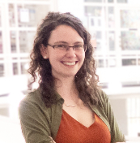
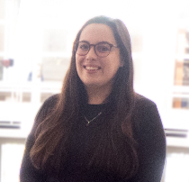
Effective Learning Advisers (International)
gla.ac.uk/myglasgow/SLD/international/UGandPGT
Dr Mona
O’Brien
Amber
Hinde
Effective Learning Adviser (International)
Effective Learning Adviser (International)

Slide 8
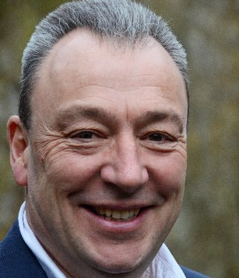
Royal Literary Fund Fellows
gla.ac.uk/myglasgow/SLD/RLF
Dr Vanessa Collingridge
Jim
Carruth
Royal Literary Fund Fellow
Royal Literary Fund Fellow

Slide 9
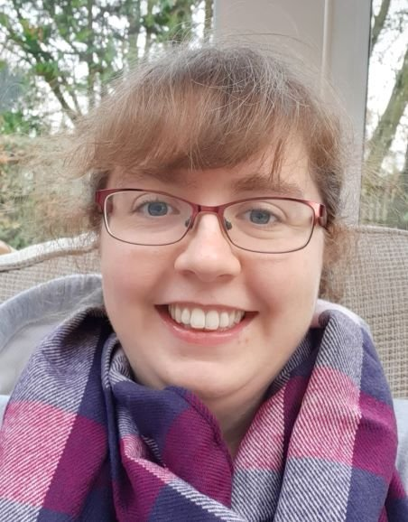
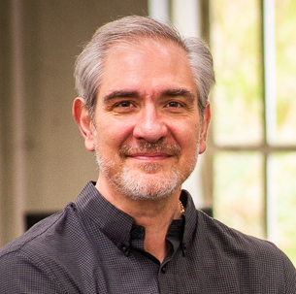
Maths & Stats Advisers
gla.ac.uk/myglasgow/SLD/MathsAndStats/
Dr Jenny August
Dr George
Vazanellis
Maths Adviser
Stats
Adviser

Slide 10
Peer Learning Advisers
gla.ac.uk/myglasgow/SLD/peer/
Bob Imbur
Peer Learning
Coordinator

Slide 11
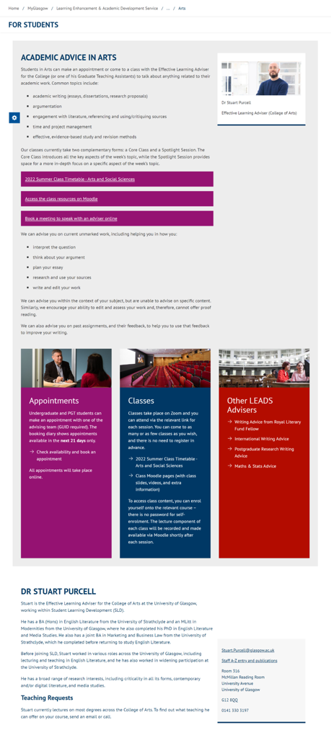
How to find us:
Classes
Appointments
Moodle resources
gla.ac.uk/SLD

Slide 12
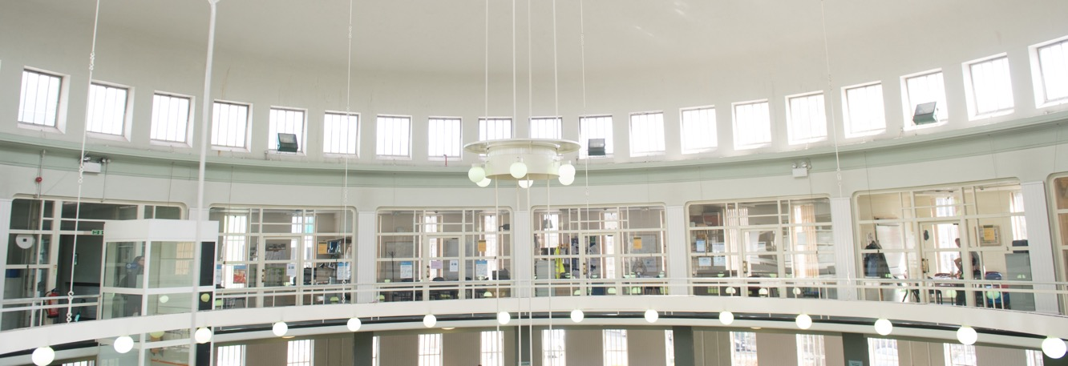
Contact details
SLD (Student Learning Development)
Dr Stuart Purcell
stuart.purcell@glasgow.ac.uk

