Slide 1

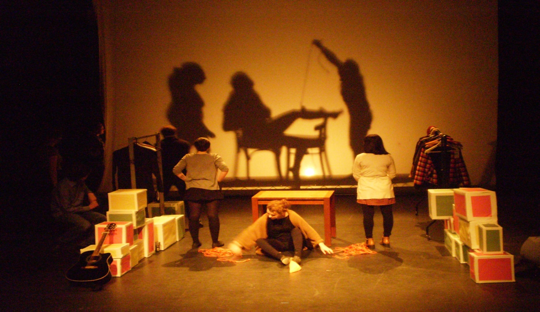
WELCOME TO THE COLLEGE OF Arts & humanities!

Slide 2
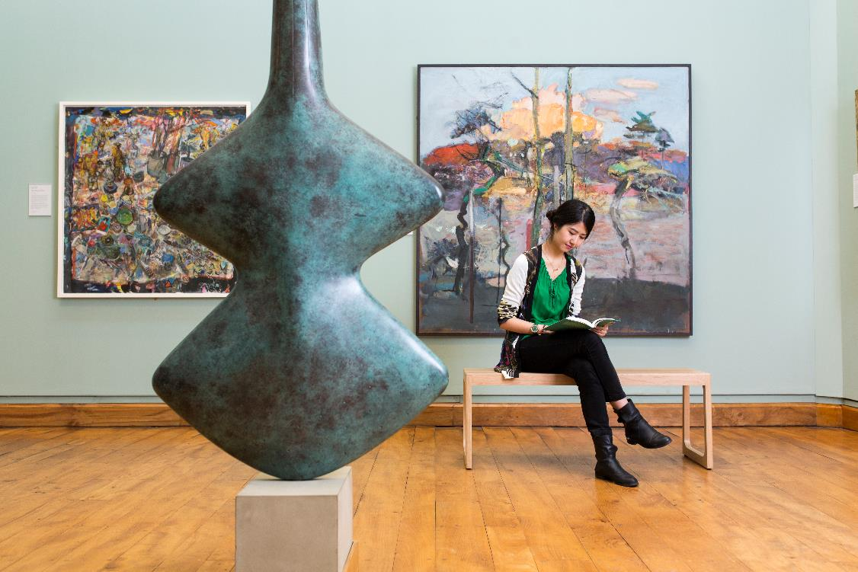
Scaffold of support built into the programmes
World-leading research
The city of Glasgow – key arts organisations and cultural events
Work-based learning opportunities and rich links with industry/practitioners

Slide 3
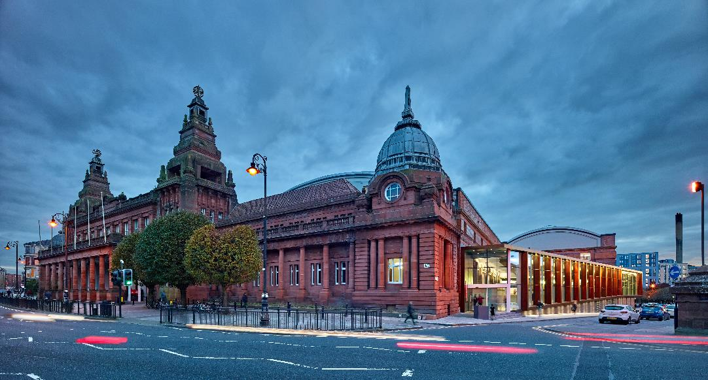
Specialist Collections
Hunterian Art Gallery: https://www.gla.ac.uk/hunterian/collections/permanentdisplays/hunterianartgallery/
Hunterian Museum: https://www.gla.ac.uk/hunterian/
Scottish Theatre Archive: http://special.lib.gla.ac.uk/STA/search/

Slide 4
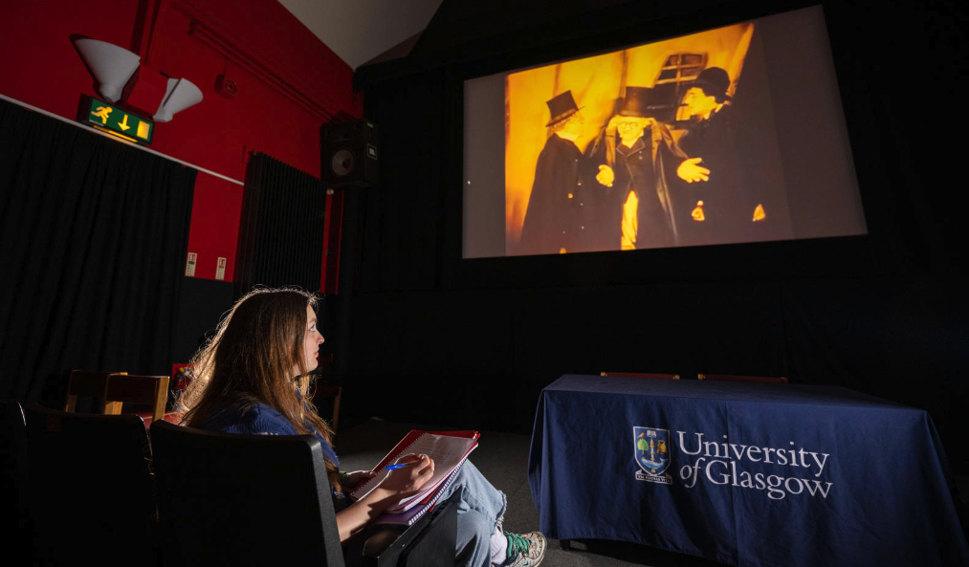
Specialist Facilities
In Kelvinhall:
The Hunterian Collections, 1 million objects​
Digital collections of the National Library of Scotland​
National Library of Scotland's Moving Image Archive​
400,000 objects from Glasgow Museums collections​
Study centre​
Conservation labs
Cinema, Theatre and Performance Studio
Practice studios and concert hall
Video editing

Slide 5
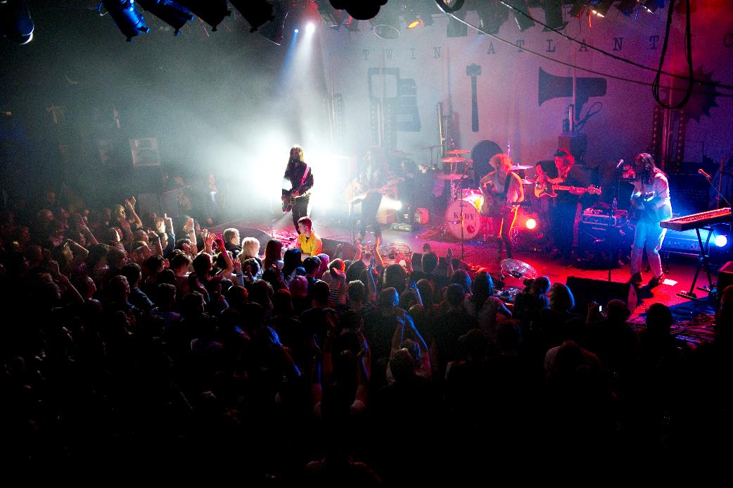
PGT Community
Monthly CoA PGTea & Coffee meet-ups
Keep an eye out for emails from your subject area, School and the College for news on workshops, research seminars, and other events

Slide 6
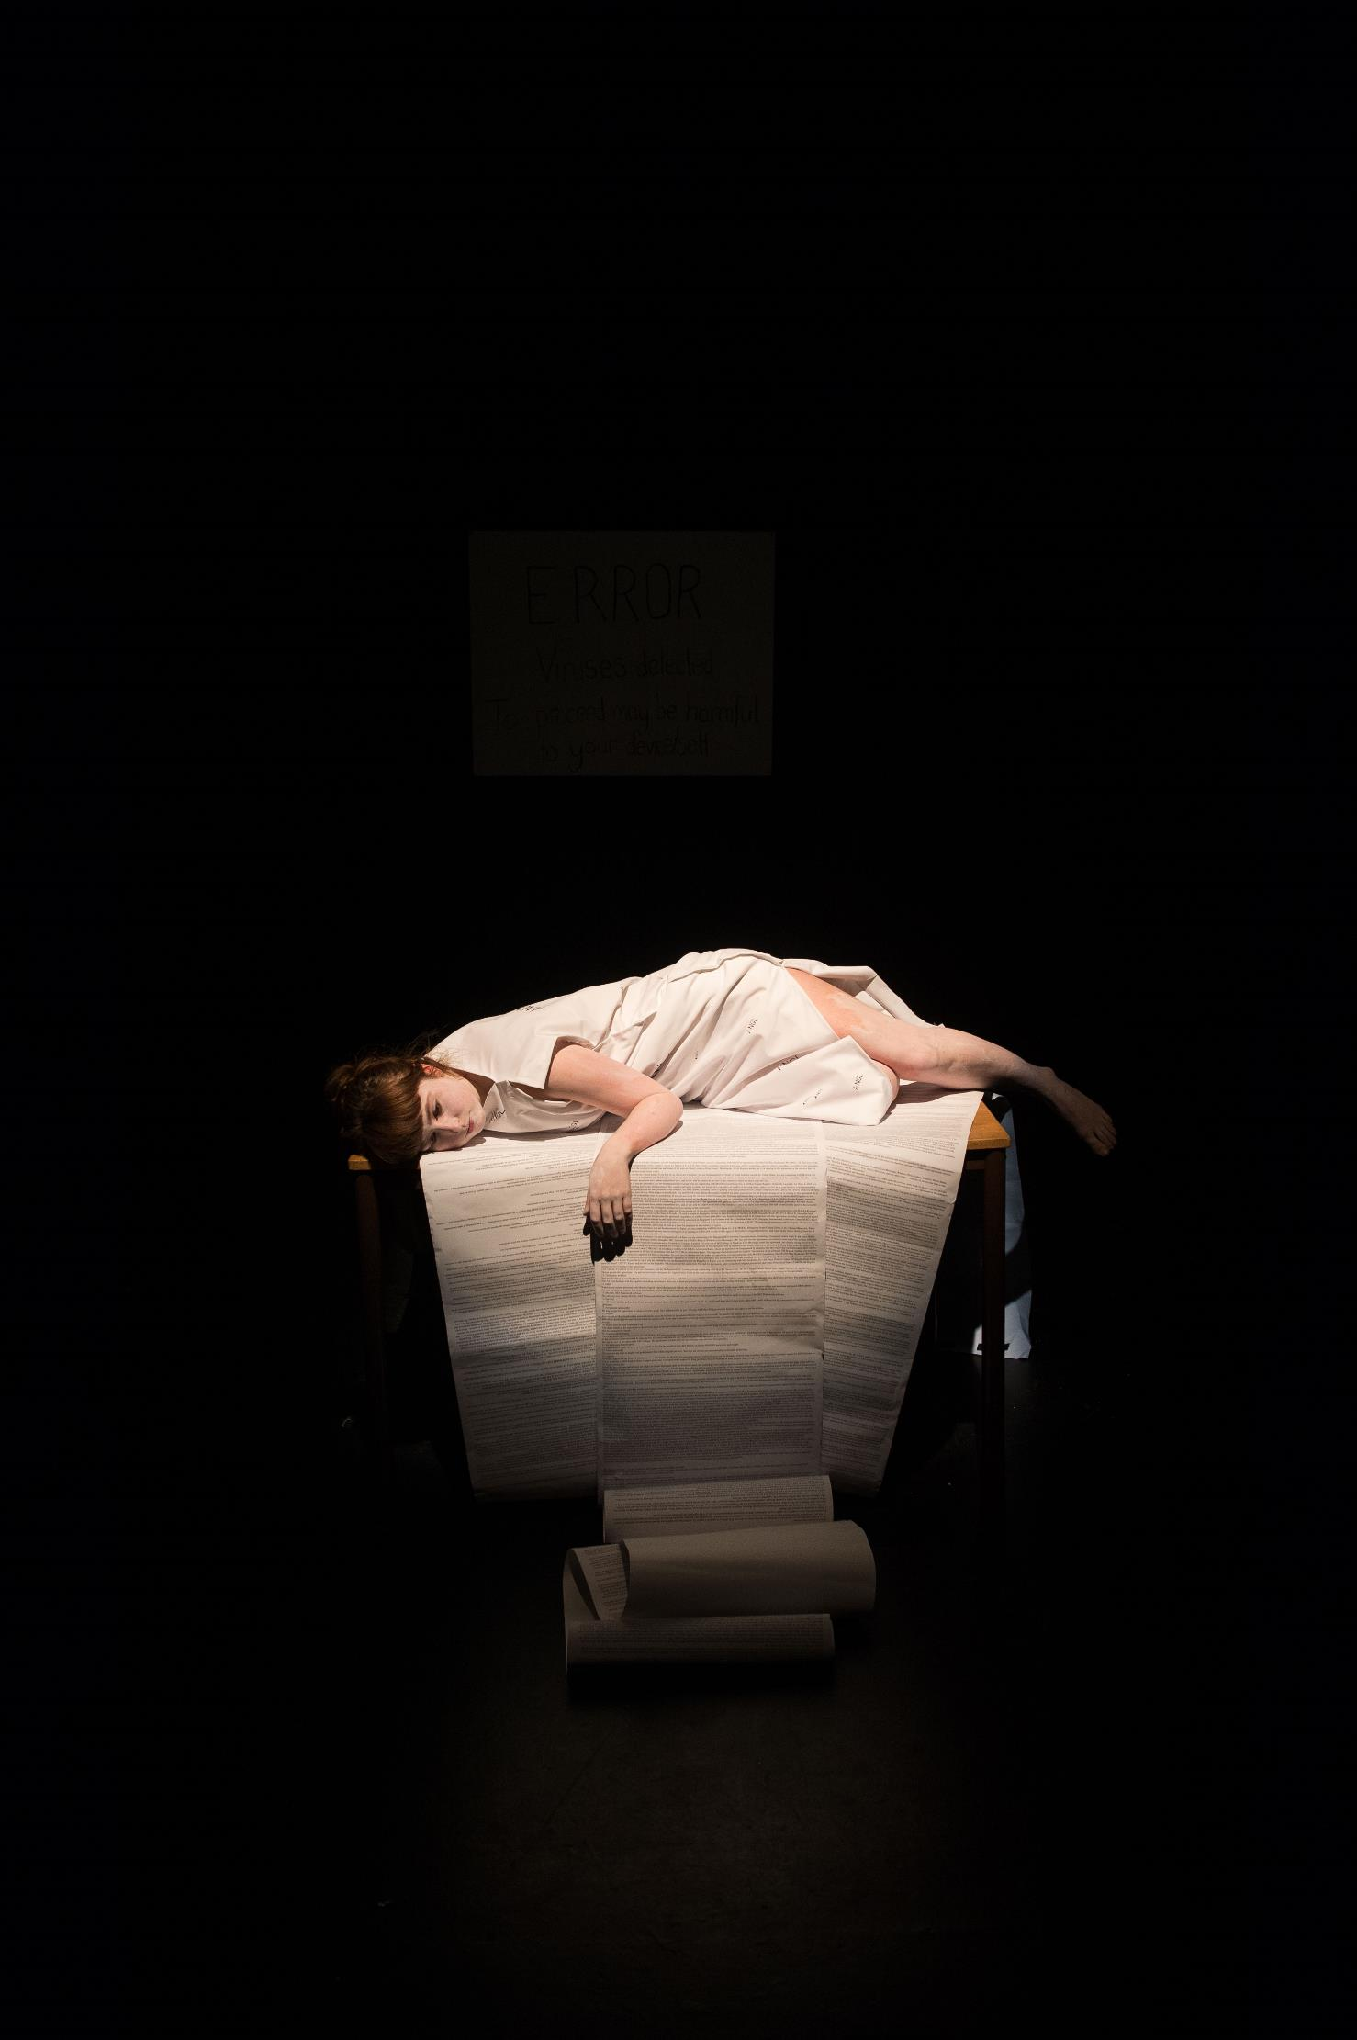
Students’ Representative
Council (SRC)
https://www.glasgowunisrc.org/

Slide 7

Careers and Global Opportunities

Slide 8
Log on to Glasgow Careers
https://glasgow.targetconnect.net

