Slide 1



Interactive, web-based Shiny apps to conduct network meta analysis through a ‘point and click’ interface and create novel data visualisations
Presented by Clareece Nevill, Ryan Field, Josie Sandercock, Nicola Cooper, Alex Sutton, Suzanne Freeman

Slide 2
Acknowledgements
Yiqiao Xin (Analysis Group)
Rhiannon Owen (Swansea)
Janion Nevill (Leicester)
All members of the NIHR Complex Reviews Support Unit
Feedback from users
This project is funded by the National Institute for Health and Care Research (NIHR) Complex Reviews Support Unit (project number 14/178/29). The views expressed are those of the author(s) and not necessarily those of the NIHR or the Department of Health and Social Care.
Notes:
Other authors
Previous users/feedback

Slide 3

Originally set up as a support group to assist NIHR review groups including Cochrane (2015-2023)
Advice and training:
  Refining review questions and scope
  Applications, protocols and report writing
  *Consideration of types of data and structure
  *Appropriate methodological approaches
Apps developed to help with implementation of more advanced evidence synthesis methods for complex data structures

Slide 4
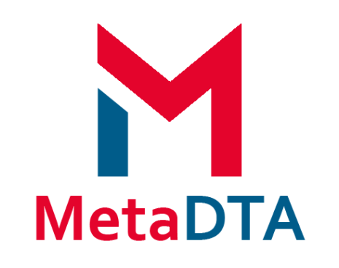







Diagnostic Test Accuracy (DTA):
DTA Primer
Educational primer on DTA studies
Meta-Analysis of DTA studies (frequentist & mostly standard approaches)
Bayesian Meta-Analysis of DTA studies (basic – advanced approaches)
App Principles
Free to use and open source
Where possible utilise existing R packages
Point and click interface
Emphasis on visualization and methods for sensitivity analysis
Online Evidence Synthesis Analysis Apps
http://www.nihrcrsu.org/guidance/
Network
Meta-Analysis (NMA):
Evidence Based Research:
NMA (frequentist & Bayesian approaches)
Sample size calculator for new study based on adding it to an existing pairwise meta-analysis
Feasibility into online interactive publication of a living NMA

Slide 5
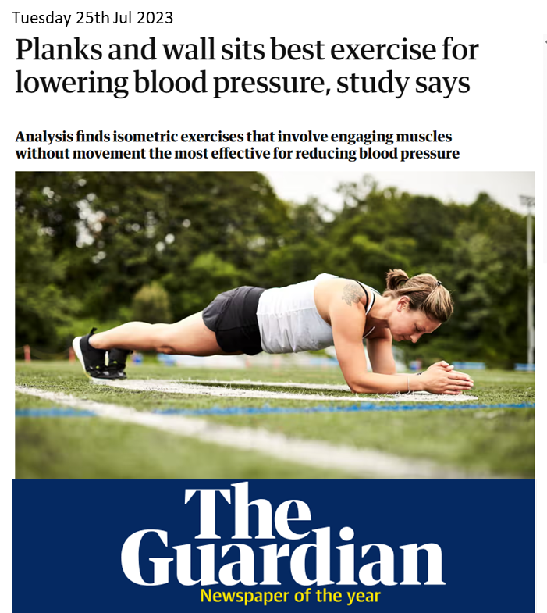
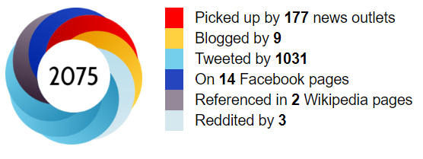
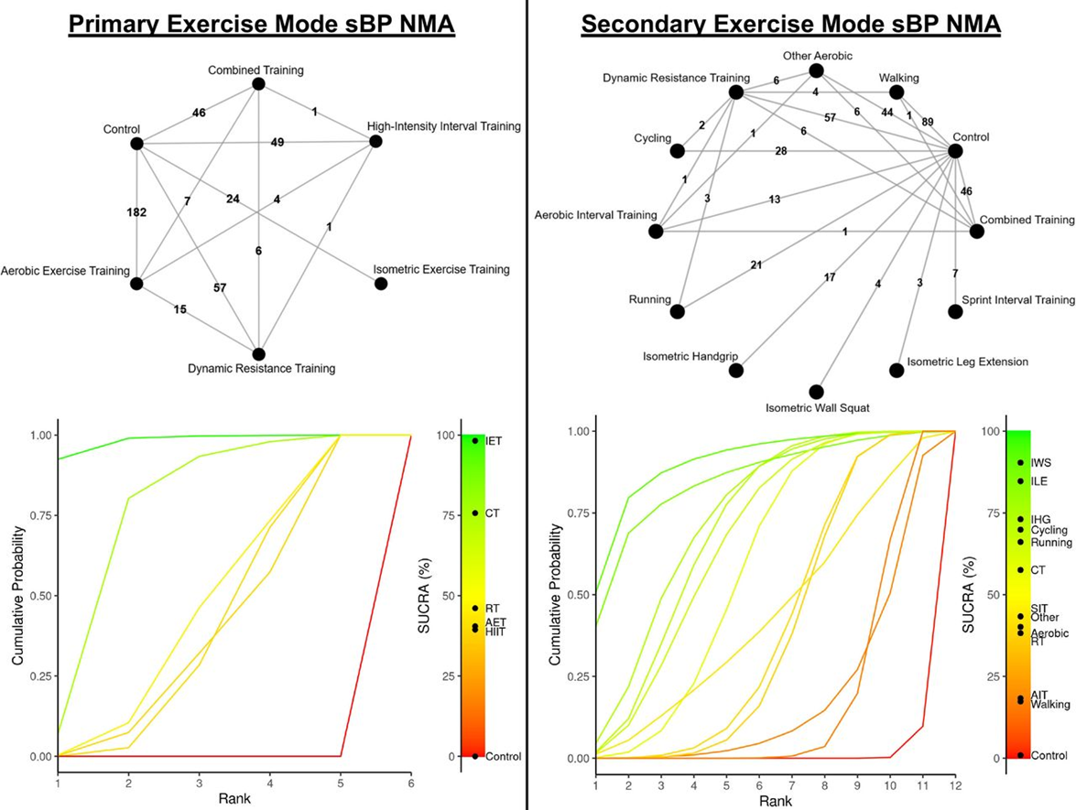


Published July 2023
“Bayesian NMAs were performed via the MetaInsight tool (version V4.0.2).”
Edwards JJ, Deenmamode AHP, Griffiths M, Arnold O, Cooper NJ, Wiles JD, O’Driscoll JM. Exercise training and resting blood pressure: a large-scale pairwise and network meta-analysis of randomised controlled trials British Journal of Sports Medicine Published Online First: 25 July 2023. doi: 10.1136/bjsports-2022-106503

Slide 6
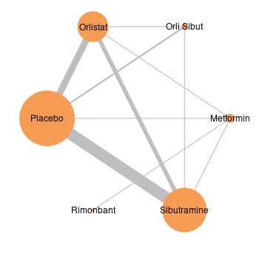
Network Meta-Analysis
Extension of pairwise meta-analysis
Direct
Indirect
Notes:
- Multiple interventions are analysed simultaneously
- Direct evidence (lines)
- Indirect evidence (along the network)

Slide 7
MetaInsight was created…
… to encourage researchers to conduct network meta-analyses (NMA) via an easy-to-use web-based app (built with R & {shiny})
Aiding those who are…
  Unfamiliar with NMA
  Unfamiliar with statistical software such as R, Stata and WinBUGS
Improving reporting of NMA
Improving computational speed
  Sensitivity analyses
Notes:
Free to use online or download locally
Point and click interface
Wealth of data visualisations
Uses established NMA packages
Sensitivity analyses can be conducted in real time

Slide 8
WARNING!
MetaInsight does not replace statisticians!
Factors that still need considering include:
Understanding underlying assumptions of NMA
Bayesian settings such as priors and burn-ins
Developing appropriate conclusions (e.g. considering RoB)

Slide 9
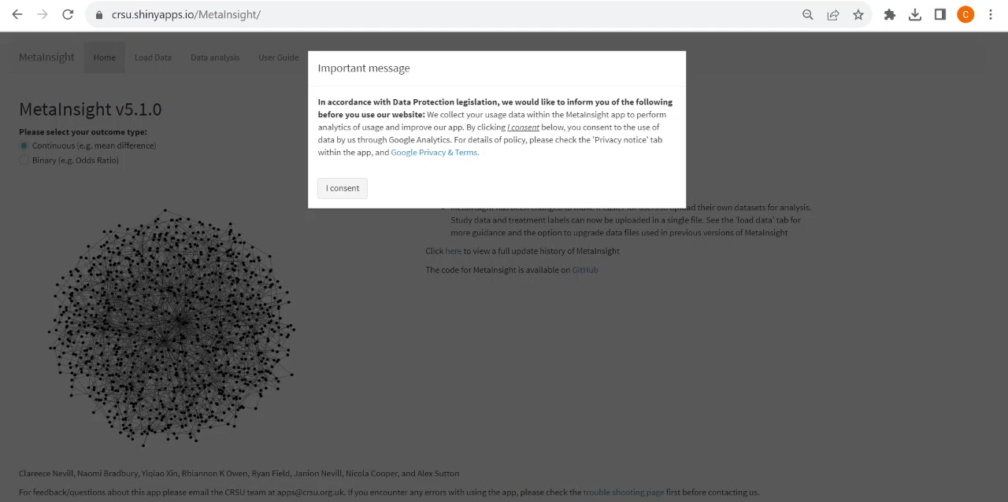
Loading MetaInsight
https://crsu.shinyapps.io/MetaInsight

Slide 10
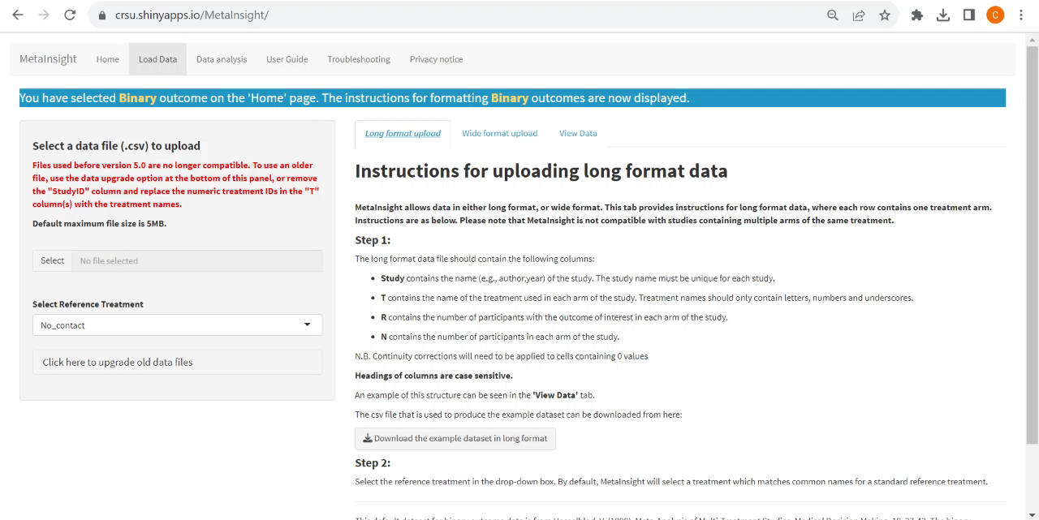
Uploading Data

Slide 11
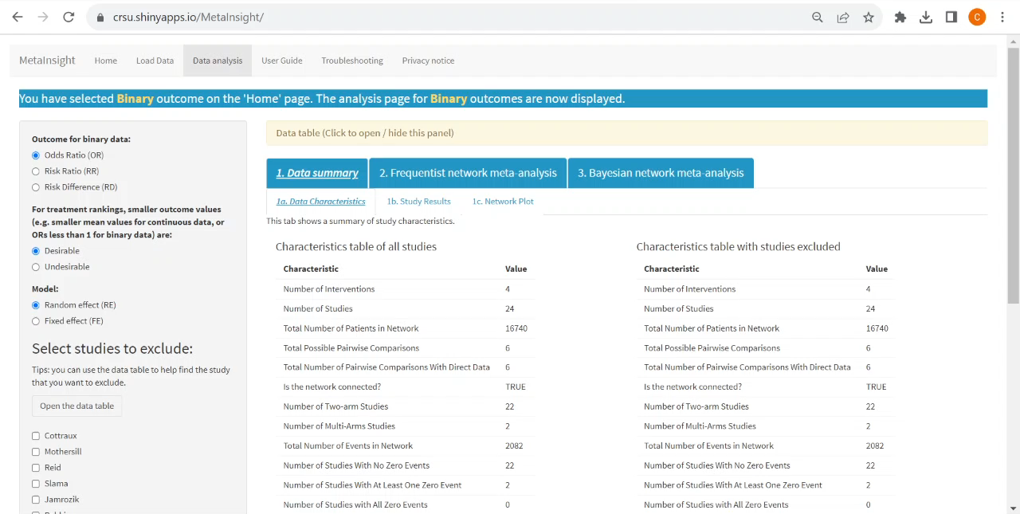
Data Summary and Settings

Slide 12
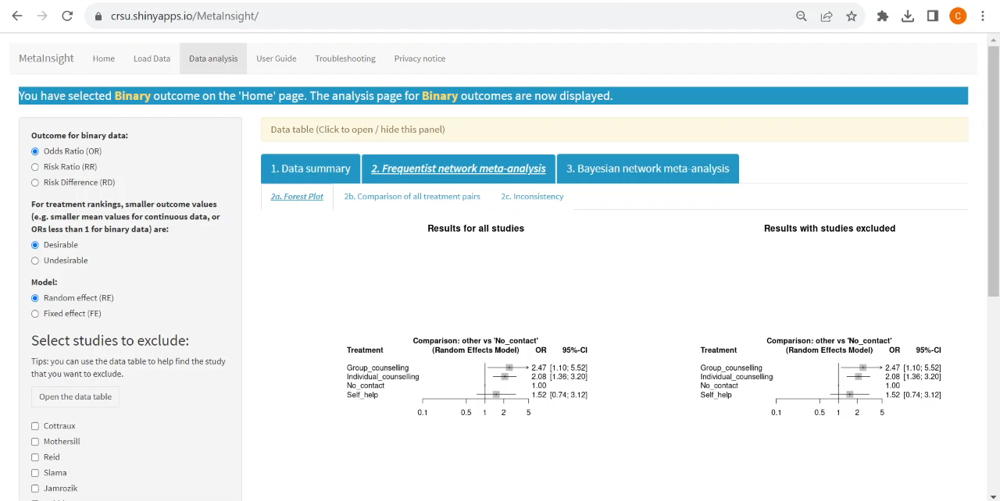
Frequentist NMA

Slide 13
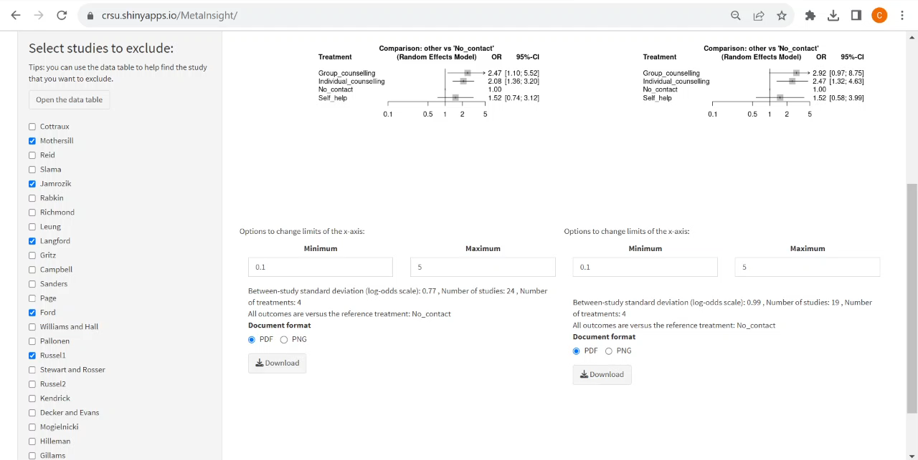
Sensitivity Analysis

Slide 14
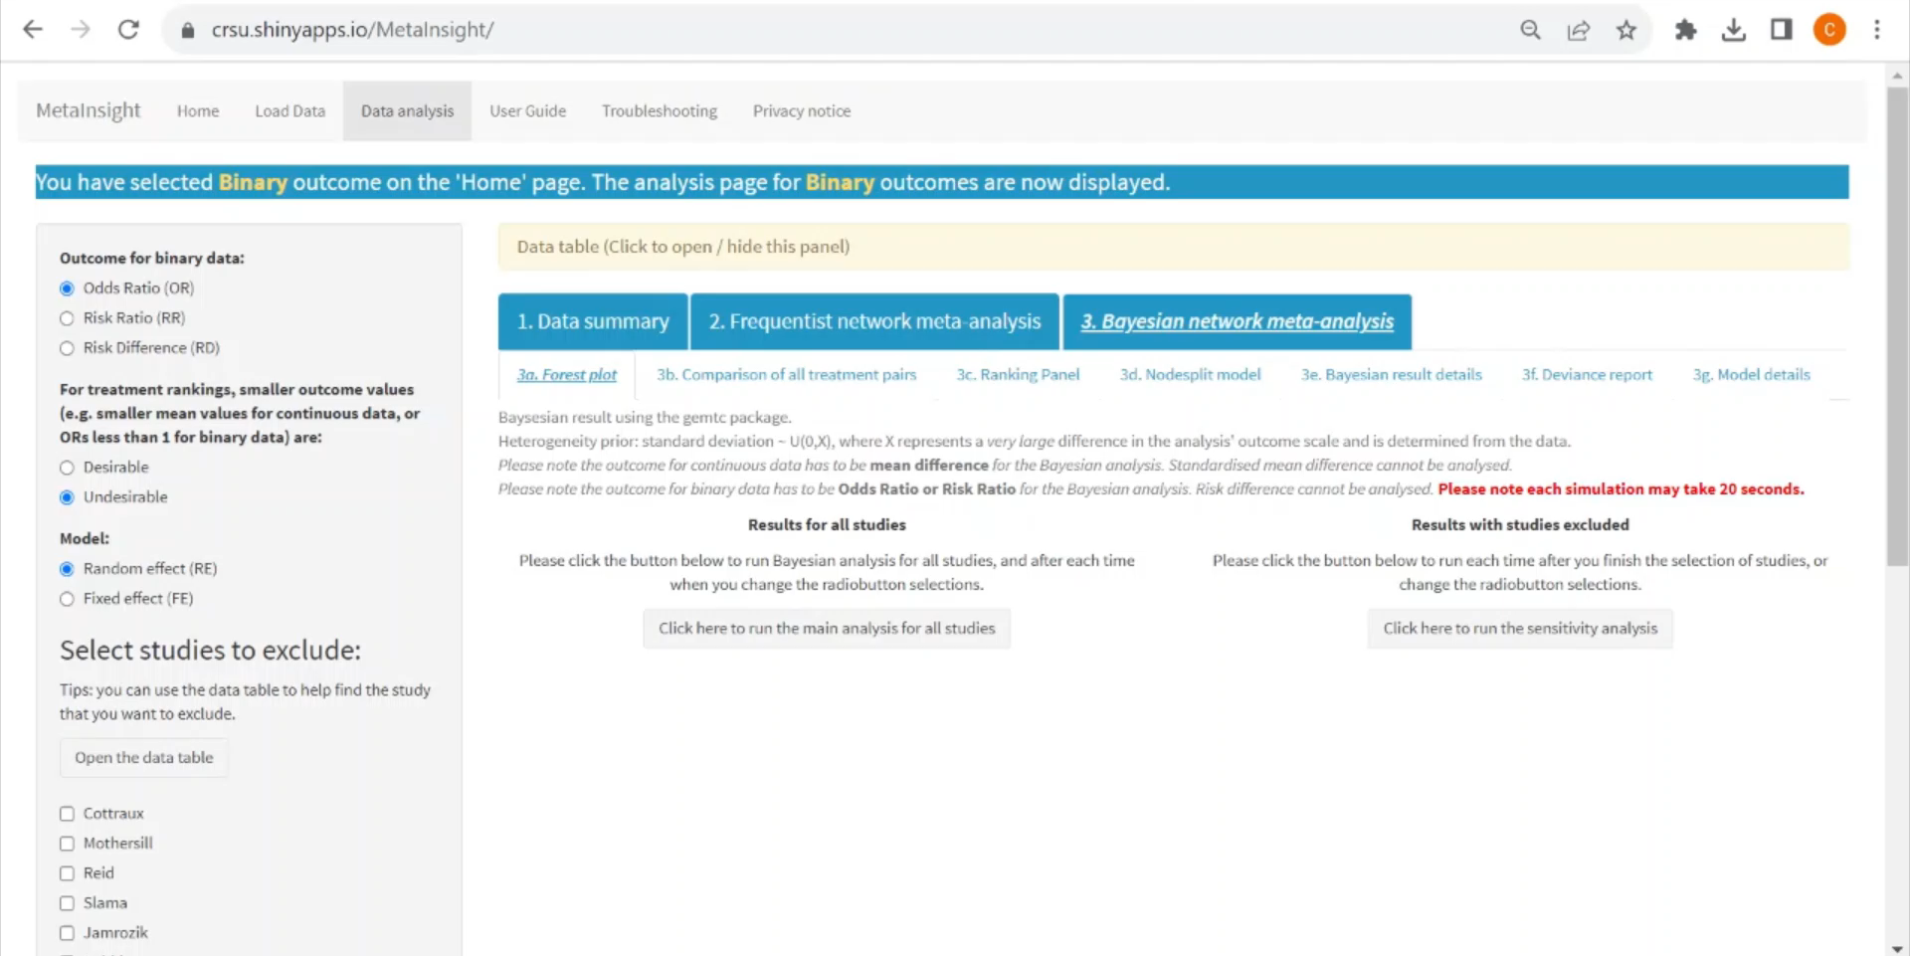
Bayesian NMA

Slide 15
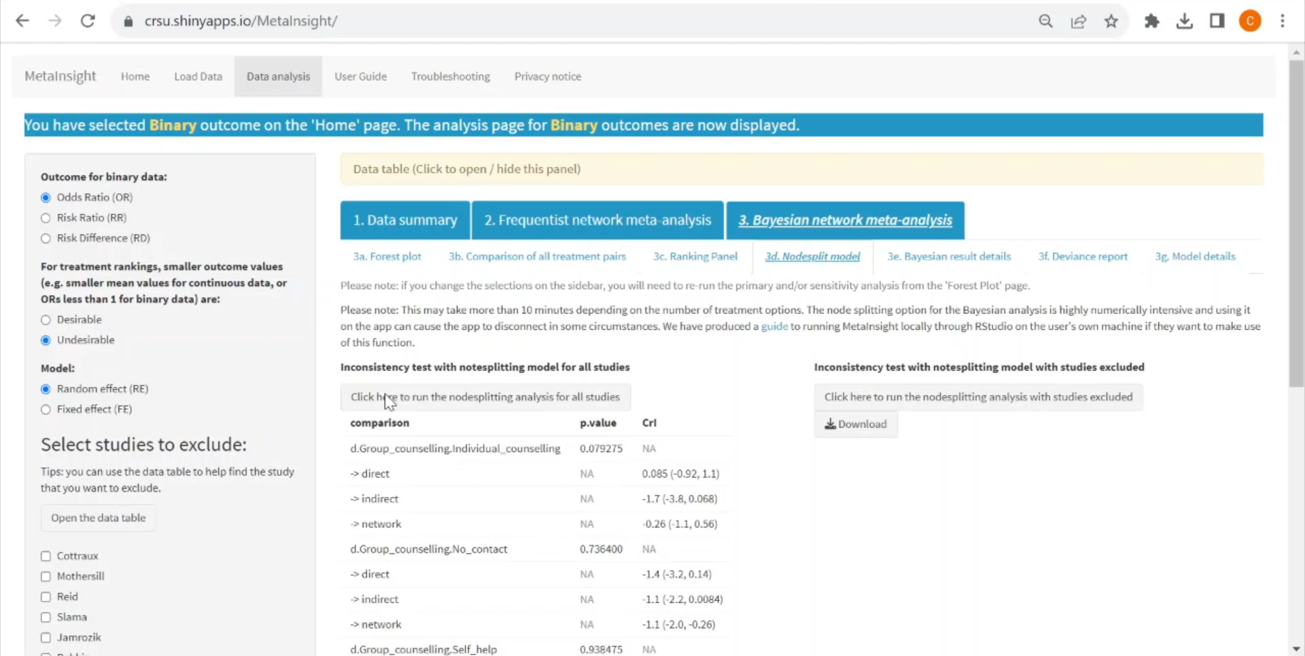
Advanced Bayesian Information
Notes:
From 3d onwards

Slide 16
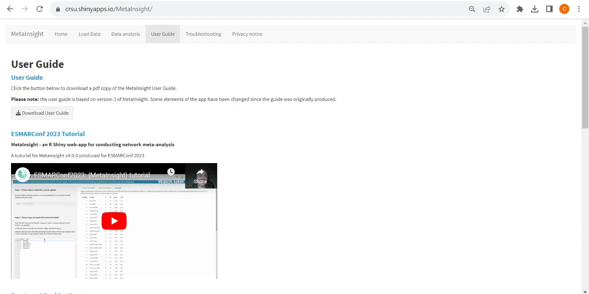
Further guides and troubleshooting

Slide 17
A user perspective
accessible
short learning curve
useful explanatory text
great visualisations
comprehensive output

Slide 18

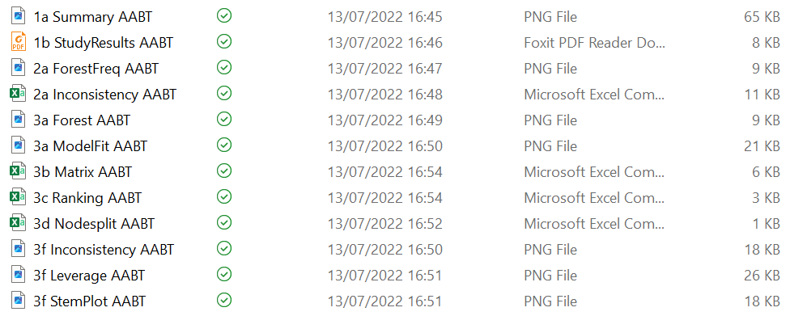

About that output…

Slide 19
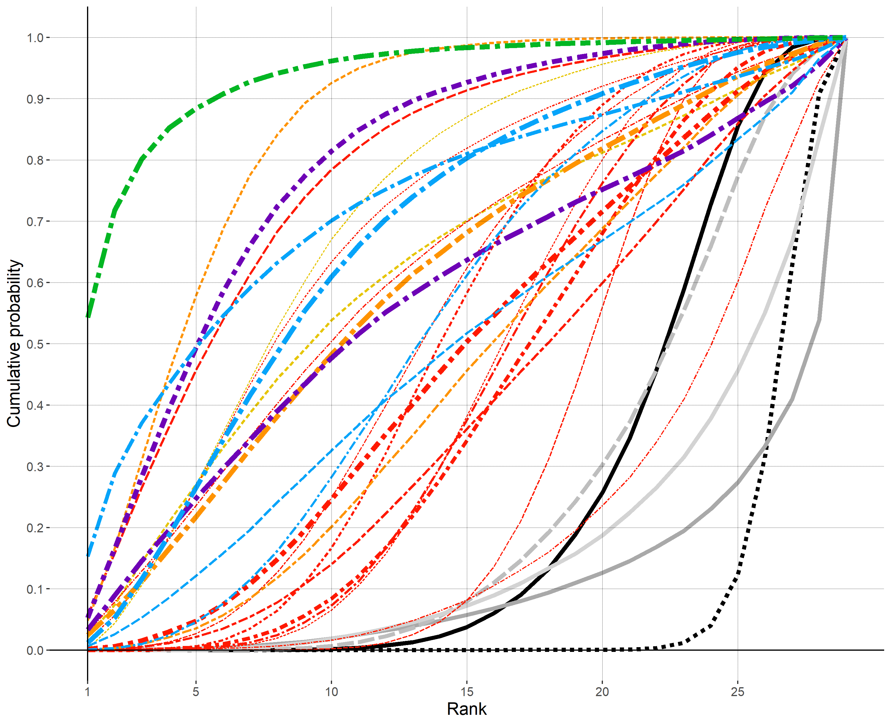
You can download the data too

Slide 20
Any Questions?

Slide 21



Practical
http://bit.ly/cochrane-colloquium

Slide 22
Any Questions?

Slide 23

MetaCNMA
Future Work
Binary & Continuous Outcomes
Frequentist and Bayesian CNMA
Frequentist - Additive model
Bayesian – 4 Models from Welton et al.
Component Network Analysis - Simplified

Slide 24

Feedback

Slide 25

Resources
Links
MetaInsight App https://crsu.shinyapps.io/MetaInsight
GitHub https://github.com/CRSU-Apps/MetaInsight
References
Owen, RK, Bradbury, N, Xin, Y, Cooper, N, Sutton, A. MetaInsight: An interactive web-based tool for analyzing, interrogating, and visualizing network meta-analyses using R-shiny and netmeta. Res Syn Meth. 2019; 10: 569-581. https://doi.org/10.1002/jrsm.1373
Nevill CR, Cooper NJ, Sutton AJ. A multifaceted graphical display, including treatment ranking, was developed to aid interpretation of network meta-analysis. J Clin Epidemiol. 2023 May; 157:83-91. https://doi.org/10.1016/j.jclinepi.2023.02.016
@NIHRCRSU

