Slide 1
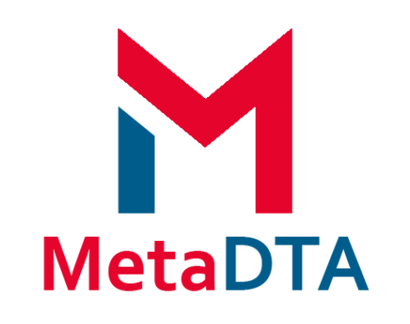
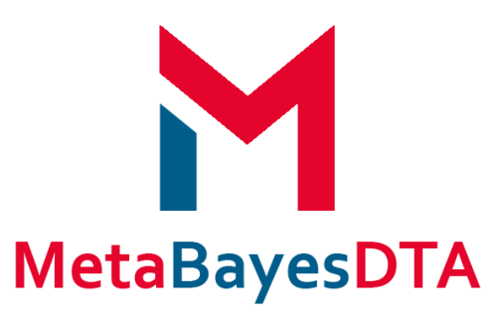
Interactive, web-based Shiny apps to conduct meta-analysis of diagnostic test accuracy data through a ‘point and click’ interface and create novel data visualisations
Presented by Nicola Cooper, Alex Sutton, Suzanne Freeman, Clareece Nevill, Ryan Field

Slide 2
Acknowledgements
Enzo Cerullo, Tom Morris, Janion Nevill (Leicester)
Amit Patel (Birmingham)
Terry Quinn, Olivia Wu (Glasgow)
All members of the NIHR Complex Reviews Support Unit
Feedback from users
This project is funded by the National Institute for Health and Care Research (NIHR) Complex Reviews Support Unit (project number 14/178/29). The views expressed are those of the author(s) and not necessarily those of the NIHR or the Department of Health and Social Care.

Slide 3
Originally set up as a support group to assist NIHR review groups including Cochrane (2015-2023)
Advice and training:
Refining review questions and scope
Applications, protocols and report writing
Consideration of types of data and structure
Appropriate methodological approaches
Apps developed to help with implementation of more advanced evidence synthesis methods for complex data structures

Slide 4
Diagnostic Test Accuracy (DTA):
DTA Primer
Educational primer on DTA studies
Meta-Analysis of DTA studies (frequentist & mostly standard approaches)
Bayesian Meta-Analysis of DTA studies (basic – advanced approaches)
App Principles
Free to use and open source
Where possible utilise existing R packages
Point and click interface
Emphasis on visualization and methods for sensitivity analysis
Online Evidence Synthesis Analysis Apps
http://www.nihrcrsu.org/guidance/
Network
Meta-Analysis (NMA):
Evidence Based Research:
NMA (frequentist & Bayesian approaches)
Sample size calculator for new study based on adding it to an existing pairwise meta-analysis
Feasibility into online interactive publication of a living NMA

Slide 5
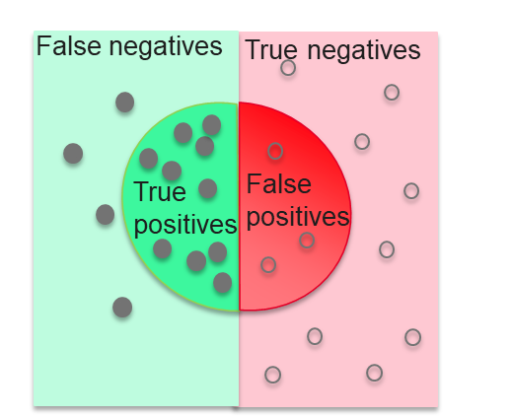
Diagnostic tests: Overview
Diagnostic tests are routinely used in healthcare for confirming the presence or absence of disease
Diagnostic tests rarely 100% accurate
Diagnostic test accuracy (DTA) measures the ability of a test to detect a condition when it is present and detect the absence of a condition when it is absent
Diseased
Non-diseased
For an interactive explorable explanation of DTA evaluation see our DTA primer available at https://crsu.shinyapps.io/diagprimer/

Slide 6
MetaDTA: Motivation
Meta-analysing diagnostic test accuracy (DTA) data is more challenging than for effectiveness data:
Two dependent variables:
Sensitivity –The proportion of people with the disease who are correctly diagnosed as positive by the test; i.e. the true positive rate.
Specificity – The proportion of people without the disease who are correctly diagnosed as negative by the test; i.e. the true negative rate
Requires fitting relatively complex bivariate statistical models
Software such as Stata, R and SAS require statistical knowledge whilst RevMan cannot fit bivariate models

Slide 7
MetaDTA: Aims
To develop a freely available user friendly, web-based “point and click” interactive tool which allows users to input their diagnostic test accuracy (DTA) study data and conduct meta-analyses for DTA reviews
Including incorporation of quality assessment (via QUADAS-2) and sensitivity analysis
To develop interactive graphical displays to facilitate exploration of the DTA data and effective communication of the results
Customise, explore and export plots

Slide 8
MetaDTA: Interface
We used the statistical software R and the existing packages Shiny and lme4.
Shiny allowed the creation of a web application with interactive user interfaces
lme4 is a package in R that fits generalised linear mixed effect models.
MetaDTA is hosted on the shinyapps server and is available to any user with a web browser, without requiring any specialist statistical software. The application is available at https://crsu.shinyapps.io/dta_ma/

Slide 9
MetaDTA v2.0.5 Demo: https://crsu.shinyapps.io/dta_ma/
Load data tab
Preloaded example dataset
Load own dataset
Meta-analysis tab
Study-level outcomes table
SROC plot – confidence region, predictive region, risk of bias
Statistics – options
Parameter estimates
Parameters for RevMan
Forest plots – sensitivity and specificity
Sensitivity analysis tab
Excluding studies, same options as for Meta-analysis
Prevalence tab
Schematic plot for communicating results
Options to set number of patients and prevalence

Slide 10
Summary
Advantages of MetaDTA
Fits bivariate meta-analysis model for diagnostic test accuracy data
Includes risk of bias and sensitivity analysis
Includes interactive graphics for data exploration
Facilitates effective communication of results
Limitations of MetaDTA
Imperfect gold standard
Different thresholds
Comparative analysis
Subgroup analysis /meta-regression
MetaBayesDTA https://crsu.shinyapps.io/MetaBayesDTA/

Slide 11
https://crsu.shinyapps.io/MetaBayesDTA/
Overcomes many of the limitations of MetaDTA (but does not allow data at multiple thresholds per study)

Slide 12
MetaBayesDTA (currently in late Beta)
•Written by Enzo Cerullo
•Create an extended version of MetaDTA which fits more complex models
•Uses Bayesian methods as implemented in STAN software exclusively – bespoke STAN code used throughout
•Encourage good practices
•Automatically report predictive intervals
•Prior distributions visualised before model fitting
•Model and sampler diagnostics automatically presented
•Updated user interface over MetaDTA

Slide 13
MetaBayesDTA v1.4 (Beta) Demo:
https://crsu.shinyapps.io/MetaBayesDTA

Slide 14
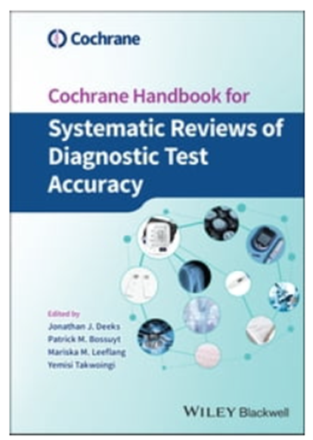
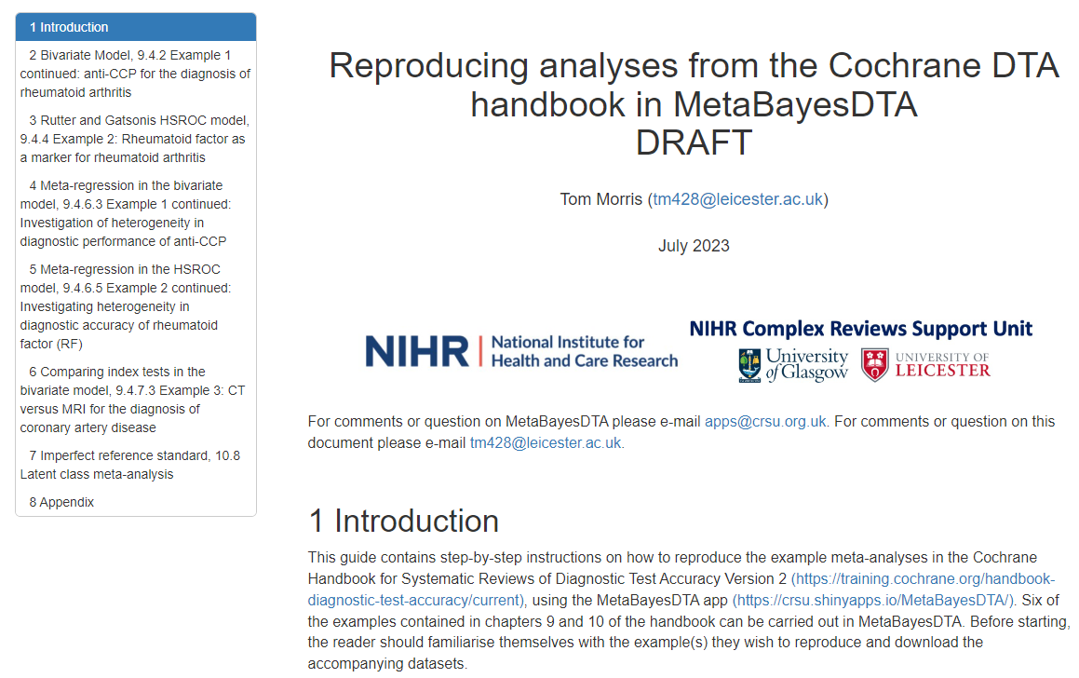
MetaBayesDTA : Further Info
A document showing how analyses from the Cochrane Handbook can be replicated in MetaBayesDTA is near completion – and should be available soon
An early version is available for use today in the practical

Slide 15
Final Comments
• Both apps:
• have links to YouTube tutorials within them
• source code is freely available on GitHub
• can be run locally in R if speed / internet connection / memory / confidentiality concerns are a problem
• Testing and bug fixing of MetaBayesDTA ongoing – hope full release soon
• MetaDTA has a manual within app
• A document showing how all possible analyses from the Cochrane Handbook can be replicated in MetaBayesDTA is being written – and should be available soon
• If anyone is interested in contributing, please get in touch

Slide 16
Practical
Worksheet for MetaDTA
Document outlining how to replicate analyses in Cochrane Handbook using MetaBayesDTA
Both can be downloaded from:
http://bit.ly/cochrane-colloquium

Slide 17
Any Questions?

Slide 18
Resources
Links
MetaDTA App: https://crsu.shinyapps.io/dta_ma/
GitHub: https://github.com/CRSU-Apps/MetaDTA
MetaBayesDTA App: https://crsu.shinyapps.io/MetaBayesDTA/
GitHub: https://github.com/CRSU-Apps/MetaBayesDTA

Slide 19
MetaCNMA
Future Work
Binary & Continuous Outcomes
Frequentist and Bayesian CNMA
Frequentist - Additive model
Bayesian – 4 Models from Welton et al.
Component Network Analysis - Simplified

Slide 20
Feedback

Slide 21
References
Freeman SC, Kerby CR, Patel A, Cooper NJ, Quinn T, Sutton AJ. Development of an interactive web-based tool to conduct and interrogate meta-analysis of diagnostic test accuracy studies: MetaDTA. BMC Medical Research Methodology (2019); 19: 81 https://doi.org/10.1186/s12874-019-0724-x
Patel A, Cooper NJ, Freeman SC, Sutton AJ. Graphical enhancements to summary receiver operating characteristic plots to facilitate the analysis and reporting of meta-analysis of diagnostic test accuracy data. Research Synthesis Methods (2021); 12: 34-44. https://doi.org/10.1002/jrsm.1439
Cerullo E, Sutton AJ, Jones HE, Wu O, Quinn TJ, Cooper NJ. MetaBayesDTA: codeless Bayesian meta-analysis of test accuracy, with or without a gold standard. BMC Medical Research Methodology (2023); 127. https://doi.org/10.1186/s12874-023-01910-y

Slide 22
Open Source
Source code for all apps available on GitHub:
https://github.com/CRSU-Apps

