Slide 1
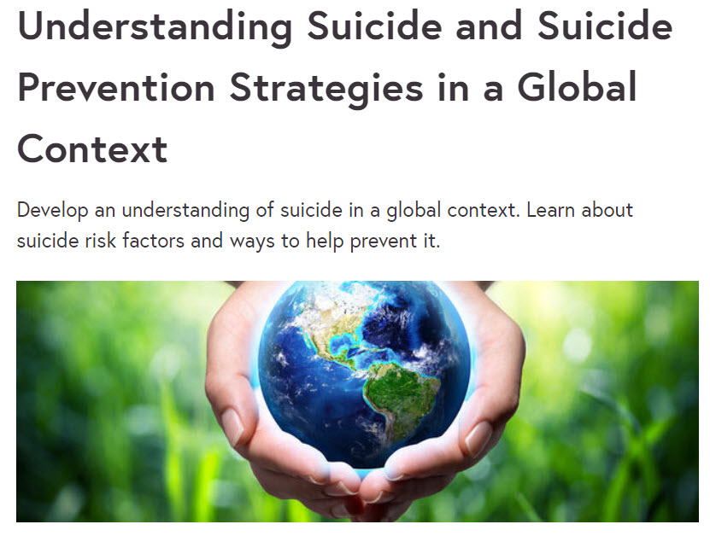
Designing a Massive Open Online Course (MOOC): Understanding Suicide and Suicide Prevention Strategies in a Global Context
Dr J Langan Martin¹, Dr L Sharp², Dr D Karadzhov³, Ms H McClelland³, Dr S Cleare³ and Prof R O’Connor³.
¹School of Medicine, Dentistry and Nursing, University of Glasgow ²Digital Education Team, University of Glasgow, ³Instititute of Health and Wellbeing University of Glasgow
Background: Suicide is preventable but it is estimated that a person dies by suicide somewhere in the world every 40 seconds.
The World Health Organisation (WHO) has a target to reduce suicide rates by 10% by 2020.
Given the increase in online learning , it was thought that a free online course could help increase knowledge, reduce stigma and help prevent death from suicide.
Methodology: A multidisciplinary team developed the educational content.
To ensure a safe learning environment, the WHO guidelines on safe reporting of suicides were used.
Self–care activities were embedded throughout each week of the MOOC and wellbeing resources were signposted at the end of each learning step.
The MOOC was moderated by a team with experience in suicide research.
Aim: To allow students to gain a broader understanding of suicide as a global issue through the creation of a 3-week, free Massive Open Online Course (MOOC).
Results: The MOOC was offered in March and September 2019
with five organisational endorsements and one accreditation.
Over 3,600 learners enrolled and 4,410 comments were made.
77.7% (n=2,278) of learners were “active learners”, almost twice the average in other Future Learn courses (42%).
The MOOC had a global reach with 51% of learners residing in the UK,
5% in Australia, 4% in the United States, 3% in Mexico, 2% in Canada,
India and China and 1% in Russia and Saudi Arabia.
1.4% (n=62) of comments were flagged & hidden due to unsafe
content. The majority were due to discussion of suicide methods.
Feedback data from 276 learners showed that:
93.5% (n=258) felt the course met or exceeded expectations
95.7% (n=264) reported new learning.
Discussion: There appears to be a global demand for education on suicide prevention. Outcome data suggest that new knowledge can be delivered through a MOOC.
Learner safety needs to be carefully considered when developing and delivering online learning. Thorough and careful moderation is essential to ensure that learners engage safely with the content.
Thanks To: Ms S Syrett, Mr M Syrett, Dr T Zortea, Dr H Paterson, Dr B Cullen, Dr L England, Ms K MacLean, Ms E Neilson, Ms J Crow and Mr J Kerr.

