Slide 1
Toolbox Talk: General
GEN03: Skin Health Surveillance

Slide 2
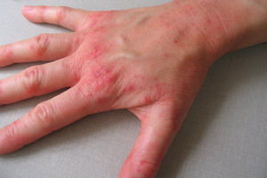
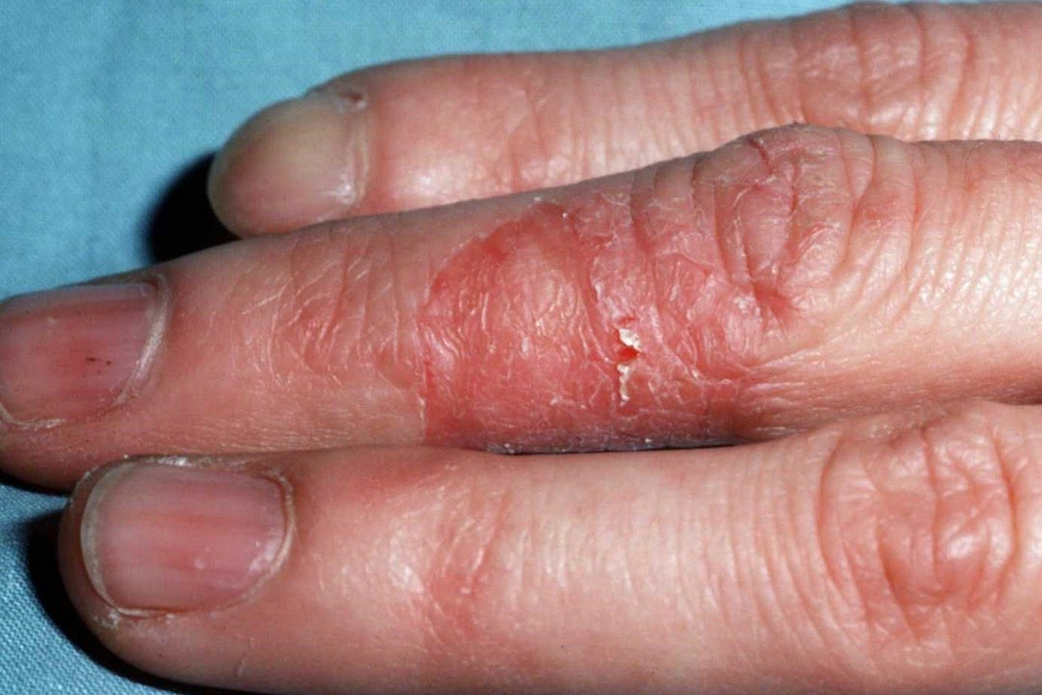
What is dermatitis?
Dermatitis is a common occupational* skin disease often caused by repeated skin irritation or sensitisation, symptoms include:
Skin redness or soreness
Itching
Skin rash or inflammation
Skin cracking or peeling
Dermatitis is easy to detect and can be managed using simple procedures but can be irreversible if left untreated
*Note: Occupational dermatitis is reportable under RIDDOR
Notes:
Notes:
Occupational dermatitis is a common problem which occurs in healthcare workers, scientists, workshop staff, cleaners and housekeeping staff due to regular exposure to certain chemicals or working conditions. It can be extremely debilitating and distressing and in some (thankfully rare) cases it can become severe enough to prevent an individual from carrying out certain tasks or being able to work in a particular profession. Around 30% of the population will suffer from dermatitis at some point during their lifetime.
Basically dermatitis is a medical condition which occurs when skin is damaged, irritated or becomes sensitive to certain substances. It is usually thought of as a skin rash but in fact can manifest as red, painful or itchy skin, rashes, inflammation or in some cases formation of blistering, cracking or peeling of the skin. It can be very severe and as with any skin damage leads to an increased risk of infection or entry of foreign substances if not carefully managed. While it’s easy to spot if left undetected or untreated dermatitis can lead to time off work, further medical problems, permanent sensitivity to certain substances and in extreme cases individuals may have to give up working in certain areas.
Further to this occupational dermatitis is reportable to the HSE under the RIDDOR Regulations and based on anecdotal evidence form other HE institutions and our colleagues in the NHS we know that the HSE have been taking a hard line on cases of occupational dermatitis making it even more important that we manage it appropriately. Note that all RIDDOR reports are made by the SEPS team.
In support of improving awareness we have revised our guidance on the requirements of health surveillance for exposure to skin sensitisers and have produced this short presentation and a supporting poster which we would recommend is placed prominently in each relevant work area to help raise awareness. Further guidance is available from the Occupational Health / SEPS websites and from the HSE website, the HSE Guidance document G403 is particularly helpful.

Slide 3
Types of dermatitis
Irritant contact dermatitis
Can be considered a form of physical damage which can be caused by exposure to contact with irritant or corrosive substances.
Regular contact with mild irritants or brief contact with strong irritants (or corrosive substances) increases the risk of dermatitis as does prolonged contact with relevant substances.
Can also be caused by physical conditions e.g. extremes of temperature or sweating caused by prolonged use of gloves (including nitrile gloves).
The risk of irritant dermatitis is increased in individuals who have atopic eczema or other skin conditions
Allergic contact dermatitis
Many substances can act as sensitisers meaning that the body develops an allergy to them after one or more exposures. In many cases there will be no immediate evidence that an individual has been affected.
Once an individual has become sensitised it is likely that they will remain so permanently, even a very minor exposure can then lead to a severe immune response causing the skin to become red and itchy.
Notes:
Notes:
Although we think of dermatitis as simply being a synonym for skin irritation there are in fact two different types which arise from differing types of exposures:
The first type, known as Irritant Contact Dermatitis refers to skin irritation which is caused by a physical or chemical effect such as exposure to a corrosive substance or extremes of temperature. Irritant contact dermatitis arises when the skin is damaged by exposure to an irritant substance, corrosive substance, some solvents (in particular degreasing solvents), very high or low temperatures or other conditions which affect the skin for example the sweating caused by repeated / long term wearing of gloves or repeated hand washing or wet working (Frequent or prolonged contact with water / mixtures usually more than 2 hours per day or more than 20 hand washes).
Generally in this case the risk is proportional to the duration / size of exposure and will of course be dependant on the substance or type of exposure involved. Long exposures to corrosive substances will have a more severe effect than short duration exposures to irritants. The risk form gloves etc. can be mitigated by use of barrier creams and taking regular breaks to allow the skin to recover.
As might be expected people who have atopic eczema are more prone to this condition.
The second type of dermatitis is Allergic Contact Dermatitis which has similar symptoms but occurs for different reasons. Some substances are classed as skin sensitisers and are assigned Risk Code 43 (examples include nickel, latex and many others). An individual can be exposed to substances of this type without any apparent ill effects but after a number of exposures may develop an allergy which can lead to the symptoms of dermatitis appearing after even a small exposure. Once this allergy has developed it is most likely to be permanent meaning that any exposure no matter how small could lead to an extreme reaction. Needless to say this can have a serious effect on the affected person and may make it impossible for them to carry out certain tasks or work with certain substances.

Slide 4
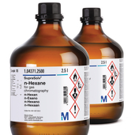
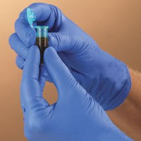
What can cause dermatitis at work?
Dermatitis at work is often caused by exposure to certain substances or conditions for example:
Wet work / regular hand washing (especially using soap or detergent)
Epoxy resins
Metalworking / cutting fluids
Latex (including latex gloves) and other rubber compounds
Exposure to solvents, irritant and corrosive chemicals
Regular use of gloves (including vinyl and nitrile gloves)
Chemicals that are irritants or skin sensitisers
Regular exposure will increase the likelihood of dermatitis which may depend on the sensitivity of the individual.
Notes:
Dermatitis can have a variety of causes and only some of them are covered above, for a more comprehensive summary see below. Some occupations are also deemed to be at higher risk of developing dermatitis, these are listed both to highlight service staff who may be at risk but also to give examples of further activities which could place research / support staff ion a higher risk category.
Substances
Epoxy resins
Latex
Rubber chemicals
Soaps, detergents, bleach and cleaning compounds
Metalworking / cutting fluids
Cement
Enzymes
Water (repeated or prolonged contact in most cases)
Any substance classed as causing skin sensitisation (Hazard Code H317 / R43), Toxic in contact with the skin (H314 / R24), irritating to the skin (H315 / R38)
Tasks
Wet work (more than two hours or 20 hand washes / exposures)
Regular hand washing (as above)
Occupations / Other Activities
Construction work
Health service work
Rubber making
Printing
Paint spraying
Agriculture / Horticulture
Electroplating
Cleaning
Catering
Hairdressing
Florist

Slide 5
Reducing the risk (Avoid, Protect, Check)
Avoid contact with materials that cause dermatitis where possible
Substitute hazardous substances with safer alternatives
Keep a safe working distance
Automate or enclose processes
Protect the skin
Provide appropriate protective clothing / gloves
Contamination should be washed from skin as quickly as possible
Hands should always be fully dried after washing
Consider providing moisturising pre-work and after work creams
Check for early signs of dermatitis
Regular skin checks should be used where the risk cannot be fully eliminated by avoidance / protection
Health surveillance should be provided where required
Notes:
Notes:
Use the APC (avoid, protect, check) approach to reduce or control the risks:
Avoid contact with materials that cause these conditions where possible.
Protect the skin.
Check for early signs of dermatitis.
Examples of how you can avoid contact are:
Substitute, by replacing a hazardous material with a safer alternative
Automate the process
Enclose the process as much as possible
Use mechanical handling
Use equipment for handling – don’t use your hands as tools
Keep a safe working distance.
If the steps above aren’t reasonably practicable or aren’t enough to totally avoid contact, you should
Provide appropriate protective clothing/gloves
Make sure clothing/gloves are used and stored correctly, and replaced when necessary
Tell employees to wash any contamination from their skin promptly
Tell them to dry their hands thoroughly after washing/cleaning
Supply moisturising pre-work and after-work creams.
When employees are exposed to residual risk of harm from hazardous substances, and you have put in place all appropriate means of controlling exposure, regular skin checks should be carried out to look for early signs of dermatitis. Checks are likely to be needed in the high risk industries mentioned under ‘Which jobs present most risk of contact dermatitis and urticaria?’
Early detection can prevent more serious dermatitis from developing.
Checks can help you to see if the preventative measures are working.
If skin problems are identified, employees should be advised to see an appropriate health professional. As the employer you will need to know what tasks affected employees are fit to do and what controls will protect them.
The law requires employers to prevent or, where that is not reasonably practicable, adequately control exposure to materials in the workplace that cause ill health like dermatitis. The Control of Substances Hazardous to Health Regulations 2002 (COSHH) require employers to:
Assess risks
Provide adequate control measures – and ensure the use and maintenance of these
Provide information, instruction and training
In appropriate cases, provide health surveillance.

Slide 6
Skin health surveillance
Health surveillance should be considered for individuals who are at risk of developing occupational dermatitis, consider the following:
Are individuals working with substances listed previously or ones assigned the risk code R43?
Are individuals carrying out tasks likely to lead to dermatitis (e.g. wet workers or glove users)?
Assessment of new workers deemed at risk should be carried out within 6 weeks of starting
Regular skin checks should be carried out by individuals on an ongoing basis
Weekly checks are recommended
Checks should be recorded to provide confirmation they are taking place
Any symptoms that are identified should be reported to the line manager / PI in the first instance
Consider carrying out a health surveillance risk assessment for any process which could cause dermatitis
*Health surveillance is not an alternative to proper exposure control
Notes:
Notes:
Health surveillance is a process used to systematically assess and detect early signs of adverse health effects of workers who may be exposed to certain hazards in the course of their employment. Primarily it is used to identify potential problems before they fully develop and help identify the need for additional control measures or changes in working practices. Various strategies and methods are used depending on the nature of the hazards associated with the work being undertaken and the working environment.
Health surveillance involves systematically monitoring for early signs of work-related ill health in employees who are exposed to certain health hazards. Robust procedures are required to achieve this and it is a requirement by law, where there is a detectable disease associated with a particular type of work.
For further information on implementing a health surveillance procedure consult the guidance on the website: https://www.gla.ac.uk/myglasgow/seps/az/healthsurveillance/

Slide 7
How to carry out skin checks
Talk to staff in your area and ask the following questions:
Ask the employee if they are having problems with their skin (itching, dryness, redness, cracking, weeping, scaling)
Ask what they are doing to protect their skin
Encourage avoidance of contact with substances and use of the correct PPE
Encourage them to tell you if problems start before their next check is due
What actions to take if a problem is identified*:
Remind the employee to:
Avoid contact with water and chemicals
Keep their hands dry
Use PPE as instructed
*Don’t try to diagnose the cause yourself, refer to the occupational health unit
Notes:
Notes:
Skin checks are usually best carried out by the staff themselves but supervisors should make sure the process is being carried out regularly and can assist if required
Regular discussions about skin health can help to reinforce safety procedures and make it easier for staff to raise issues or report skin irritation / dermatitis
Some higher risk individuals who already receive respiratory health surveillance with Occupational Health will have their skin checked at the same time
Diagnosis should be left to the Occupational Health unit although it will be helpful to have a list of the substances used in an area along with precautions / PPE taken to reduce the risk.

Slide 8
Dr. Phil Rodger (Chemical Safety Adviser)
Dr. Mary Blatchford (Occupational Health Physician)
https://www.gla.ac.uk/myglasgow/seps/az/healthsurveillance/
https://www.gla.ac.uk/myglasgow/occupationalhealthunit/
Notes:
Websites and resources for further information:
https://www.gla.ac.uk/myglasgow/seps/az/healthsurveillance/
https://www.gla.ac.uk/myglasgow/occupationalhealthunit/
http://www.hse.gov.uk/cleaning/topics/dermatitis.htm
http://www.hse.gov.uk/skin/posters/skindermatitis.pdf
http://www.hse.gov.uk/pubns/ms24.pdf
http://www.hse.gov.uk/skin/posters/distance.pdf
http://www.hse.gov.uk/statistics/causdis/dermatitis/index.htm

