Slide 1
Guidance notes
These slides are intended to support staff who are making presentations about the University and have been designed to complement the University’s main PowerPoint templates, which can be downloaded from the Brand Toolkit.
These slides should not be edited as the content is approved.
If you require assistance or guidance, please email laura.tyler@glasgow.ac.uk

Slide 2
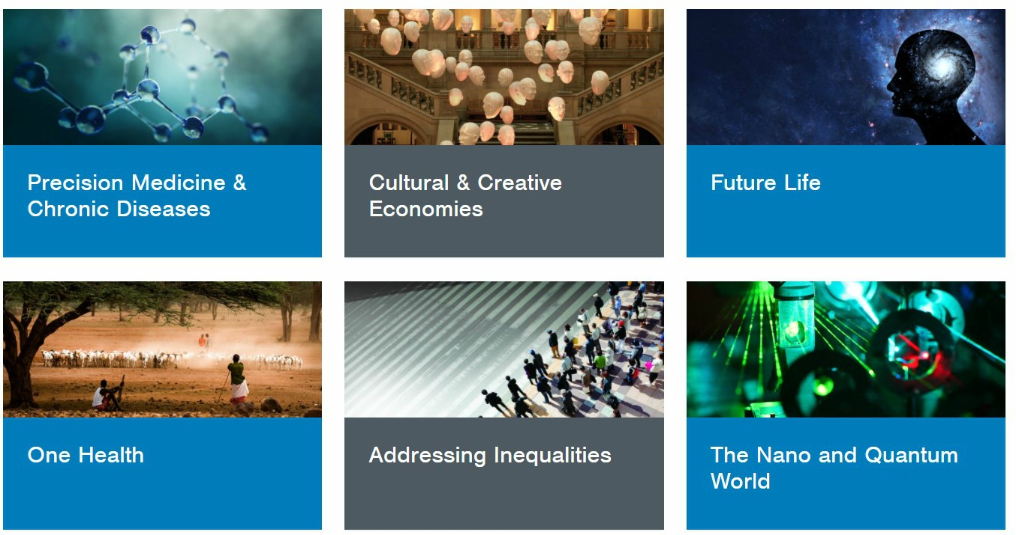
World-changing Research
Six broad-based, cross-disciplinary themed areas.
Research excellence and world-changing impact.
Areas in which we have been successful in attracting major external investment.
www.gla.ac.uk/research/worldchanging/

Slide 3
Addressing Inequalities
Working collaboratively with communities, governments and international organisations to understand the causes of inequality across the world.
Supporting real-world change by evaluating and developing policies to:
Improve social regeneration and the physical environment in deprived neighbourhoods and communities.
Reduce or mitigate health inequalities.
Support marginalised groups such as refugees and asylum seekers.
Empower poor, marginalized groups globally.
www.gla.ac.uk/inequalities

Slide 4
Cultural & Creative Economies
Our research has impacts on all aspects of creativity, cultural life and the creative economy:
We are creating unique digital tools & resources to generate and share research.
Our Centre for Cultural Policy Research informs policy development throughout the world.
CREATe, our international research centre specialising in copyright and information law, focuses on innovation in the creative economy.
Our research engages, informs and connects the public and policymakers with their heritage.
www.gla.ac.uk/creativeeconomies

Slide 5
Future Life
We have developed ground-breaking methods to reverse-engineer human cognitive processes – with the aim of giving robots flexible cognitive abilities.
We are exploring the digital control of chemistry by using robotic systems to control complex chemical systems from the discovery of life-like reaction networks to new drugs.
We are developing diagnostic tools and novel stem-cell based engineering solutions to target disease before symptoms are evident.
www.gla.ac.uk/futurelife

Slide 6
One Health
Glasgow is an international leader in One Health research.
Researchers from human and veterinary clinical medicine are closely integrated with life-scientists, social scientists and physical scientists to deliver world-changing research:
Our scientists are at the forefront of rabies elimination.
With partners in Malawi we investigate the interface between non-communicable and infectious disease.
We are leading research into a number of neglected zoonotic diseases, such as the Zika virus and brucellosis.
Our collaborations have made a significant impact on key national, global health and veterinary agendas.
www.gla.ac.uk/onehealth

Slide 7
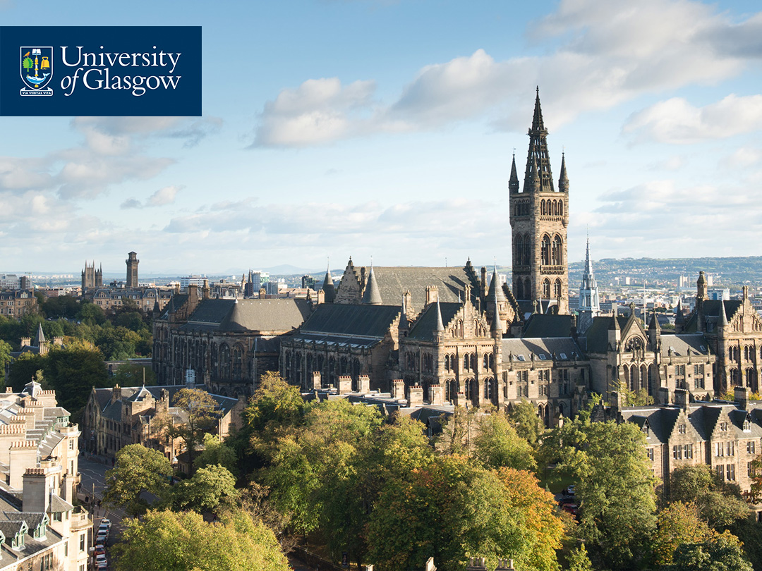
Precision Medicine & Chronic Diseases
Our researchers are leading the world in the development of new treatments and diagnostics for chronic diseases.
Precision Medicine uses advanced genomic, imaging and information technologies to generate treatments that are tailored for particular groups of patients.
Our new £32m Imaging Centre of Excellence (ICE) includes Scotland’s only 7 Tesla MRI scanner. By using this ultra-high resolution scanner, ICE will drive the development of imaging technology to understand and benefit diseases such as stroke, brain tumours and multiple sclerosis.
Our ambition is to be a global centre of excellence for chronic disease, precision medicine and imaging.
www.gla.ac.uk/precisionmedicine

Slide 8
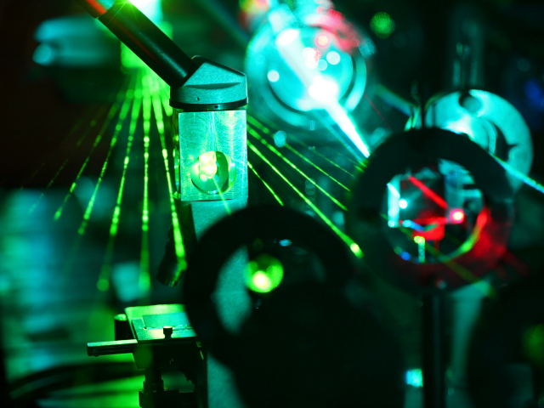
The Nano & Quantum World
Glasgow is an International centre of excellence in quantum and nano-science.
We are home to QuantIC, the UK’s Quantum Technology Hub in imaging, the James Watt Nanofabrication Centre, the Centre for Doctoral Training in Sensing and Measurement, and the Institute for Gravitational Research.
On the smallest possible scale, we study and control particles of matter and light to understand the building blocks of the universe, and apply this understanding to make new types of sensor and imaging systems.
On the largest scale, we use our expertise to open new windows to the universe through the detection of gravitational waves.
www.gla.ac.uk/nanoquantum

