Slide 1





Making sense of social data
Francesco D’Orazio, @abc3d
Pulsarpla8orm.com

Slide 2
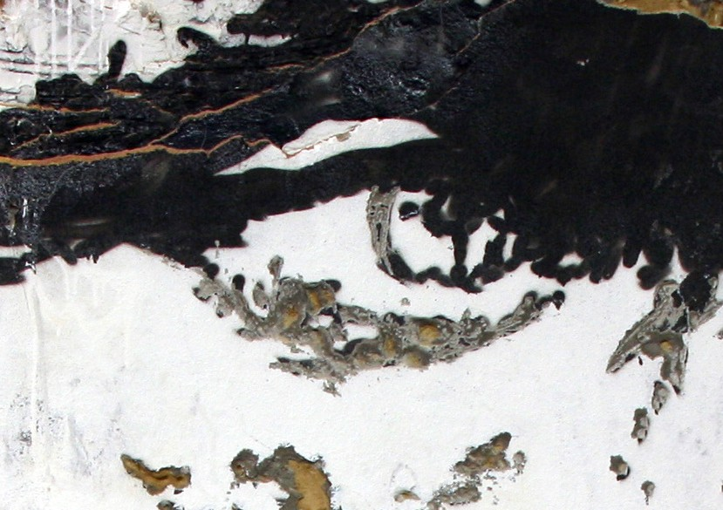
© Alexandre Farto aka Vhils 2010
Most Social Media Research
focus on just Content

Slide 3
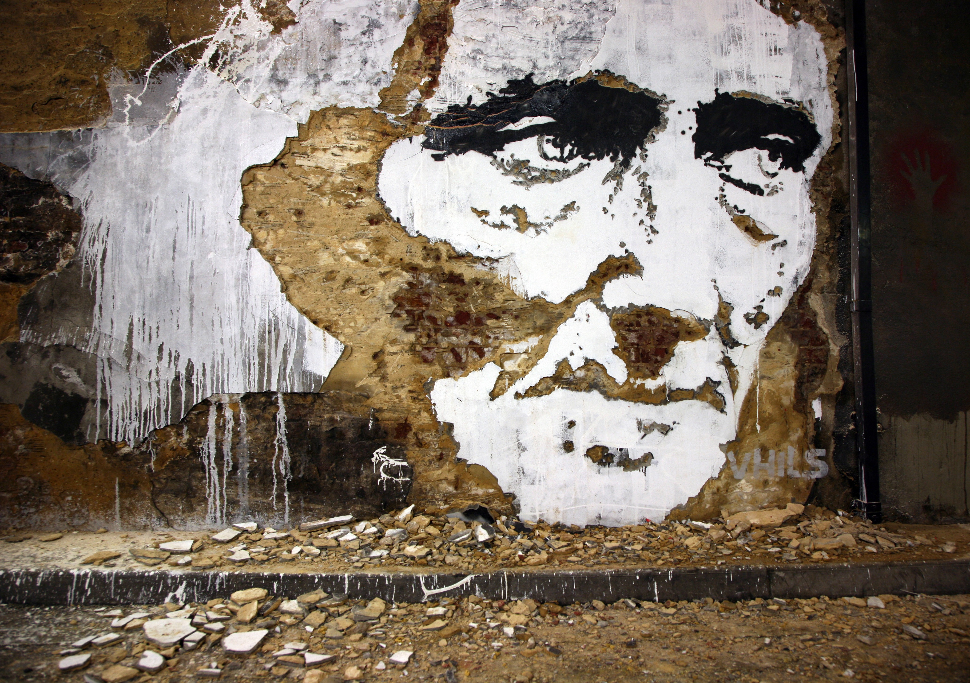
© Alexandre Farto aka Vhils 2010
Missing out on
Context and Behaviour

Slide 4
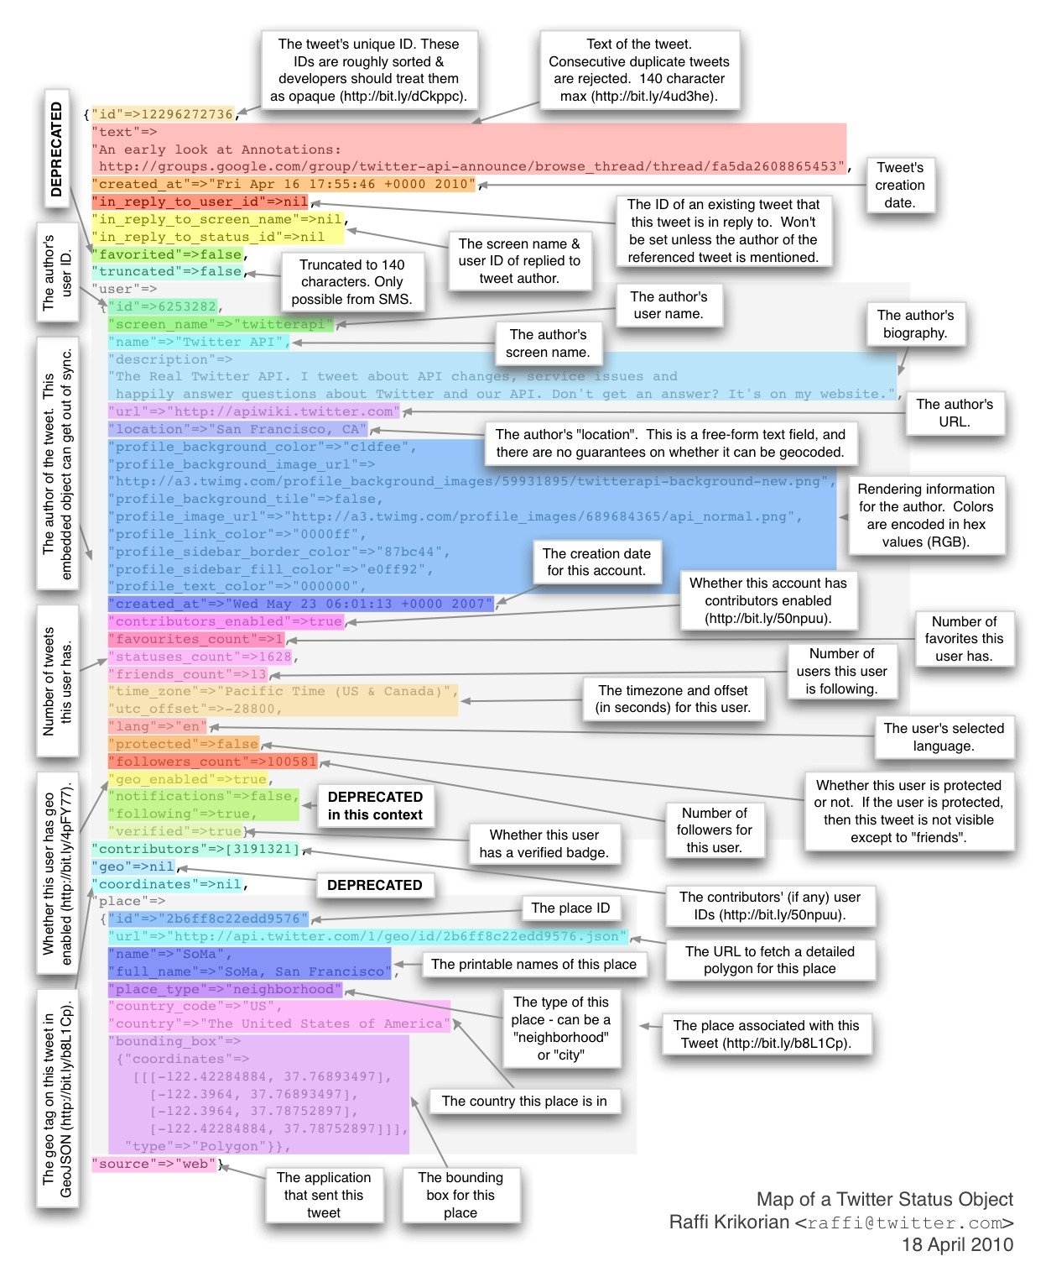

The code behind a tweet

Slide 5


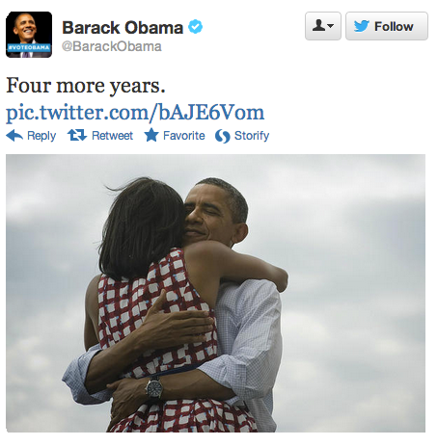

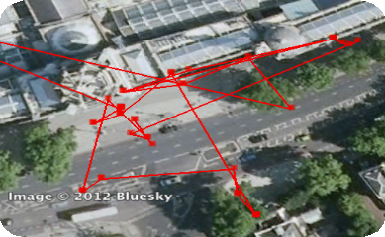



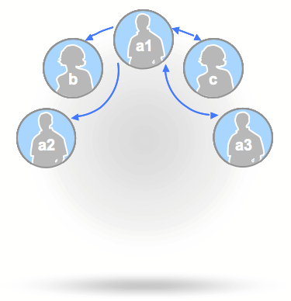
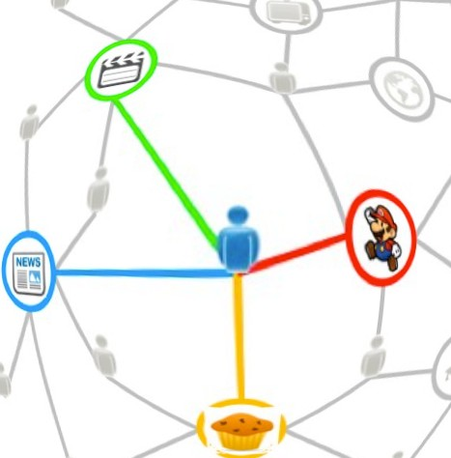
Dimensions of Social Data
Content
Demographics
Behaviours
Social Graph
Interest Graph

Slide 6
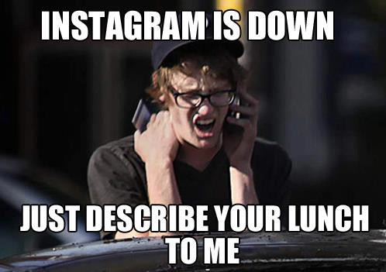

Slide 7
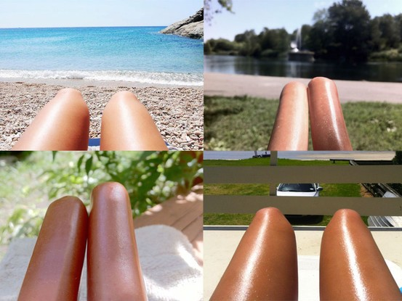

Slide 8

#tumblr: 85m post / day
75% images

Slide 9
It’s not quantitative data

Slide 10
It’s qualitative data on a quantitative scale

Slide 11
Social science
+
Social data
+
Computation
Computational Social Science

Slide 12
{
Keywords Geofencing Audience
Content (links or images)
Sample
Structure {
Natural Language Processing Machine Learning
Network Analysis Deep Learning Computer Vision
{
Visualise
Python and R D3.js
Gephi

Slide 13
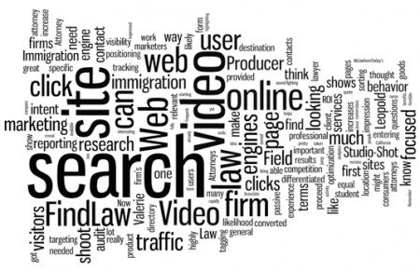
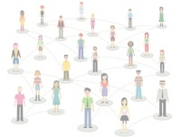
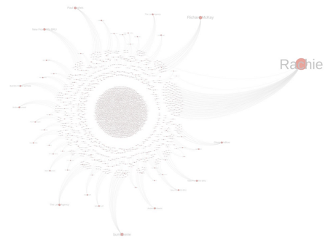
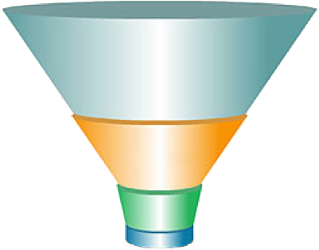
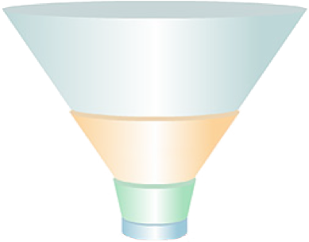
TOPIC analysis > keyword tracking
1
By keywords
By audience
By URL
Share of Voice
Share of Mind
Share of Diffusion

Slide 14
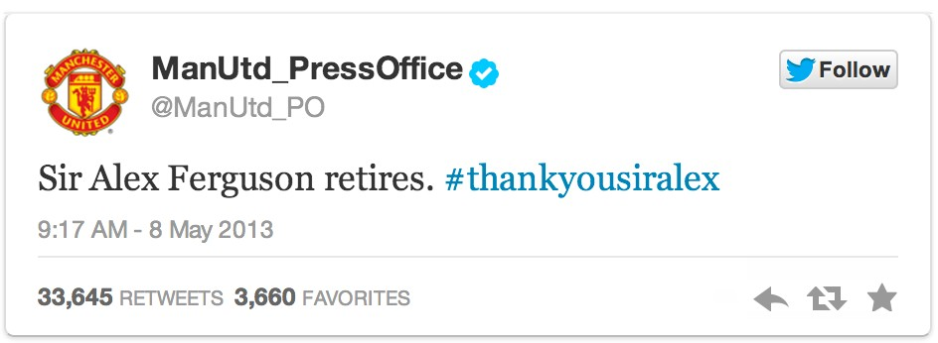




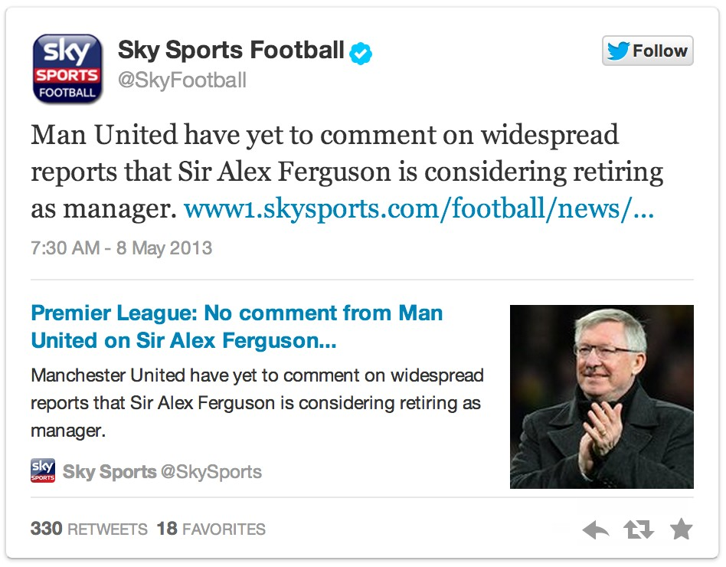
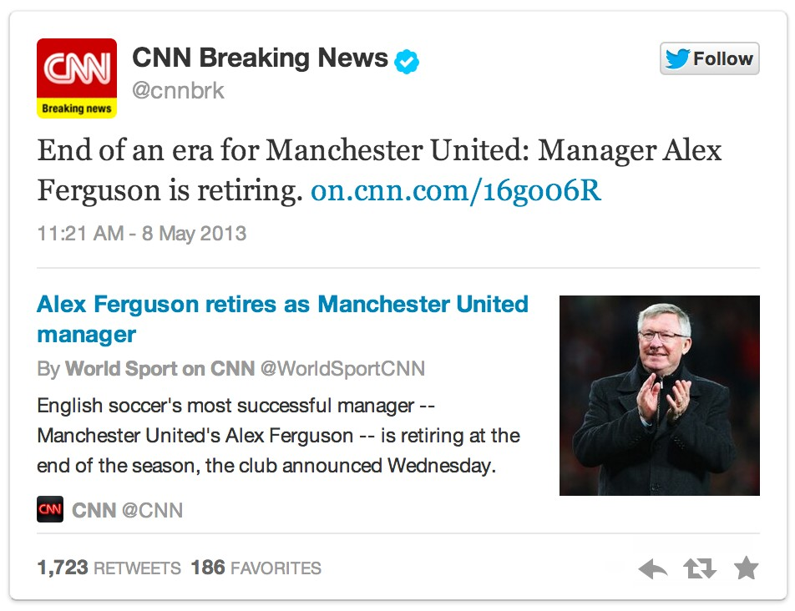





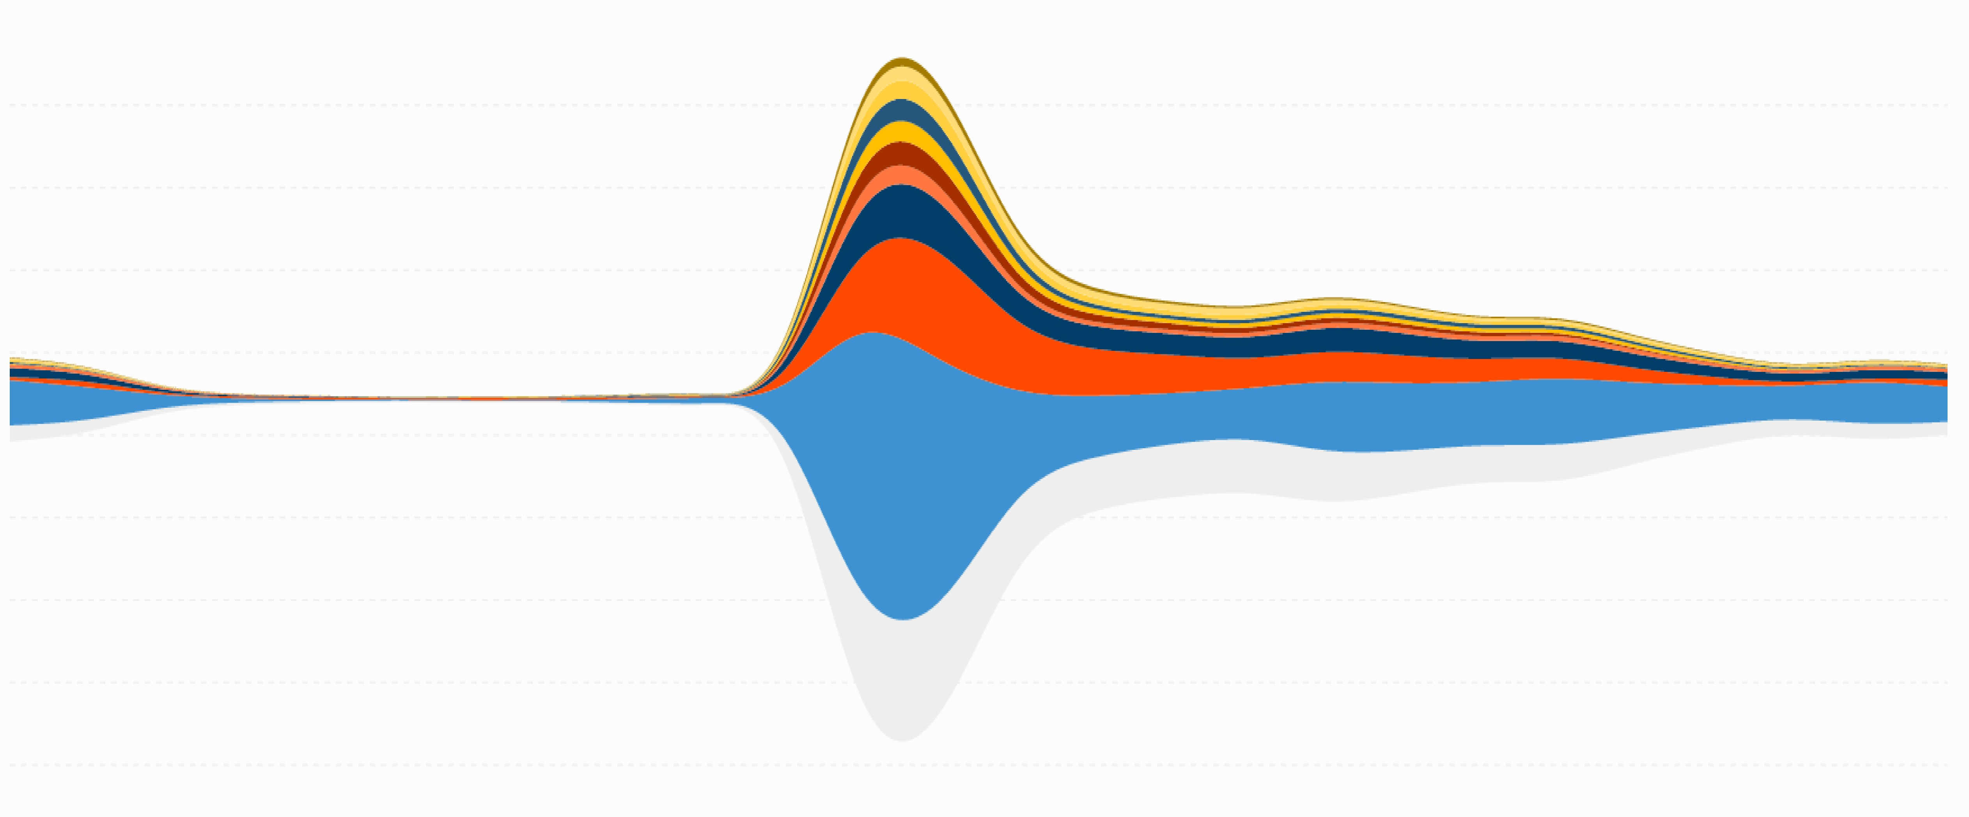
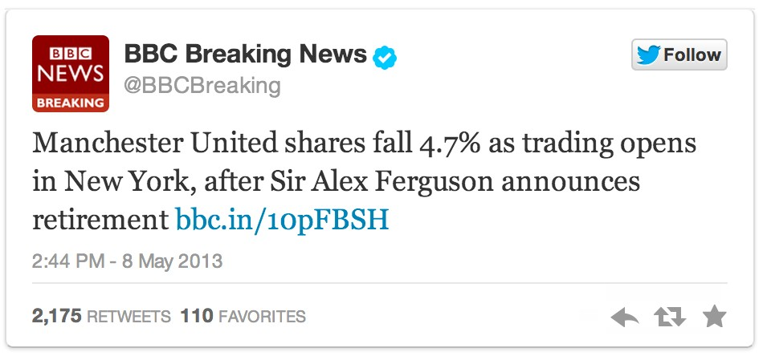
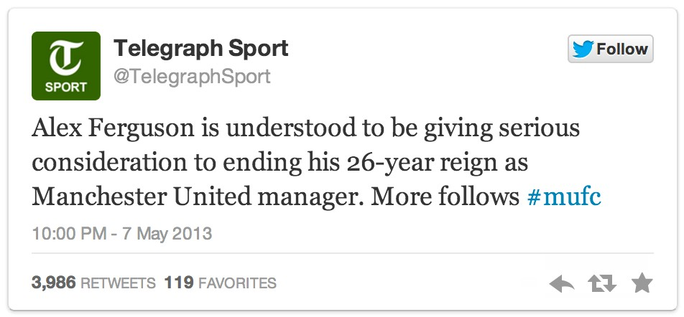
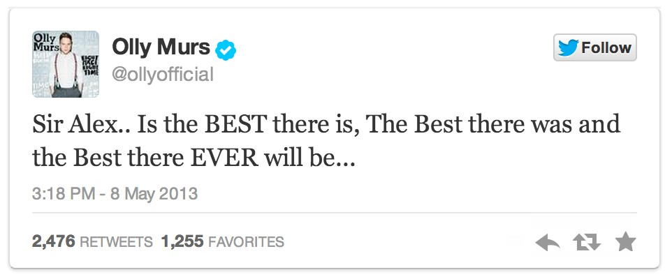
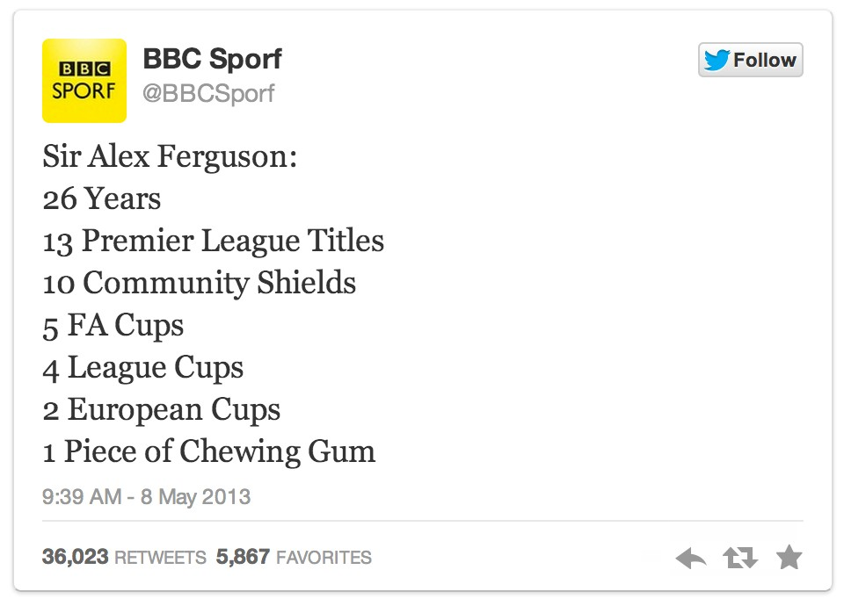
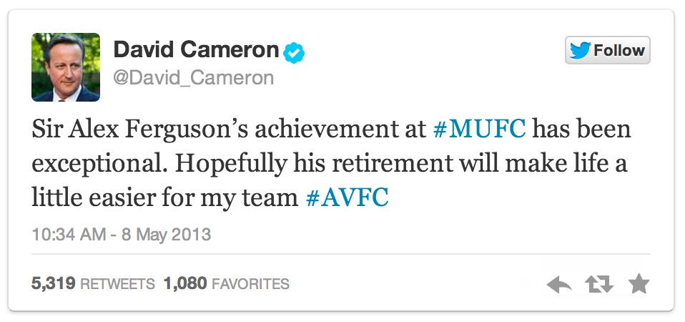
Great Britain Indonesia USA
Malaysia Nigeria
Ireland India Spain
France South Africa
Other
07 May 2013,
10 pm
the rumour spreads on TwiPer
How fast does news travel?
Conversations about Alex Ferguson retirement by the hour by country
10 PM 11 PM Wed 08 1 AM 2 AM 3 AM 4 AM 5 AM 6 AM 7 AM 8 AM 9 AM 10 AM 11 AM 12 PM 1 PM
2 PM 3 PM 4 PM 5 PM
6 PM 7 PM 8 PM 9 PM 10 PM

Slide 15
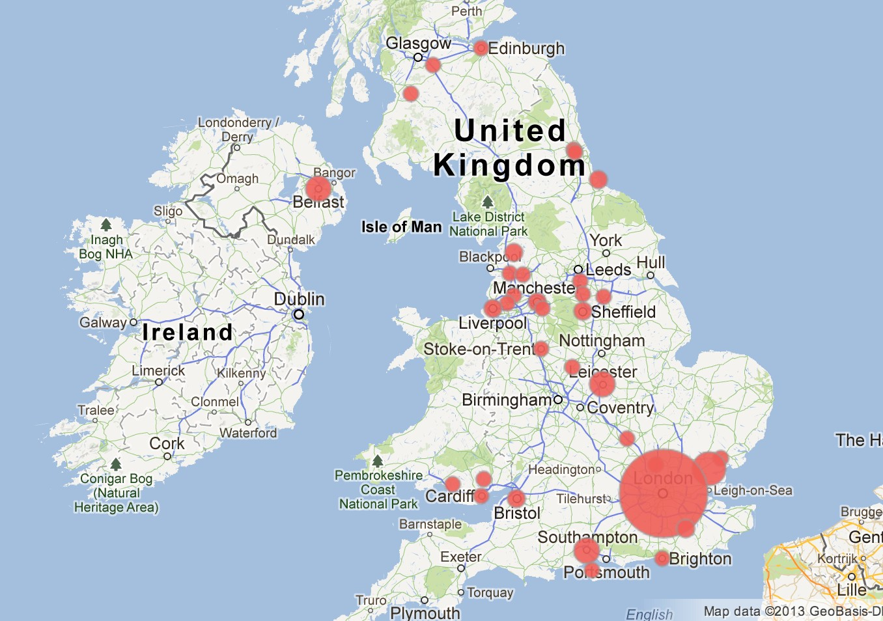
Localized Tweets highlight network disruptions Real-time conversations indicating network disruptions for a top global mobile operator

Slide 16
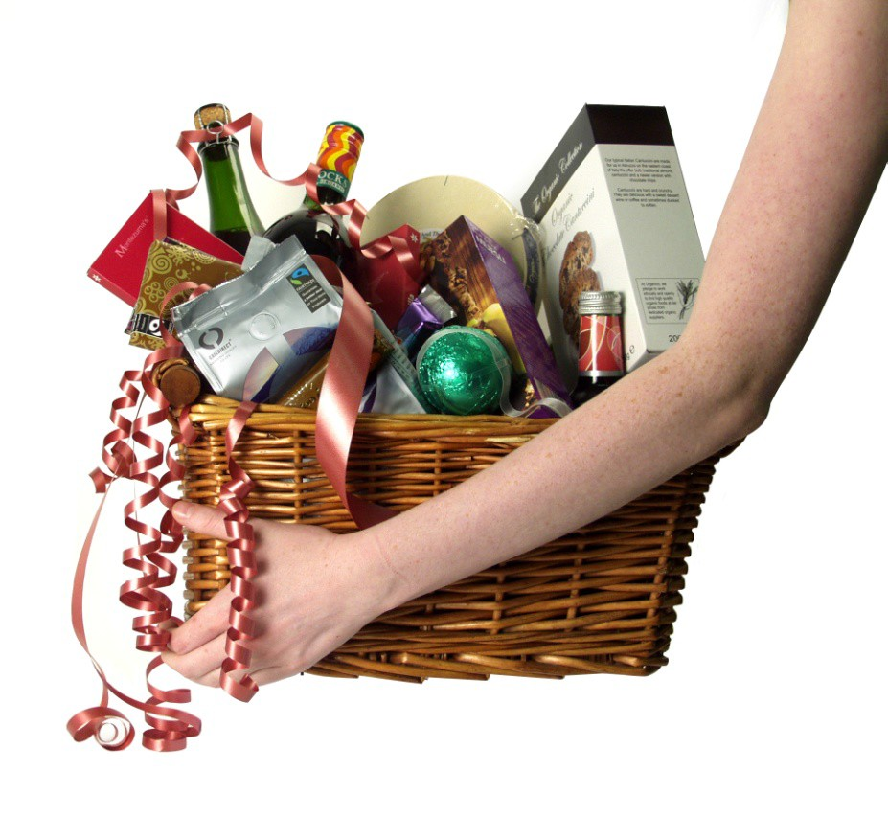



Geo-fencing for data driven ads and retail stock

Slide 17

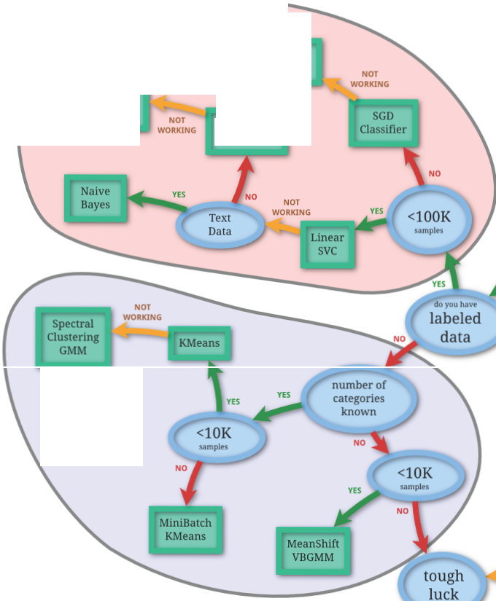
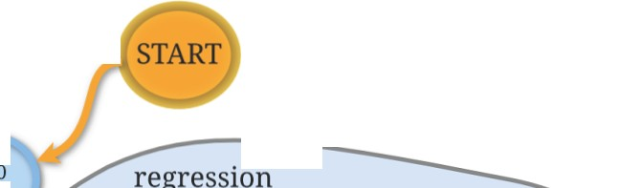
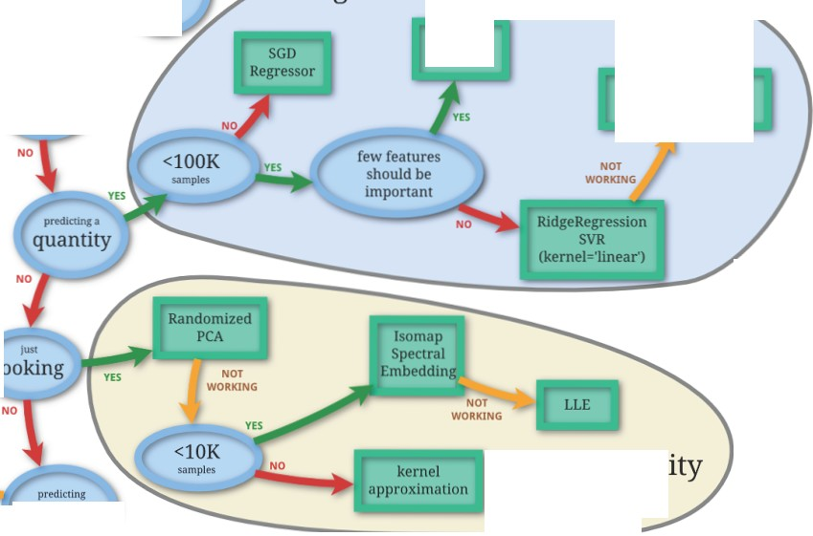

classification
scikit-learn
algorithm cheat-sheet
kernel approximation
svc
Ensemble aasslfiers
KNeighbors Classifier
ElasticNet
Lasso
SVR(kemel='rbrJ EnsembleRegressors
clustering
just
looking
dimensionality reduction
structure

Slide 18
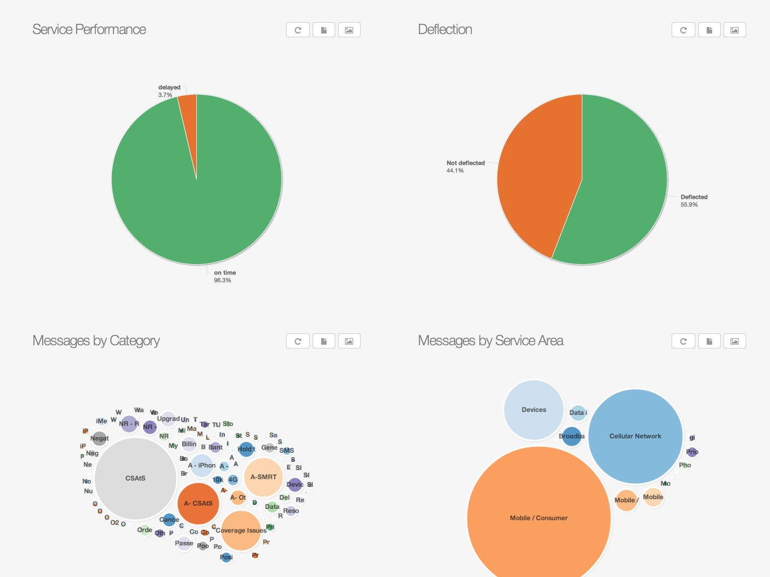
Social CRM Analysis Customers enquiries classified by category and service area

Slide 19
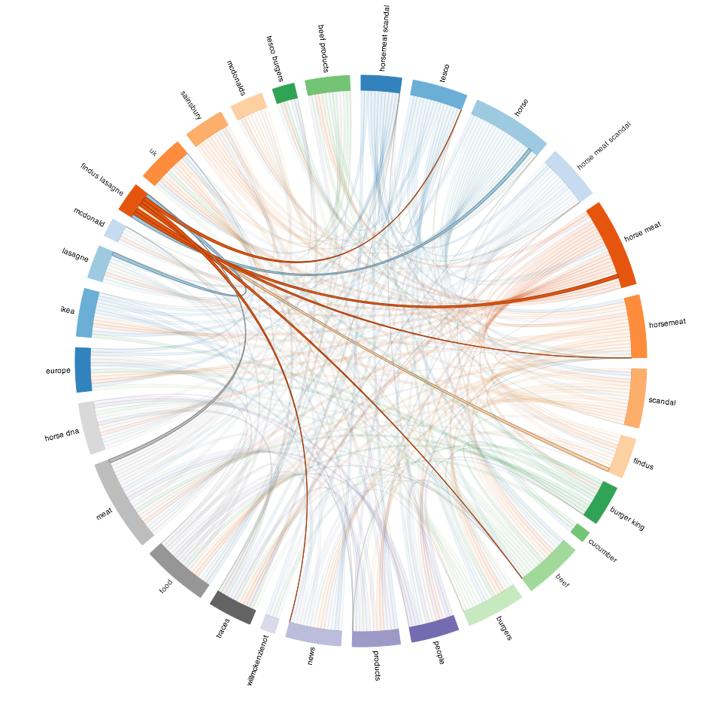
How is a brand involved in a global crisis? Discourse analysis on conversations about the Horse Meat Scandal involving top food brands across the world

Slide 20
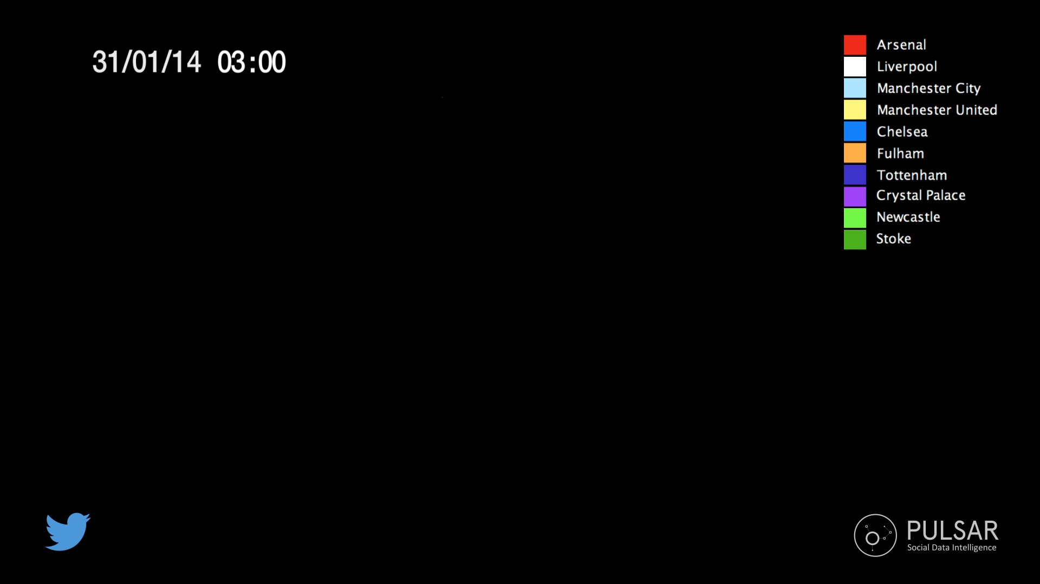

Slide 21





2
CONTENT diffusion > where, how and who is sharing a piece of content
By keywords
By audience
By URL
Share of Voice
Share of Mind
Share of Diffusion

Slide 22
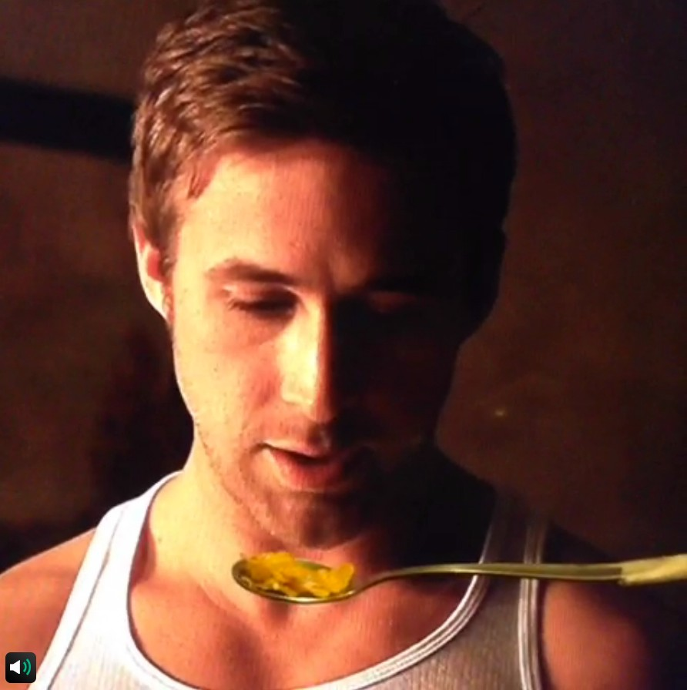

Slide 23
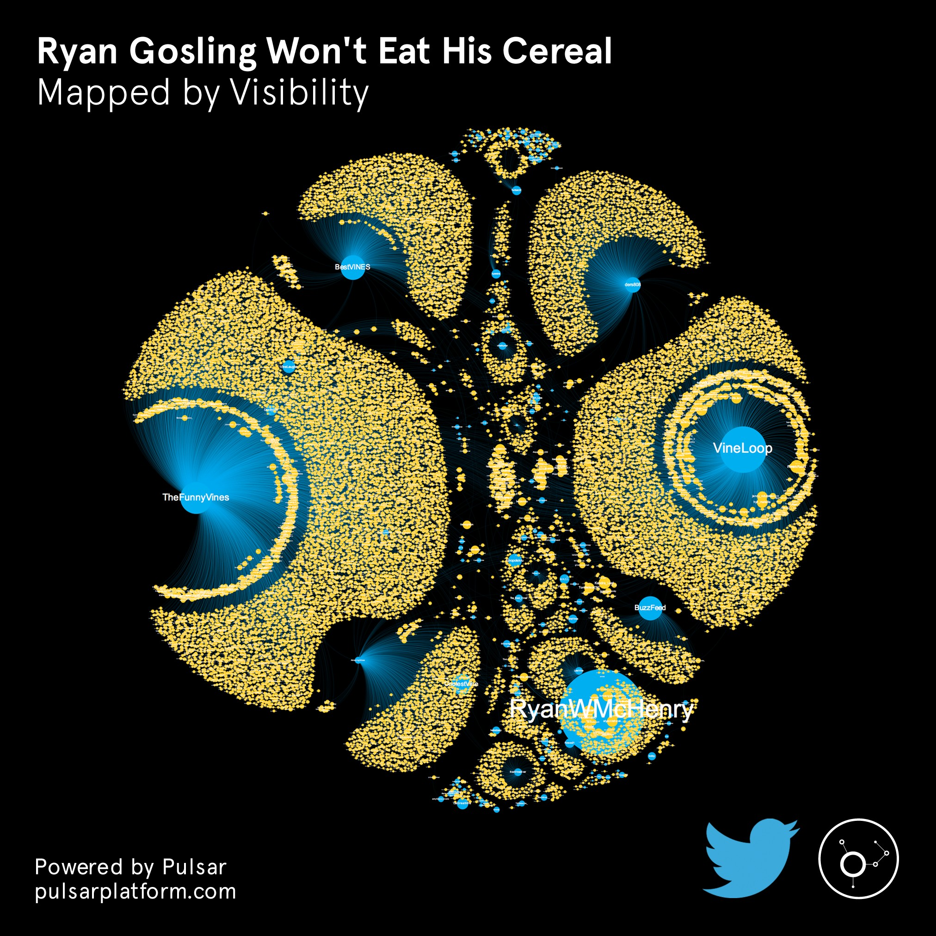

Slide 24
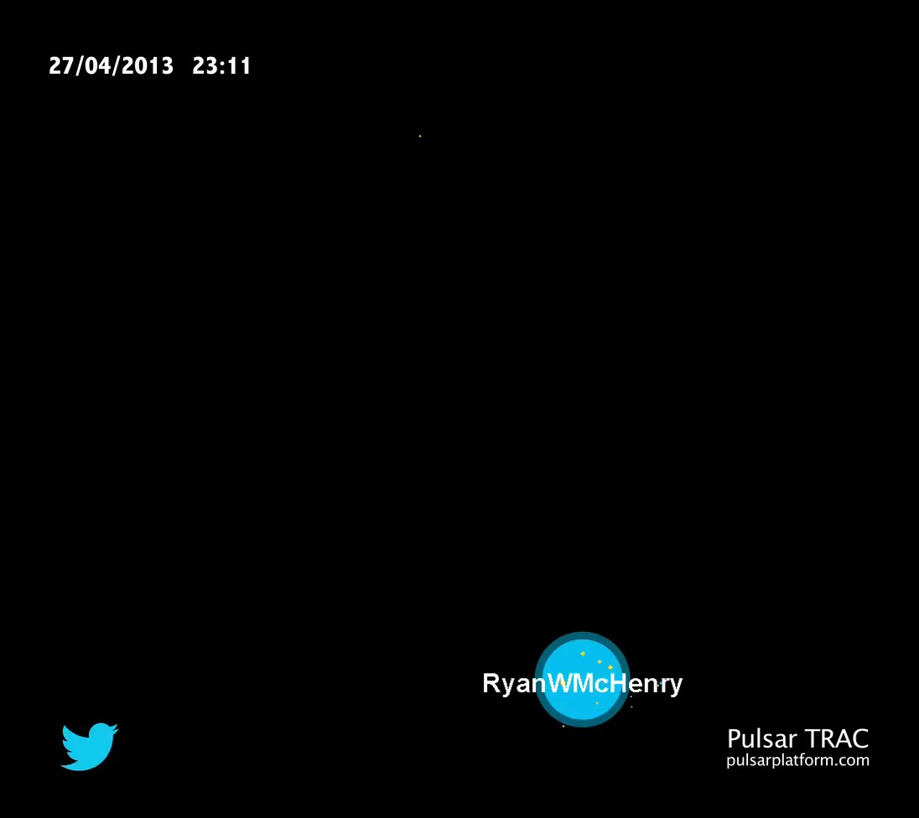

Slide 25
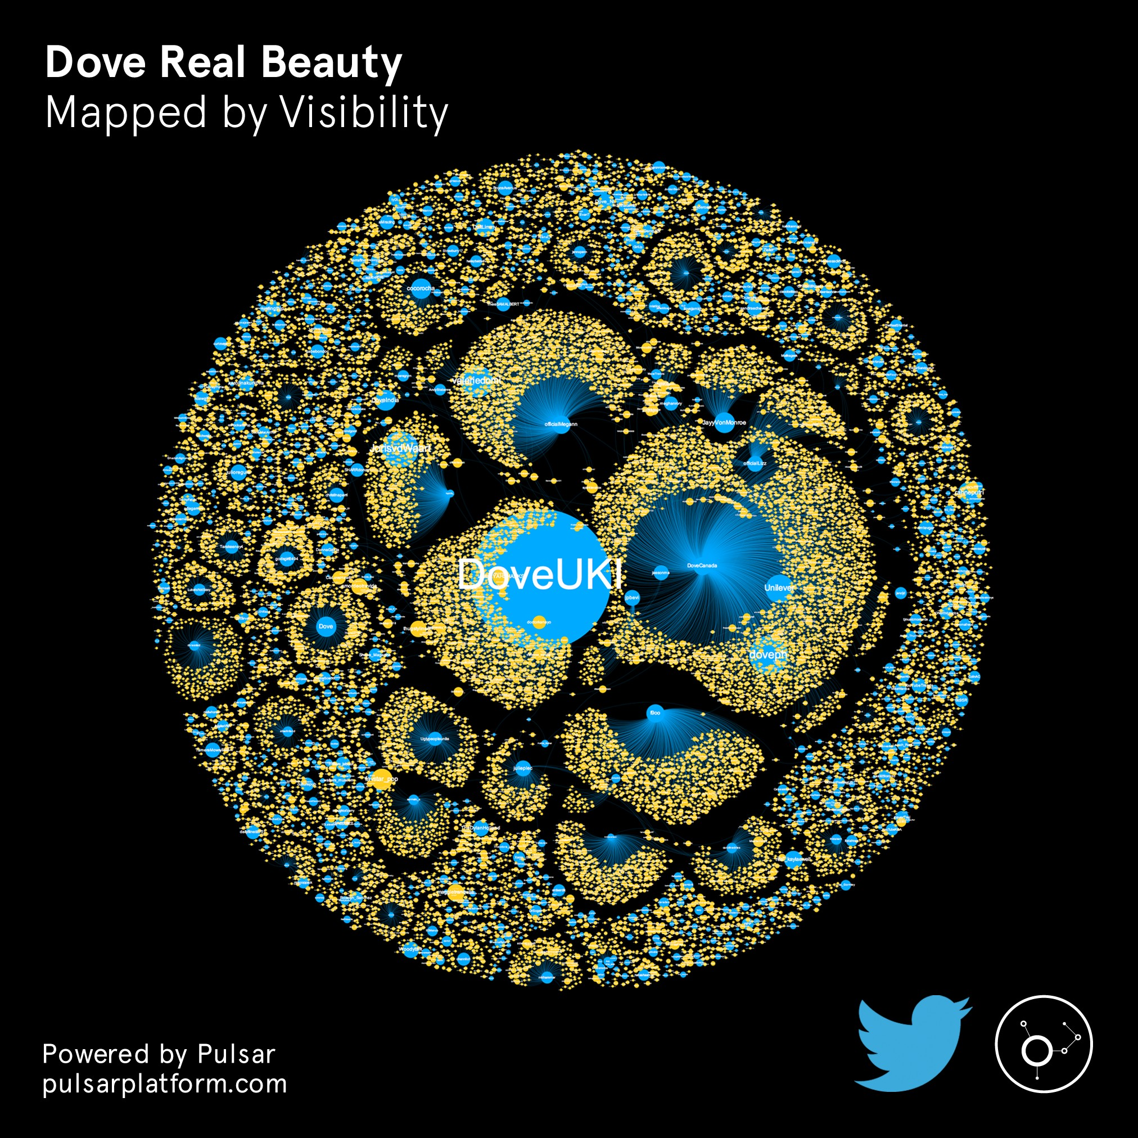
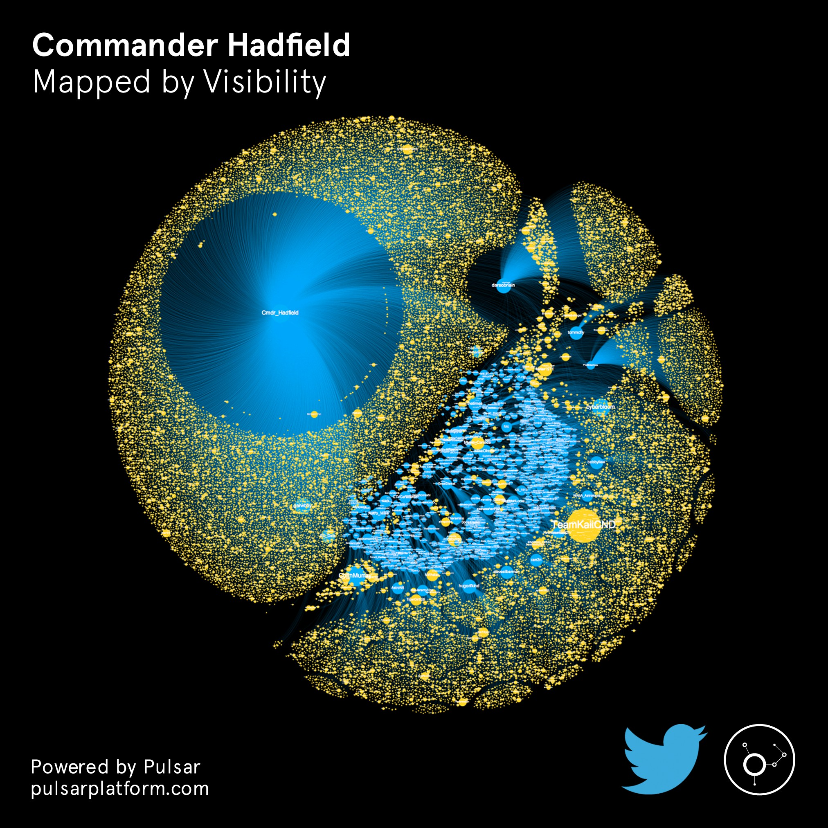
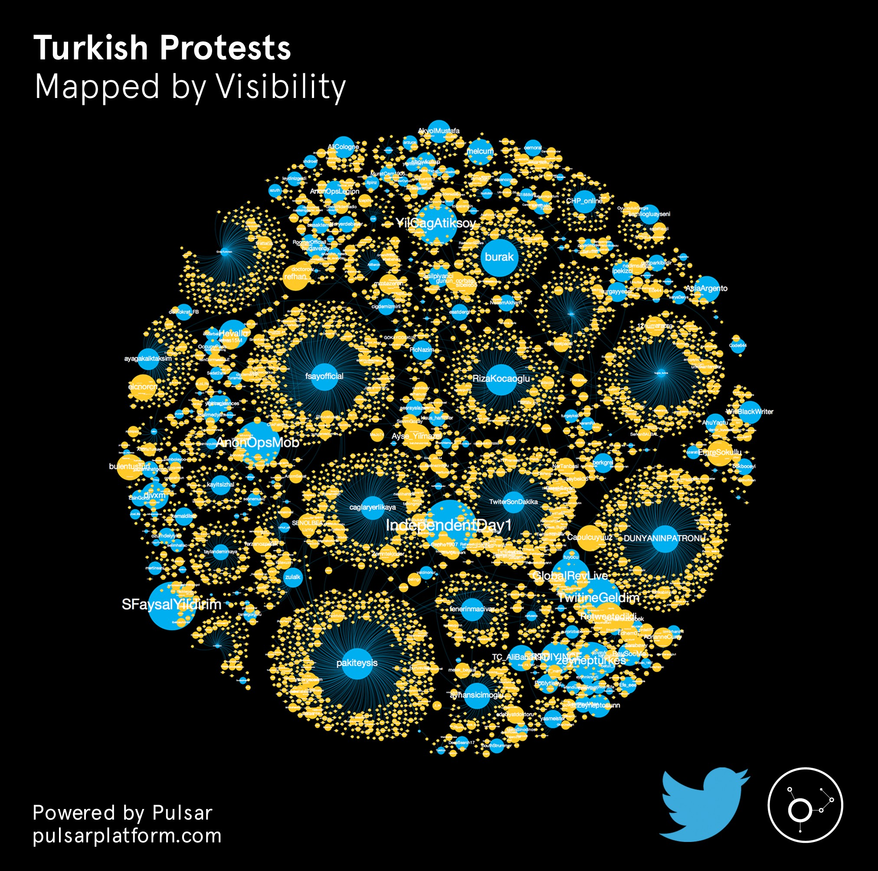
4 maps
by v
isibility

Slide 26

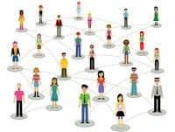



AUDIENCE mapping > the brand graph
3
By keywords
By audience
By URL
Share of Voice
Share of Mind
Share of Diffusion

Slide 27
Mentions of brand x
@Brand follower activity
0.1%

Slide 28

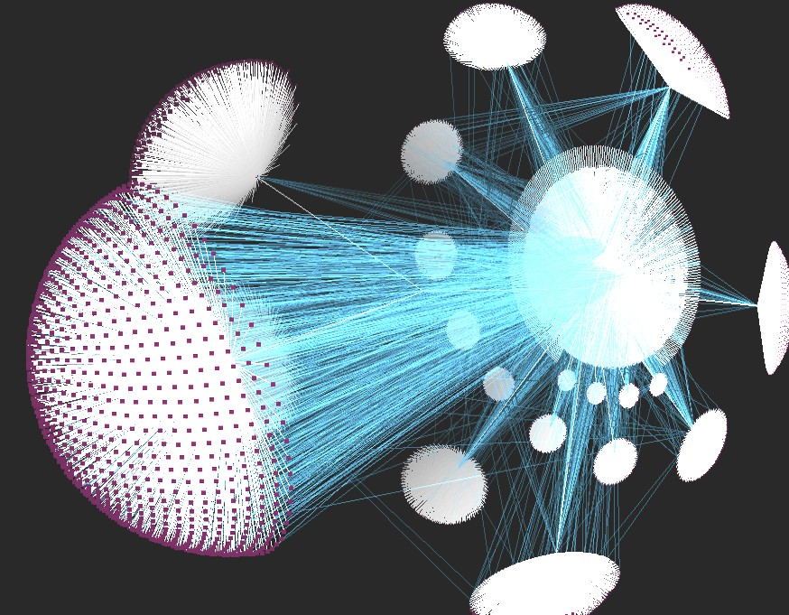

Decoding your online audience Discovering clusters of fans using Social Network Analysis

Slide 29
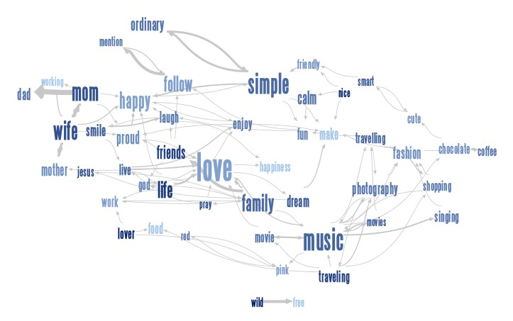
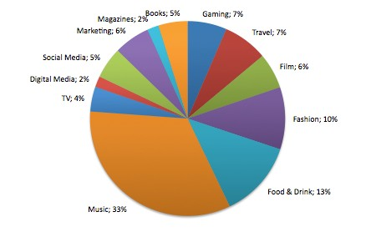
Decoding your online audience discover interests, behaviors and demographic clusters to fine tune your social strategy

Slide 30
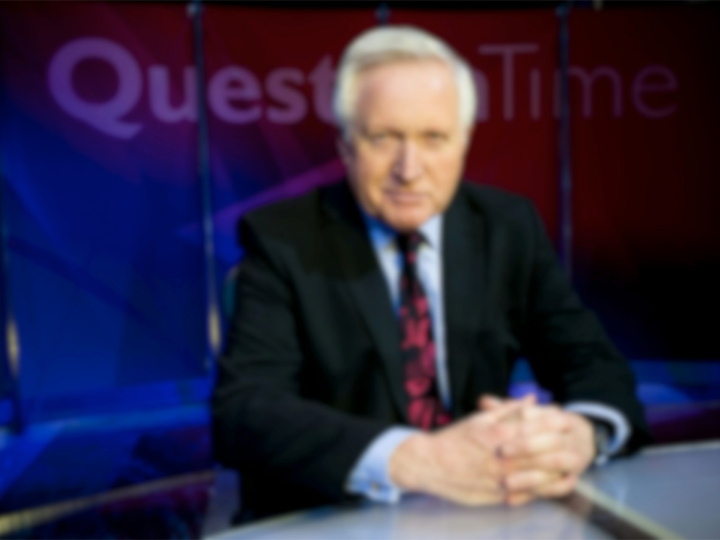


23,135
Tweets
10,582,690
Potential Reach (the sum of unique followers of the Active Audience)
17,246
Unique Authors / Active Audience
13,456
Retweets
613X
Audience Amplification (Potential Reach divided by Active Audience)

Slide 31

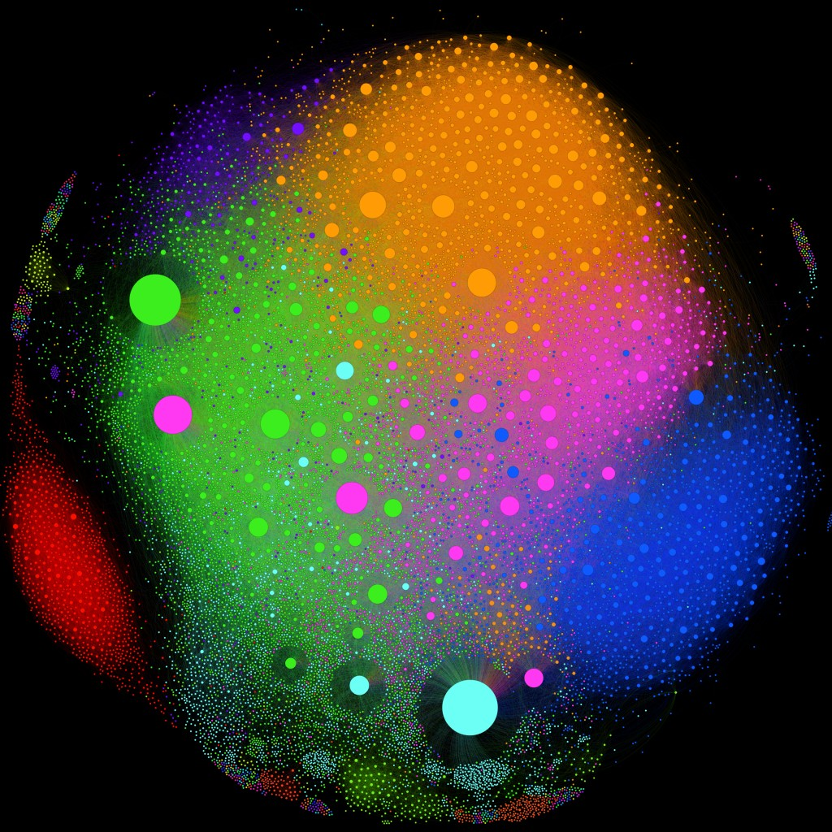
This is the Question Time Audience Map. It shows how the users who mentioned the show (Authors / Active Audience) are connected to each other (either following or being followed by another Author in the Audience).
NHAparty
WillBlackWriter
Each node is an author, each edge is a directed connection (following/ being followed) between the users.
OwenJones84
RippedOffBriton
The size of the nodes represents the degree of each node (how many edges are connected to it) weighted by the strength of those connections (Weighted Degree).
SalmaYaqoob
johnprescott
PennyRed
ChrisBryantMP
richardcalhoun
steveclarkuk
mehdirhasan
paulwaugh
The color of the node represents the community the author is part of. Communities have been detected using a randomised Modularity algorithm that describes how the the network is compartmentalized into sub-networks.
fleetstreetfox
oflynnexpress
davidschneider
RicHolden
bbc5live
BBCNews afneil
bbcquestiontime
Unique Authors: 17.246
Connected Users: 14.956
Edges: 346.876
Network Modularity: 0.408
Total Communities: 259
Average Degree: 23.1 Average Weighted Degree: 44

Slide 32


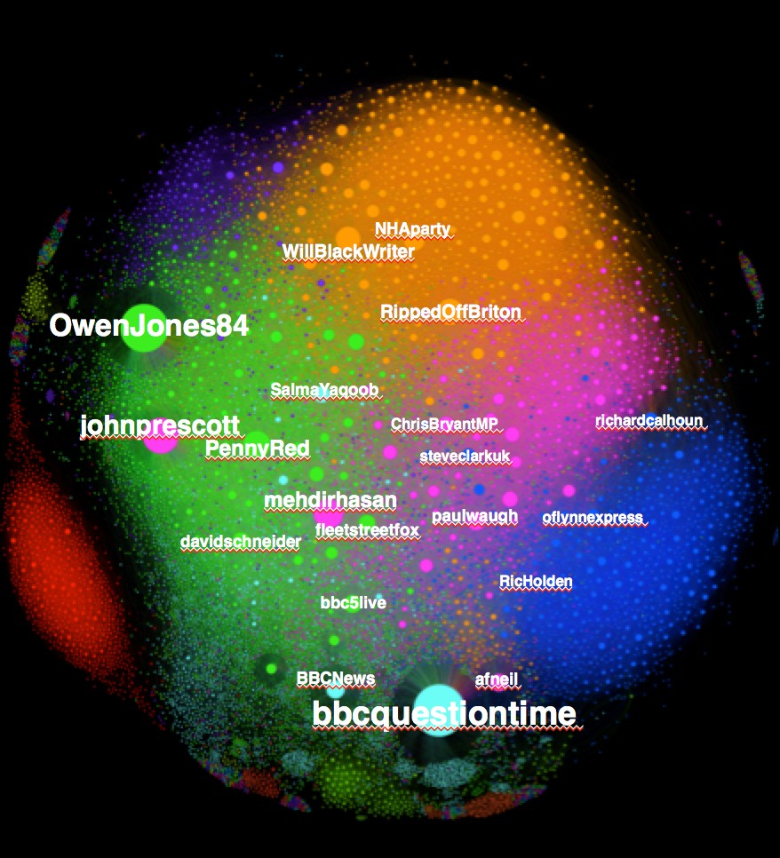
Orange Cluster
- 42 y.o. White British
Manufacturing professionals, Nurses, Teachers
From London (48%), Manchester (6%), Liverpool (5%)
Jewish, Christian
Into politics, tech news, environment, cooking, tennis;
Following @BBCBreaking, @Ed_Miliband, @Queen_UK.
41%
59%
Fuchsia Cluster
Green Cluster
32 y.o., White British
Manufacturing professionals, Nurses, Teachers
From London (48%), Manchester (6%), Cardiff (3%)
Jewish, Christian
Into Business news, reading, history, rugby, tennis and golf;
Following @BBCBreaking
@Number10gov @Lord_Sugar.
28 y.o., White British
Students, Musicians and actors
From London (41%), Manchester (10%),
Liverpool (4%)
Christian and Jewish
Into partying , reading, comedy, football;
Following @stephenfry, @RealDMitchell and @daraobriain
44%
56%
37%
63%
Blue Cluster
- 35 y.o., White Birtish
- Senior Managers , Journalists, Writers and Lawyers
From London (50%), Manchester (3%), Leeds (2%)
- Christian and Jewish
  Into Politics, dining and wining, tennis, football;
  Following @David_Cameron,
@stephenfry, @Number10gov
Pale Blue Cluster
20%
20 y.o, White British, Black
Manufacturing professionals, Nurses, Teachers
From London (48%), Manchester (8%), Belfast (4%)
Muslim, Christian
Into Gaming , comedy/humor, sports;
Following @jimmycarr, @andy_murray, @rioferdy5
80%
31%
69%

Slide 33
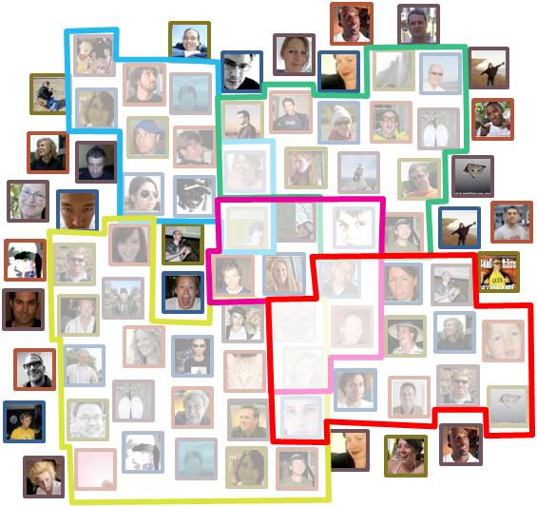

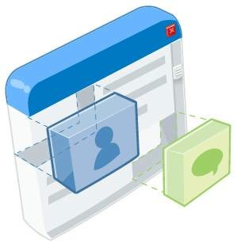

SOCIAL PANELS > real-time segments
4
Dynamic Segments
Real-time Audience Insights

Slide 34



A Nation Divided?
A case study in Social Panels

Slide 35






A Nation Divided?
A case study in Audience Mapping
50k readers
50k readers
50k readers
23,000 Tweets
22,000 Tweets
47,000 Tweets
50k readers
50k readers
50k readers
63,000 Tweets
32,000 Tweets
12,000 Tweets

Slide 36






















A Nation Divided? How 300,000 readers of six top UK newspapers are feeling about the death of Margaret Thatcher
Positive towards Thatcher Negative towards Thatcher Neutral: hidden
The Daily Mail
23,000 Tweets
10%
8%
23%
16%
26%
The Guardian
22,000 Tweets
19%
The Daily Mirror
63,000 Tweets
The Independent
47,000 Tweets
8%
The Telegraph
32,000 Tweets
15%
12%
19%
23%
18%

Slide 37


Hybrid > social in context
5
Predicting the Oscars Integrating social data with multiple external datasets to increase predictability

Slide 38


Dove
Blue Room •23/04/2014 Genre: Documentary
Francesco Dorazio •YouTube •On Device •Media Type: Advertisements
:::::<. Std Deviation
,..., Arousal
•••••• Valence
KM Key Moments
······ Benchmarks

Slide 39

















Images
Location
EXP #1
Call Log
REALITY MINING
SMS Log
Bluetooth
Accelerometer
THE PICTURES AS TEMPORAL AND SPATIAL MARKERS OF THE JOURNEY
Gyroscope
Orientation
Activity
Running Apps Battery
Screen
Browser Searches

Slide 40



Slide 41















6
Augmentation > layering social data on a Panel or a Community

Slide 42








SOCIAL SIMULATIONS
7
20 participants
20 alpha-bots
designed by them
20 beta-bots tested and fine- tuned by us
20 beta-bots cloned 20 times each (400 beta-clones active over a 2 weeks period)

Slide 43

Social Data Intelligence
@abc3d | PulsarPla8orm.com

