Slide 1
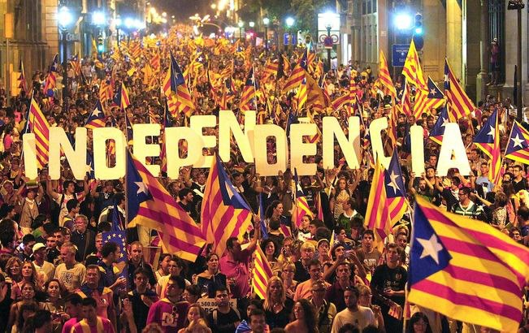
Social media use by civil pro-independence groups in Catalonia
Kathryn Crameri

Slide 2
Catalans’ preferred relationship with Spain
Data taken from the Centre d’Estudis d’Opinió, Baròmetre d’opinió política (‘Barometer of Political Opinion’), (Generalitat de Catalunya, 2005-13)

Slide 3
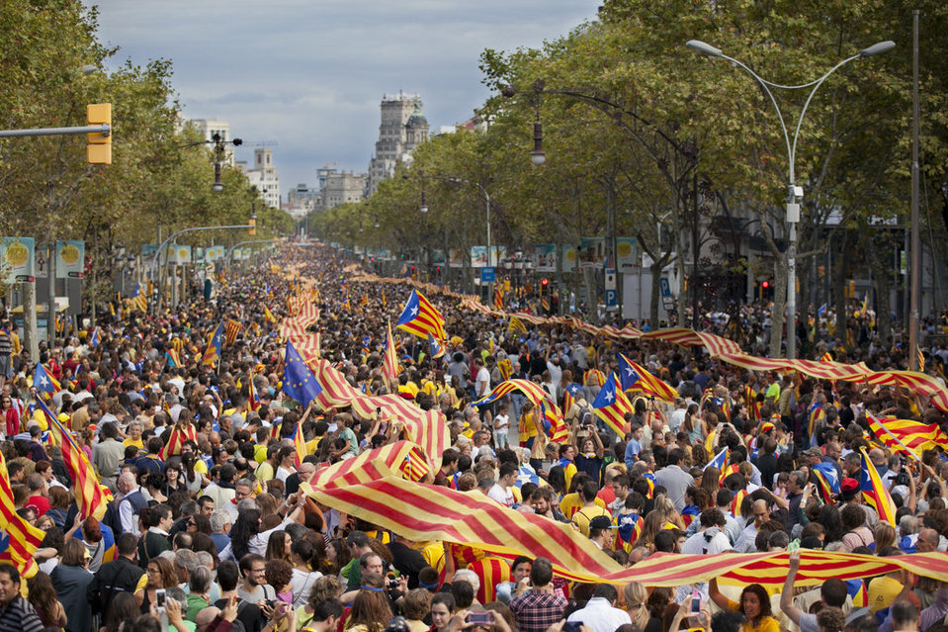
Civil Society
Disillusionment with party politics
Desire for voice/agency
Key role of emotion/affect
Growth of civil organisations
E.g. Assemblea Nacional Catalana which organised 11 Sept demonstrations in 2012 & 13 (‘Via catalana’)
Crucial role of internet activism/social media

Slide 4
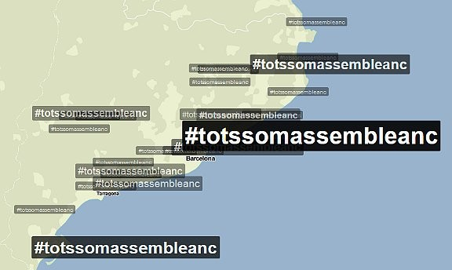
Examples
Barcelona, 10 July 2010: ‘The world’s first Demonstration 2.0’
Twitter: #TotsSomAssembleaNC
Pro-independence ARA newspaper: innovative multiplatform environment

Slide 5
A hypothesis and some questions:
Hypothesis: the Catalan independence movement would not have captured the huge numbers of diverse supporters it has in such a short space of time without social media, even if the ‘drivers’ for independence had been exactly the same.
(Cf. Manuel Castells ‘The development of communication technologies can be understood as the gradual decoupling of contiguity and time-sharing.’ Communication Power (Oxford University Press, 2009), p. 34.

Slide 6
Questions:
How has social media aided the following?:
Organisation of events
Dissemination of information
Creation of activist networks/coalitions
‘Five-minute activism’
National and international exposure for the cause
Creation of a sense of community of like-minded people (‘tipping point’/building trust)
Keeping people passionate about the cause
i.e. how does it reduce the costs of participation while increasing the benefits?

