Slide 1
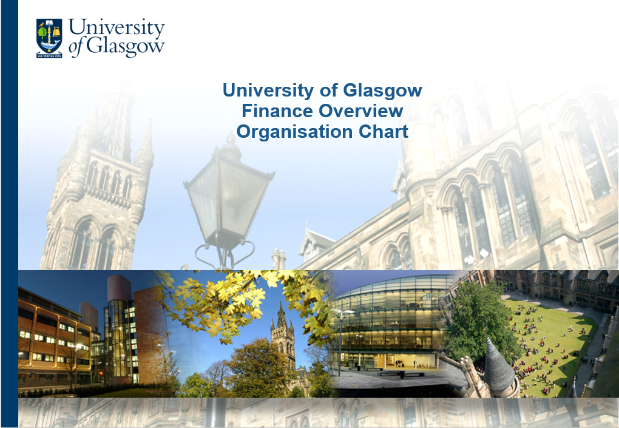
University of Glasgow Finance Overview Organisation Chart

Slide 2
Finance Structure
Gregor Caldow
Executive Director of Finance
Angus Ross
Deputy Director of Finance
John Redmond
Head of Research Finance Office
Josephine Gallagher
Director of Procurement
Nina Douglas/ Adrian Griffin Heads of Finance – University Services
Craig Chapman- Smith
Director of Strategy, Implementation & Risk
4 x Heads of Finance - Colleges
(Indirect Reporting Line)

Slide 3
Finance Structure
Angus Ross
Deputy Director of Finance
Jacqueline Bett
Head of Tax, Treasury & Financial Reporting
Brenda Massie
Head of Management Accounts
Jim Ross
Head of Pay & Pensions
John Cummings
ERP Systems Manager

Slide 4
Procurement Team
Josephine Gallagher
Director of Procurement
Cara Wright Deputy Director of Procurement
Shazia Ghafoor
Procurement Administrator
Marylise Tate
Procurement Administrator
Sarah Saleh
Procurement Specialist
Stephen Otiende
Category Manager
Emma Fleck
Category Manager
Rhona Wilson
Category Manager
Con Church
Category Manager
Elizabeth McLaughlin
Category Manager

Slide 5
Management Accounts Team
Brenda Massie / Scott Proctor
Head of Management Accounts
Vacancy
Deputy Head of Management Accounts
(Projects)
Elaine Sloan
Financial Analyst
(Secondment to TM1)
Sarah Jane Robb
Deputy Head of Management Accounts
(Maternity Cover)
Vacancy
Financial Analyst (Secondment to TM1)
Richard Beattie
Senior Finance Analyst
Monika Marczak
Finance Analyst
Colin Bain
Senior Financial Analyst
Matthew Edmonds
Finance Analyst
Kirsty McKinnon
Finance Programme Office Administrator
Paul Reyes
Finance Graduate Trainee
Craig Stewart
Finance Assistant

Slide 6
Tax, Treasury & Financial Reporting Team
Jacqueline Bett
Head of Tax, Treasury & Financial Reporting
Jacqueline Fergusson
Financial Reporting Manager
Dominic Vella
Finance Graduate Trainee
Sunmei Younis
Tax Analyst
Stephanie Roos
Treasury & Commercial Accounting Manager (Maternity Cover)
Rose McGrath
Financial Accountant (Maternity leave)
Patrick McIntyre
UGS Finance Manager (maternity cover – Joanna Luo
Dorcas Apraku-Boadu
Tax Technician
Darryn Barbour
Treasury Supervisor
Arthur Dobson
Insurance Analyst
Sophie Morrison
Financial Accountant
Vacancy
Tax, Treasury & Reporting Project Accountant
Derek Simpson
Treasury Assistant
Catherine Higgins
Treasury Assistant
Sheryl Sproule
Temporary
Andrew Hazledine
Temp Treasury Assistant

Slide 7
Finance Systems Support & Development Team
John Cummings
ERP Systems Manager
Kevin Roarty
Senior Analyst / Programmer
Andrew Duffy
Senior ERP Systems Analyst
Ian Brown
Training & Support Supervisor
Lesley Cumming
Senior Financial Analyst
Gordon Allan
Database Manager
Helen Larkin
Senior Analyst / Programmer
Carol Goldthorp
Systems Manager
Ladislav Langer
Training & Support Advisor
Susan Sawers
Finance Systems Analyst
Mark Campbell
Business Intelligence Developer

Slide 8
Pay & Pensions Team
Jim Ross
Head of Pay & Pensions Systems / Projects
Vacancy
Head of Pay & Pensions Operations
Lesley Murphy
Acting Deputy Head of Pay & Pensions
Claire MacLachlan
Pay & Pensions Team Leader
Sonia Bakshi
Pay & Pensions Team Leader
Chelsey Cathcart
Pay Control Supervisor
Sophia Scholle
Pay & Pension Systems Analyst
Joyce Kerr
Pay & Pensions Administrator
Nicola Ormiston
Pay & Pensions Administrator
Kay Dickson
Pay Control Administrator
Raluca Stoican
Pay & Pensions Administrator
Wendy McParland
Pay & Pensions Administrator
Udaya Krishnanunni
Pay Control Administrator
Felicity Cooper
Pay & Pensions Administrator
Sonali Perera
Pay & Pensions Administrator
Kelly Merrilees
Pay & Pensions Administrator

Slide 9
Research Support Structure
John Redmond
Head of Research Finance Office
Hazel Tollan
Research Support Advisor – UK & Overseas
Joe Galloway
Research Support Manager – EU & Federal
Ben Kassous
Senior Research Assurance Officer
Karen Mcelveen
Finance Operations Manager

Slide 10
Research Support Office - UK/Overseas Team
Hazel Tollan
Research Support Advisor
Public Team
Non-Public Team
Consultancy
Overseas Team
Johnpaul McMahon
Research Finance Team Leader
Lewis Cook
Research Finance Team Leader
Stacey Cameron
Research Financial Administrator (Mat leave)
Euan McLellan
Research Financial
Administrator
Nicole Pietrzak
Senior Research Financial Administrator
Other
Overseas
Claire Scoular
Senior Research Financial
Administrator
Richard Skinner​
Research
Financial
Administrator​
Suzanne Griffin
Senior Research Financial
Administrator
Darren Johns
Senior Research Financial
Administrator
Walter Eze
Research Financial Administrator
Martin Ryan
Senior Research
Financial
Administrator
Abimbola Salami
Research Financial
Administrator
Gary Brown
Research
Financial
Administrator
Alastair Macfie
Research Financial Administrator
Pardis Katoozi
Research Financial
Administrator
Monika Lenty Research Financial
Administrator
Lucy Smith
Research Financial
Administrator
Andrea Karla Kantor-Ross
Research Financial
Administrator
Ida Cleland​
Research
Financial
Administrator
Amy Coats
Research Financial
Administrator
Pamela Bone
Research Financial
Administrator
Navarro Sullivan
Research Financial
Administrator

Slide 11
Research Support Overseas Funders Team
Joe Galloway
Research Support Manager
Ania Gieremek
EU & International Grants & Contracts Specialist
Katie Wright
EU Project Manager
Lesley Arnold
EU & International Grants & Contracts Specialist
Jay Pert
Project Officer
David Iglesias
Project Officer
Karen Harron
EU & International Grants Specialist

Slide 12
Research Assurance Team
John Redmond
Head of Research Finance Office
Ben Kassous
Senior Research Assurance
Officer
Mary McCabe
Research Assurance
Officer
Jennifer Wardale
Finance Graduate Trainee

Slide 13
Finance Operations Team
Karen Mcelveen
Finance Operations Manager
Gemma Caldwell
Deputy Finance Operations Manager
Joanne Aiken
Accounts Payable Supervisor
Lynn Stewart
Credit Control Supervisor
(Accounts Receivable Team)
Christopher Thomson
Finance Operations Supervisor
(Credit Control Team)
Continued next slide
Continued next slide
Continued next slide

Slide 14
Finance Operations Team (cont.)
Joanne Aiken
Accounts Payable Supervisor
Lynn Stewart
Credit Control Supervisor
(Accounts Receivable Team)
Christopher Thomson
Finance Operations Supervisor
(Credit Control Team)
Julie Donohoe
Deputy Supervisor
Michael Hepburn
Accounting Assistant
Kenny McEwan Accounts Receivable Administrator
Barry Collinge Accounts Receivable Deputy Supervisor
Dean McCormick
Deputy Credit Control Supervisor
Louise Colquhoun
Finance Assistant
Amanda McLaughlan
Finance Assistant
Tia Dendy
Accounts Receivable Administrator
Ally Imrie
Finance Assistant
Ally Clark
Credit Controller
Angela Duffy
Clerical Assistant
Joanne Hill
Data Control Assistant
Mary McChrystal Accounts Receivable Administrator
Chris Duerden
Finance Assistant
Olivia Ao
Collections Team Member
Paul Bell
Administrative Assistant
Kirsty Kennedy Wylie Clerical Assistant
Cameron Hutton
Accounts Receivable Administrator
Denise McMillan
Finance Assistant (Temp)
Karen McLean
Clerical Assistant
Juan Diego Del Rosario Grimon
Finance Graduate Trainee
Sonal Pandey
Finance Assistant
Craig Owens
Collections Team Member
Chantal Gage
Collections Team Member / Credit Controller

Slide 15
University Services Finance Structure
Gregor Caldow
Executive Director of Finance
David Duncan
Deputy Vice Chancellor – Operations & Chief Operating Officer
Nina Douglas
Head of Finance – University Services
Adrian Griffin
Head of Estates Finance
Total Number of Staff
10
7

Slide 16
US Finance (Non-Estates)
Nina Douglas
Head of Finance University Services
Catriona Ewen
Deputy Head of Finance (University Services)
Hayley Jenkins
Senior Project Accountant
Anne Campbell
Senior Financial Analyst
Stacey Mundell
Senior Financial Analyst
David Carse
Financial Analyst
Awais Ahmed
Finance Analyst
Anna McDonagh
Assistant Project Accountant
Jennifer Cooke
Finance Assistant
Kirsten Morrison
Financial Analyst
Caroline Bradley
Finance Administrator
Hunterian
Finance
Student & Academic Services
Student Experience Strategy
Strategy & Planning
Commercial Services
Catering
Sport
Accommodation
Print
Nursery
GU Heritage
Information Services (BAU)
Transformation (Bau)
P&OD
Research Services
Innovation
Economic Dev
External Relations
Information Services Projects
Transformation Projects

Slide 17
US Finance (Estates)
Adrian Griffin
Head of Finance Estates
Ailish Finnegan
Finance Analyst
James
Robertson
Finance Assistant
Douglas Hervey
Head of Project Accounting
Karen Richmond
Senior Project Accountant (Major Projects)
Humza Iqbal
Project Accountant (Asset Management)
Mhairi Rose Fox
Assistant Project Accountant
Mark Wallace (Temporary)
Project Accountant
(Maintenance)
Estates Operations
Estates Capital Projects

Slide 18
Strategy, Risk & Implementation
Craig Chapman-Smith
Director of Strategy, Risk & Implementation
Jane Hoey
Head of Risk
Kirsty McKinnon
Finance Programme Office Administrator

Slide 19
Science & Engineering College Finance
Elizabeth Graham
Head of College Finance
Mark Bennett
Deputy Head of Finance
Emma Field
Senior Financial Analyst
Drew Beaton
Research Accountant
Mariacarmen Garcia-Perez
Finance Transactions Hub Supervisor
Alan Bowman
Finance Transactions Hub Supervisor
Dawn Beaton
Finance Assistant
Magadalena Mowat
Finance Assistant
Nicola McCreath
Finance Assistant
Aswad Choudhry
Finance Assistant
Fraser Gilchrist
Financial Analyst
Elspeth Baird
Finance Assistant
Stacey Wallace
Finance Assistant
Tanya Furniss
Finance Assistant
Yixuan Hao
Finance Assistant
Rachael Milroy
Finance Graduate Trainee
Barbara Grant
Finance Assistant
Rose Phillips
Finance Assistant
Maciej Muszynski
Finance Assistant
Andrew Stuart
Finance Assistant
Caitlin Dempster
Finance Assistant
Esther Richter
Finance Assistant

Slide 20
Social Sciences College Finance
Jennifer Davies
Head of College Finance
Fiona Lawn
Deputy Head of Finance
Andrea Carr-MacDonald
Senior Financial Analyst
Michelle Guthrie
Senior Financial Analyst
Susan Rodger
Finance Manager
Ross Galloway
Financial Analyst – College Office
Eilidh McIntosh
Senior Financial Analyst
Maciej Muszynski
Finance Assistant
Fiona Small
Finance Administrator
Nadya Dryburgh
Finance Administrator
Karen Rider
Finance Administrator
Gary Jackson
Finance Office Administrator
Sharon Campbell
Finance Administrator
Eleanor Johnston
Finance & Purchasing Asst
Barbara Richards Finance Administrator
Alison Graham
Finance Administrator

Slide 21
Arts & Humanities College Finance
Stefan Jaretzke
Head of Finance
Hugh Woods
Senior Financial Analyst
Kyrian Breckney
Financial Analyst

Slide 22
MVLS College Finance
Stuart McDonald
Head of Finance
Paul Burns
Senior Financial Analyst
Sally Wighton-Tait
Senior Finance & Programme Manager
Richard Stevenson
Senior Financial Analyst
John Richmond
Resource Manager
Ian McGregor
Financial Analyst
Stephen Thomson
Head of MVLS Finance Projects
William Burrows
Senior Financial Analyst
Henry Watson
Senior Financial Analyst
Andrew Mason
Senior Financial Analyst
College Finance Hub
(continued next slide)
Pritpal Raju
Finance Assistant
Martin Ferris
Finance Analyst
Martin Irons-Roberts
Finance Analyst

Slide 23
MVLS College Finance Hub
William Burrows
Research Accountant
Yvonne O’Donnell
Transaction Hub Team Lead
Ann Blacklaw
Transaction Hub Team Lead
Claire Bremner
Senior Accounts Assistant
Eileen Boyle
Accounts Assistant
Karolina Siwiak
Accounts Assistant
Jodie Bain
Accounts Assistant
Fraser Bennett
Accounts Assistant
Stacey Logan
Accounts Assistant
Heather Cantwell
Accounts Assistant
Elliot Ralph
Accounts Assistant
Holly Stewart
Accounts Assistant
Olga Getsaeva
Accounts Assistant

